Slide 1
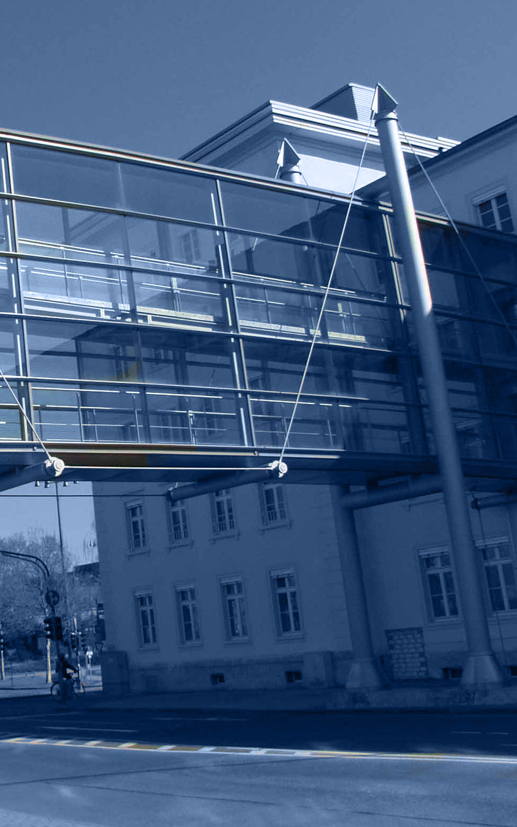


Welcome to the
German
Federal Institute of Hydrology
(BfG)
Federal Institute of Hydrology Am Mainzer Tor 1 56068 Koblenz, Germany Tel.: +49 (0)261 1306 0 Fax : +49 (0)261 1306 5302 E-Mail: posteingang@bafg.de URL: http://www.bafg.de
Stand 10/2014

Slide 2
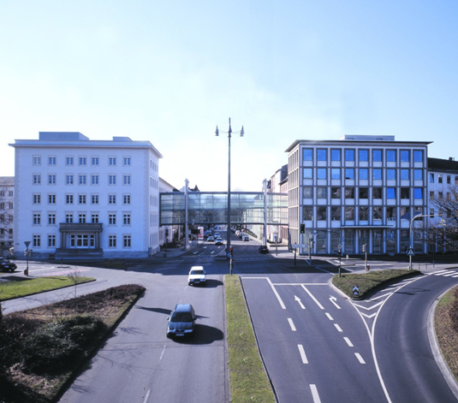
The Federal Institute of Hydrology is...
the scientific institute of the Federal Government for research, assessments, and consulting in the fields of
hydrology
water-resources management
ecology and
conservation of waters
the specialised consultant of the Federal Waterways and Shipping Administration regarding the planning, development and new construction of Federal waterways
consultant for Federal Ministries (transport, environment, research, foreign affairs/international development) in decision-making
a higher authority of the Federal Republic of Germany under the jurisdiction of the Federal Ministry of Transport and Digital Infrastructure (BMVI)
run by approximately 400 members of staff
We are…

Slide 3
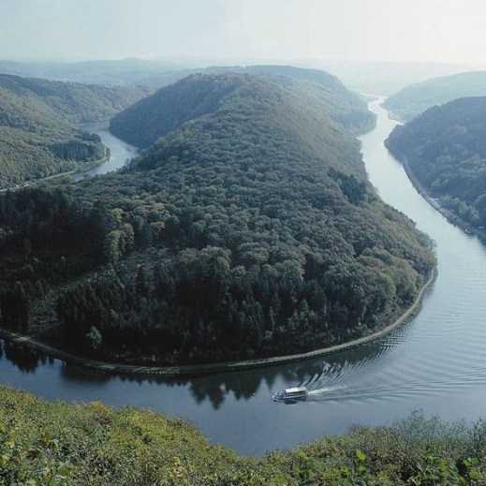
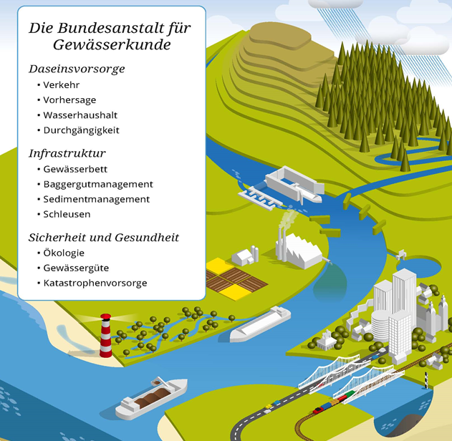
BfG activity fields
Services for the public
Inland and coastal waterway transport
Hydrological predictions
Flood defence and warning
Waterways infrastructure
Fairways, harbours, locks
Engineered and biological embankments
Sediment management and dredging
European enviromental directives
Ecological quality of waters
Hydrological regime
River continuity
Morphological conditions
Fairways and more

Slide 4
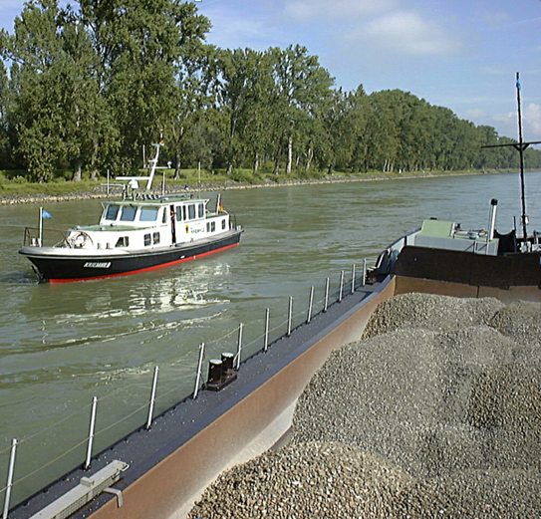
Main tasks
Identifying and solving conflicting interests regarding Federal Waterways between
transportation function
water-resources management (quantity and quality)
ecology
Studying floodflow and low-flow conditions
Hydrological and ecological forecasting
Computing water balances
Setting up methodologies for environmental impact studies
Impact assessment of anthropogenic activities on water quality, their risks for humans and environment
Monitoring of water quality in Federal waterways
radiological ➔ alarm system
chemical ➔ water, suspended solids and sediments
biological ➔ water, habitats, impacts
Skills

Slide 5
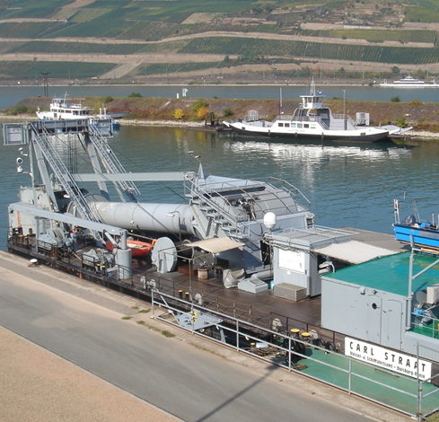

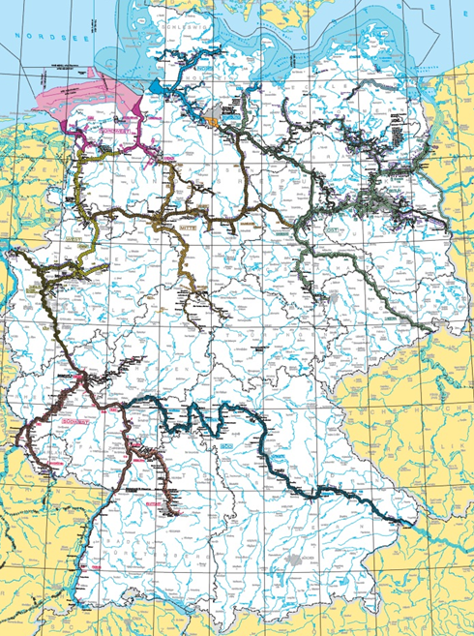
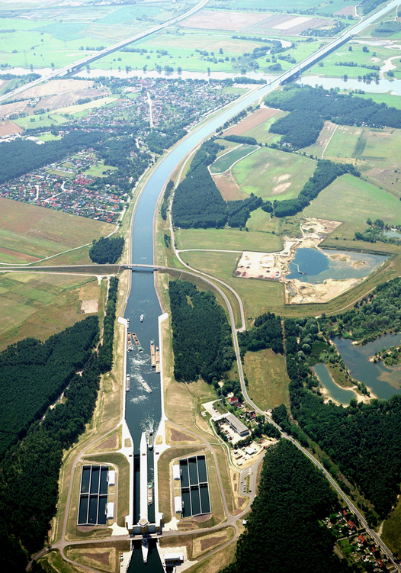
Federal Waterways and Shipping Administration (WSV)
The waterways in the ownership of the Federal Government are managed by the Federal Waterways and Shipping Agency (GDWS) with 40 local offices and 13,000 employees.
WSV
German Federal Waterways

Slide 6
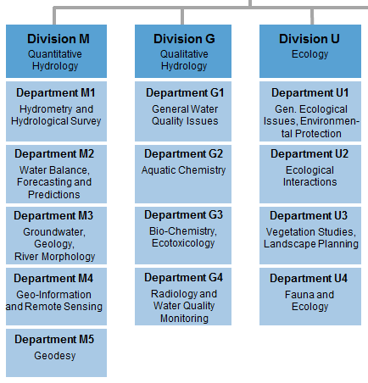
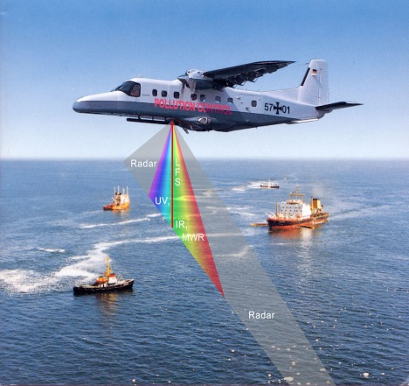
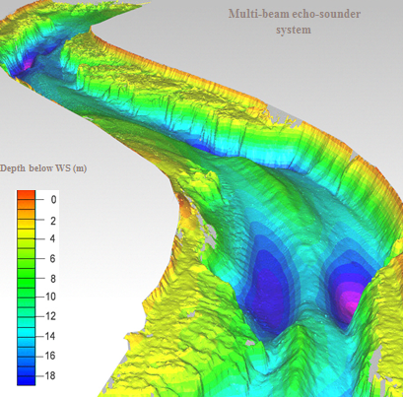
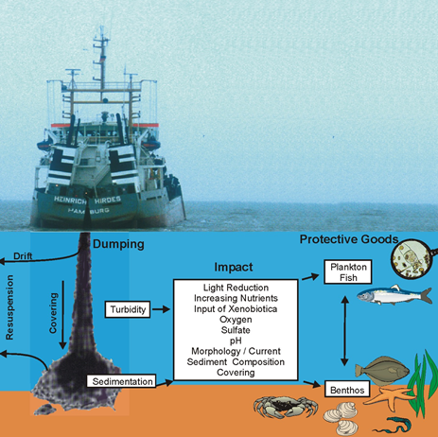
Interdisciplinary fields of activity
Division M
Environmental impact assessments
System analyses, e.g. of tidal waters
Sediment and dredged material management concepts
Scientific/technical support to airborne surveillance and disaster management
Detection, quantification and classification of
oil spills and
chemical pollution
on the surface of German territorial waters in the North Sea and the Baltic Sea
Quantitative Hydrology
Division G
Qualitative Hydrology
Division U
Ecology
Interdisciplinary fields

Slide 7
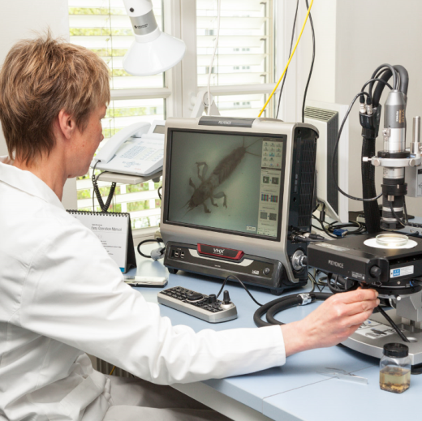
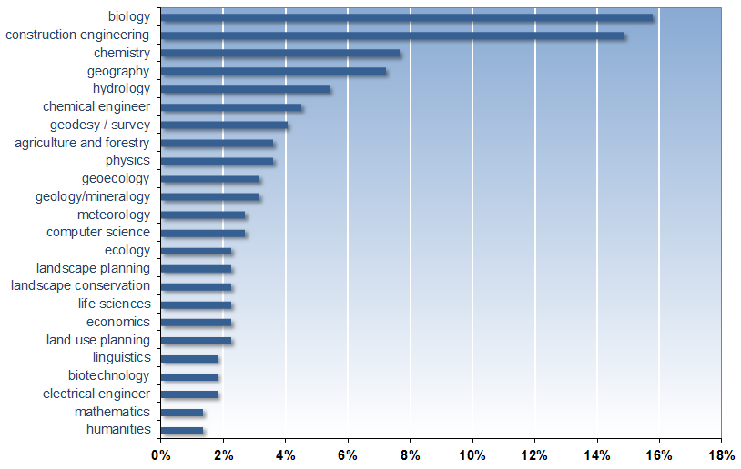
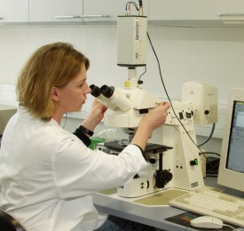
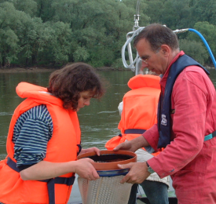
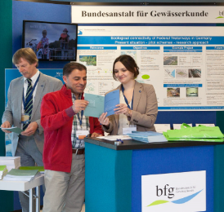
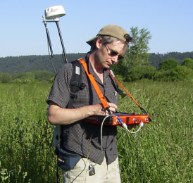
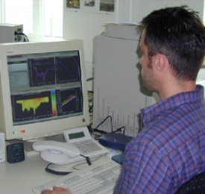
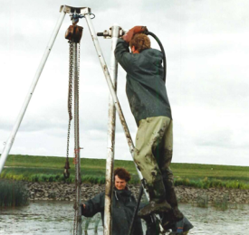
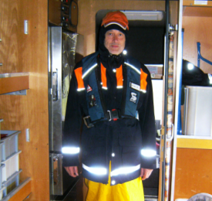
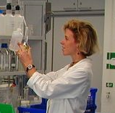
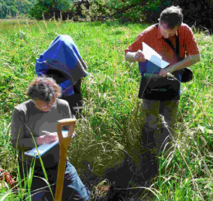
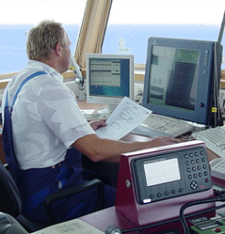
BfG works with a number of university experts
250
scientists and
scientific assistants
Scientists
Distribution to the scientists
(2014)

Slide 8

Networking and Co-operation
Centre for Water Resources and Global Change
UNESCO Cat II Centre
Research projects
Capacity development
Data
Networks
IHP /HWRP Secretariat
Seamless prediction
E-Learning
Global Water Data Centre
Hydroforum
IHP projects
Climate impact research in Vietnam
Technical workshops for improving operational capabilities
GEMStat
Scientific Commissions
HWRP projects
Scientific workshops
Global Water Portal
HyWa
Conferences
DHG
Partners
CHR – GRDC – GPCC – IAHS – IAH – ICRAG – UN-Water – UNEP – UNESCO – WMO - WWAP
UNESCO
Cat II Centre
The Federal Institute of Hydrology is serving the international community by operating the Global Water Data Centre & the Center for Water Resources and Global Change

Slide 9
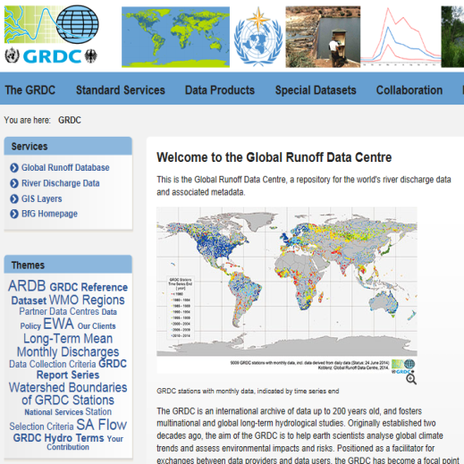
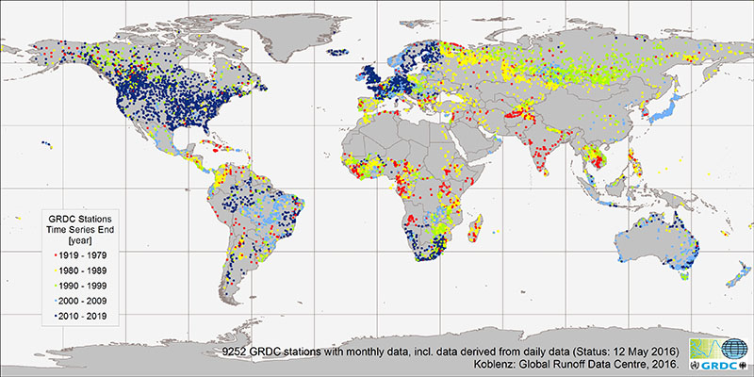
Global Runoff Data Centre (GRDC)
The BfG operates the GRDC under the auspices of the World Meteorological Organization.
This international archive of river discharge times series is supporting global change research.
GRDC
www.bafg.de/GRDC

Slide 10

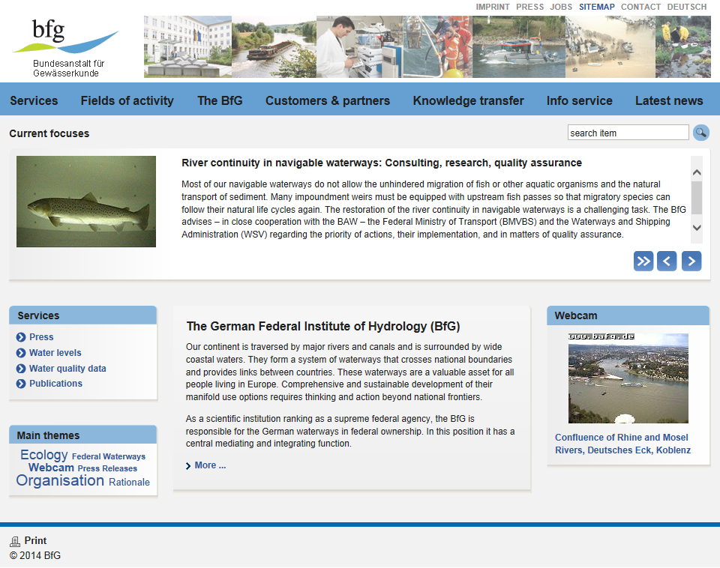
www.bafg.de
WWW

