Slide 1
Deltares experiences with WaterML 2.0
Examples and lessons learnt

Slide 2
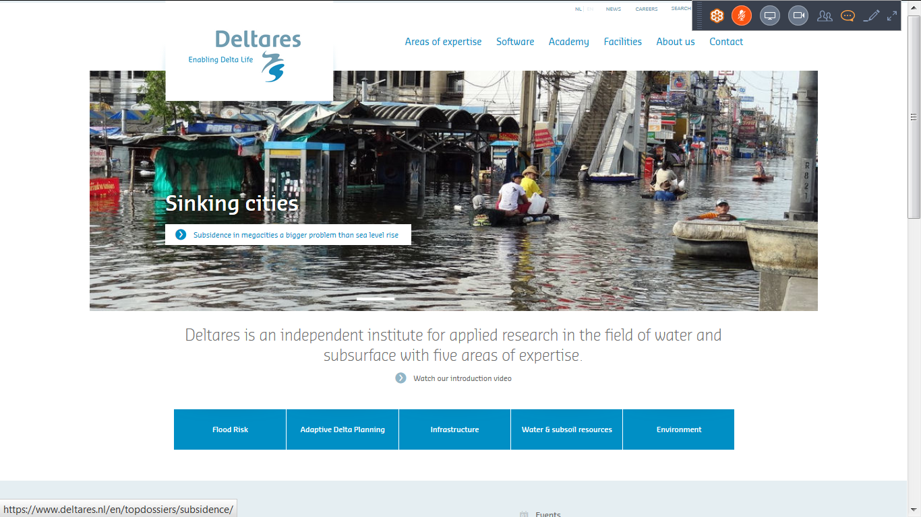
Deltares

Slide 3
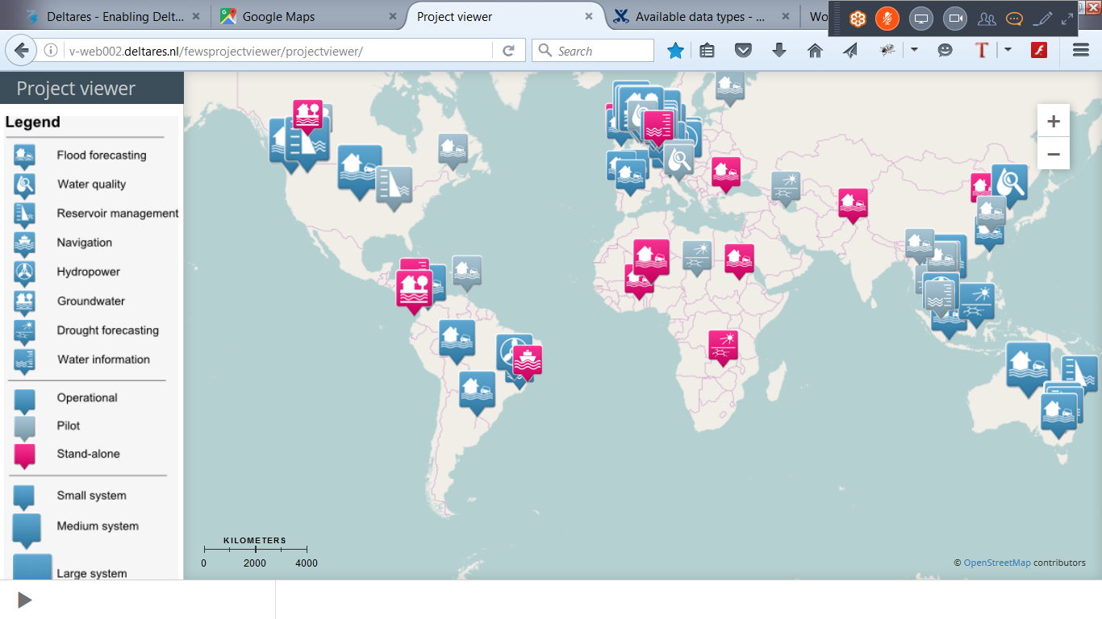
Delft-FEWS

Slide 4
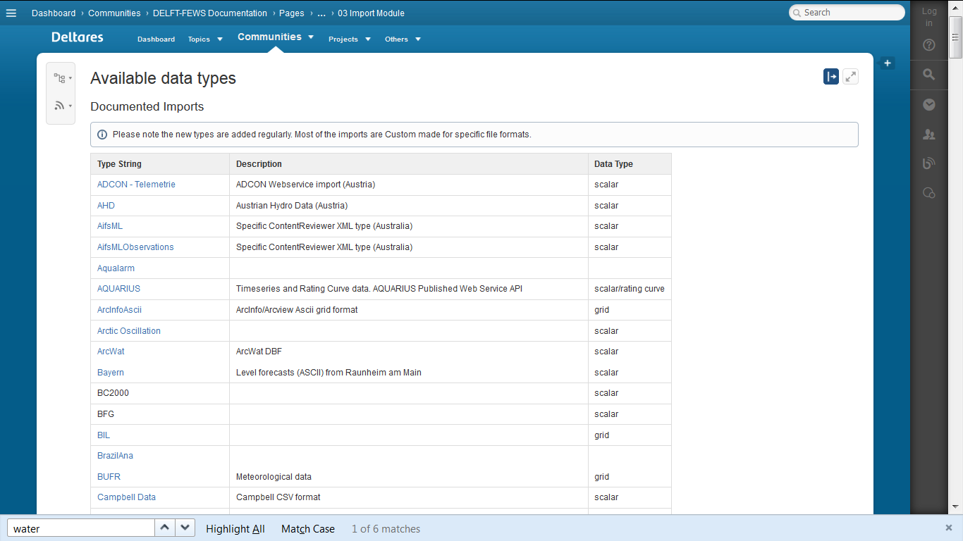
Supported import types
https://publicwiki.deltares.nl/display/FEWSDOC/Available+data+types

Slide 5
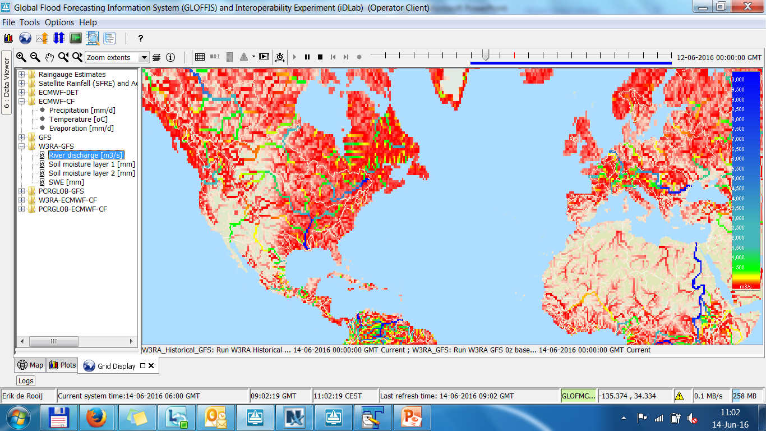
Possibilities of online data
More info on GLOFFIS

Slide 6
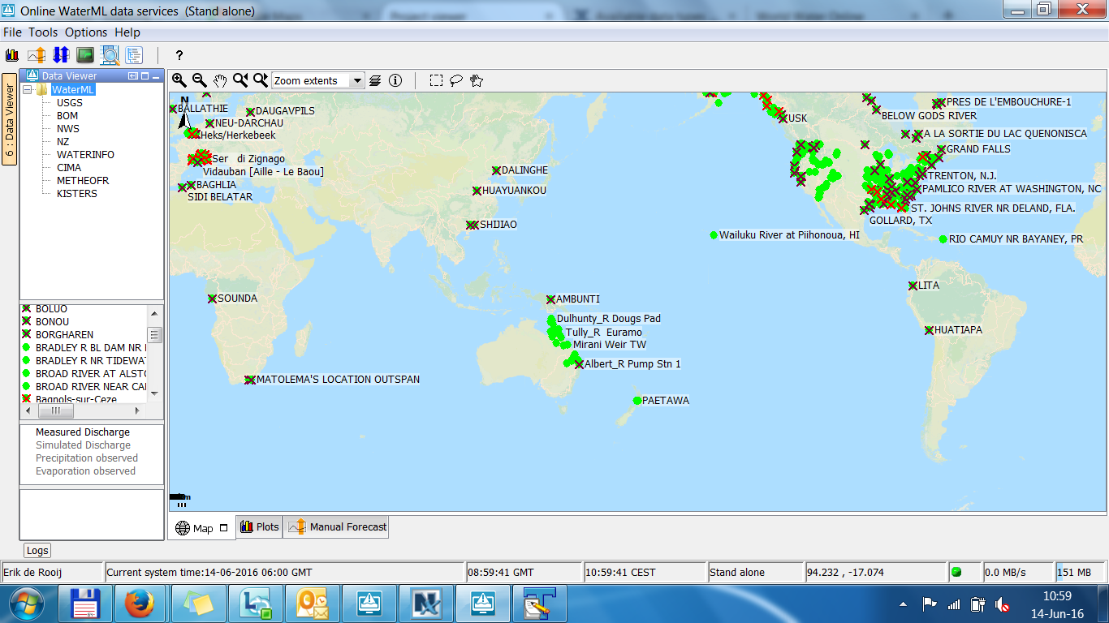
WaterML 2.0 data sources

Slide 7
FEWS history of WaterML2
Can we import WaterML2 ?
Yes we can! But we need an example first….
1st implementation April 2012
2012 to 2014 >>> NOTHING
Implement - KIWIS 2014 - WaterBoard Dommel, USGS, BOM 2015 (multiple locations single request, gzip response)

Slide 8
Comparison
Supported Producers:
Deltares (Deltares, NWS)
Kisters (BOM, WATERINFO, BrabantseDelta)
CINERGI (CIMA, METHEO FR)
Hilltop (NZ)
USGS (USGS)

Slide 9
Deltares flow chart for parsing WaterML
Wml2:Collection - observationMember - OM_Observation
Sos:GetObservationResponse (kiwis sos2 profile) - observationData - OM_Observation

Slide 10
Deltares flow chart for parsing WaterML
om:OM_Observation
- phenomenonTime: estimate length of time series expected: gml:TimePeriod with attr gml:id alternative: temporalExtent value or reference (CIMA) - resultTime: creation time of time series
expected: gml:TimeInstant - procedure: use as qualifier expected: href or title or ObservationProcess id (CIMA) - observedProperty: parameter id expected: href or title - parameter: extract forecast time (forecasting example)
expected: xlink:role=analysisTime - featureOfInterest: location id
expected: href or title or MonitoringPoint id (Deltares) or identifier or sampledFeature - result: time series data

Slide 11
Deltares flow chart for parsing WaterML
om:result > wml2:MeasurementTimeseries - temporalExtent: estimate length of time series can have reference to phenomenonTime - metadata: start time (use with timestep), timestep, parameter type, aggregation period expected: MeasurementTimeseriesMetadata - baseTime (start time) (daily-discharge..xml) - spacing (timestep) - cumulative (CHIMA) - aggregationDuration - temporalExtent - defaultPointMetadata: unit, interpolation type, flag expected: DefaultTVPMeasurementMetadata - uom (uom, code or title) - interpolationType - qualifier (href, title or Quantity (KIWIS.xml)) - point: value, time, flag

Slide 12
Request formats
BOM / WATERINFO:
service=kisters&type=queryServices&request=getTimeseriesValues&format=wml2&to=?&from=?&datasource=?&ts_id=?
CIMA / METHEO FR:
location=?&variable=?&startDate=?&endDate=?
NWS / DELTARES:
request=GetObservation&featureId=?&observedProperty=?&beginPosition=?&endPosition=?
USGS:
site=?&format=waterml,2.0&startDT=?&endDT=?&parameterCd=?
NZ:
service=SOS&request=GetObservation&featureOfInterest=?&ObservedProperty=?&temporalFilter=om:phenomenomTime,?/?

Slide 13
Remarks
1. Requested content can differ from Response:
CIMA / METHEO FR:
request location=CIMA1:1138 > response gml:id="CIMA1-1138“
USGS:
request site=15239050 > response gml:id="USGS.MP.USGS.15239050.00060.1.00003“
2. Retrieving forecasts: Is this the accepted solution? <om:parameter>
<om:NamedValue>
<om:name xlink:title="T0 (Time of analysis)" xlink:role="analysisTime"/>
<om:value xsi:type="gml:TimePositionType">2010-05-06T00:00:00+00:00</om:value>
</om:NamedValue>
</om:parameter>
3. Multiple locations in single request?
featureId=loc1,loc2,loc3

Slide 14
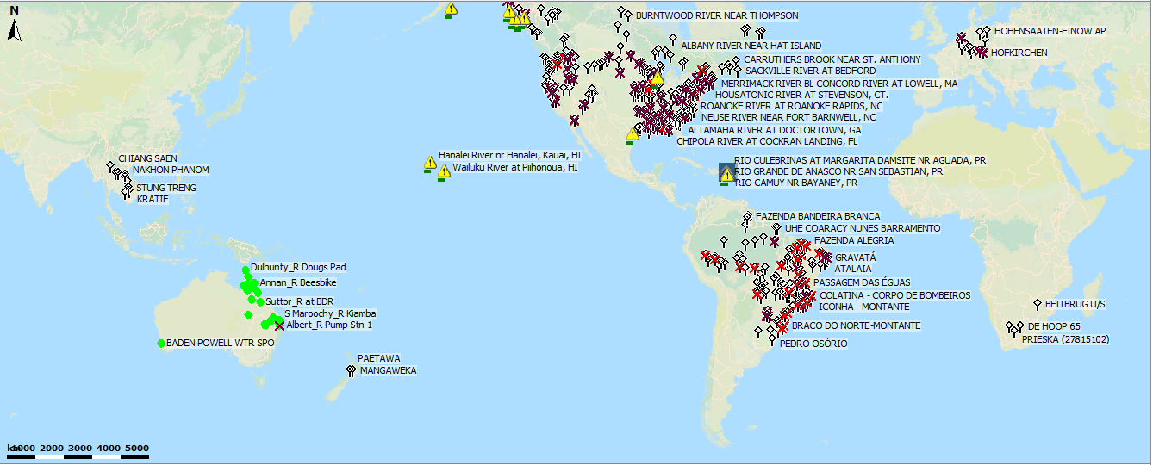
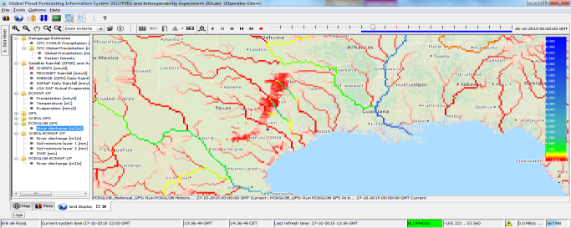
GLOFFIS demo
GLOFFIS (Global Flood Forecasting Information System)
Data Sources
NOAA CPC/GFS (USA), NASA IMERGE (USA), USGS FEWS NET (USA),ECMWF TIGGE (EU), BOM (AU), EC (CA), ANA (BR), PEGEL (DE)
Models
World Wide Water Resources Assessment (Australian National University)
PCRaster Global Water Balance (University of Utrecht)
Outputs
Water Balance
Discharges
Soil Moisture, etc.
Contact: Albrecht Weerts
Go to GLOFFIS

