Slide 1
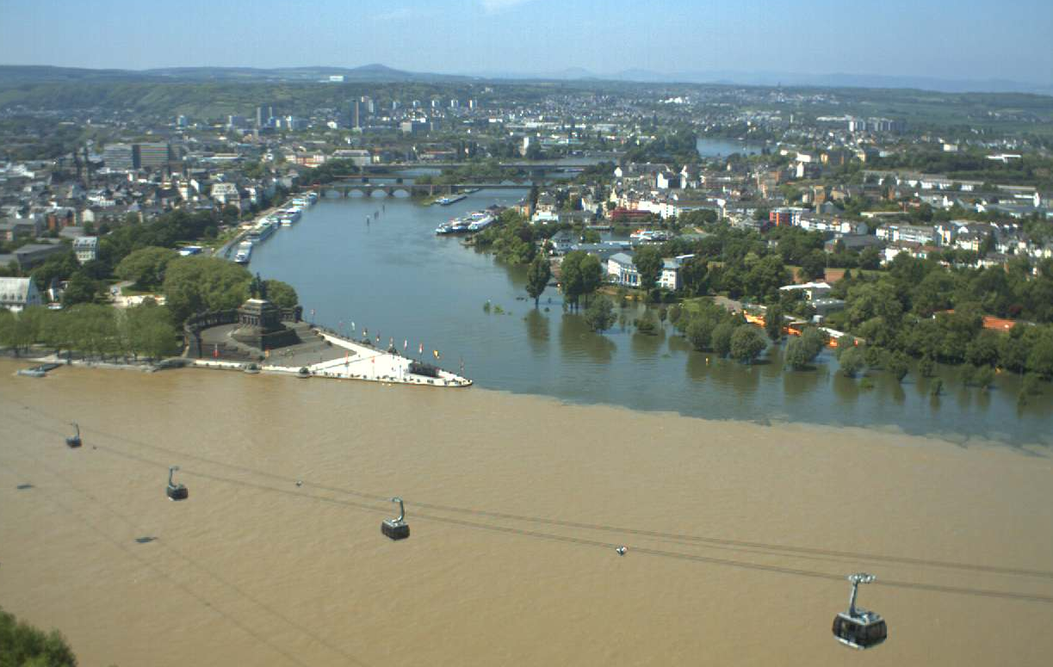



Invitation
OGC/WMO Hydrology Domain Working Group
Workshop: 13 – 17 June 2016
Federal Institute of Hydrology (BfG)
Koblenz, Germany
Information at HydroDWG Wiki
Copyright © 2016 Open Geospatial Consortium

