Slide 1
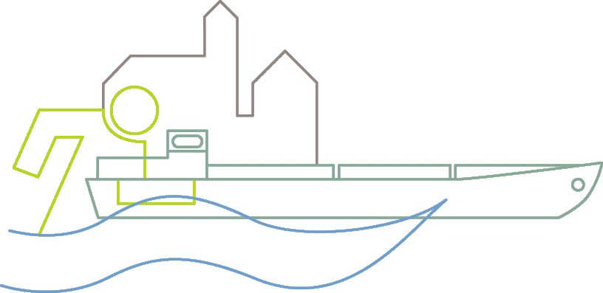
Dr. Sven-Henrik Kleber, Bundesanstalt für Gewässerkunde, Koblenz
Management of Geo-Data
WasserBLIcK

Slide 2
Organisation and tasks of BfG
The Federal Institute of Hydrology is ...
a higher authority of the Federal Republic of Germany under the auspices of the Federal Ministry of Transport and Digital Infrastructure (BMVI)
the scientific institute of the Federal Government for research, assessment and consulting in the fields of
    hydrology
    water resources management
    ecology and
    conservation of waters
consultant for Federal Ministries (e.g. BMVI, BMU, BMBF, BMG) in decision-making

Slide 3
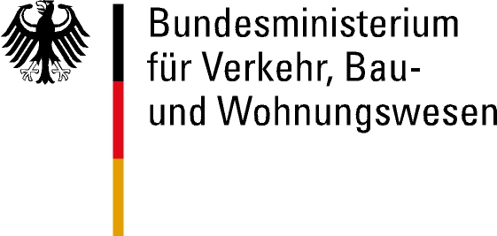
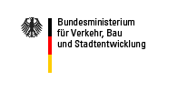



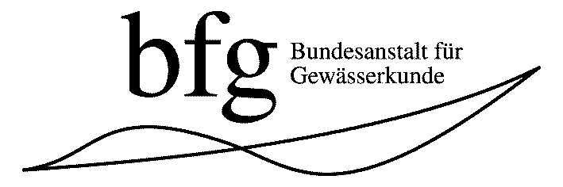
How the BfG is financed...
Federal Ministry of Transport
and digital infrastructure
85 %
Others
(BMBF, BMZ, BMG, EU...)
Federal Ministry for the
Environment, Nature Conservation,
Building and Nuclear Safety
5 %
10 % (appr. 20 Projects)
Federal Institute of Hydrology

Slide 4
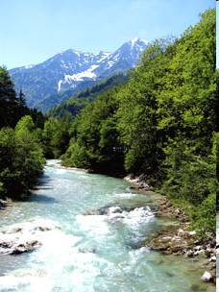
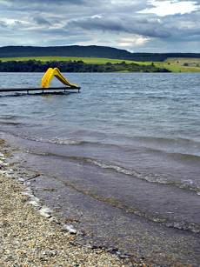
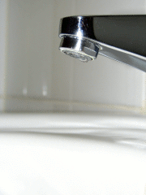
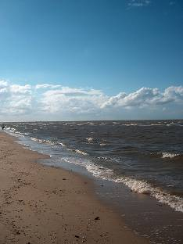
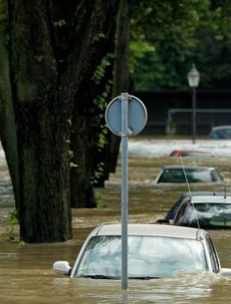
BfG – Europe:
Reporting for water-relevant directives
Water Framework Directive (2000/60/EC)
Urban Waste Water Treatment Directive (91/271/EEC)
Bathing Water Directive (2006/7/EC)
Nitrates Directive (91/676/EEC)
Drinking Water Directive (98/83/EC)
Flood Directive (2007/60/EC)
Marine Strategy Framework Directive
Freiwillige Umweltberichterstattung
EEA: Status of Environment
Marine Environment DB (MUDAB)

Slide 5
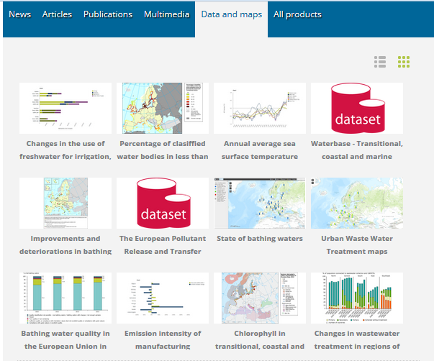
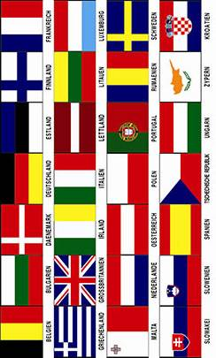

WaterInformationSystem for Europe
Partnership between European Commission (DG Environment, Joint Research Centre and Eurostat) and EEA

Slide 6
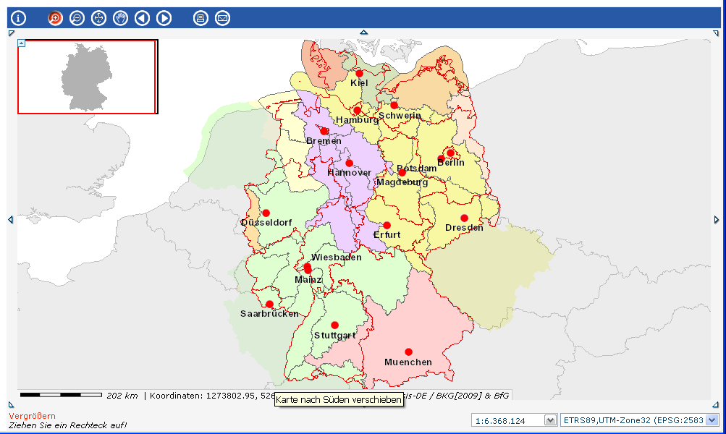
Level of Competent Authorities:
Länder

Slide 7
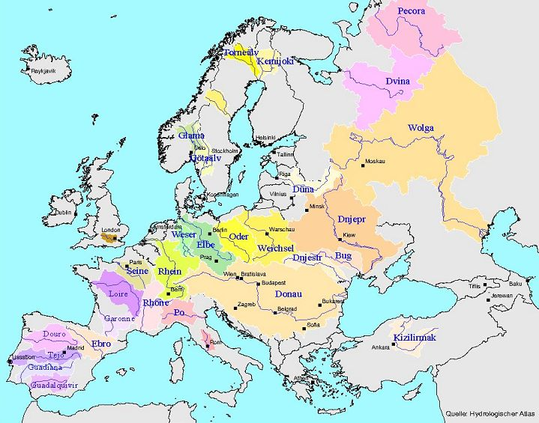
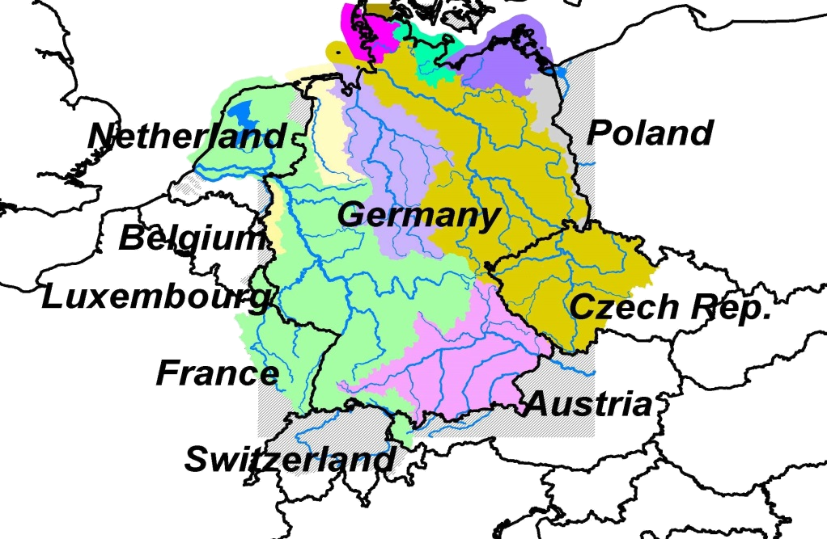
Major river basins in Europe
River basins in central Europe
shared by Germany and riparian states

Slide 8
Our Challange
Interoperability for data and information in an inhomogeneous user community
Rebuilding of 16 information to ONE federal reporting bundle
Building common datamodels
Define quality standards
Creation of an electronic platform for data exchange

Slide 9

Solution: WasserBLIcK
Our national answer:
Bund- Länder- Informations- und Kommunikationsplattform
WebGenesis: Content Management System (CMS) of Fraunhofer Institute
Two parts: Reporting- and Communicationplatform
Workflowdefinitions

Slide 10
Information and data exchange
Each Directive has its own ReportNavigator (they are not identical but similar)
Text based information is collected via WasserBLIcK Web-Forms
Data and spatial data are collected via file based push or pull
(fully automated) mechanism
All information are automatically quality checked transfered into a single DataBase – prepared for the generation of online and offline products (maps, statistics) and EU-reporting
All products (regional, federal or internatinal level) are generated from the same data source

Slide 11
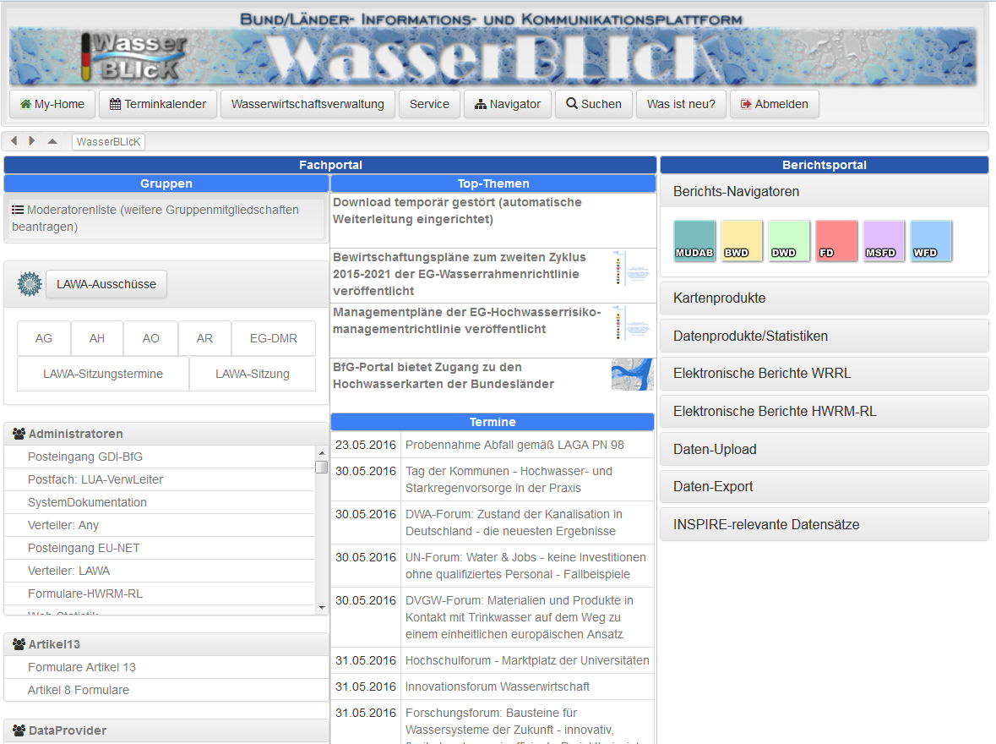
Webportal WasserBLIcK

Slide 12
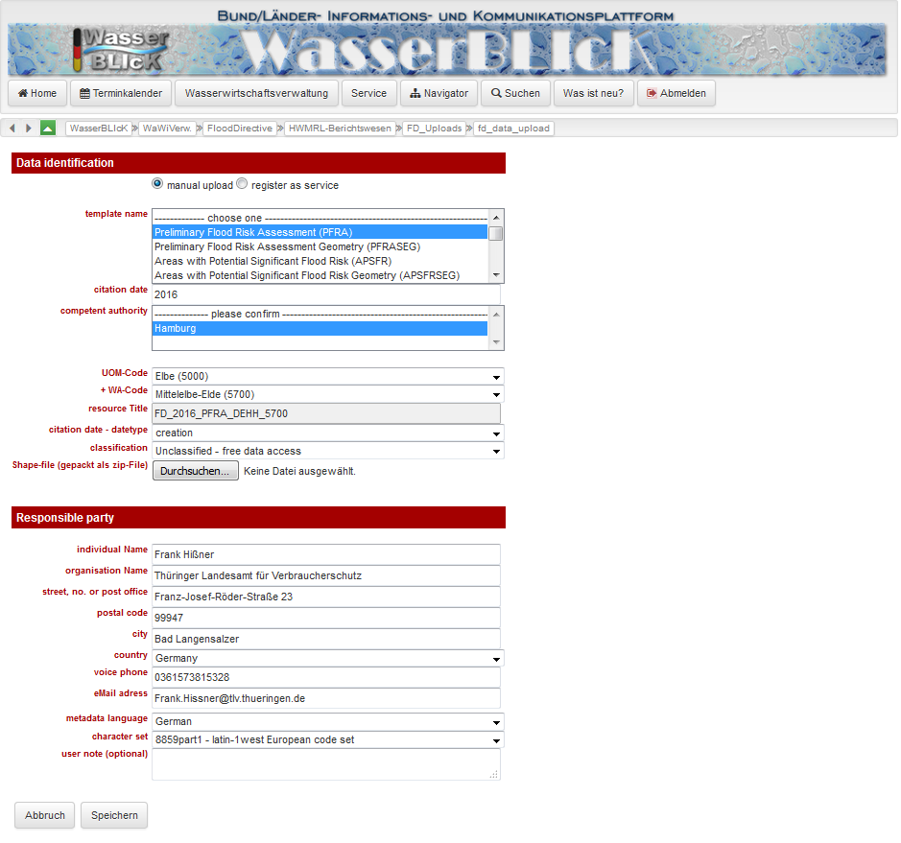
Manual Upload

Slide 13
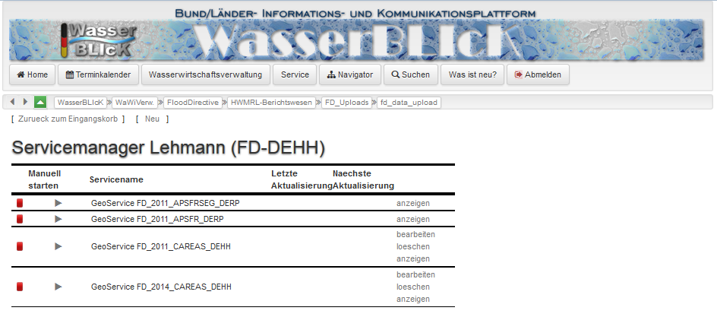
Upload per Service

Slide 14
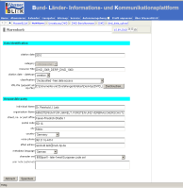


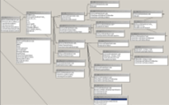
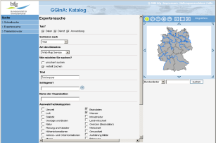
Dataflow
Metadata
Checks (FME)
Checks temporal area
Online-Tools
Active database

Slide 15
Dataflow
Metadata
Checks (FME)
Documentation
Templates
(Shape / XSD)
3. FME-Scripts
Checks temporal database
Online-Tools
Database model
Trigger / Procedures
Active database

Slide 16

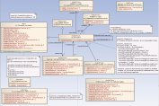
Dataflow
ISO 19100
Applicationschema
Encoding Rules
Shape
Change
Steuerparameter
FME Scripts
XML / GML
PDF Documentation
Shape Templates
XML / GML
DDL

Slide 17
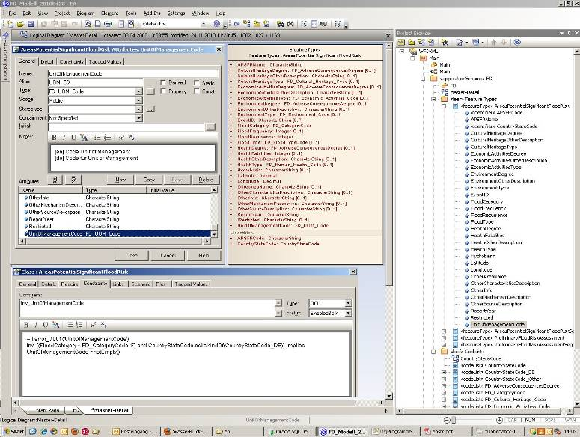
Data modeling
MoAp-Editor:
Software
Enterprise
Architect (EA)

Slide 18
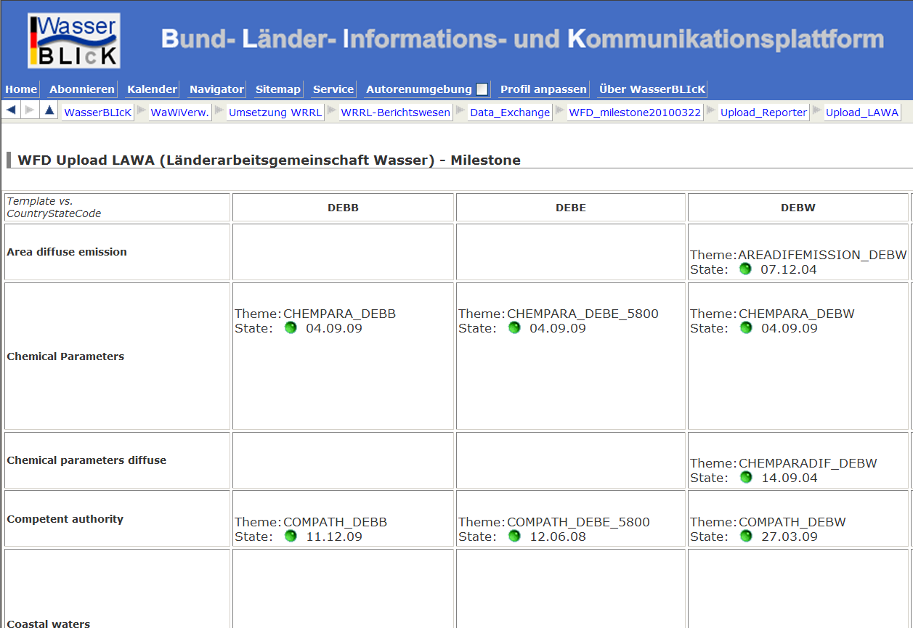
Upload-Reporter

Slide 19
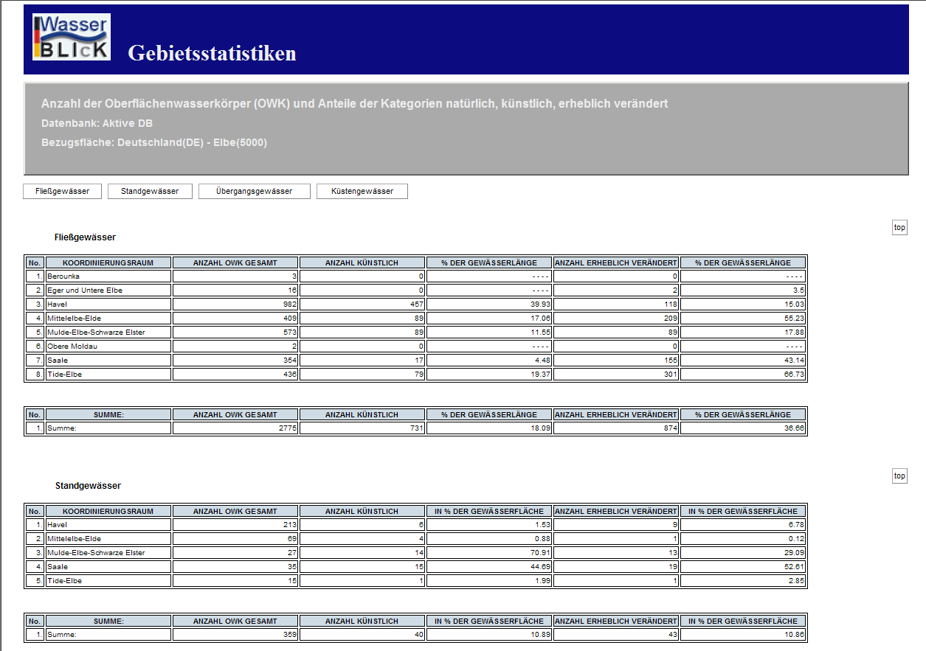
Statistics

Slide 20
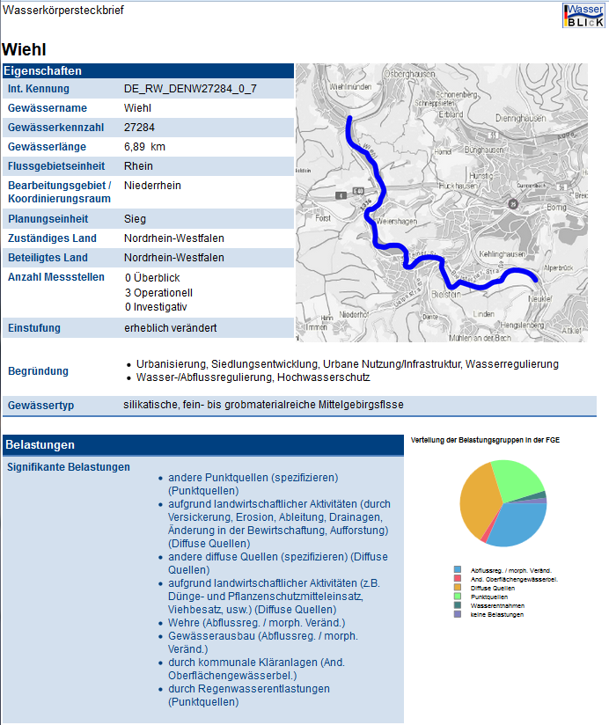
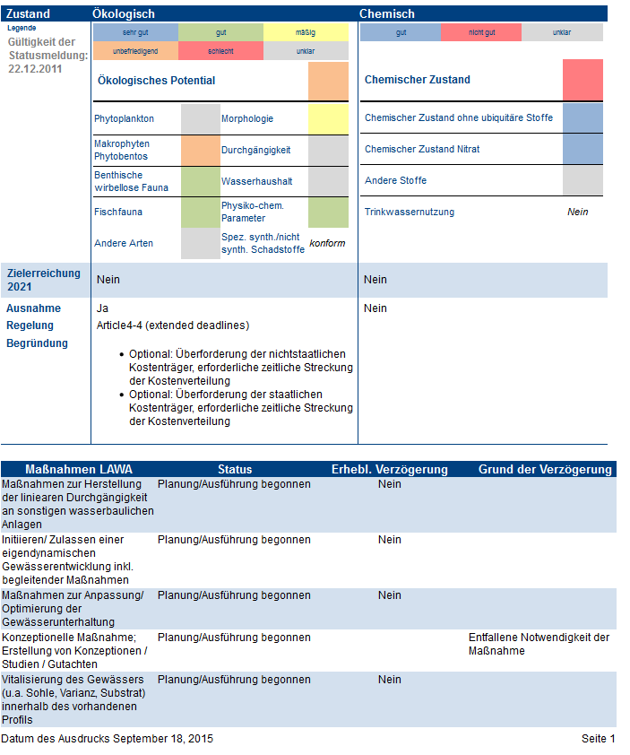
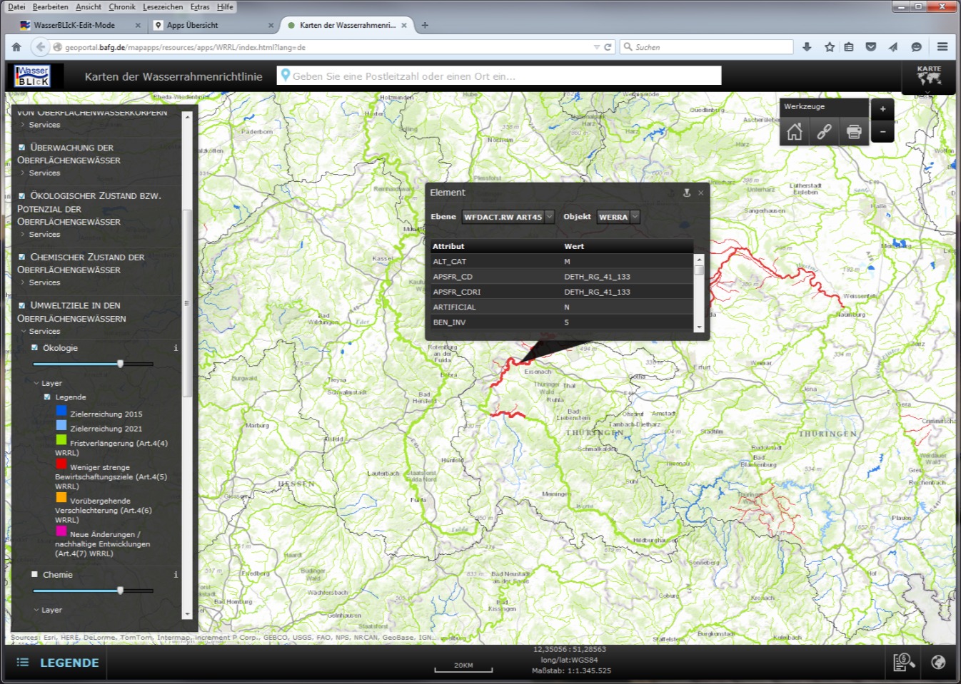
Reports

Slide 21
Thank you!
Dr. Sven-Henrik Kleber
Referat Geoinformation und Fernerkundung, GRDC
Bundesanstalt für Gewässerkunde
Am Mainzer Tor 1
56068 Koblenz
Email: kleber@bafg.de
Phone: 0049 (0)261 1306-5995

