Slide 1
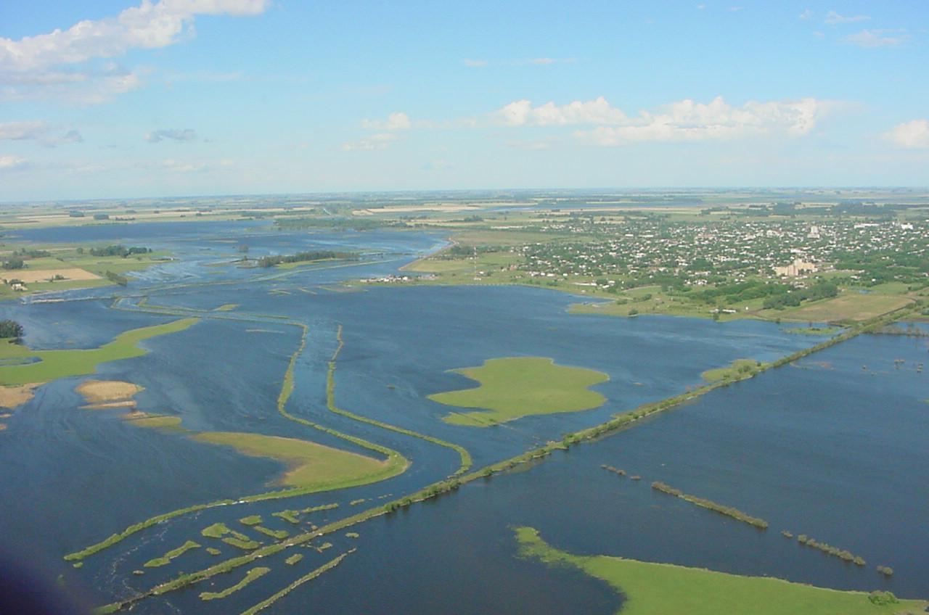


National Presidency
Undersecretariat for Water Resources
National Institute on Waters
Hydrological Warning System

Slide 2

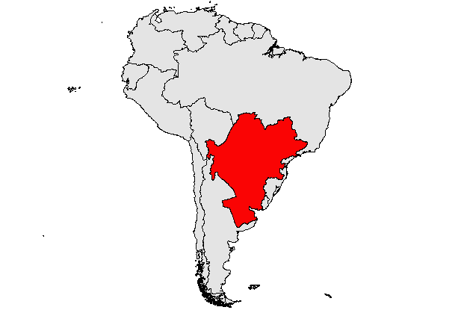

De La Plata River Basin - Continental Location
Southamerica

Slide 3
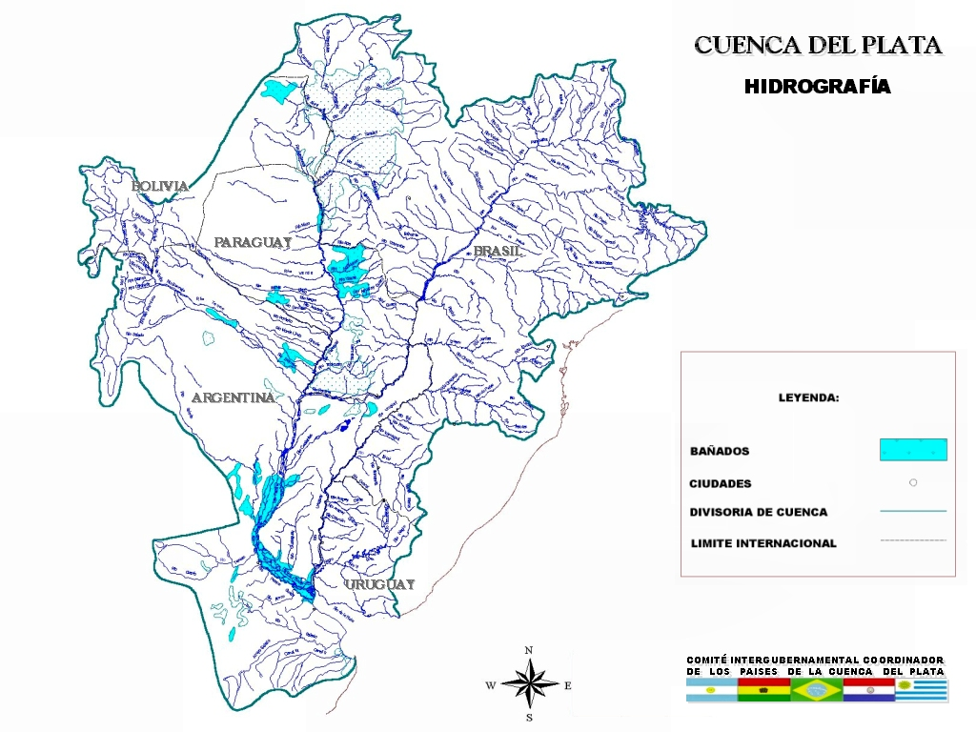
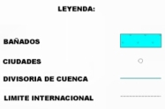
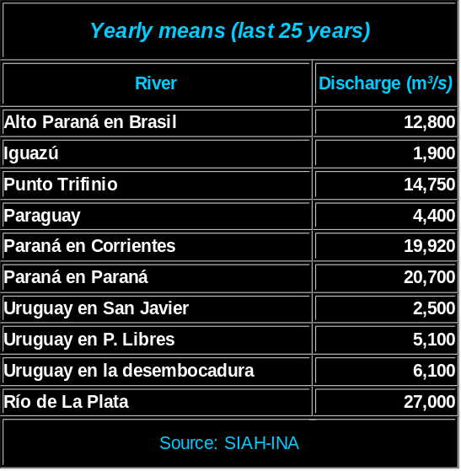

DEL PLATA BASIN
HYDROGRAPHY
MAPA00-HIDROGRAFÍA

Slide 4
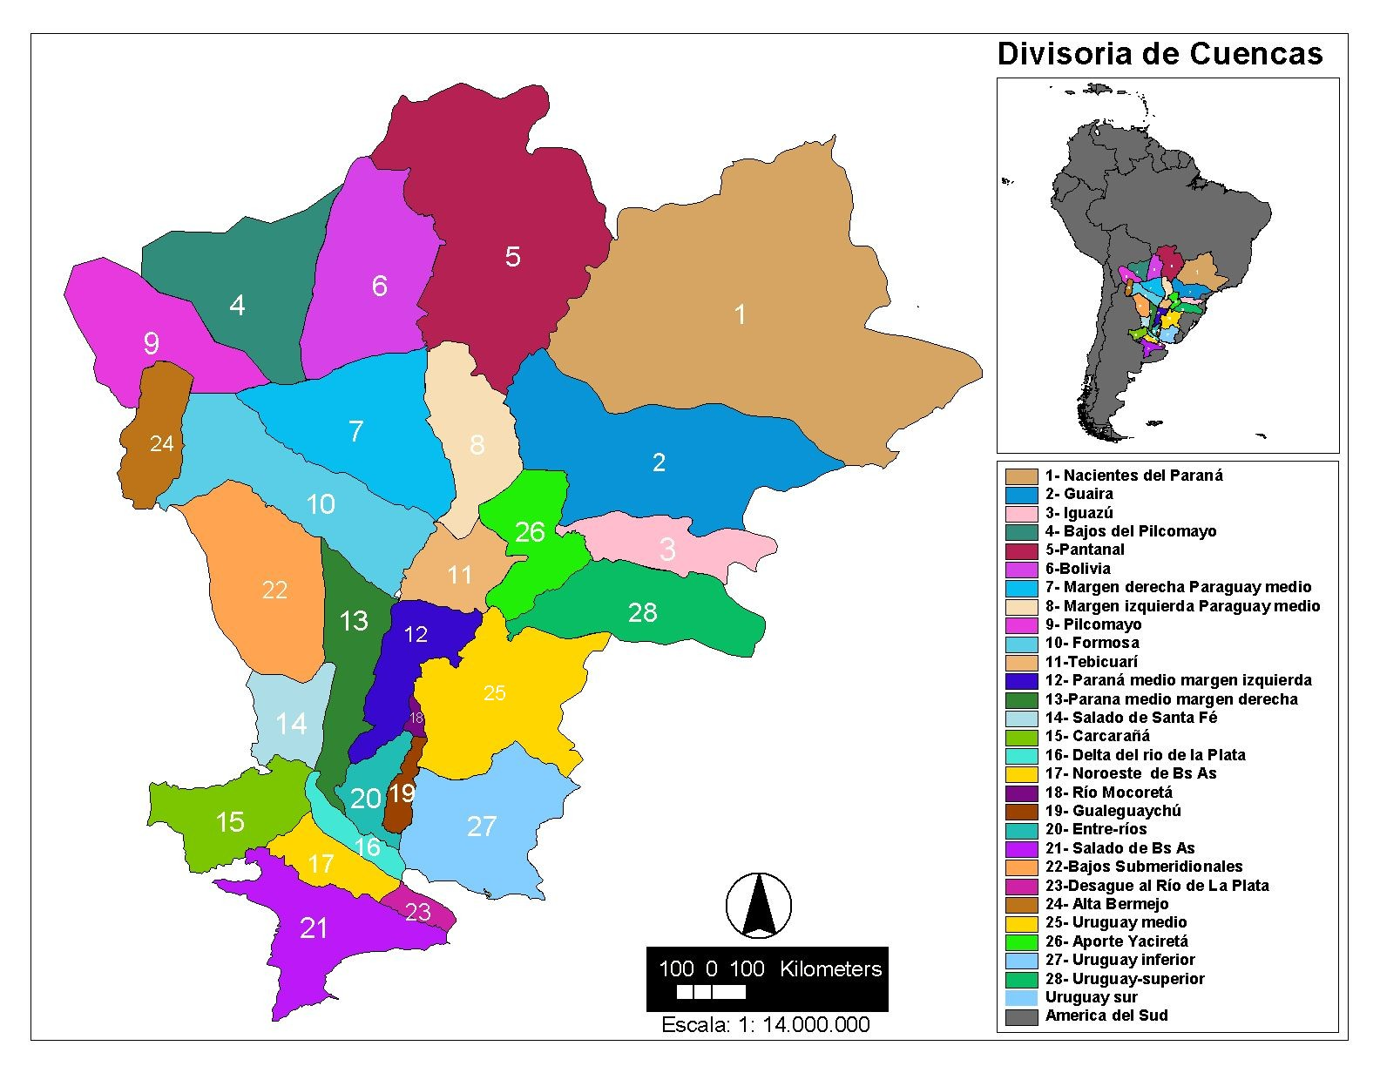

Slide 5
De La Plata River Basin – Description – Economic Relevance
Description:
  Approximate Extension:
  ~ 3,200,000 km2
  5 countries comprised:
  Argentina (downstream)
  Bolivia
  Brazil (upstream)
  Paraguay
  Uruguay
Main Rivers:
  Paraná, Paraguay, Uruguay, Iguazú, Pilcomayo, and Bermejo.
Economic Relevance:
  Population:
  ~ 100,000,000 inhabitants.
  80% of the GNP’s of the five countries is produced in the Basin.
  More than 60 hydropower dams are built in its rivers, supplying 80% of the regional demand.
  Its rivers are partially navigable by river barge convoys.
  The Paraguay- Paraná waterway is being implemented.

Slide 6
Hydrological Warning System - Goals
Permanent basin condition control.
Anticipation of flood events or very sharp low water situations as early as possible.
Regularly hydrologic forecasts in each main gauge station.

Slide 7
Hydrological Warning System - Activities
Meteorological, hydrometric and field data reception.
Database development and update.
Hydrological and Hydrodynamic Modeling.
Data processing and GIS applications.
Satellital images processing.
Forecasting and Hydrological Warning Service
Forecasting and Hydrological Warning Service
Forecasting and Hydrological Warning Service
Forecasting and Hydrological Warning Service

Slide 8

Hydrological Warning System – Nomal Conditions Products
Daily reports containing hydrometeorological information.
Two weekly reports on the basin’s hydrometeorological conditions and forecasts.
Basin data processing for users requirements.
Normal
Conditions

Slide 9

Hydrological Warning System – Emergency Products
Early warning reports on risk conditions in the Basin.
Daily reports describing the situation and presenting short, medium and long-term prospects.
Forecasts of maximum river stages indicating the probable number of days at risk.
Specials reports of prevent risk according with user needs.
Emergency

Slide 10
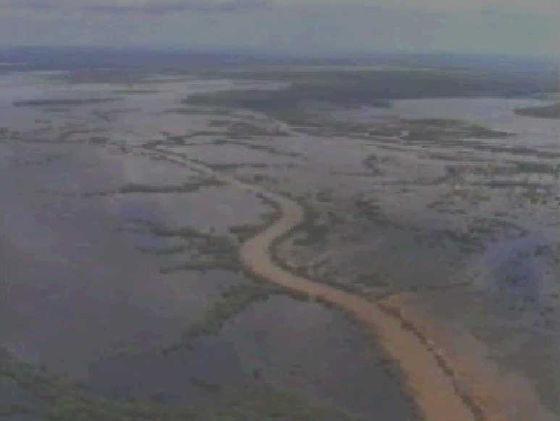

Information Sources
BRASIL
    CENTRO de PREDICAO de TEMPO E ESTUDOS CLIMÁTICOS (CPTEC)/INPE/MCT.
    SISTEMA METEOROLÓGICO DEL ESTADO DE PARANÁ (SIMEPAR)
PARAGUAY
    ADMINISTRACIÓN NACIONAL DE NAVEGACIÓN Y PUERTOS (A.N.N.P.).
URUGUAY
    DIRECCIÓN NACIONAL DE HIDROGRAFÍA (D.N.H).
ARGENTINA BINATIONAL ENTITIES:
    ENTE BINACIONAL YACYRETÁ.
    COMISIÓN TÉCNIA MIXTA DE SALTO GRANDE.
    COMISIÓN MIXTA ARGENTINO-PARAGUAYA DEL RÍO PARANÁ.
  NATIONAL INTSTITUTIONS:
    SERVICIO METEOROLÓGICO NACIONAL.
    PREFECTURA NAVAL ARGENTINA .
    COMISION NACIONAL DE APLICACIONES ESPACIALES.
    SERVICIO DE HIDROGRAFÍA NAVAL.
    INTA - INSTITUTO DE CLIMA Y AGUA.
    DIRECCIÓN NACIONAL DE CONSTRUCCIONES PORTUARIAS Y VIAS NAVEGABLES.
Notes:
2

Slide 11
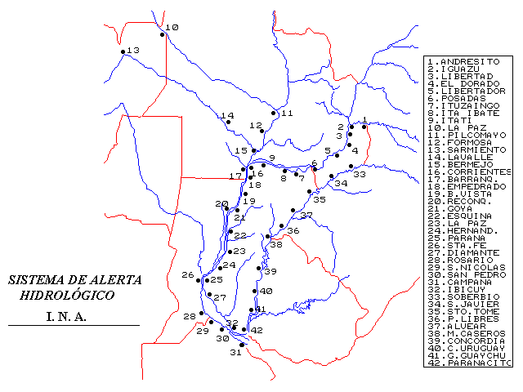


Hydrological Warning System – Hydrometric Network in the Country

Slide 12
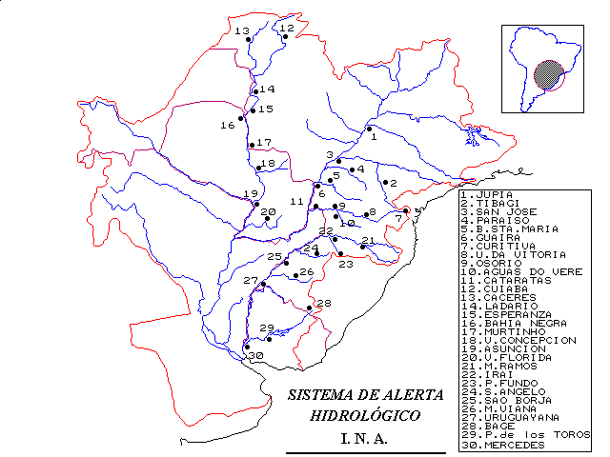


Hydrological Warning System – International Hydrometric Net

Slide 13

Hydrological Warning System – Information Flow
IMPUT DATA:
PROCESSING and DATA BASES
FORECASTS:
PRODUCTS:
Evaluation
Synoptic Situation
Meteorologic
Hydrometric Depth
Central
and Province
nodes
USERS
Hydrologic
Discharge
Remote Sensor
Satellital
Satellital Images
Methodology

Slide 14
Hydrological Warning System – METEOROLOGICAL ACTIVITIES FOR HYDROLOGICAL PURPOSES
WEATHER DIAGNOSTIC
  Reception of SYNOP and other source data.
  Satellite Rainfall Estimation and Storm tracking.
  Spatial and temporal evolution of precipitation.
WEATHER AND CLIMATE FORECAST
  Weather monitoring through different atmospheric models
  ENSO Monitoring and large scale coupled ocean - atmospheric process
  Daily reports and special issues.

Slide 15
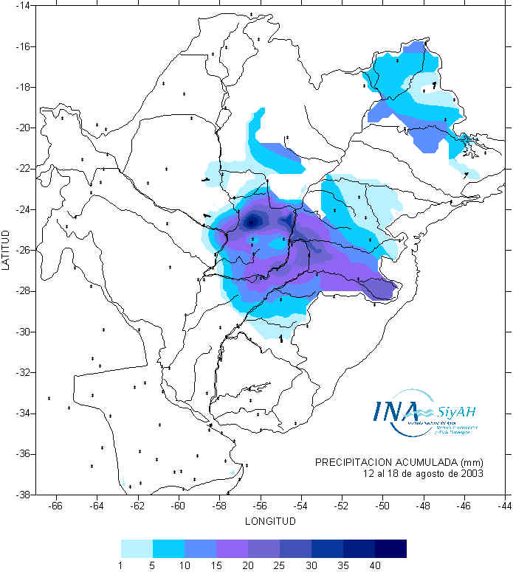
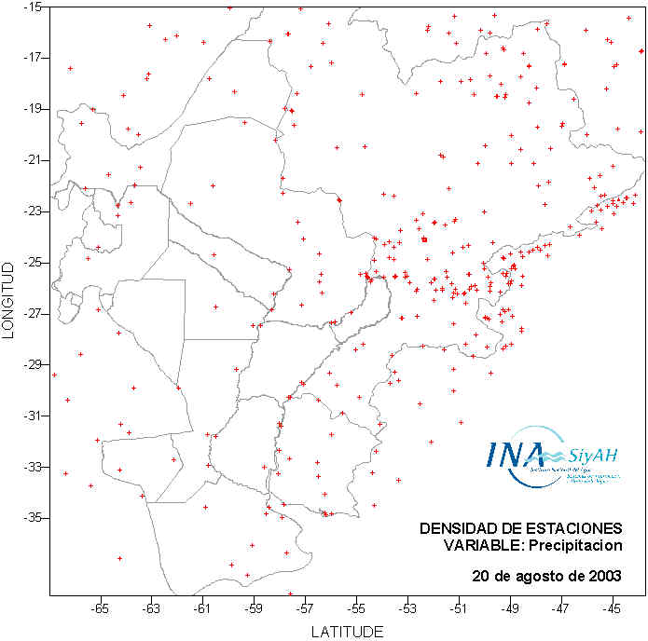
Hydrological Warning System – METEOROLOGICAL ACTIVITIES FOR HYDROLOGICAL PURPOSES
REAL TIME PRECIPITATION DATA
Source: WMO and other agencies

Slide 16
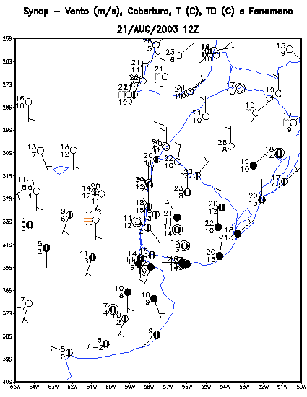
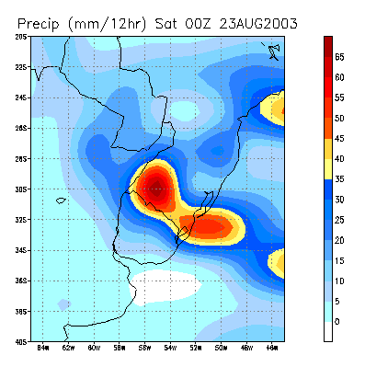

Hydrological Warning System – METEOROLOGICAL ACTIVITIES FOR HYDROLOGICAL PURPOSES
WEATHER FORECAST
Source: NOAA, CPTEC and other agencies

Slide 17
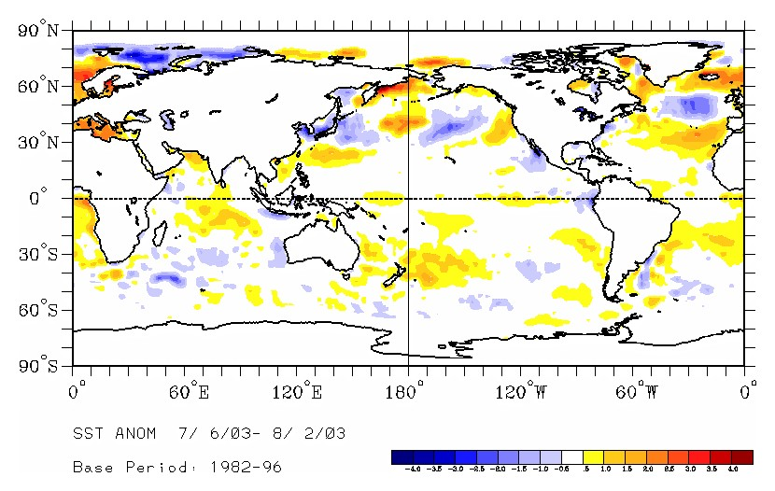
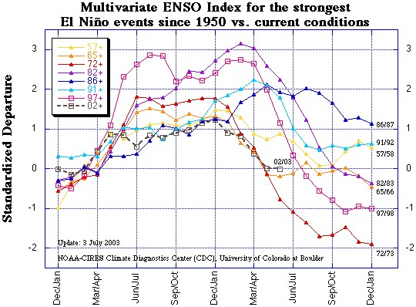

Hydrological Warning System – METEOROLOGICAL ACTIVITIES FOR HYDROLOGICAL PURPOSES
CLIMATIC MONITORING AND ENSO
Source: NOAA and other agencies

Slide 18
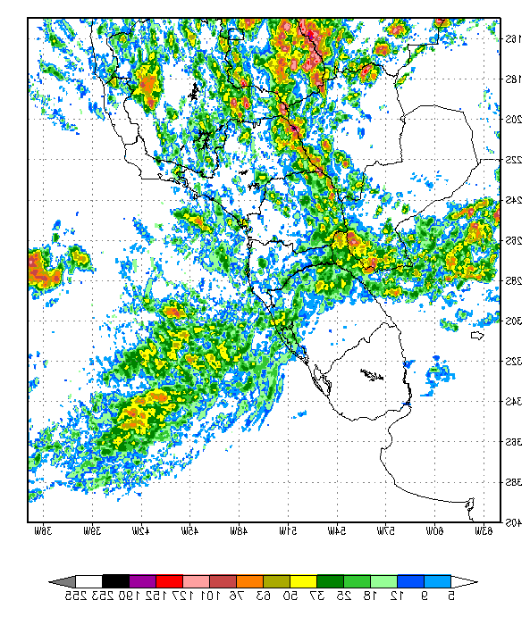
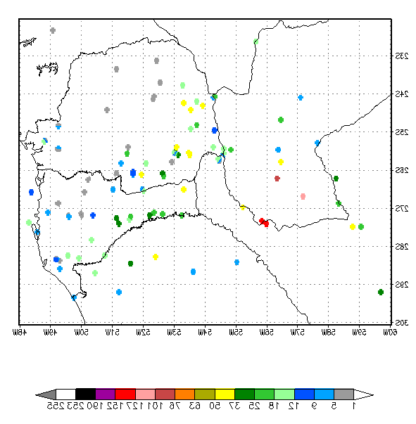
Hydrological Warning System – METEOROLOGICAL ACTIVITIES FOR HYDROLOGICAL PURPOSES
SATELLITE RAINFALL ESTIMATION: HYDROESTIMATOR TECHNIQUE
21/jan/2003

Slide 19
Simulation and forecast models in real time.
Fitted and available for the operation in real time.
  AUTOREGRESSIVE STRUCTURE WITH EXOGENOUS VARIABLES.
  PARAMETER ESTIMATION USING "KALMAN FILTERING” TECHNIQUE.
  NEURAL NETWORKS.
  SACRAMENTO (SAC) MODEL (US. NATIONAL WEATHER SERVICE ).
  CONTINUOUS, DETERMINSTIC AND CONCEPTUAL HYDROLOGICAL
  MODEL.
  UNIFIED CONCENTRATED PARAMETERS.
  APPLIED TO LOWER IGUAZÚ CATCHMENT.
CORPS OF ENGINEERS - U.S. ARMY.
  HYDROLOGICAL MODEL FOR SIMULATION AND FORECAST BY EVENT.
  RAIN/DISCHARGE MODEL AND WAVE PROPAGATION.
  APPLIED TO LOWER IGUAZÚ CATCHMENT AND MIDDLE URUGUAY CATCHMENT.
  HYDRODYNAMIC MODEL
  DEVELOPED BY THE APPLIED HYDRAULICS LABORATORY-INA.
  DYNAMIC WAVE PROPAGATION
  ONE-DIMENSIONAL CHANNEL NETWORK MODEL.
  CALIBRATED FOR PARANA RIVER FROM YACYRETÁ TO VILLA CONSTITUCIÓN.
TIME SERIES ANALYSIS
NWSAFS
NUMERICAL
MODELS
HEC-1
HYDRODYNAMIC MODEL

Slide 20

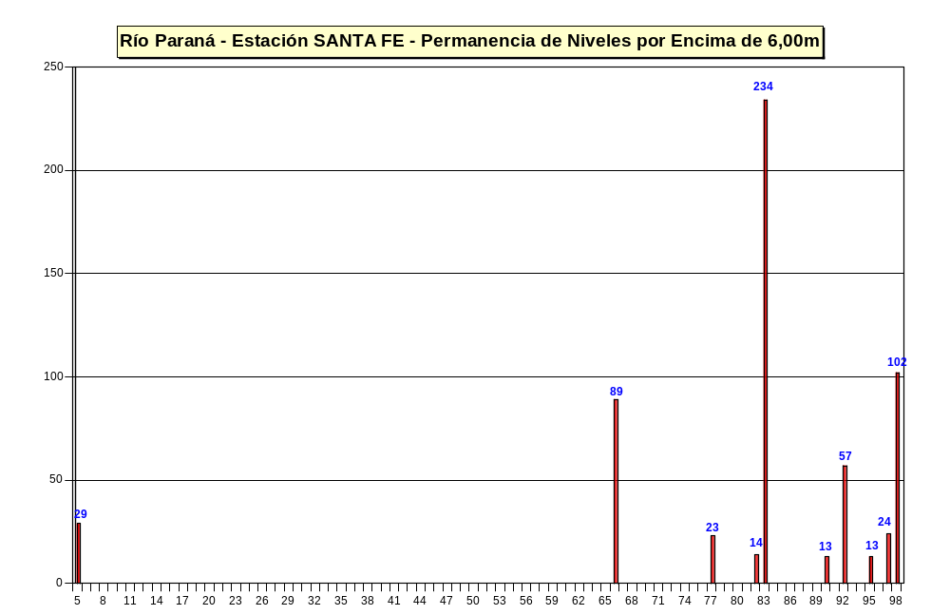
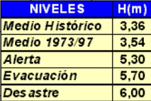
CANTIDAD DE DÍAS POR ENCIMA DE 6,00m
FECHAS = 1900 + Año

Slide 21
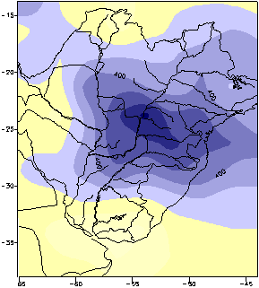
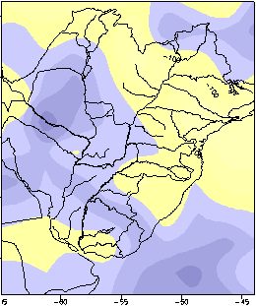
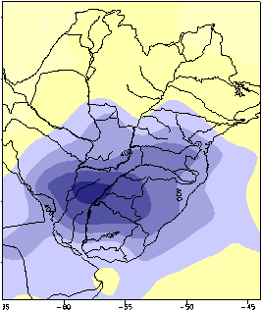

ENSO Events
Precipitation anomalies against normal (period 1979/2001)
Oct’82 – jul’83
Oct’91 – jul’92
Oct’97 – jul’98
Fuente: CPC Merged Analysis of Precipitation (CMAP)

Slide 22
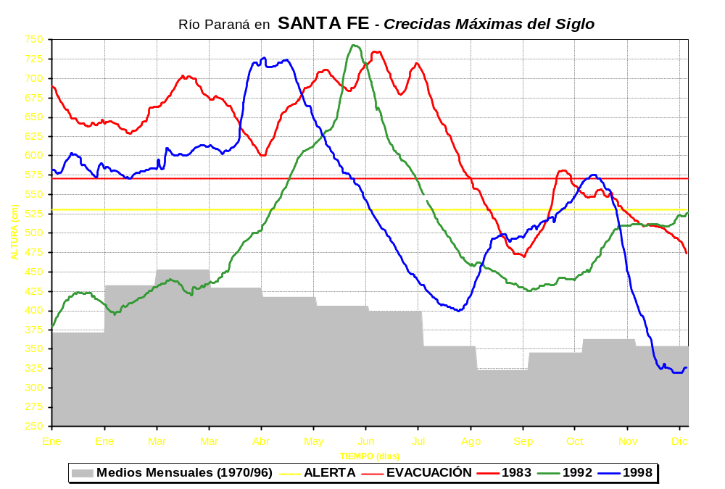
Paraná River at SANTA FE – Greatest Discharges
Monthly Means
ALERT
EVACUATION

Slide 23


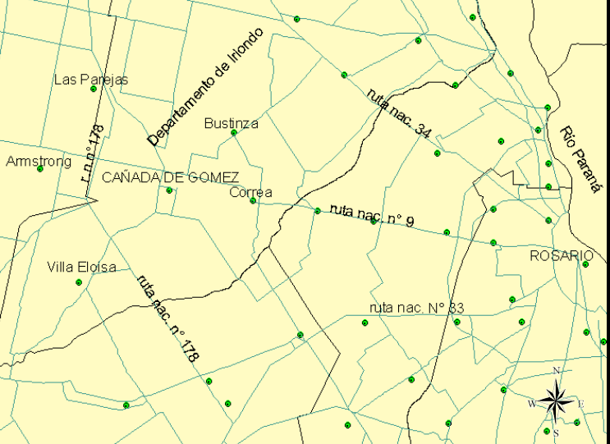
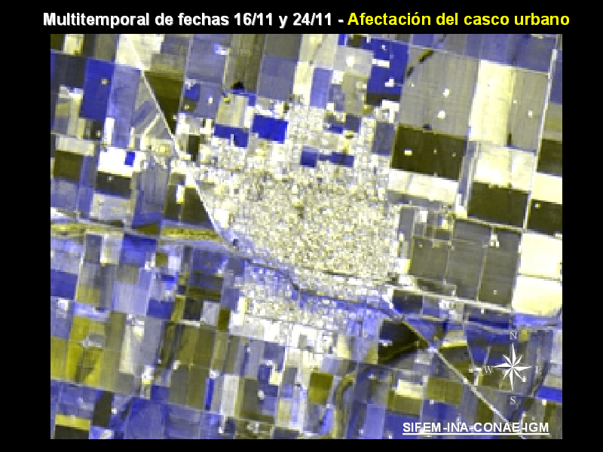
Hydrological Warning System – DATA INTEGRATION TECHNIQUES

Slide 24
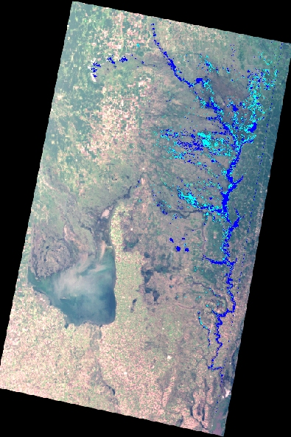
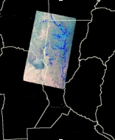


SANTA FE
Salado River Basin
Bajos Submeridionales
Image SAC-C / MMRS
February 17, 2003
Santiago del Estero
Chaco
Corrientes
CLASIFICATION
SATURATED SOIL
TOSTADO
Entre Rios
FLOOD
Arroyo
Golondrinas
Cordoba
Río Salado
Santa Fe
Buenos Aires
Arroyo
Calchaqui
Arroyo
Las Conchas
SAN CRISTOBAL
FLOOD ASSESMENT
Laguna de Mar Chiquita
Río San Antonio
ALMOST 30 KM2 IN FLOOD
ALMOST 18 KM2 OF SATURATED SOIL
Arroyo
Cululú
Río Salado
RAFAELA
SANTA FE

Slide 25

Spacecraft Utilization and Data delivery
SPOT data : One newly acquired scene requested still not delivered. More SPOT are necessary in following days.
RADARSAT: 2 programmed acquisitions requested and delivered. No historic archive data were provided.
ERS data : 4 scenes acquired and delivered. These scenes have been acquired outside the interest region.
20 historic and newly acquired TM images Delivered 2 more ERS-2 reference scenes (Year 2001) from DLR D-PAF
3 SAC-C/MMRS newly acquired images.
Data received by CONAE’s ground station at Cordoba delivered to end
users not within official “Charter Call”.

Slide 26
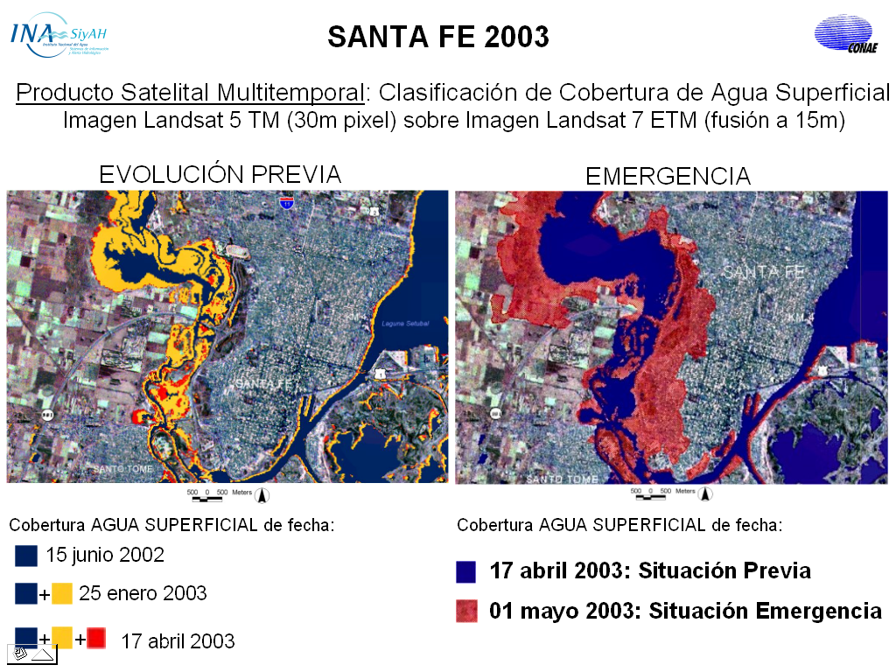

Slide 27

HIS Cuenca del Plata
An oportunity to improve the flow of observation data between and within countries to achieve more reliable and faster hydrological predictions
So far, almost all countries have developed their own databases and web interfaces for data access.
But the access offered is not in the form of a web service as defined by W3C: “a software system designed to support interoperable machine-to-machine interaction over a network”. Instead, the interfaces were designed for human access only. Some efforts have been made to capture the data by 'scraping' the websites, but the solutions proved to be unstable and many fundamental data sources couldn't be sorted out in this way. Then, we still rely mostly on manual data entry, and many potentially valuable observations are not used.
J. Borus and J. Bianchi, 13 Jun 2016

Slide 28
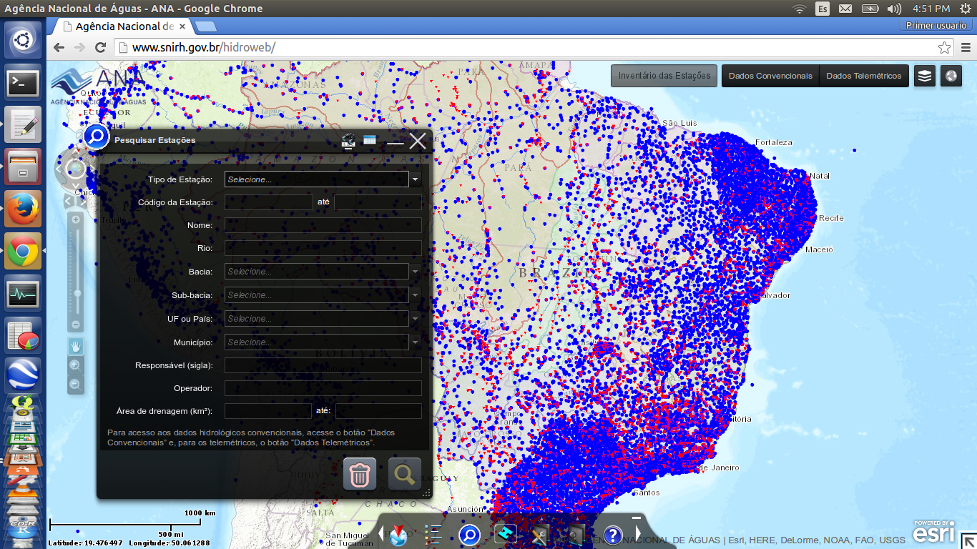
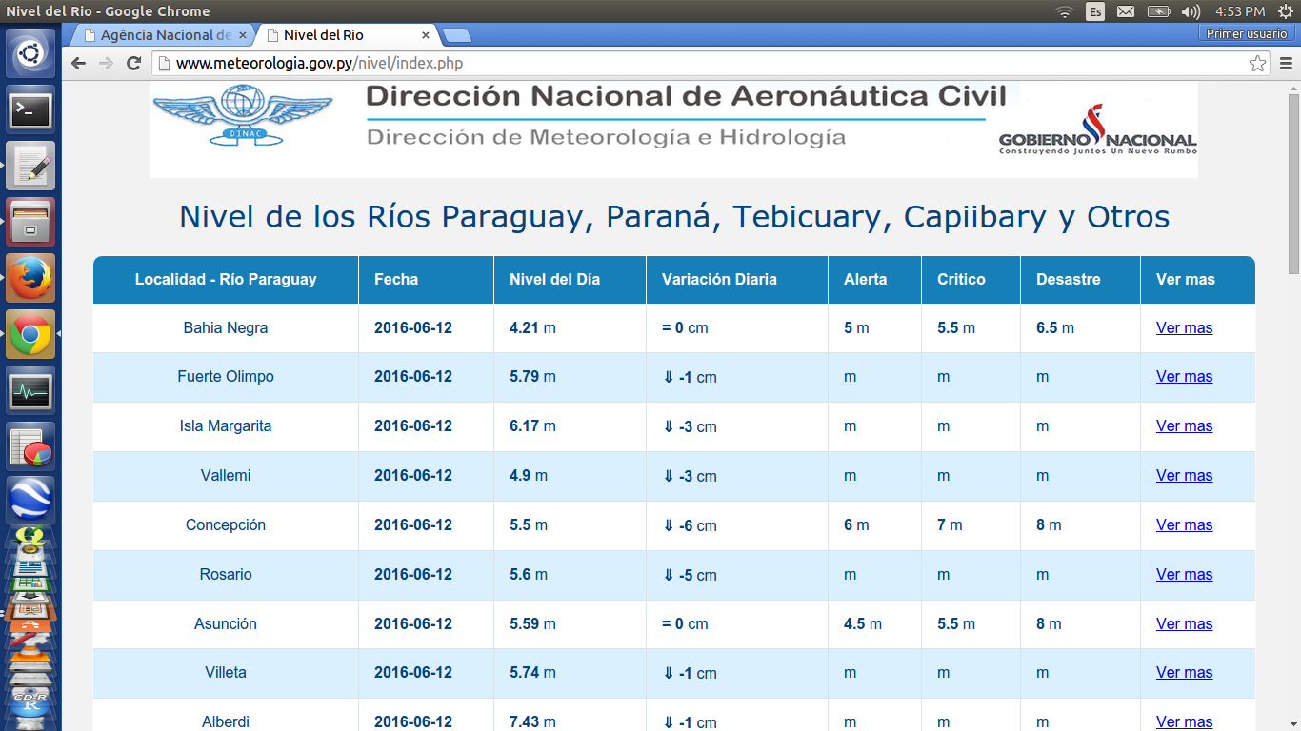
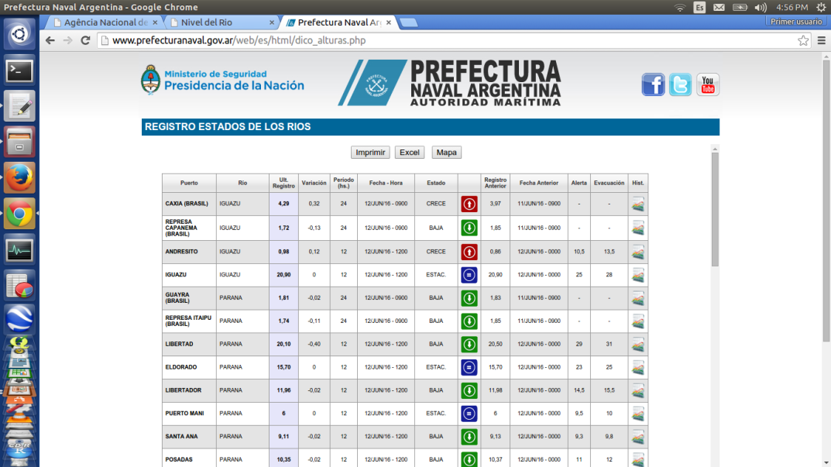
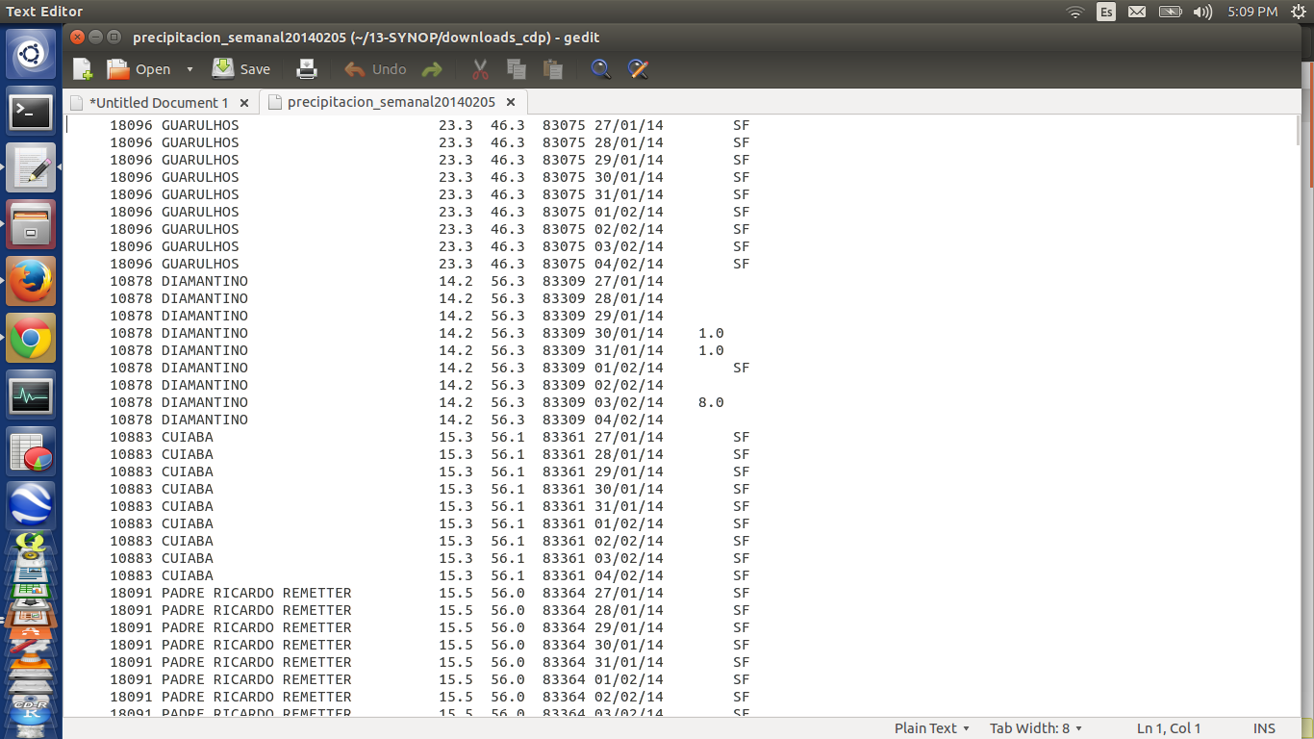
Del Plata Basin RT Meteo-Hydrological Data Availability
Brazil - ANA
Paraguay - DINAC
Most complete but hardest to 'scrap'
'Scrapable'
Argentina - PN
CDP Rain gauge FTP download
Scrapable but unstable (no station.ids)
Still our best option
J. Borus and J. Bianchi, 13 Jun 2016

Slide 29

Some Challenges for Data Exchange in the Del Plata Basin
To propagate knowledge about the web service paradigm in all countries and involved institutions, by showing what it is and its potential, and why it is important (HIS Plata demo),
To enhance the interaction between data producers and users in order to arrive to specific solutions to data exchange problems (bi/multilateral cooperation projects),
To divulgate the existence of international standards for observation data publishing, and interoperable data formats,
To integrate the many different data sources within each country.
Greetings
from
INA !!!!
J. Borus and J. Bianchi, 13 Jun 2016

