Slide 1

QGIS / GDAL GML application schema support update : use case on French Groundwater Information Network (GIN)
BRGM – S.Grellet

Slide 2
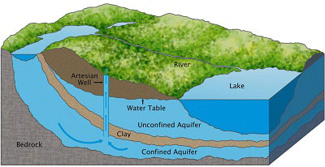

French GIN – linked data use case
Objectives
To provide stable and resolvable links to resources
To allow reference / data citation
Independant from underlying technologies used to provide data
I am #Piezometre/00634X0147/PZ1.2
attached to #Borehole/00634X0147/PZ1.2
I have a lot of #GroundWater Levels observations regarding #EntiteHydroGeol/107AK01
I am #Piezometre/00634X0147/PZ1.2
attached to #Borehole/00634X0147/PZ1.2
I am #EntiteHydroGeol/107AK01
I am monitored by #Piezometre/00634X0147/PZ1.2
I am #EntiteHydroGeol/107AK01
#GroundWater Levels obs. from #Piezometre/00634X0147/PZ1.2
Notes:
2
2

Slide 3



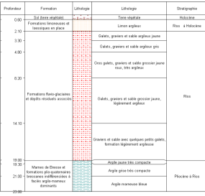

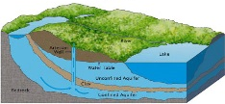
French GIN – linked data use case
Flows based on OGC and INSPIRE defined featureTypes
Env. Monitoring Facility
environmentalMonitoringFacility
hasObservation
GroundWater
raw levels
Borehole
attachedTo
relatedMonitoringFeature
GroundWater validated levels
featureOfInterest
relatedObservation
featureOfInterest
Observations/ Geological logs
Geology / HydroGeology
xx
Legend:
Feature(s)
Observation(s)
Notes:
2
2

Slide 4
French GIN – linked data use case
Object instances are associated by their URI
Env. Monitoring Facility
URI
URI
GroundWater
raw levels
Borehole
URI
URI
GroundWater validated levels
URI
URI
URI
Observations/ Geological logs
Geology / HydroGeology
URI
Legend:
Feature(s)
Observation(s)
Notes:
2
2

Slide 5
French GIN – linked data use case
URI allowing to dereference content exposed by OGC services
Env. Monitoring Facility
URI
WFS
URI
GroundWater
raw levels
Borehole
URI
WFS
URI
SOS
GroundWater validated levels
URI
URI
URI
SOS
Observations/ Geological logs
Geology / HydroGeology
URI
WFS
SOS
Legend:
Feature(s)
Observation(s)
Notes:
2
2

Slide 6
GML application schema toolbox - overall context
Initial idea
Reuse information available in XML compliant to xsd(s) to handle this content with no hardcoded configuration -> enriched XML and database generation on the fly.
Retrieve objects of interest described according to a standard
= semantic and geographical representation
interacts with the content (XML and Database). Database -> plug other tools
Resolve XLinks to add more content
vocabulary registry definitions (multilinguism is handled)
linked domain features / observation
Notes:
2
2

Slide 7
GML application schema toolbox - overall context
Trigger custom widgets based on standards
working: Waterml 2 timeseries, Inspire PointTimeSeries
drafty: GW_GeologyLogCoverage
on-going EU AirqualityDirective timeseries
Writes content (file not WFS-T)
Standalone OGR/GDAL driver -> reuse
Previously presented during last year workshop
Koblenz 2016 Hydro DWG Workshop presentation of the Proof Of Concept QGIS plugin
Notes:
2
2

Slide 8
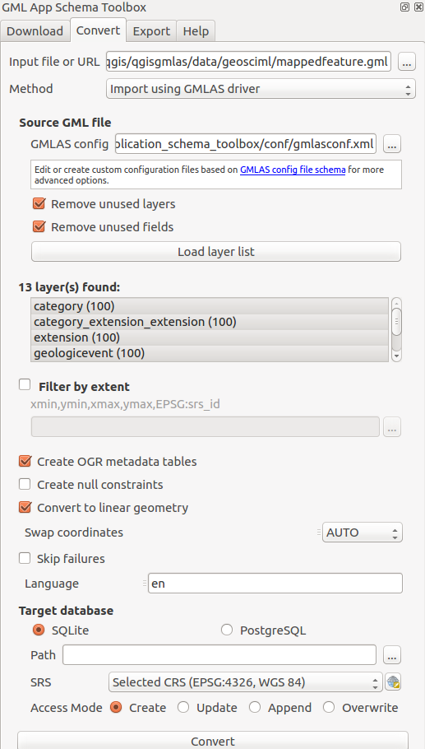
GML application schema toolbox use – QGIS 3
Notes:
2
2

Slide 9
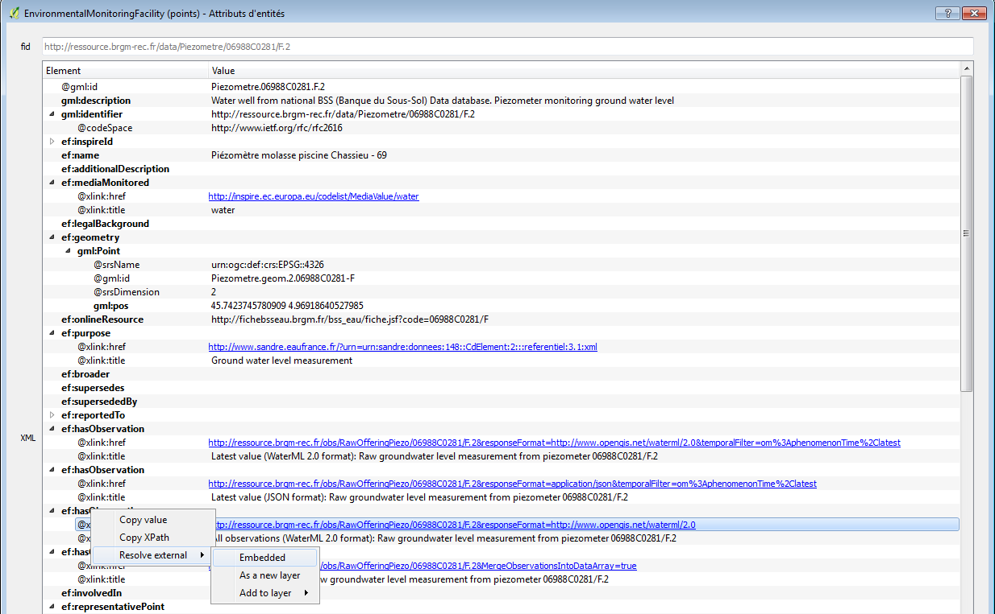
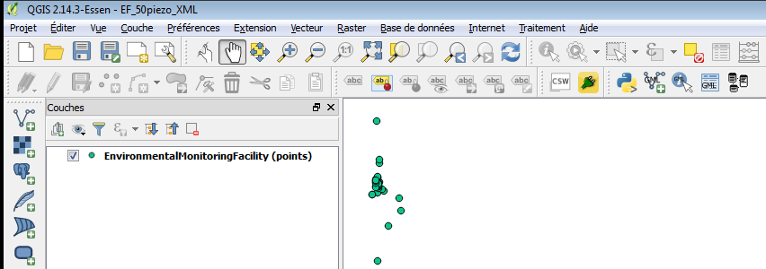
GML application schema toolbox use – XML
Env. Monitoring Facility
GroundWater
raw levels
URI
URI
1
2
Notes:
2
2

Slide 10
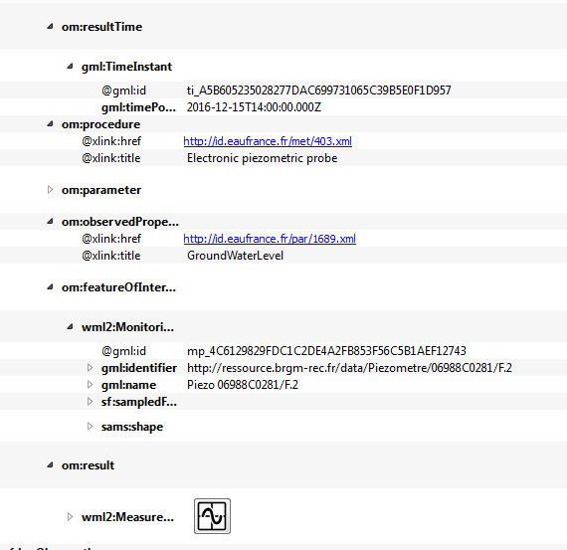
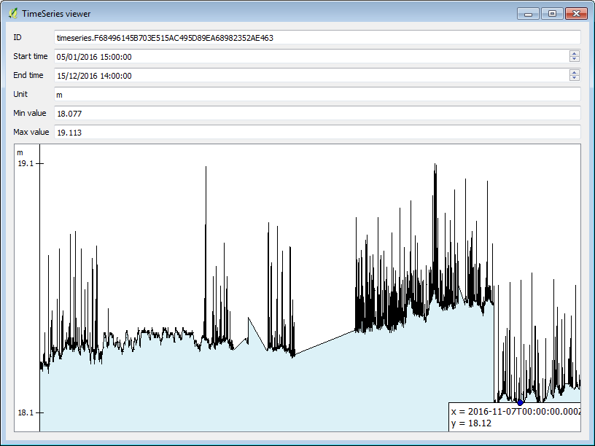
GML application schema toolbox use – XML
Env. Monitoring Facility
GroundWater
raw levels
URI
URI
3
Notes:
2
2

Slide 11
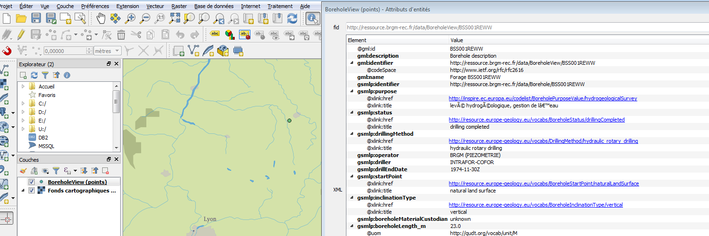
GML application schema toolbox use – XML
Borehole
A
Notes:
2
2

Slide 12
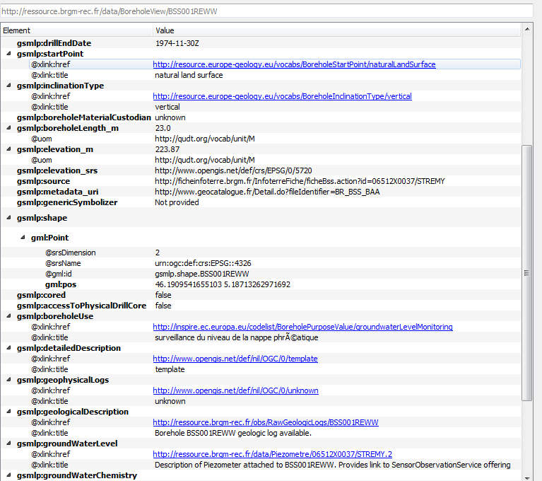
GML application schema toolbox use – XML
Borehole
Notes:
2
2

Slide 13
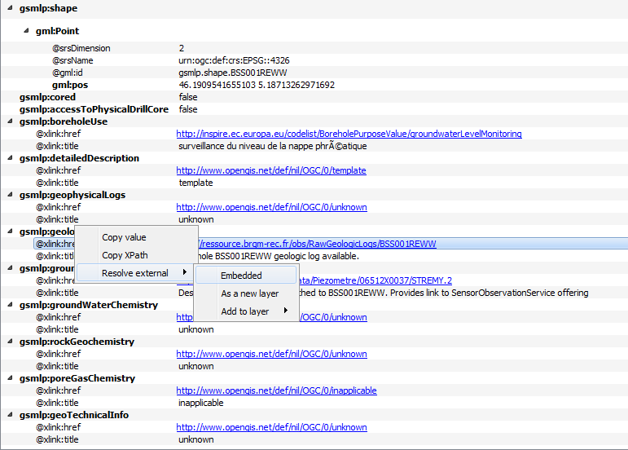
GML application schema toolbox use – XML
Borehole
URI
URI
Observations/ Geological logs
B
Notes:
2
2

Slide 14
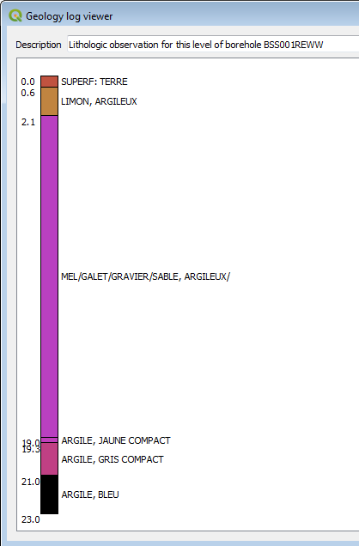
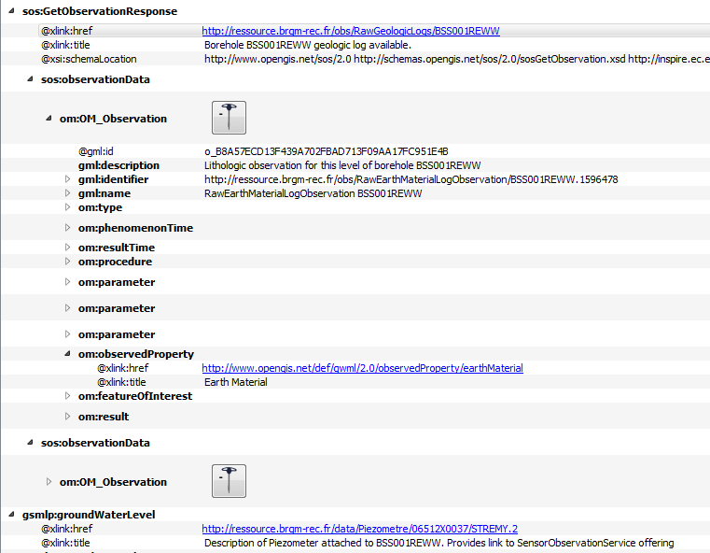
GML application schema toolbox use – XML
Borehole
C
URI
URI
Observations/ Geological logs
Notes:
2
2

Slide 15
GML application schema toolbox use – XML
Borehole
URI
URI
Env. Monitoring Facility
-> back to slides 9, 10
Notes:
2
2

Slide 16
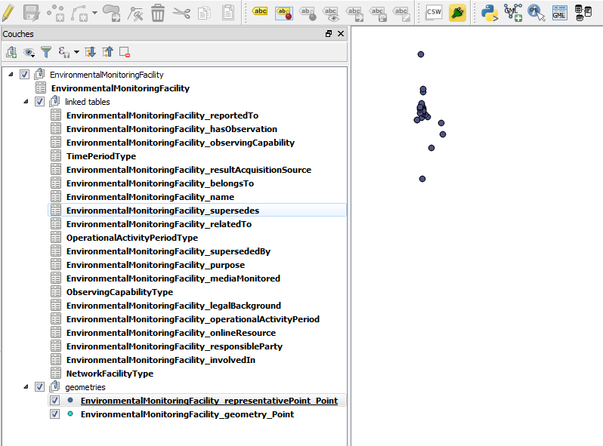
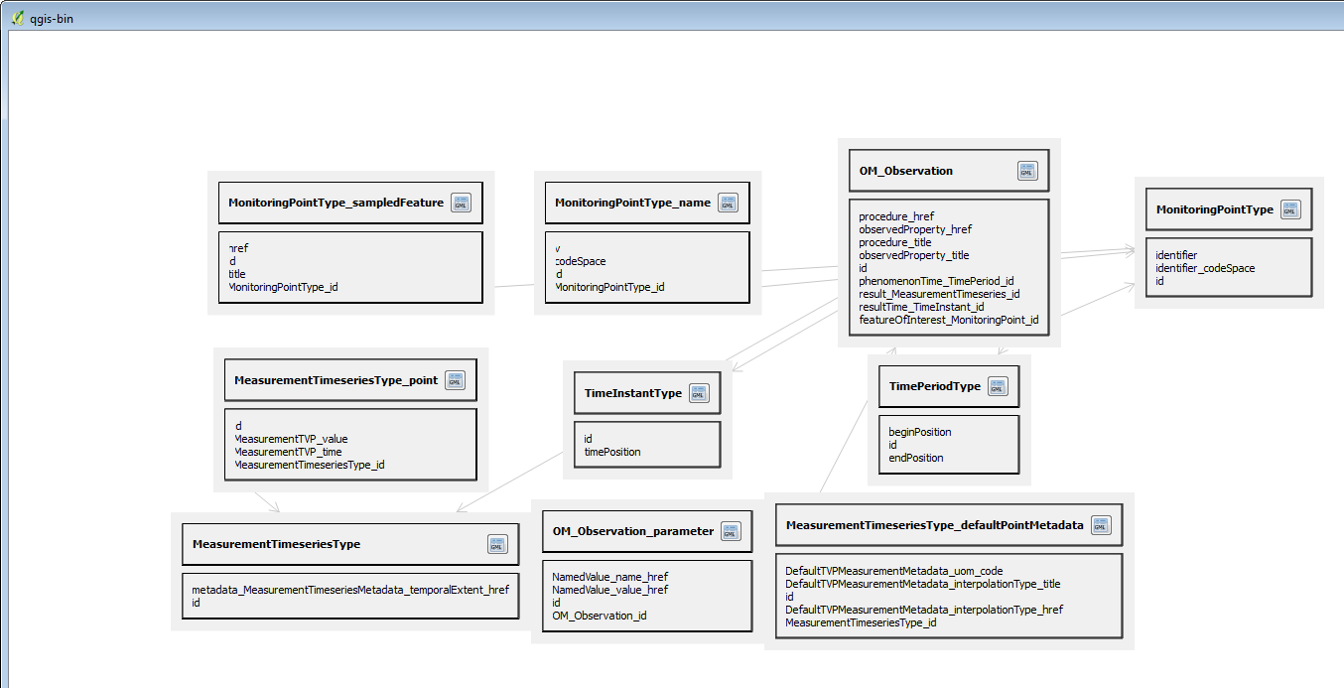
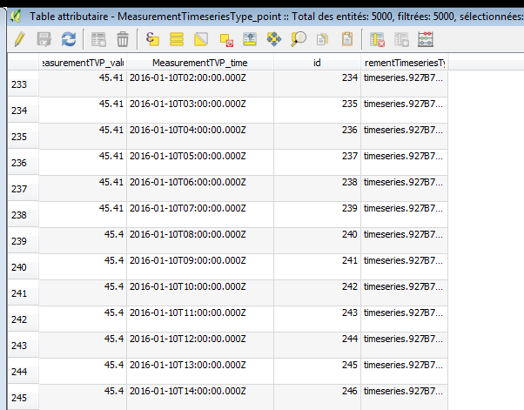
GML application schema toolbox use – Database
WaterML2 flow (see slide 10, Timeseries viewer) but client in database mode
Tables created dynamically
by GDAL GMLAS
Notes:
2
2

Slide 17
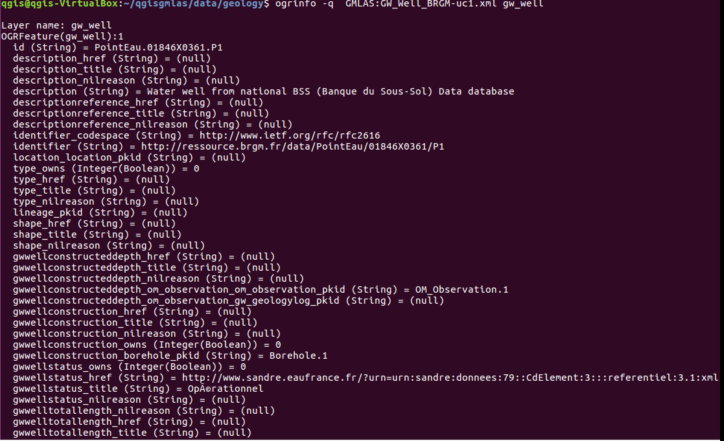
GML application schema toolbox use – ogrinfo
Ex: direct driver access to GroundWaterML2 GW_Well
Notes:
2
2

Slide 18
Overall – development story
NO DATA
?
NO CLIENT
« another approach to demonstrate
the usefulenessof interoperable standards »
or
« having something to show to those
who consider XML is not sexy »
Notes:
2
2

Slide 19





Overall – development story
From the ProofOfConcept to an enhanced approach
2016
2017
Run n° 1
QGIS 2.x GML application schema toolbox POC
Run n°2
GML App Schema OGR Driver and QGIS 3 integration
Run n°3
(now)
GML App Schema OGR Driver and QGIS 3 integration enhancements
Notes:
2
2

Slide 20


Overall – development story
From the ProofOfConcept to an enhanced approach
Run n° 1
QGIS 2.x GML application schema toolbox POC
Run n°2
GML App Schema OGR Driver and QGIS 3 integration
PyXB -> specific OGR/GDAL GMLAS driver (targetting GDAL 2.2), handling both reading and writing
Integration within QGIS 3
Run n°3
(now)
GML App Schema OGR Driver and QGIS 3 integration enhancements
- GDAL GMLAS : addition handling specific SWE types based on GWML2 GW_GeologyLogCoverage and EU Air Quality Reportings (dataArray, dataRecord, …)
- QGIS 3 : enhanced widgets for timeseries, and borehole logs + some commit to the trunk
2.2
3
Notes:
2
2

Slide 21
Useful links
https://plugins.qgis.org/plugins/gml_application_schema_toolbox/
https://github.com/BRGM/gml_application_schema_toolbox
Documentation, GUI presentation
Multilinguism handling
on INSPIRE registry: same flow asking for English then Greek definitions
https://www.youtube.com/watch?v=EeAyyUOykVE
How to test under QGIS3 until its official release
Use OSGeo4W installer
Advanced install \ Desktop -> add qgis-dev
Then install the plugin from QGIS repository
Notes:
2
2

Slide 22
Conclusion
Generic work successfully tested on
OGC : GroundWaterML2, GeoSciML4, WaterML2
INSPIRE : EnvironmentalMonitoringFacilities, BioGeographicalRegions, LandCover, ProtectedSites, MineralResources, PointTimeSeriesObservation
Our domain colleagues can now finally make use of standardized content ☺
Next steps
Address (some) SWE specificities
Have more domain widgets
Handle other content type (JSON-LD ?)
Workshop at Foss4G-E : github ticket to gather content to play with
Feel free to use, test, enhance it, propose evolutions
Notes:
2
2

Slide 23
Conclusion - whishlist
Input
data
reading
Data
format
Data
use
Output
data
writing
Input
connector
GUI-Widget WaterML2
WFS 2 client
<XML>
GUI-Widget GWML2 BoreholeLog
File
GMLAS
GUI-Widget EU AQD
TimeSeries
GMLAS
PostreGre/GIS
Spatialite
SOS 2 client
More data structures
More data structures
More domain
GUI-widgets
Data processing libs
GML Application schema toobox
Existing
Evolution idea
Notes:
2
2

Slide 24
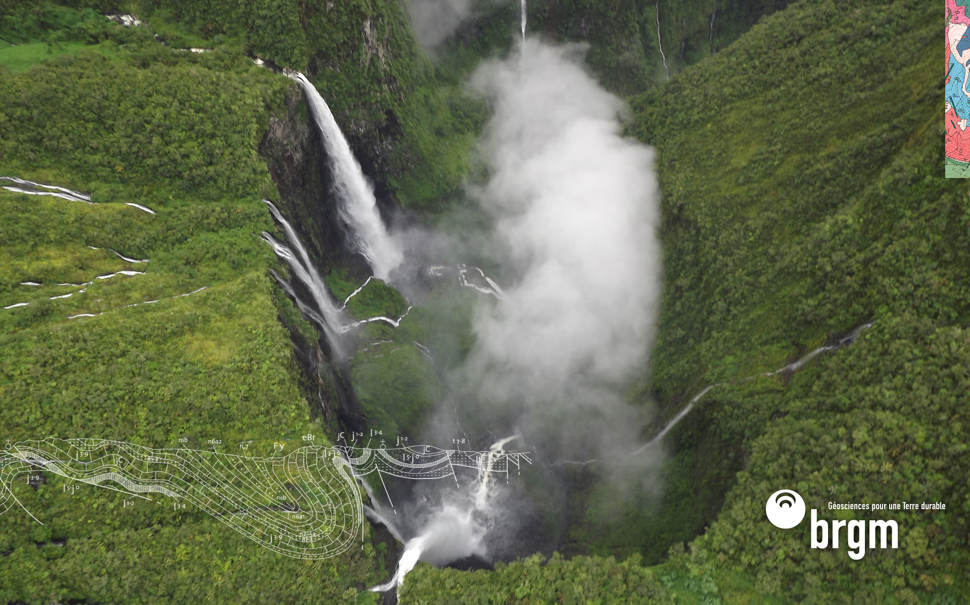
Thank you
s.grellet@brgm.fr
m.beaufils@brgm.fr
Notes:
2
2

