Slide 1
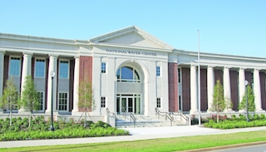
2017 WMO/OGC Hydrology Domain Working Group workshop
National Water Center
Tuscaloosa, USA
20-23 June 2017

Slide 2
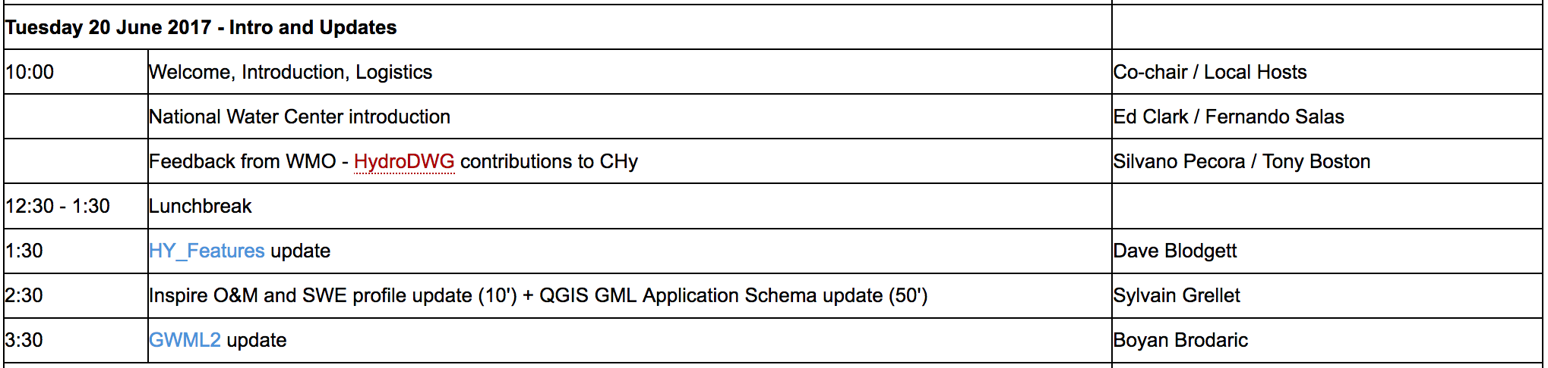
Draft Agenda
Day 1

Slide 3
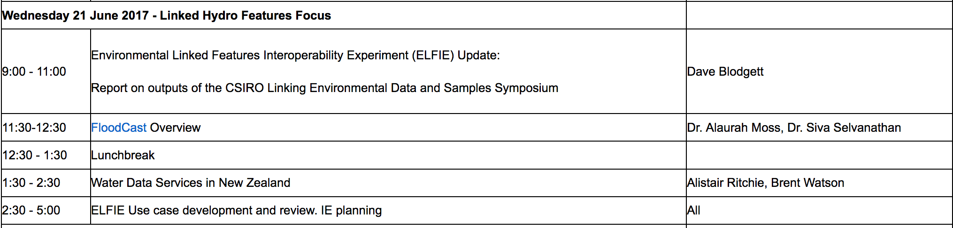
Draft Agenda
Day 2

Slide 4
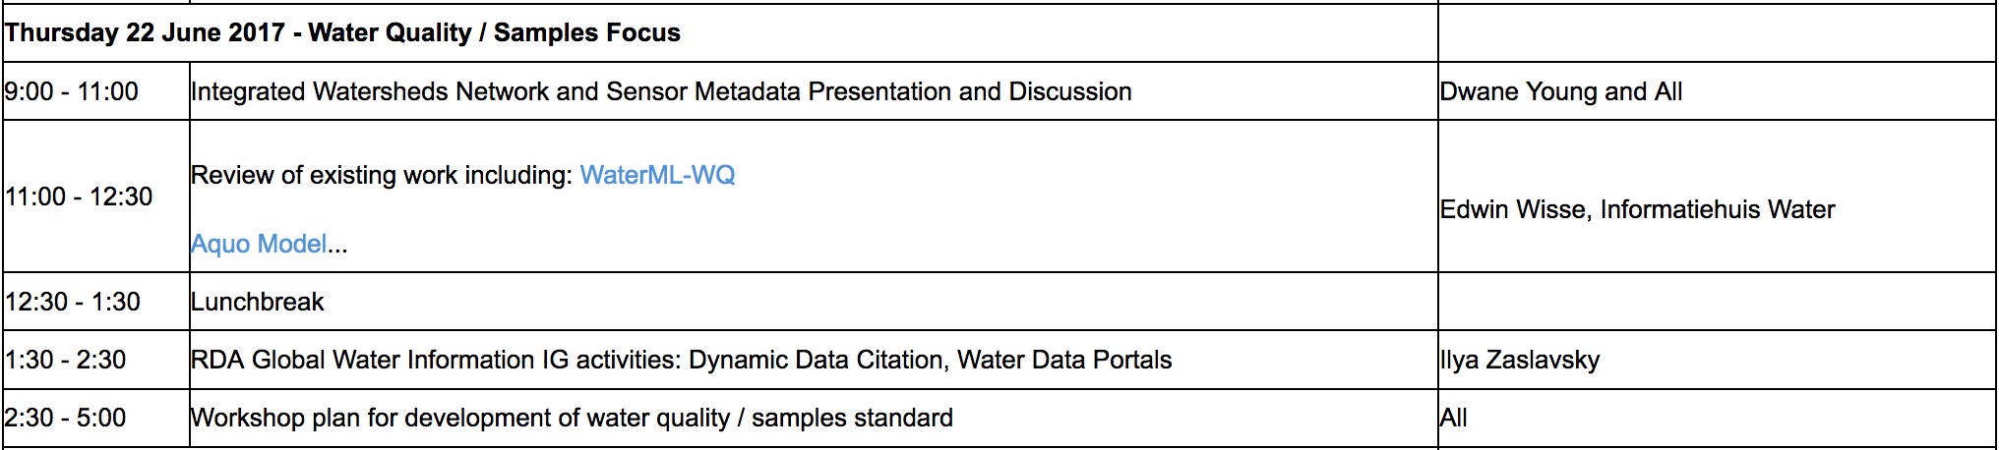
Draft Agenda
Day 3

Slide 5
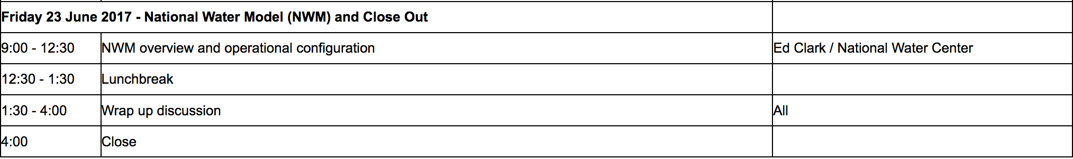
Draft Agenda
Day 4

Slide 6
Admin
Logistics
Workshop dinner Wednesday 21 June. Venue TBD
GotoMeeting available for remote attendees
National Water Center
National Water Model
Summer Institute
Enjoy the workshop!

