Slide 1

GWML2 Update
Eric Boisvert, Boyan Brodaric &
Groundwater Standards Working Group

Slide 2
GWML2 Quick History
2012 June GW2IE Kick-off (47 telecons, 2 workshops)
2016 April GW2IE End
2016 April GW2IE Report published (15-082)
2016 March Groundwater SWG Kick-off
2016 June ------ HDWG Workshop Koblenz ------
2016 July GWML2 Spec submitted
2016 August GWML2 Spec approved (OGC TC)
2016 Sept GWML2 Spec approved (OGC PC)
2017 Feb GWML Paper submitted (HJ)
2017 March GWML2 Spec published! (16-032r2)

Slide 3
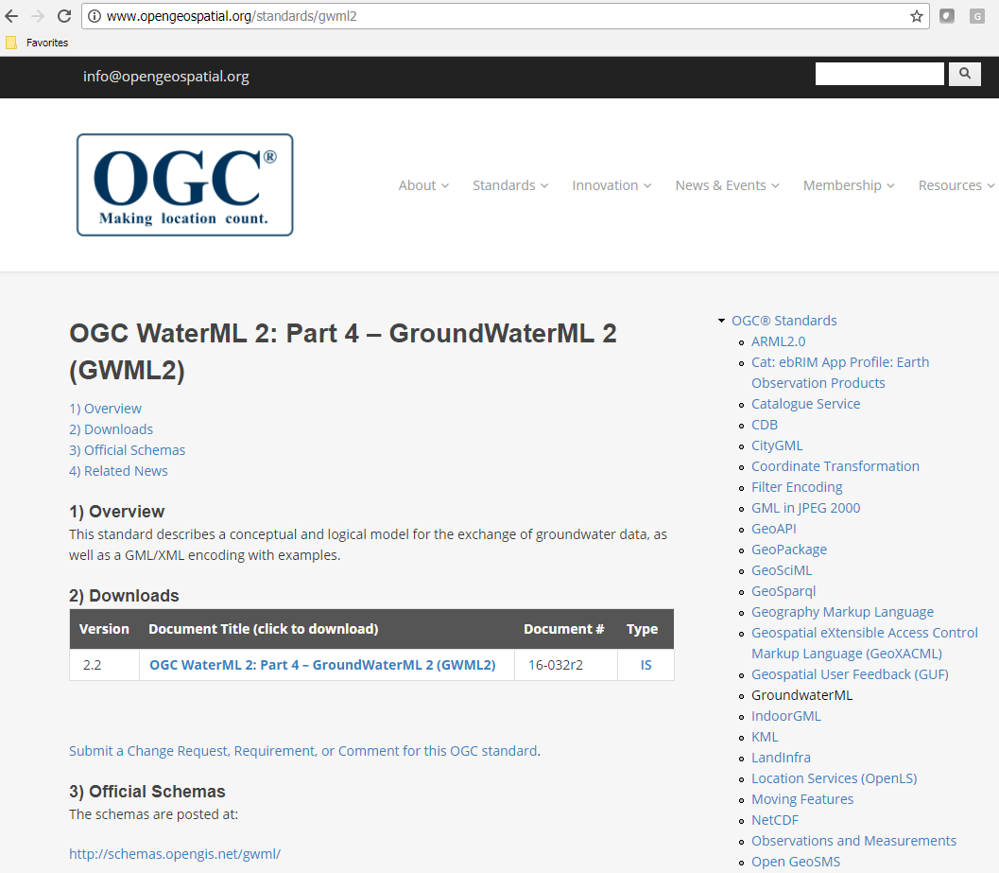

Slide 4
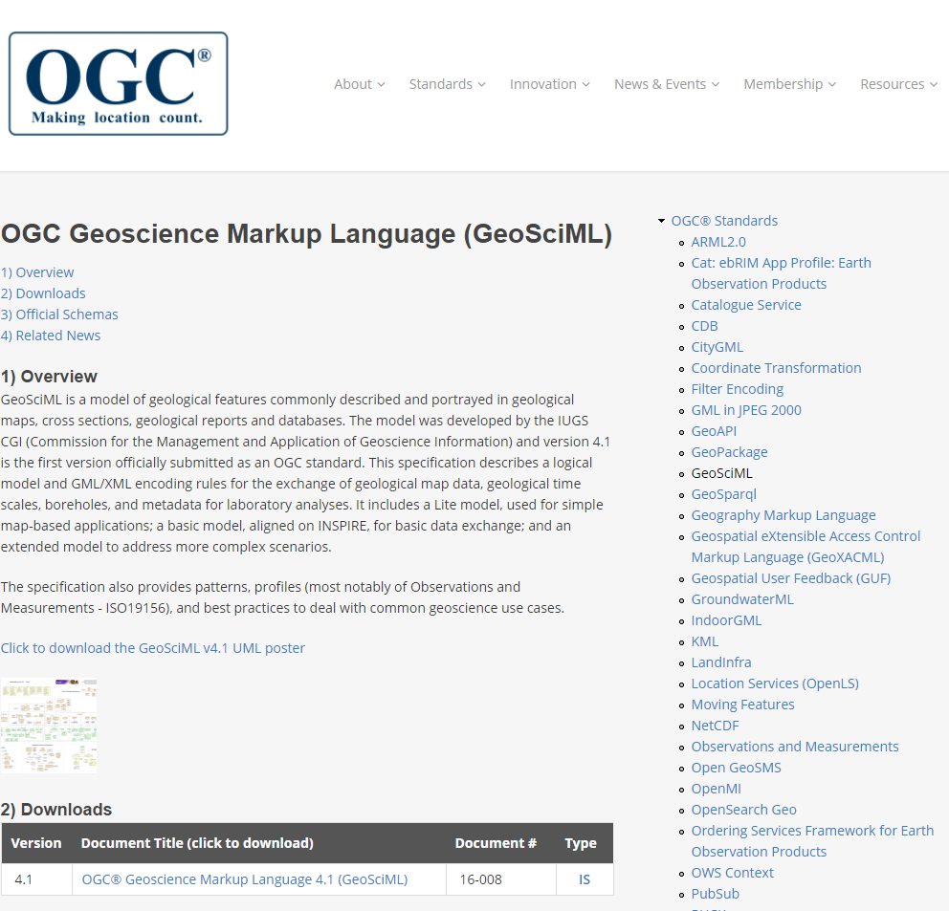
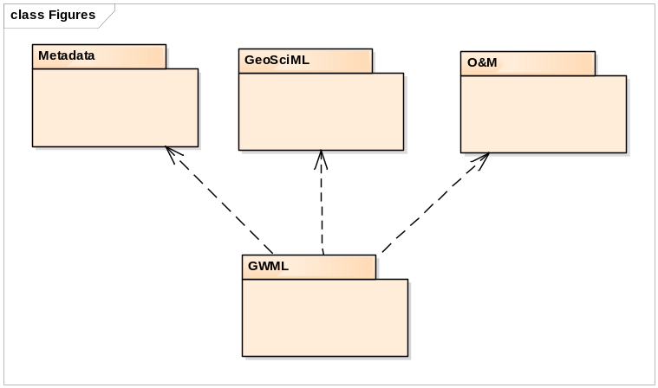
Dependencies

Slide 5
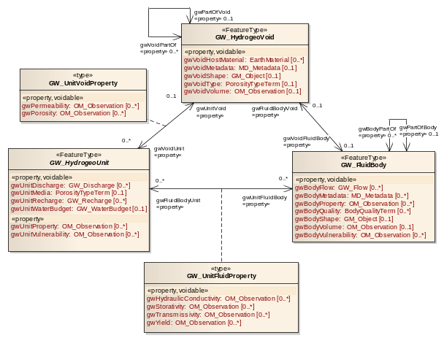
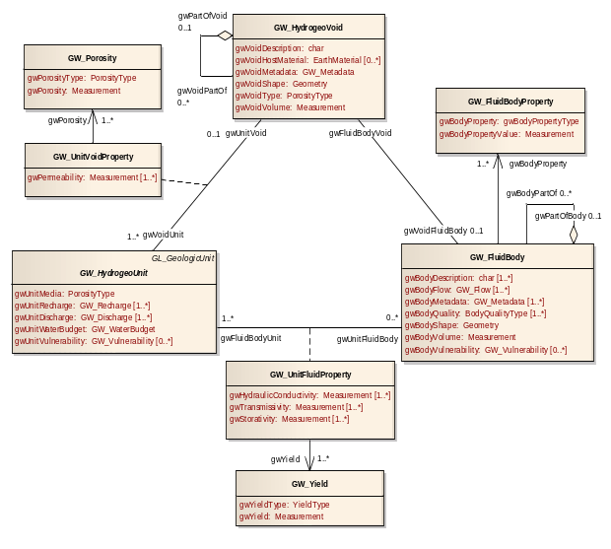
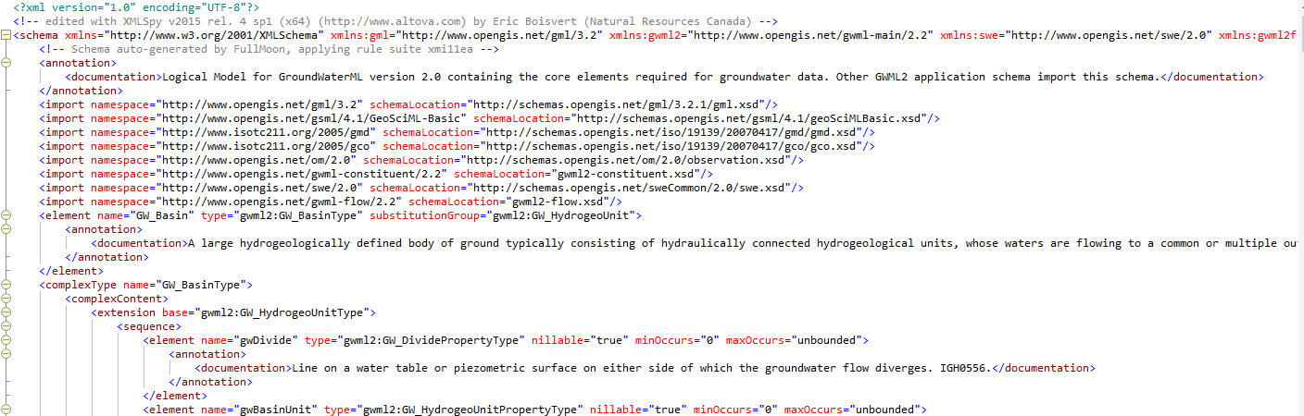
GWML2 How
Use Cases
Vocabulary
Conceptual Schema
Logical Schema
Physical Schema
RDF
JSON

Slide 6
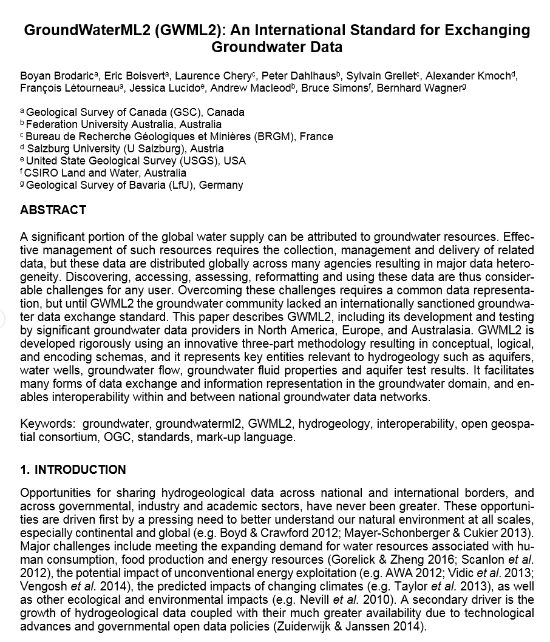

Slide 7
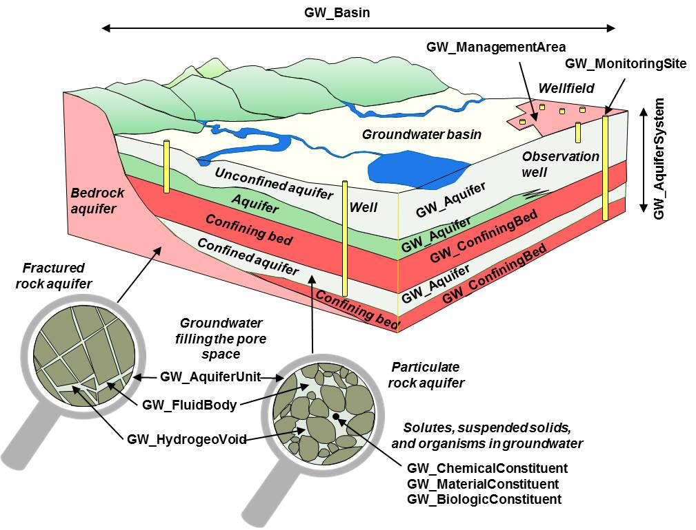
GWML2 What

Slide 8
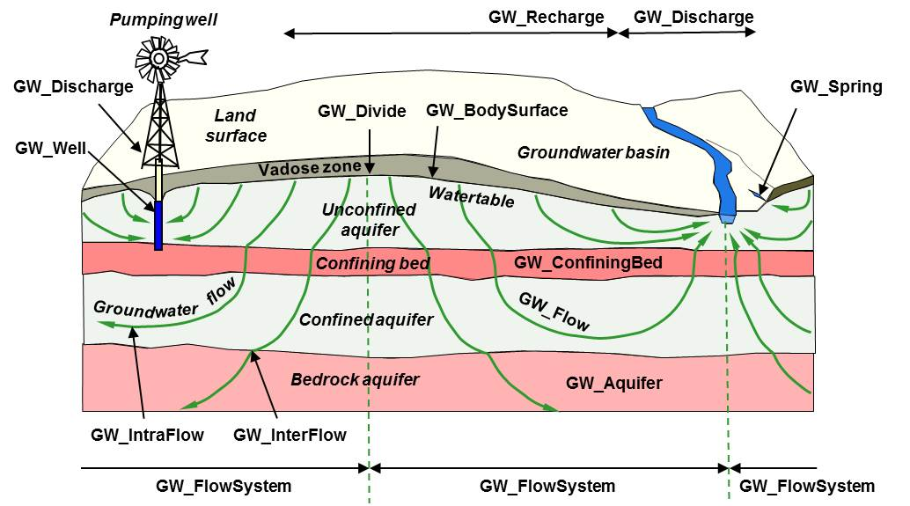
GWML2 What

Slide 9
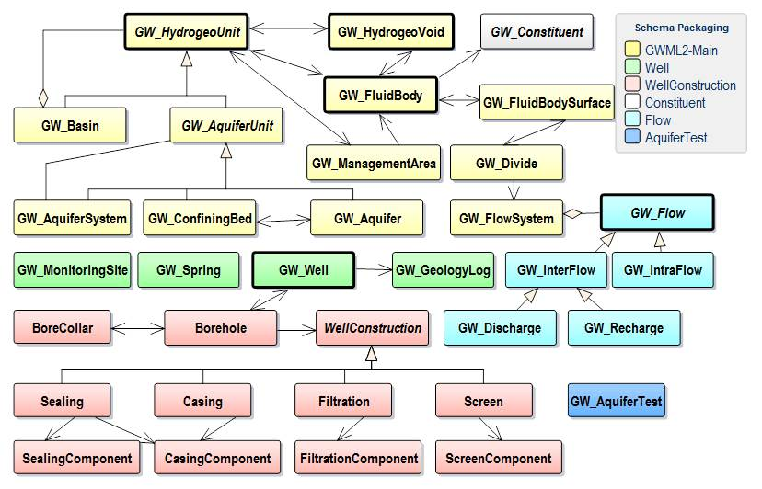
GWML2 What

Slide 10
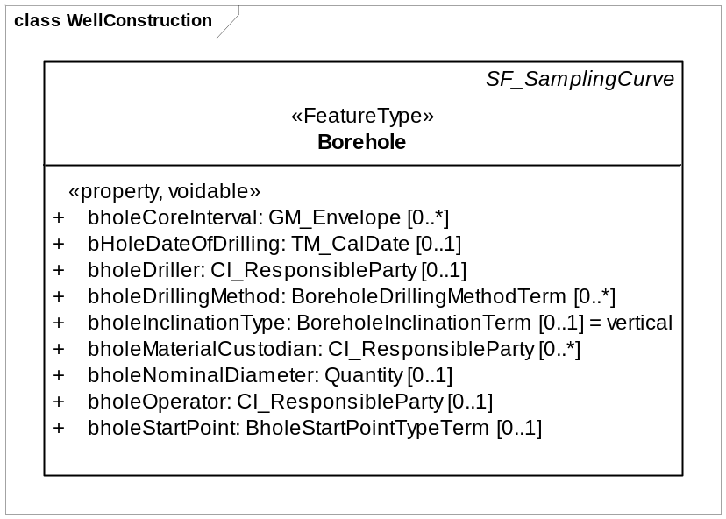
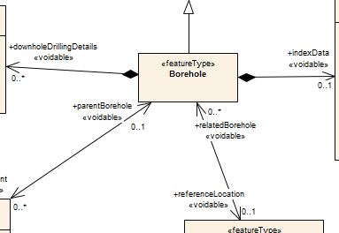
Standing issue
GeoSciML
GWML

Slide 11

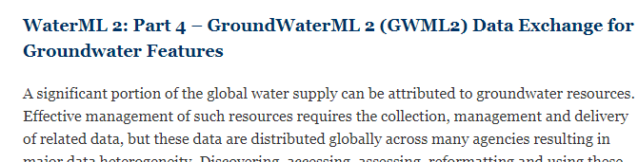
GWML2 What’s next
2017 HJ paper revision (due Sept 2017)
2017 HJ essay on gw data networks
2017 - support WMO-CHy submission process
including GWML2
2017 SWG meeting soon – for regrouping
2017 GW-SW LOD Pilot

Slide 12
Thank you!
Questions?

