Slide 1

Feedback from WMO
HydroDWG contributions to CHy
Silvano Pecora
Vice-President of CHy
Tony Boston
HydroDWG co-chair
HDWG Workshop
National Water Center, Tuscaloosa, USA
20 June 2017

Slide 2
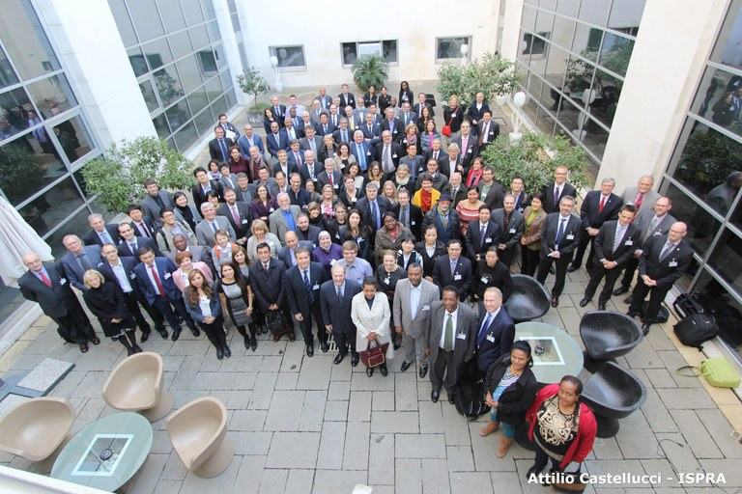
WMO CHy-15 session
7 - 13 December 2016, Rome, Italy

Slide 3


Slide 4


Slide 5

WMO CHy-15 pre-session discussion

Slide 6
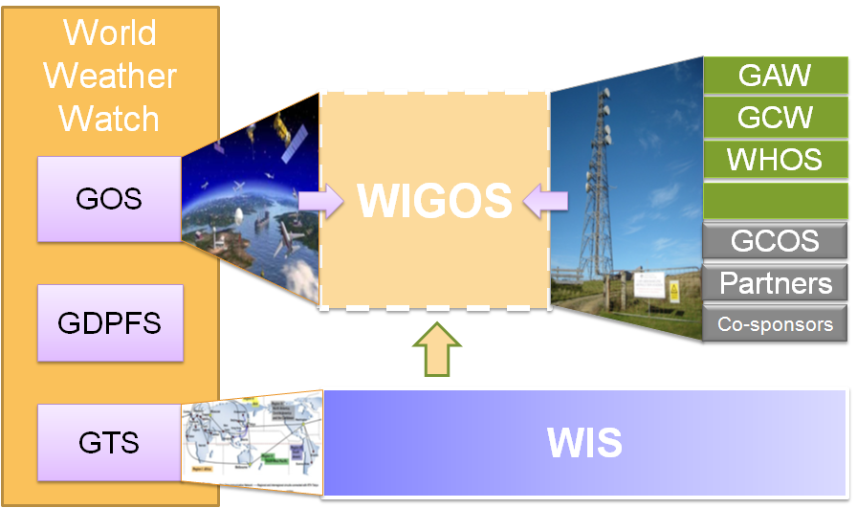
WMO INTEGRATED GLOBAL OBSERVING SYSTEM (WIGOS) and WMO HYDROLOGICAL OBSERVING SYSTEM (WHOS)
In June 2015 the President of CHy informed Cg-17 of CHy proposal to develop WHOS as the CHy contribution to WIGOS
Congress welcomed the effort and urged the president of CHy to continue guiding WHOS to full implementation
Congress urged the promotion of WHOS among NHSs and the hydrological community

Slide 7
WMO Hydrological Observing System (WHOS)
Implementation:
Phase 1:
Map interface with links to those NHSs that make their real-time and historical stage and discharge data available online. implemented in August 2015.
Phase 2:
A fully WIS/WIGOS compliant services-oriented framework linking hydrologic data providers and users through a hydrologic information system enabling data registration, data discovery, and data access.
Beta version for CHy-15 review and endorsement (Dec 2016)
Initial implementation for EC approval (June 2018)

Slide 8
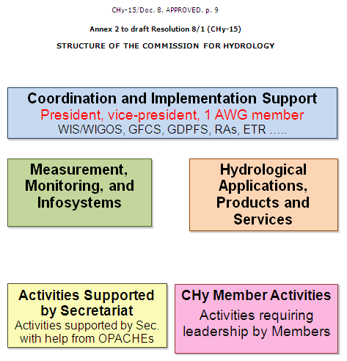

Slide 9
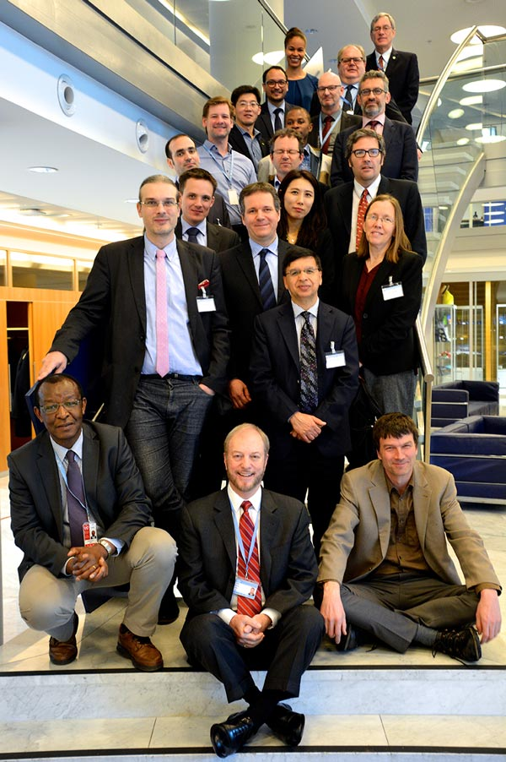
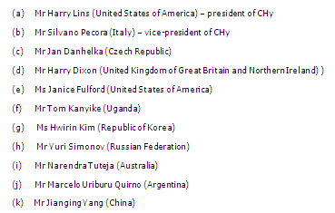
First Session of CHy Advisory Working Group
27 February - 3 March 2017, Geneva, Switzerland

Slide 10
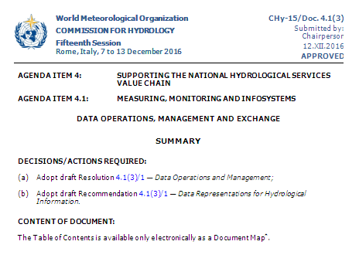

Slide 11
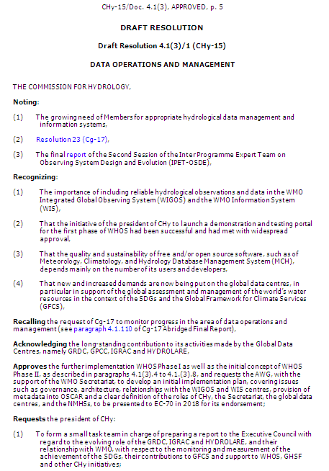
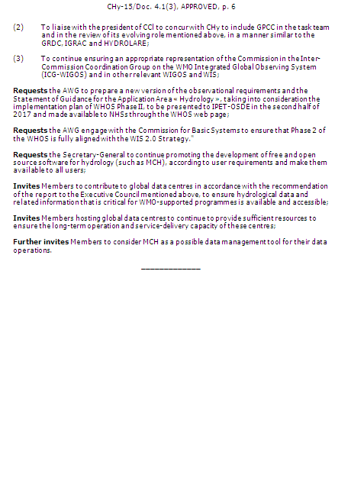

Slide 12
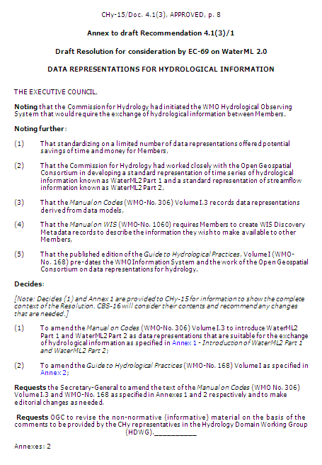
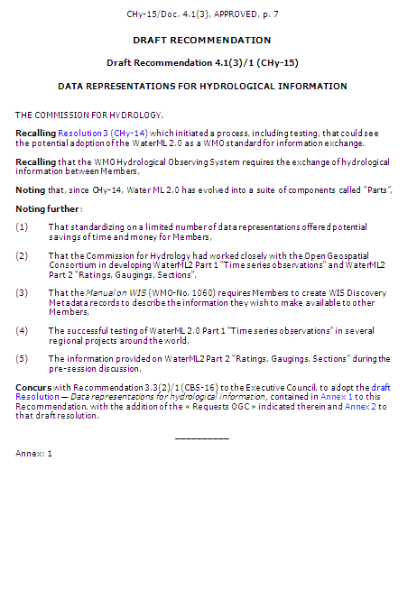

Slide 13
DATA NEEDS IN HYDROLOGY

Slide 14
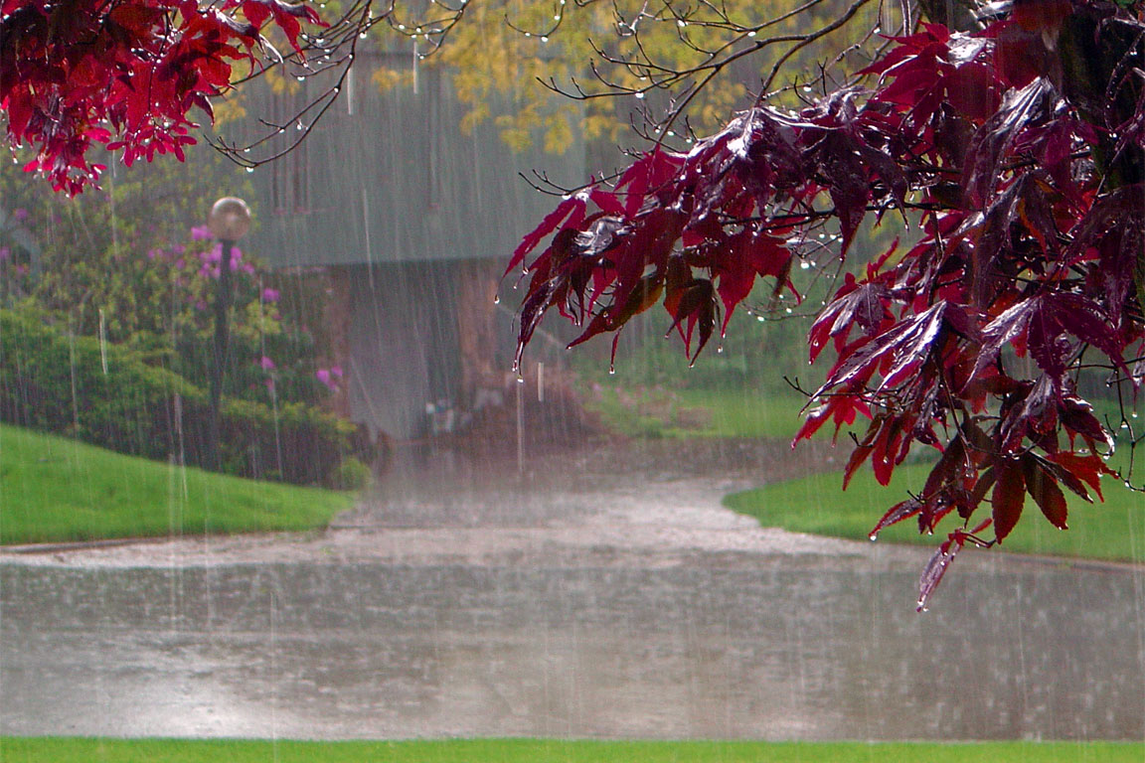

It’s raining,
but how much?
Notes:
Make available real time data

Slide 15
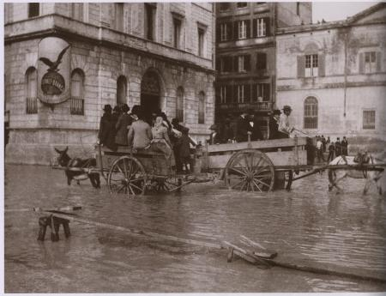

Rain ... heavy rain ... and there was a severe flood in the city
but ... when exactly? And how much?
What observed water levels?
Notes:
Make available historical data

Slide 16

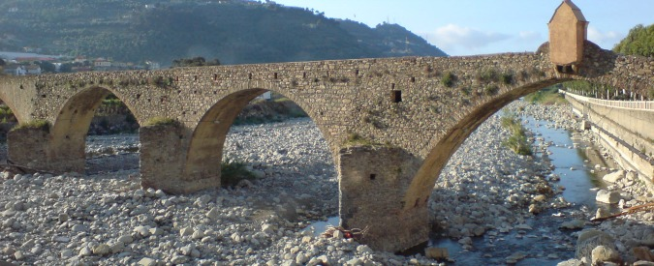
??? This year another drought... Is it only affecting the river near my town or everywhere?
Can I compare it with past events? Is it an extreme event?

Slide 17

What are you looking for?
hidroloških podataka
datos
hidrológicos
hydrological data
水文资料
поток
stromen
流れ
fließen
Different people, different languages, different perceptions but same needs

Slide 18

What are you looking for?
I need hydrological data for river district planning
I need hydrological data to manage water resources conflicts
I need hydrological data to manage emergencies
fließen
what is the real need?
What are our exact needs?

Slide 19


We need hydrological data all over the world, of easy, smart and dynamic access and use
We have a problem...

Slide 20

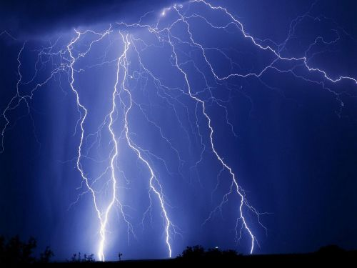


We can’t stop extreme events, but we can be prepared to cope them. Everyone should be informed about the current situation
All over the world people need a

Slide 21


Which way?
An easy way to connect within the “water world”
It exists now!

Slide 22



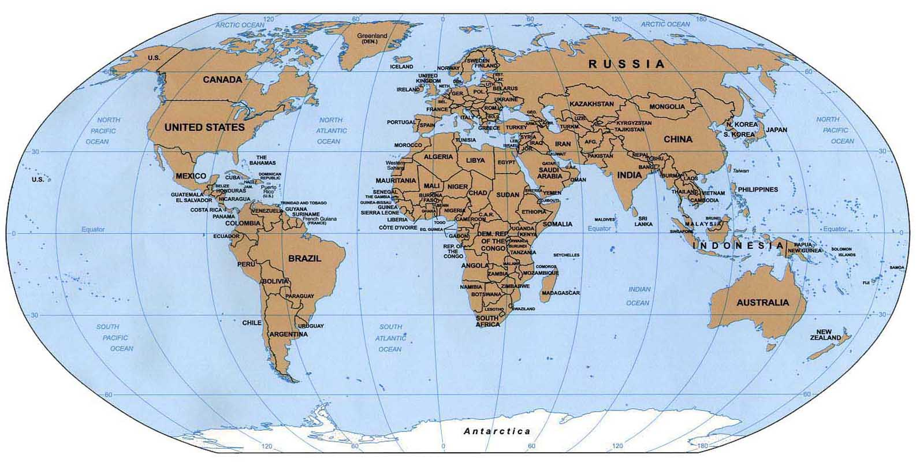

Hydrological data supports activities…
How can I define a programme for hydrological monitoring?
What and where are the priorities?
Using
Some days after…
We got the right solution

Slide 23



Helps in emergency conditions… at the beginning we were in the dark
EXTREME EVENT
Which is the situation in the emergency place?
How can I reach it?
When an extreme event occurs… often we are in the dark

Slide 24
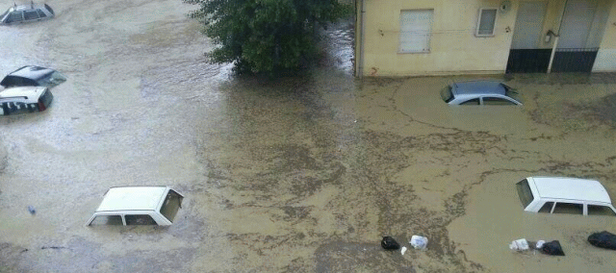

Helps for extreme events
Now I’m informed about the real situation…
by using

Slide 25




Hydrological data exchange among different offices…
Done…
Some days after…
A lot of documents…
What a confusion!
To manage all these data and information…
I need a simple and efficient solution to do it!!!
H
E
R
E
I
S

Slide 26



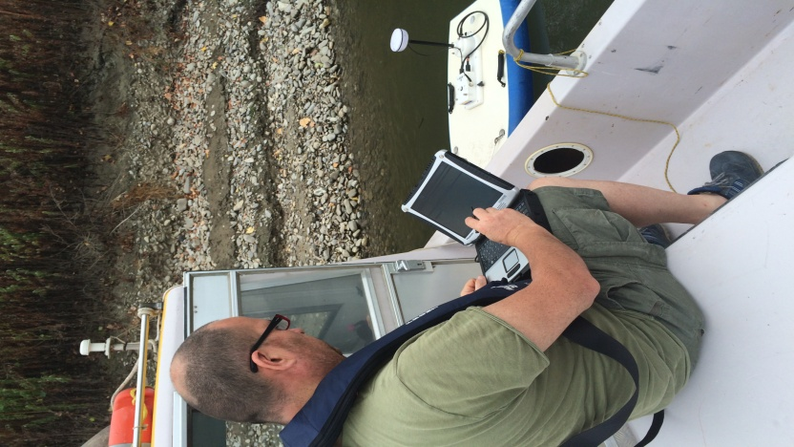

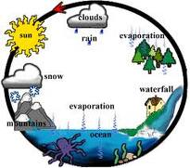






O
N
T
O
L
O
G
Y
rain
drought
discharge
groundwater
numerical model
stochastic model
evapotranspiration
water balance
...
HYDROLOGY

Slide 27
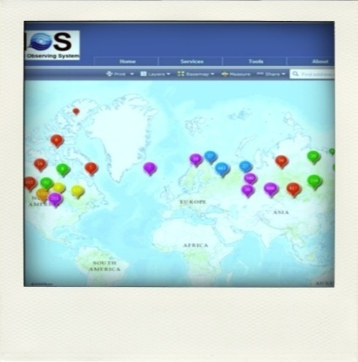
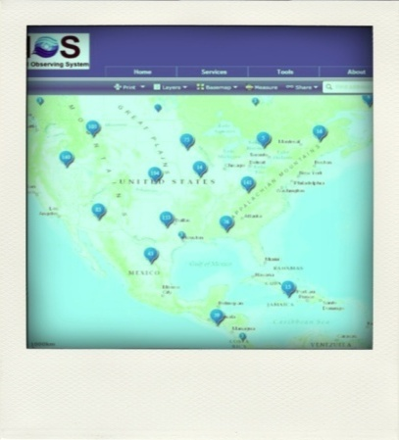

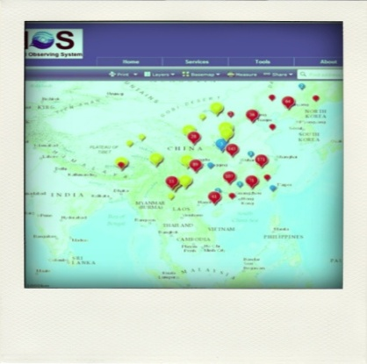
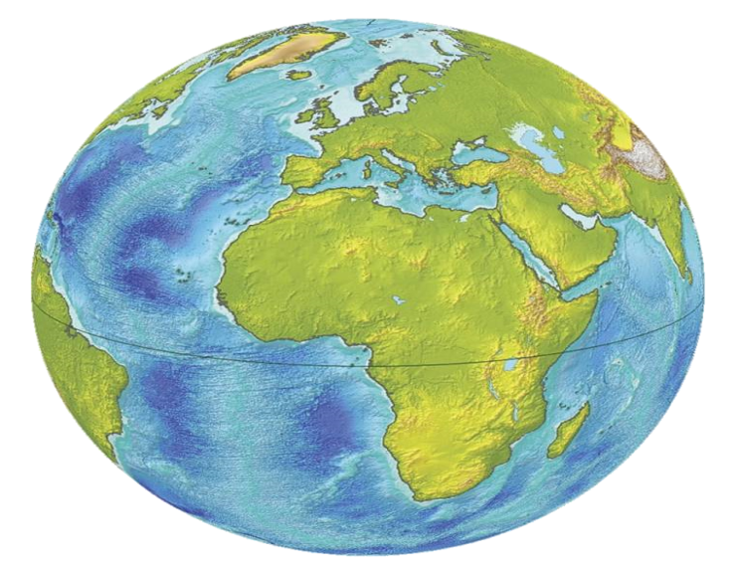
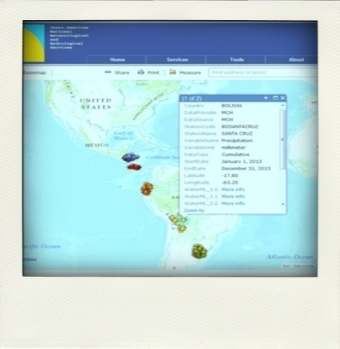
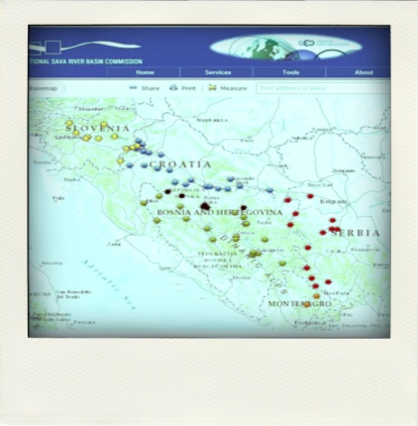
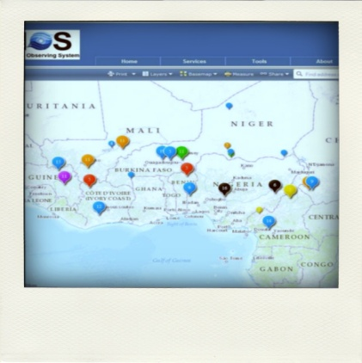
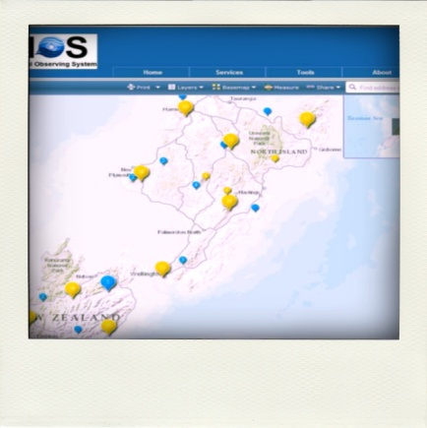
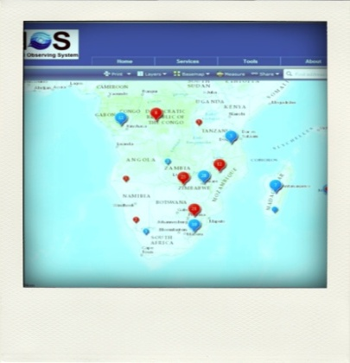


Data all around the world to help you
C
A
T
A
L
O
G
WHOS allows you to be immediately operative, to create custom “data catalogs“ and to increase your knowledge, ready to be shared with the world
S

Slide 28
AN OPERATIONAL PROTOTYPE

Slide 29

http://hydrolite.ddns.net/whos/

Slide 30
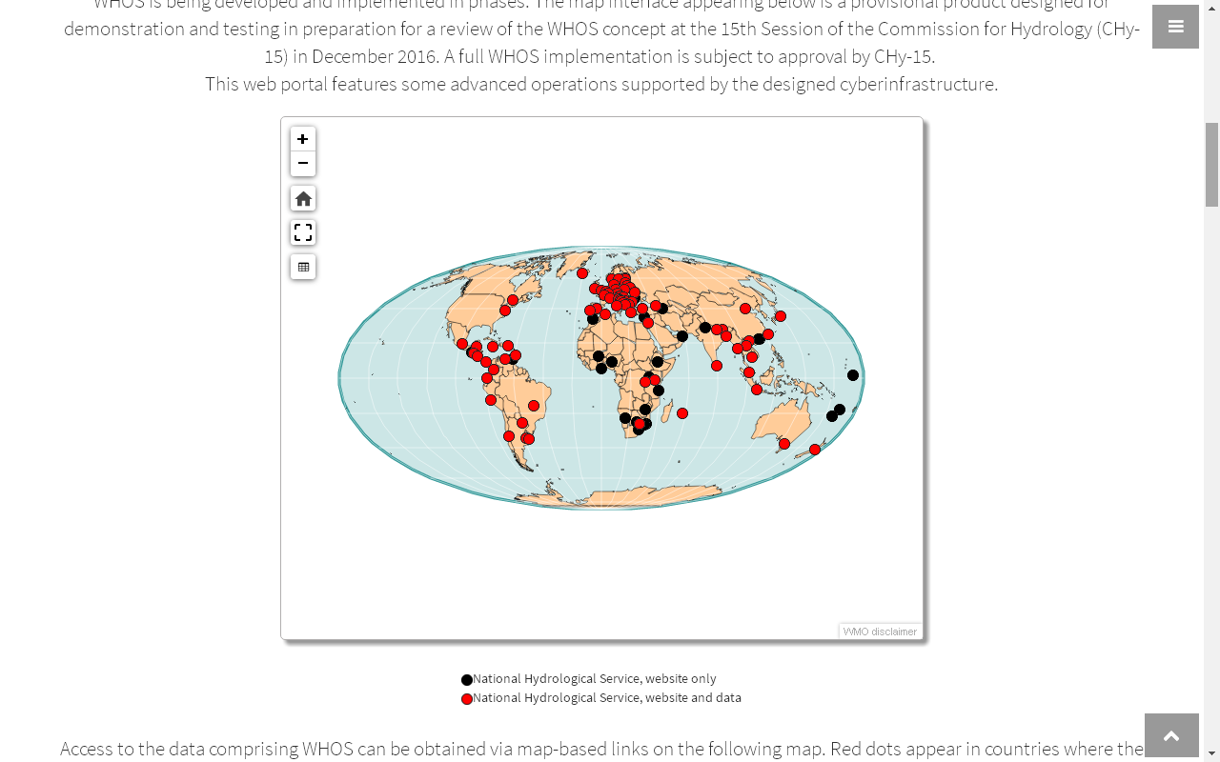

Slide 31
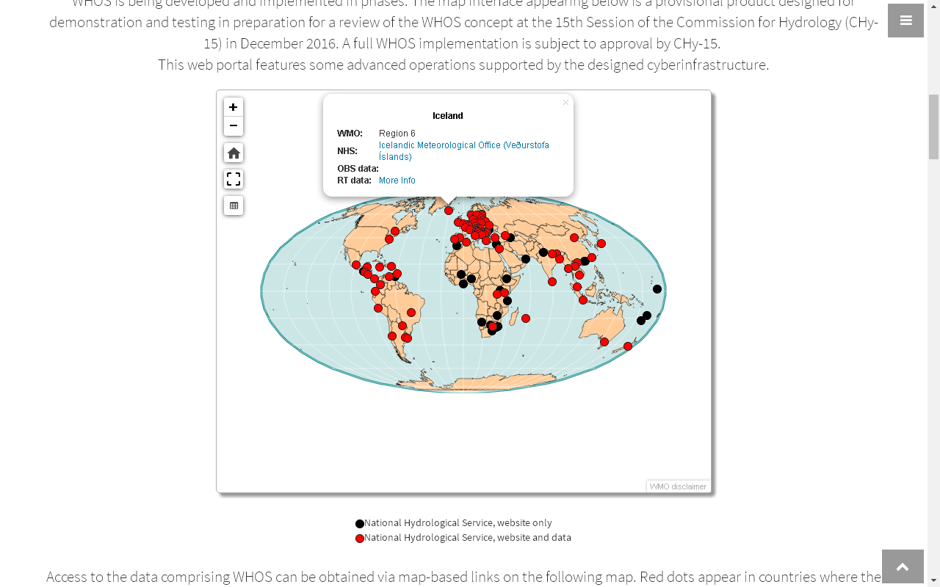

Slide 32
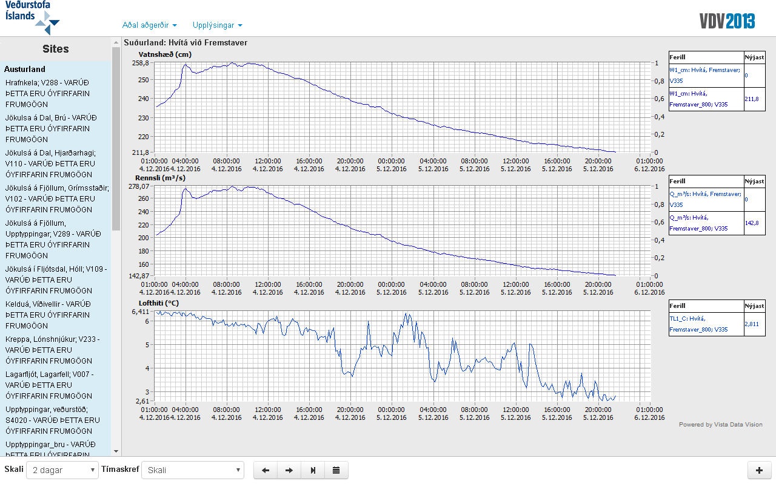

Slide 33
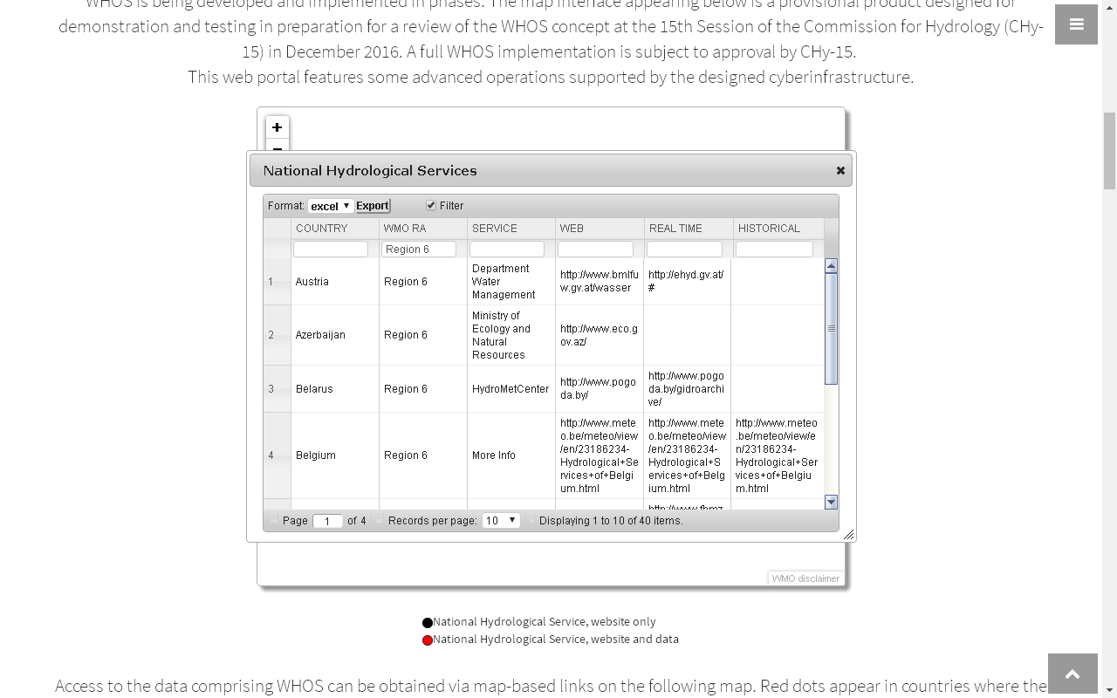

Slide 34
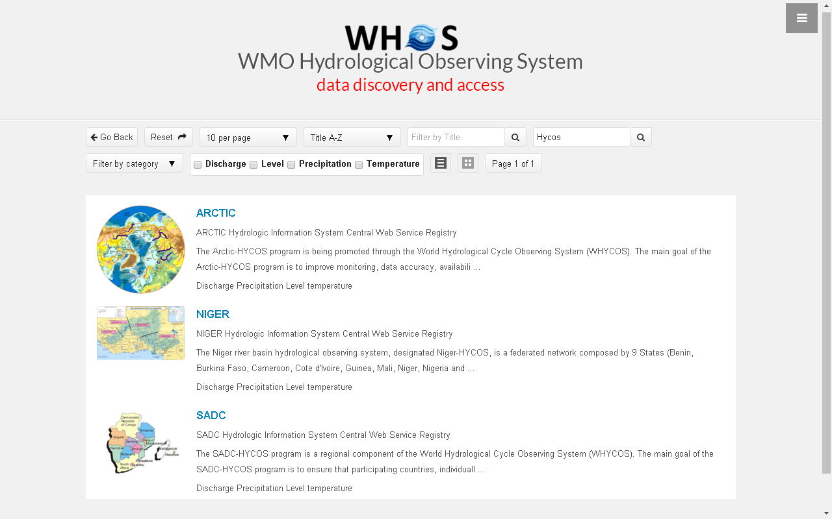

Slide 35
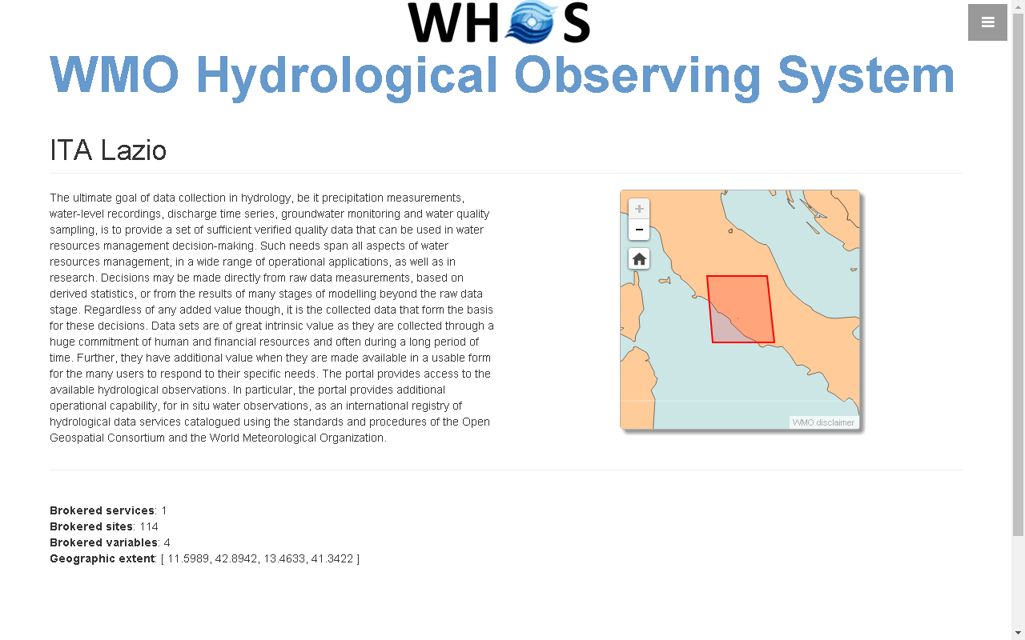

Slide 36
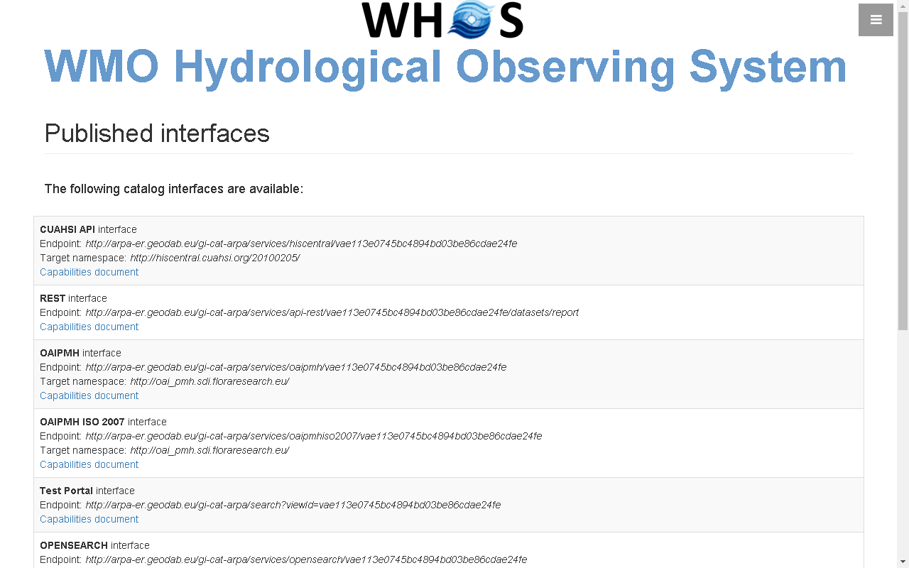

Slide 37
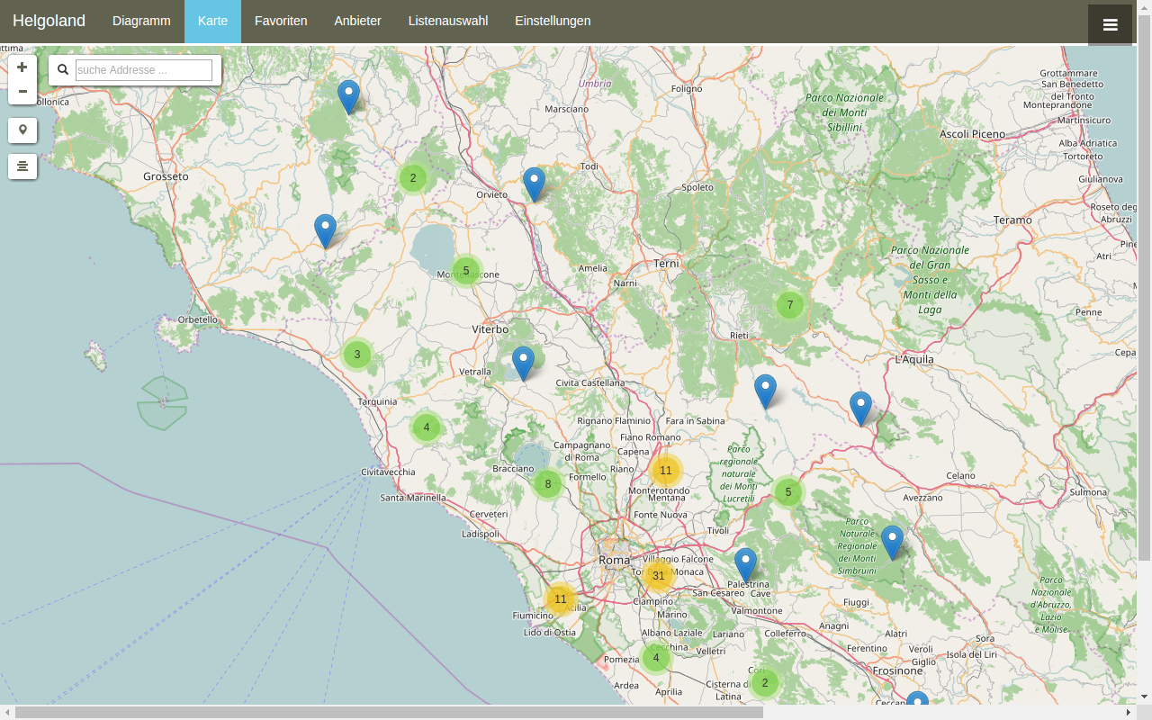
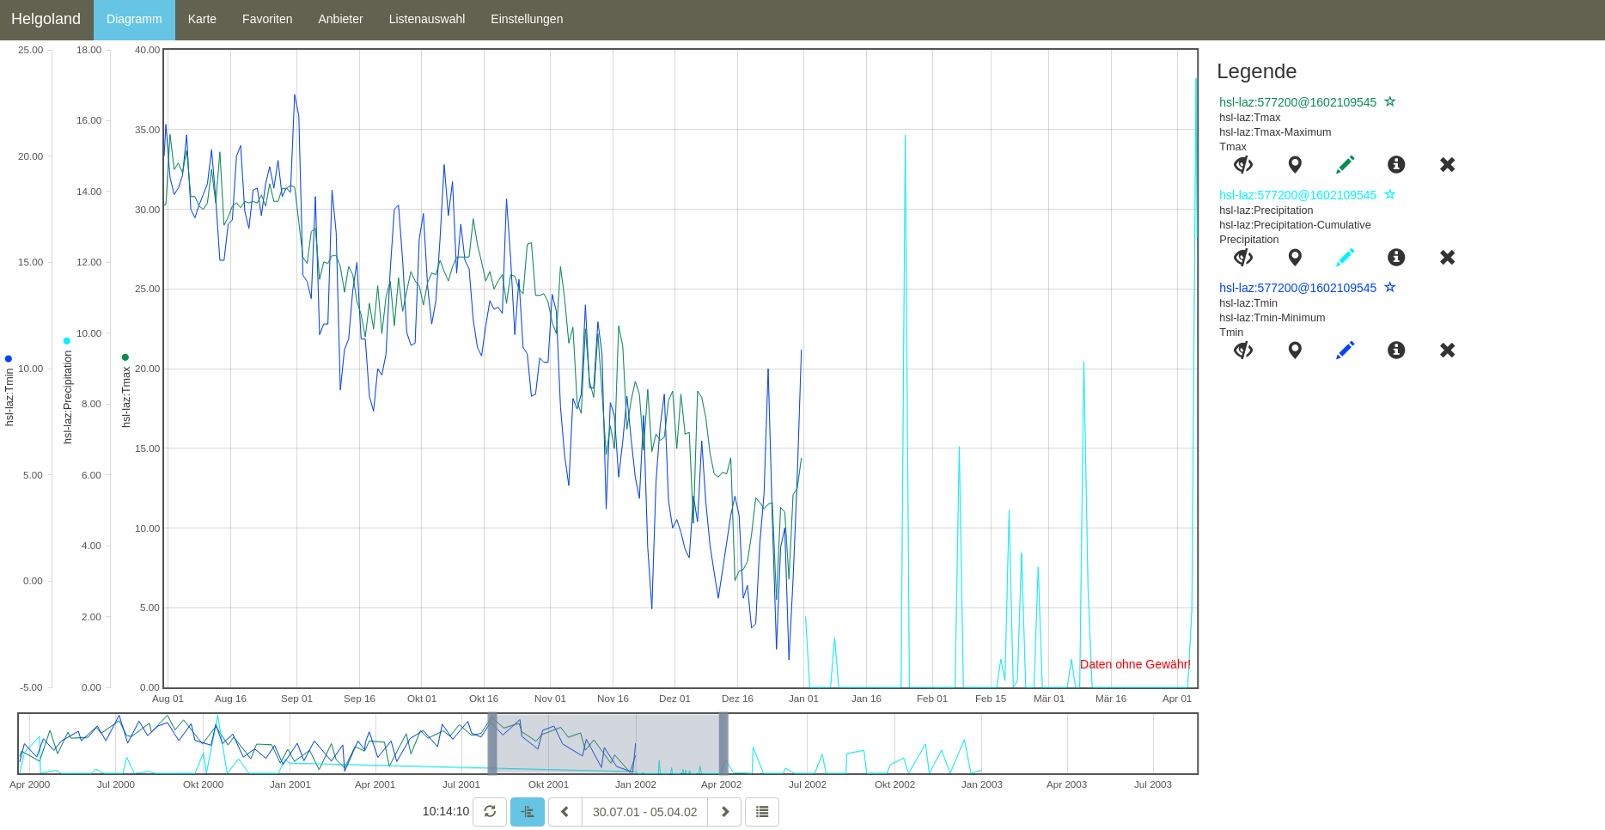

Slide 38
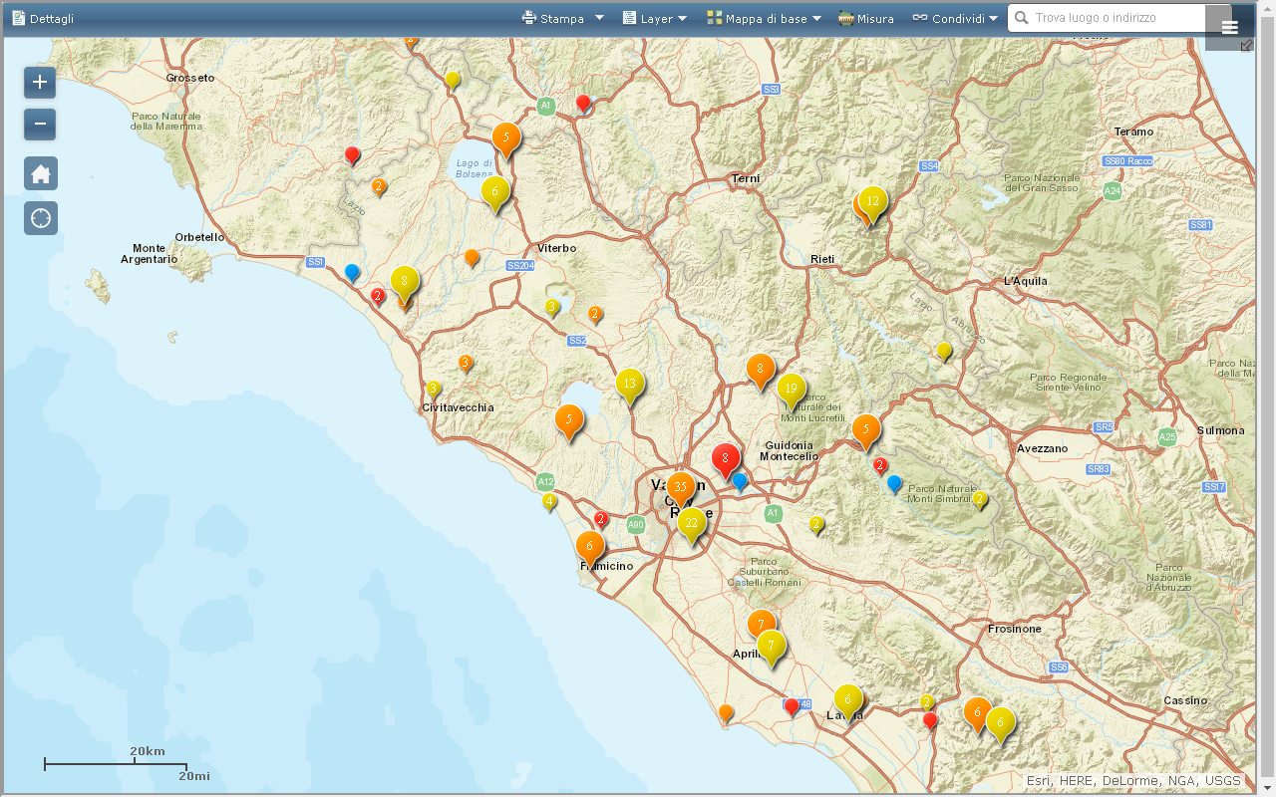
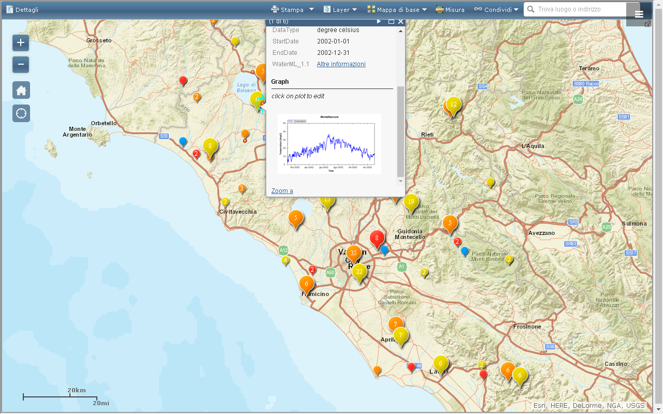

Slide 39
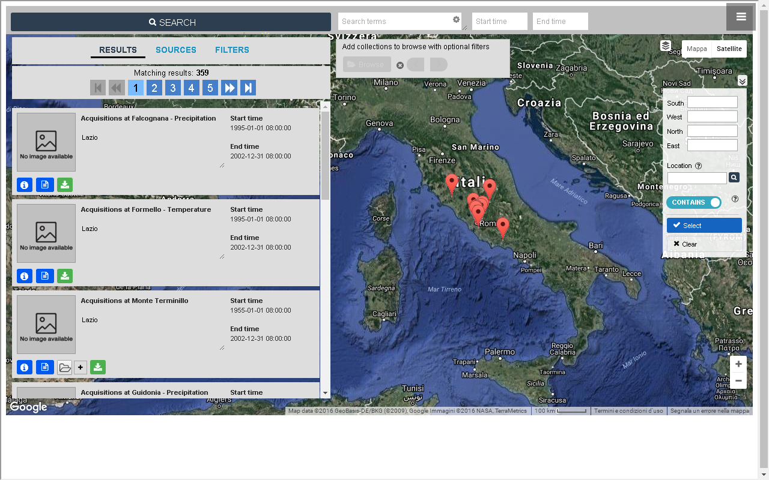

Slide 40
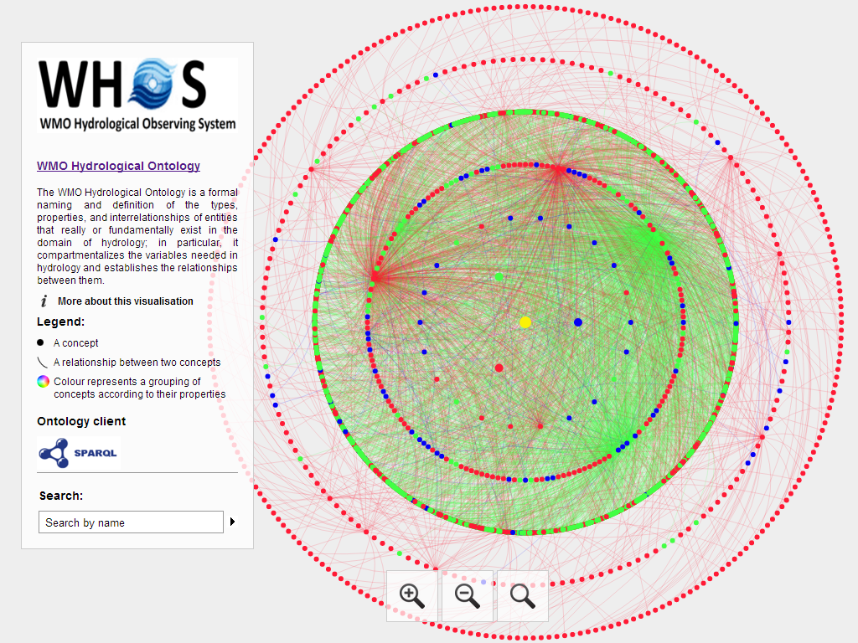
Notes:
hiscentral.ddns.net:8088/ontology/

Slide 41
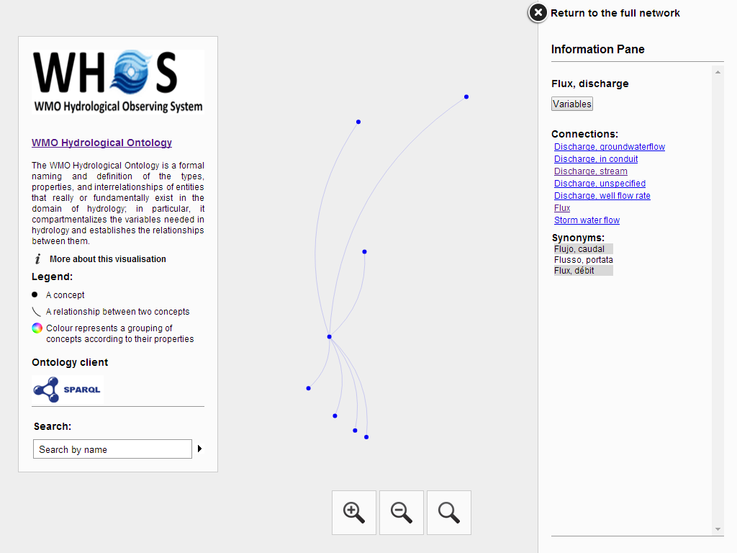

Slide 42
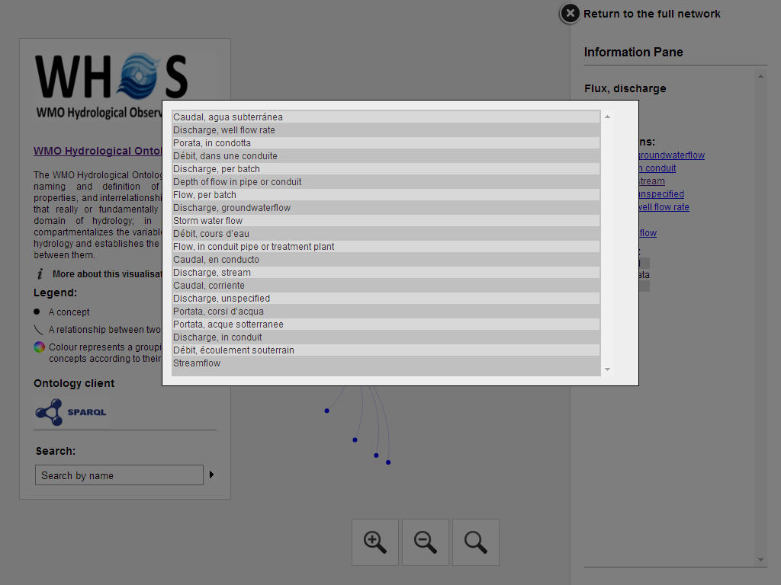

Slide 43
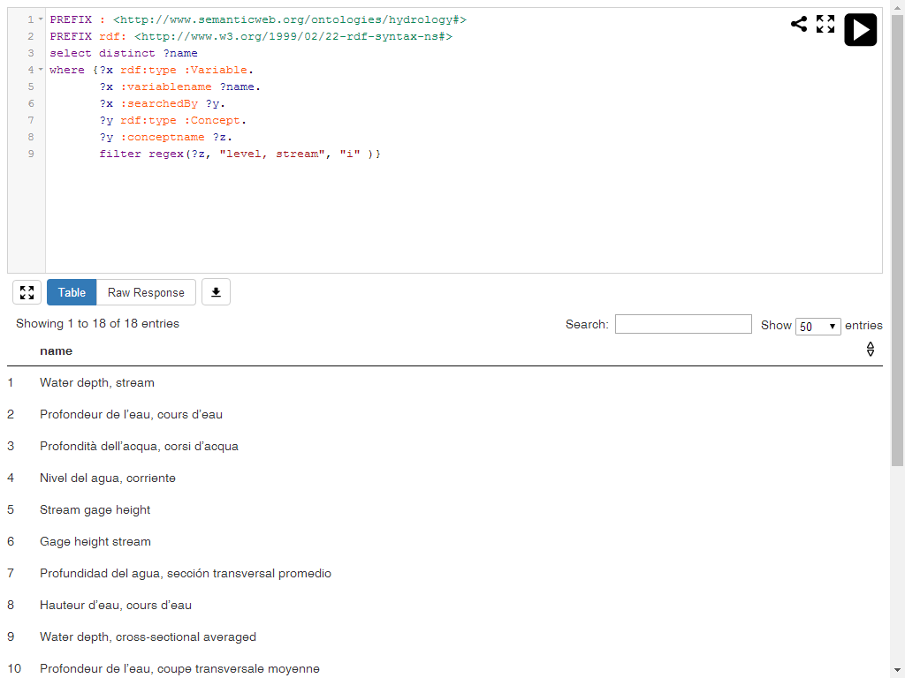
Notes:
PREFIX : <http://www.semanticweb.org/ontologies/hydrology#> PREFIX rdf: <http://www.w3.org/1999/02/22-rdf-syntax-ns#> select distinct ?name where {?x rdf:type :Variable. ?x :variablename ?name. ?x :searchedBy ?y. ?y rdf:type :Concept. ?y :conceptname ?z. filter regex(?z, "level, stream", "i" )}

Slide 44
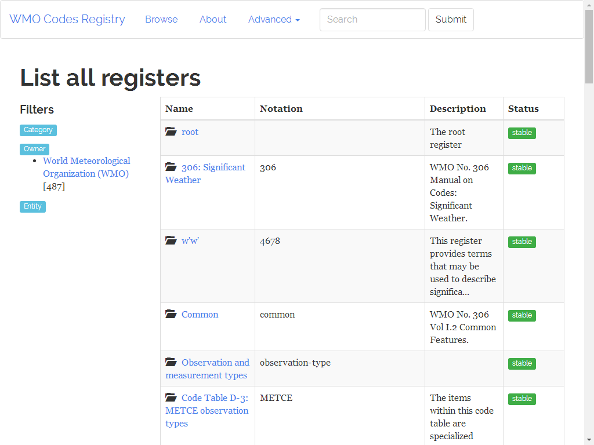
http://codes.wmo.int/
Notes:
http://codes.wmo.int/

Slide 45
DATA DISSEMINATION IN WHOS

Slide 46
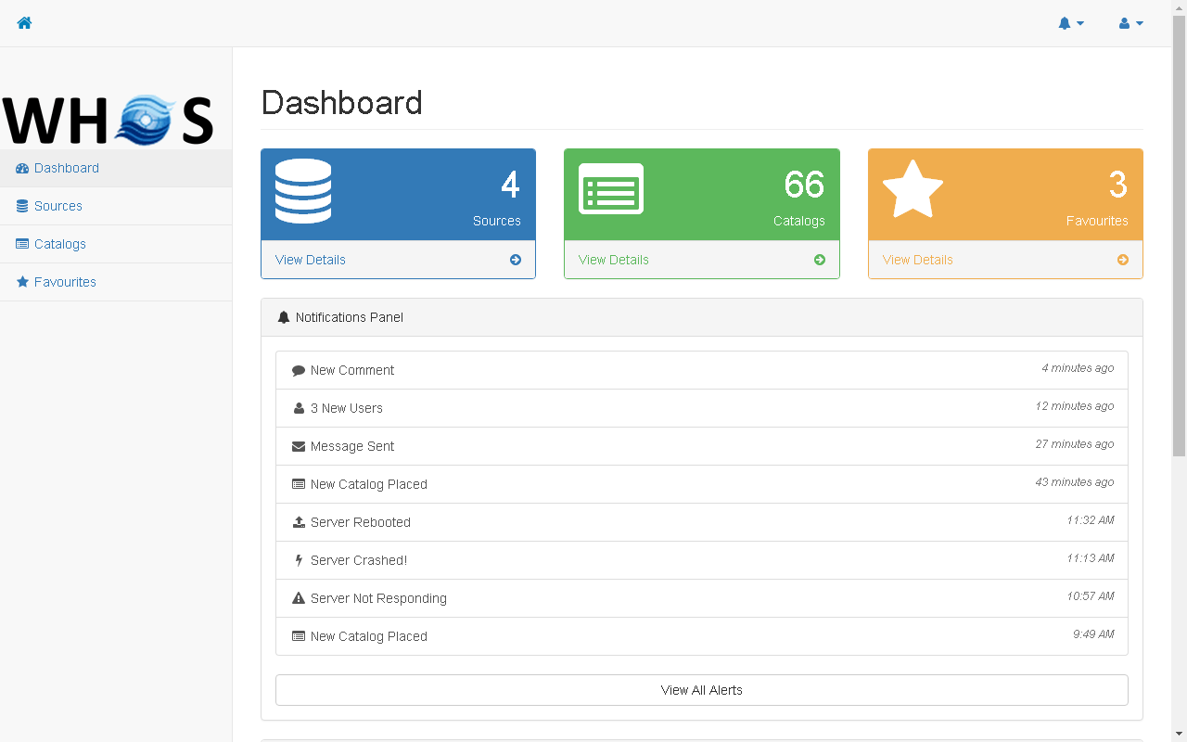

Slide 47
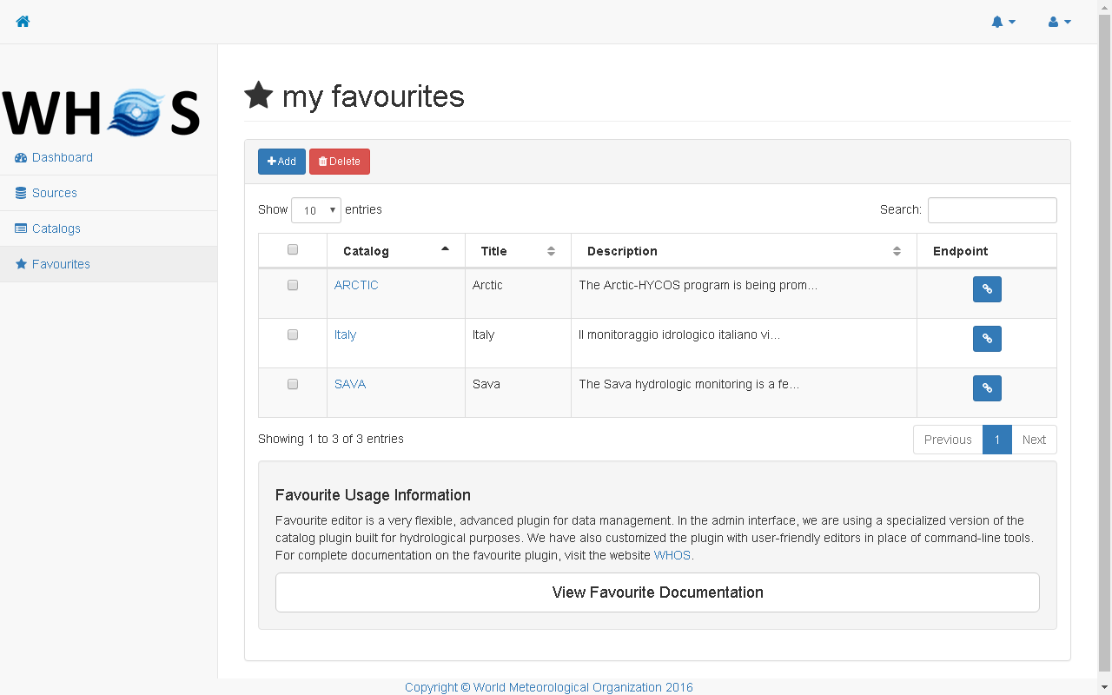

Slide 48
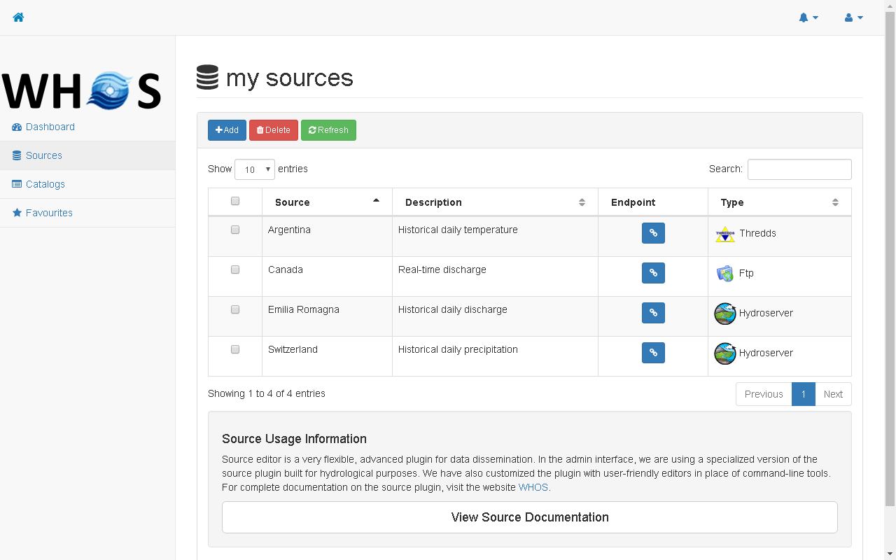

Slide 49
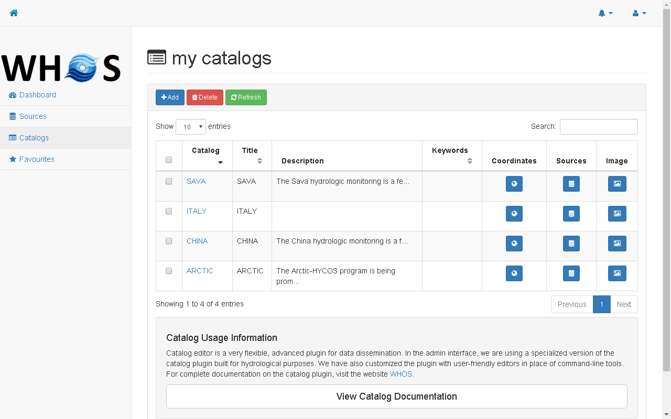

Slide 50
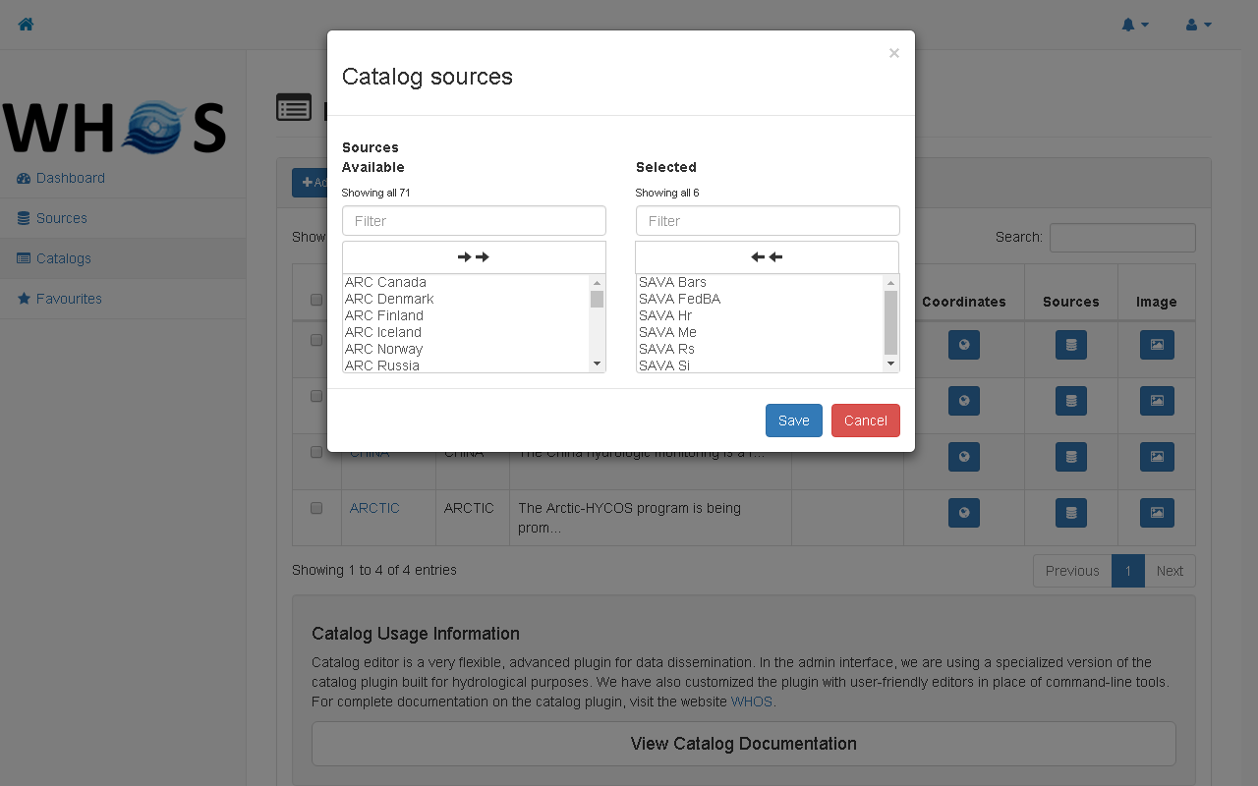

Slide 51
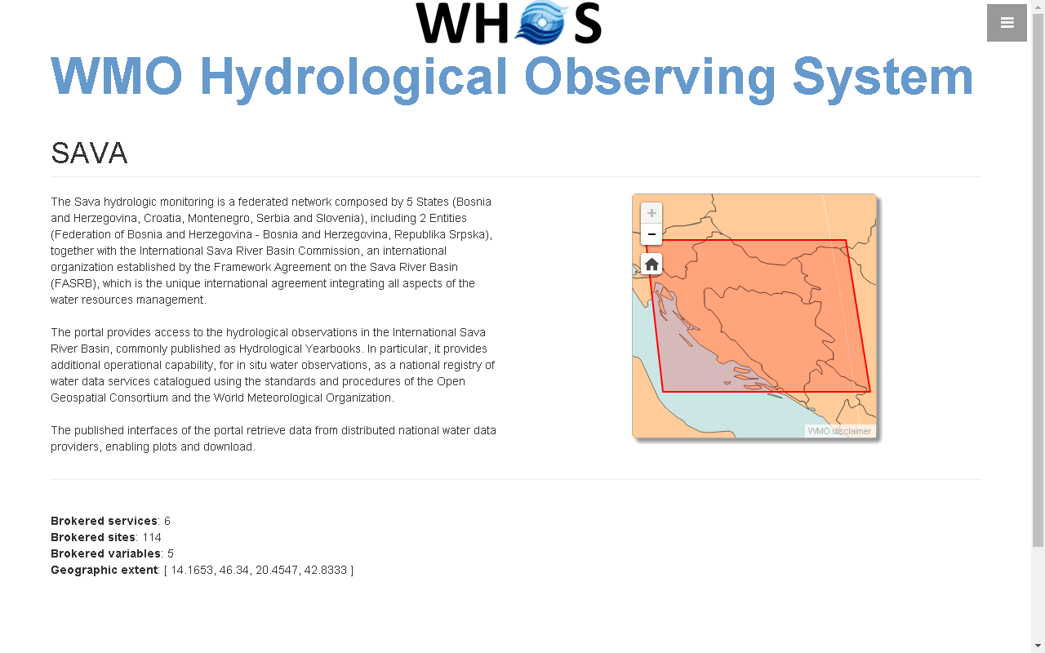

Slide 52


Slide 53


