Slide 1
STANDARDS IN OPERATIONAL HYDROLOGY

Slide 2
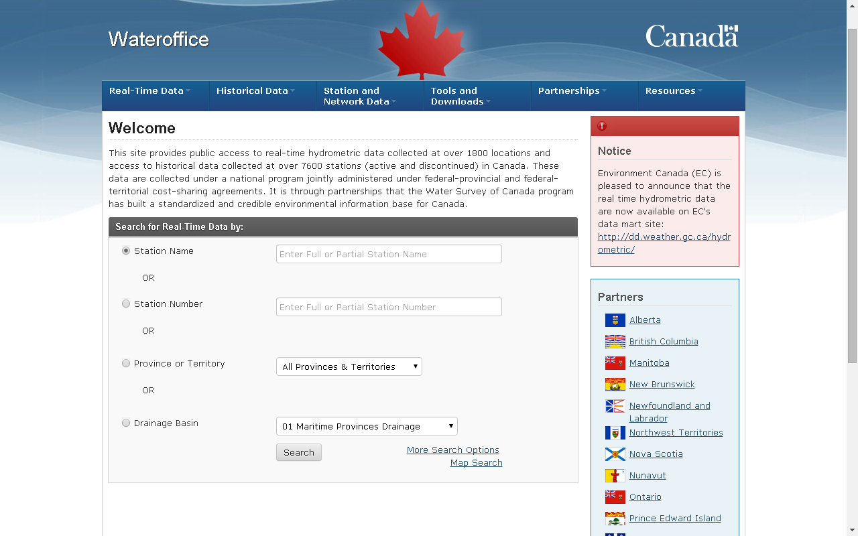
Notes:
http://wateroffice.ec.gc.ca/index_e.html

Slide 3
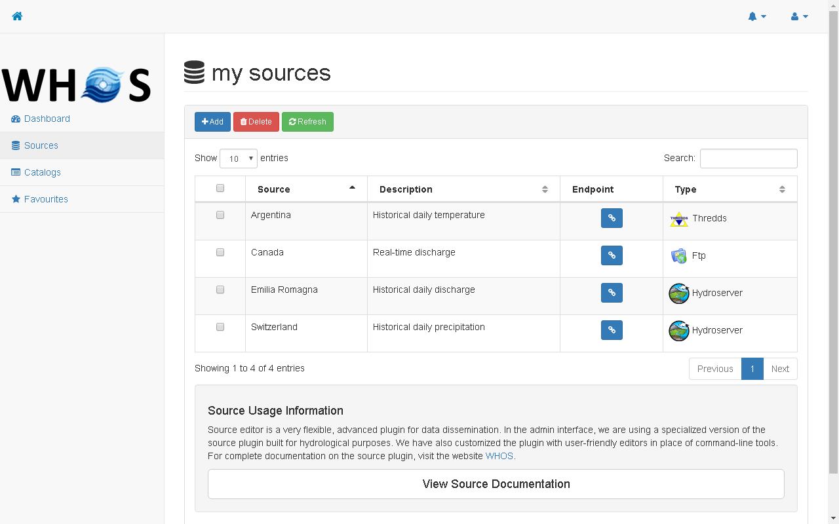

Slide 4
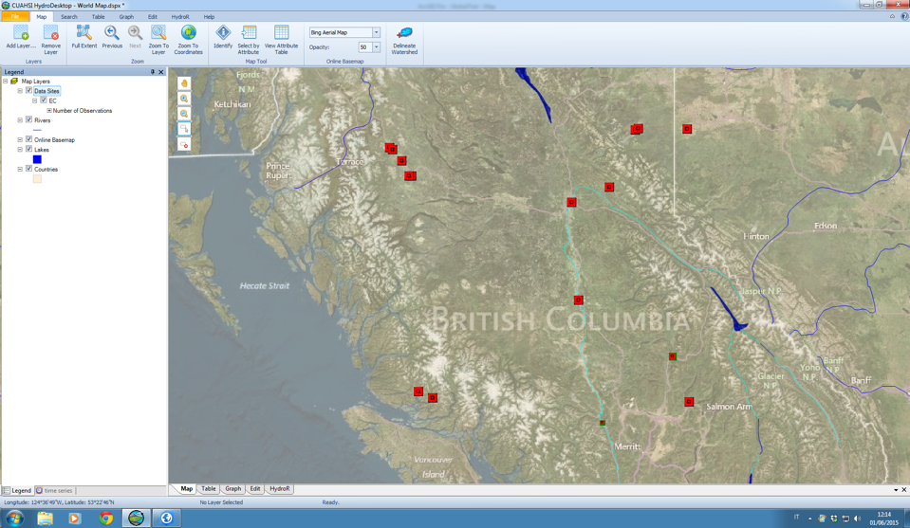

Slide 5
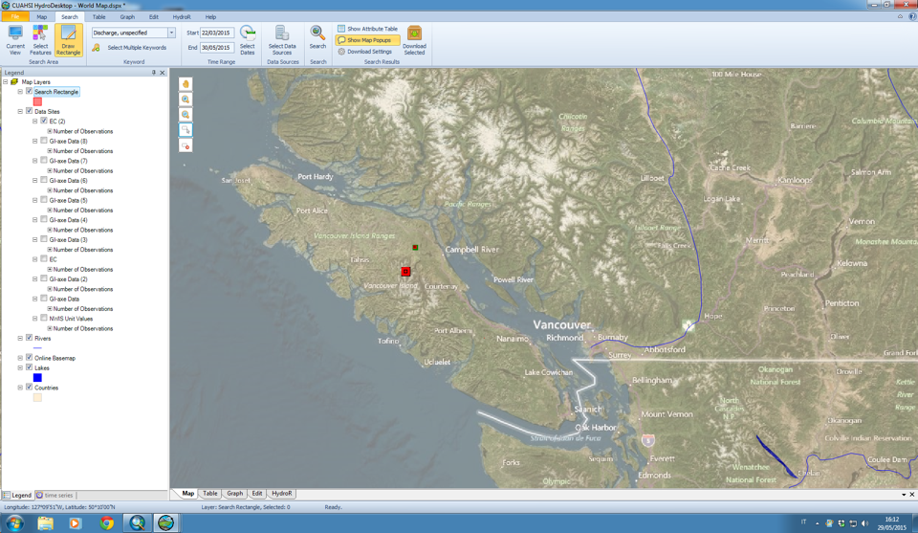
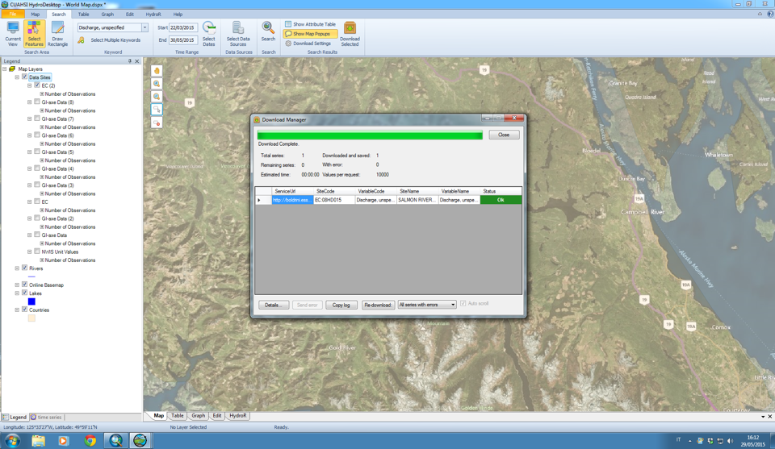
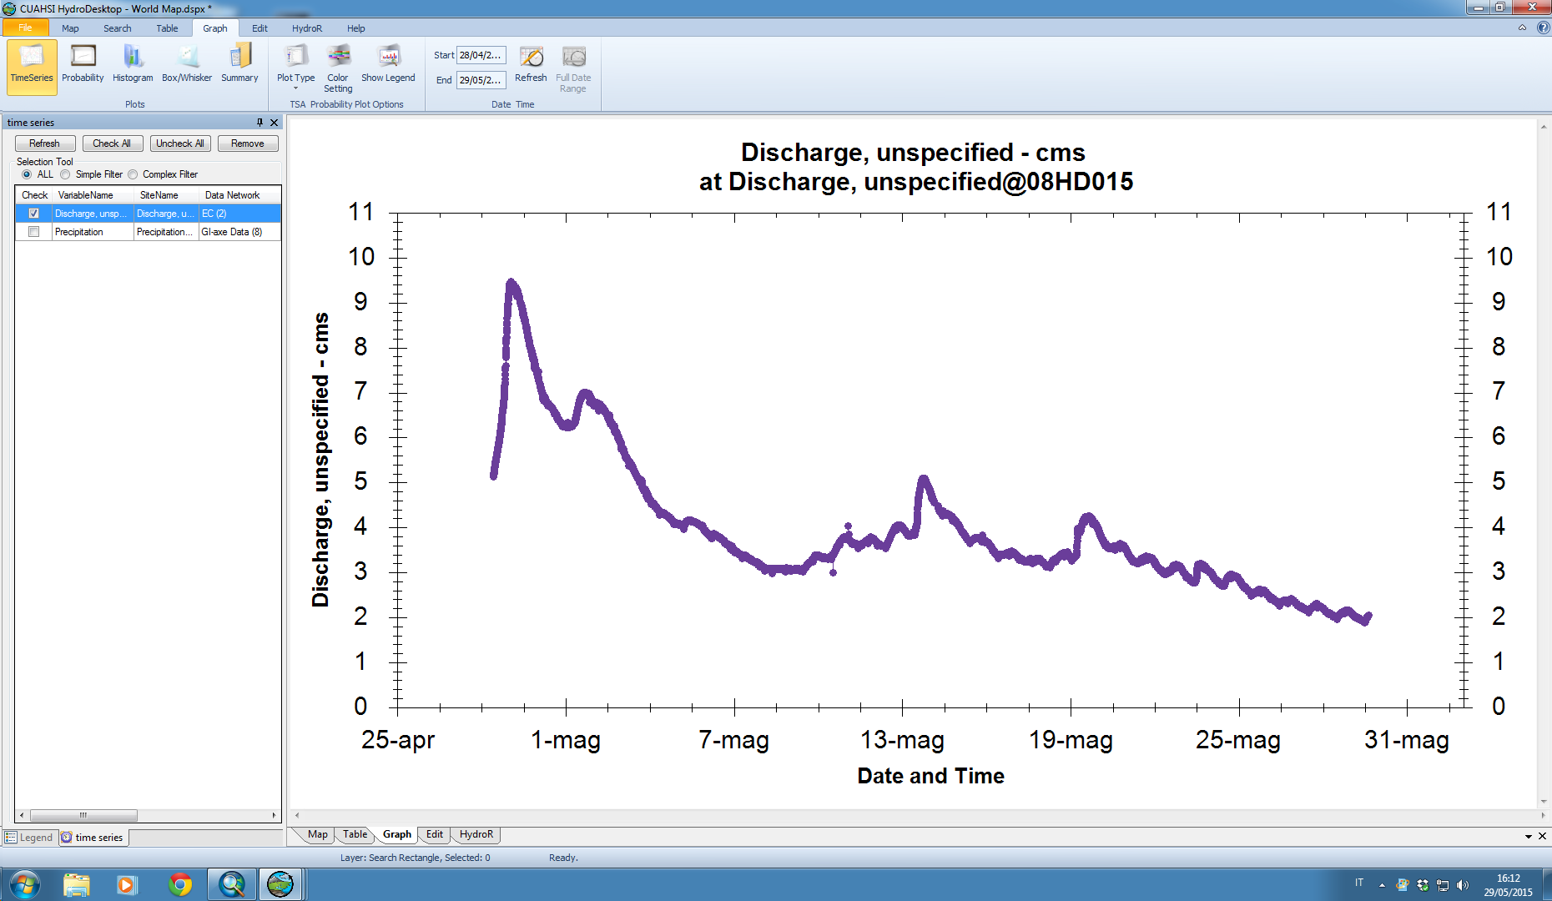

Slide 6
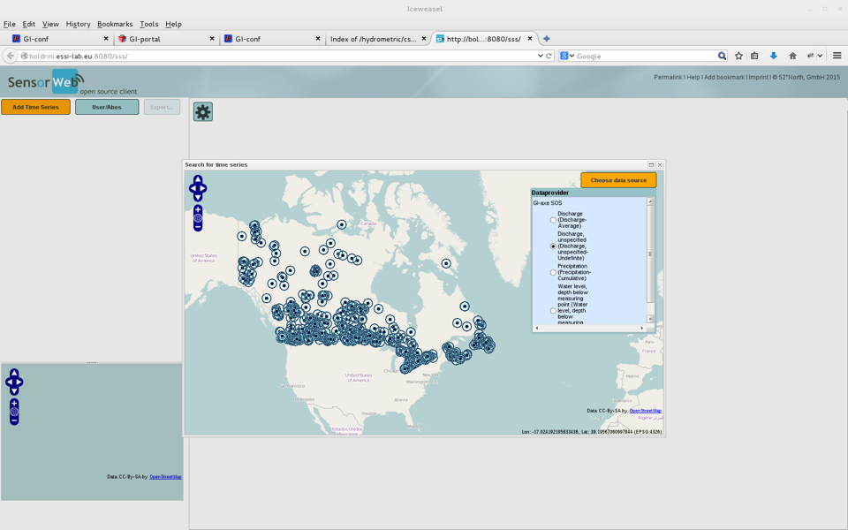

Slide 7
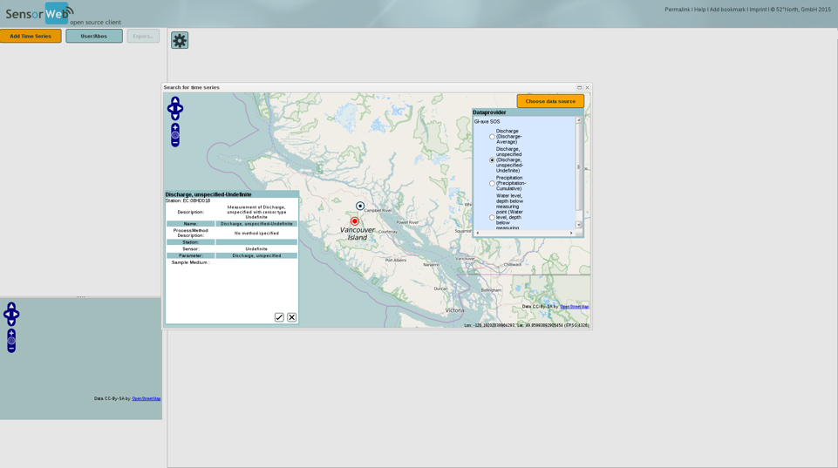
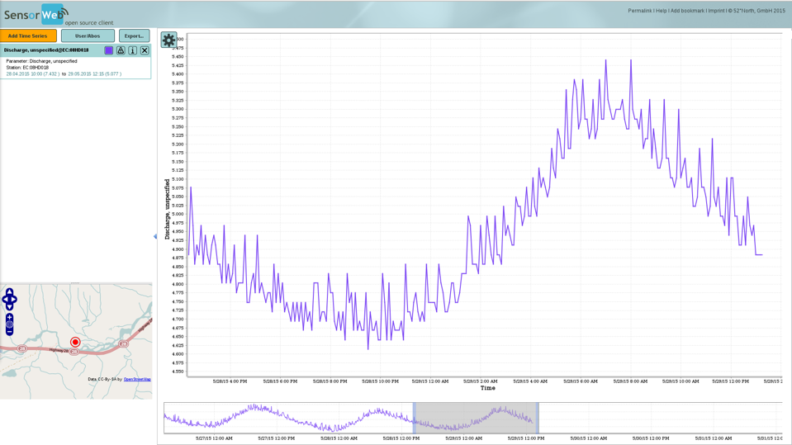

Slide 8




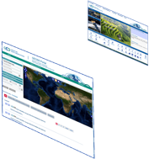

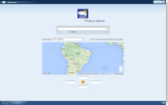








Hydrologic Information System in the Plata basin
CIC
Home Page
GISC Brasilia
Home Page
Argentina
Bolivia
PLATA HIS Portal
5 national
brokered systems
Brasil
Paraguay
Broker
and
Mediator
Systems
Registry
Semantic engines
Uruguay
...
.. .
Brokered Data Providers (capacities, systems, networks, etc.)
.. .
.. .
Hydrologic tools (tested interoperability)

Slide 9
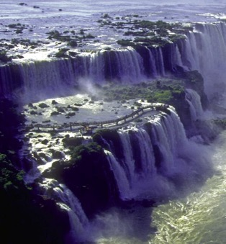
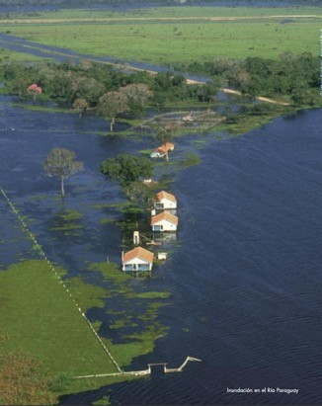
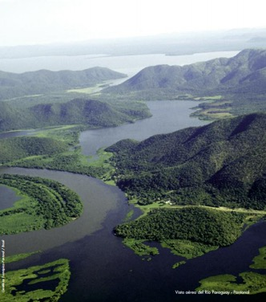
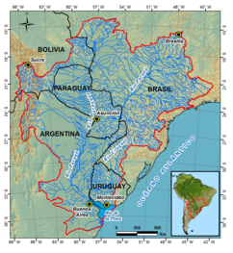
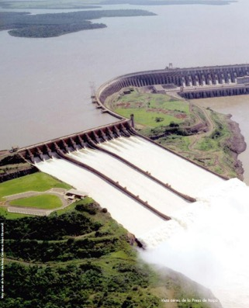
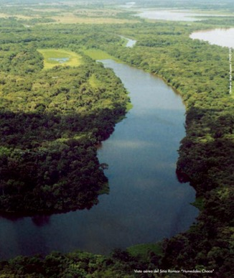
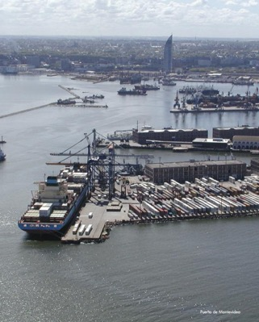

Slide 10
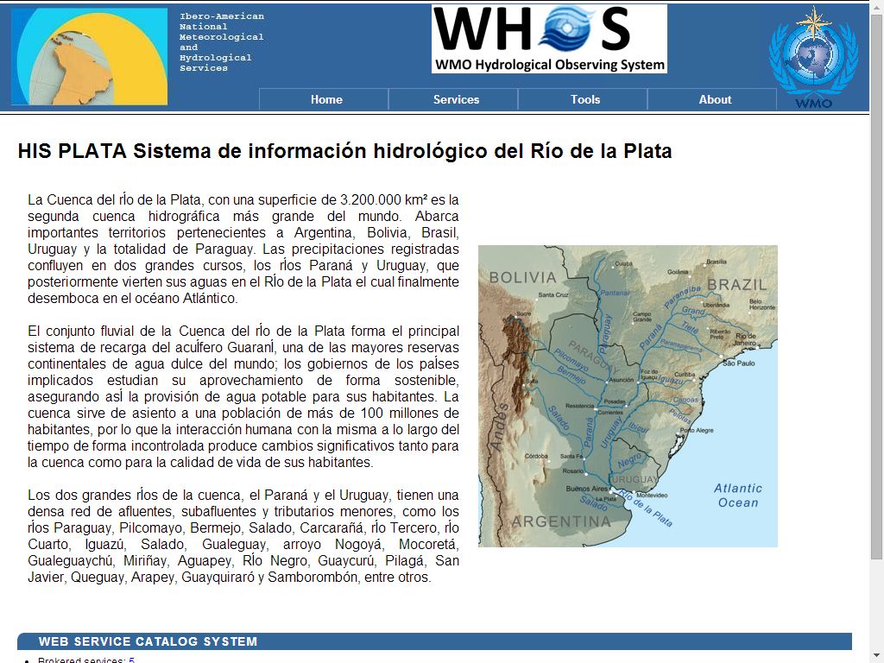
HIS in La Plata Basin

Slide 11
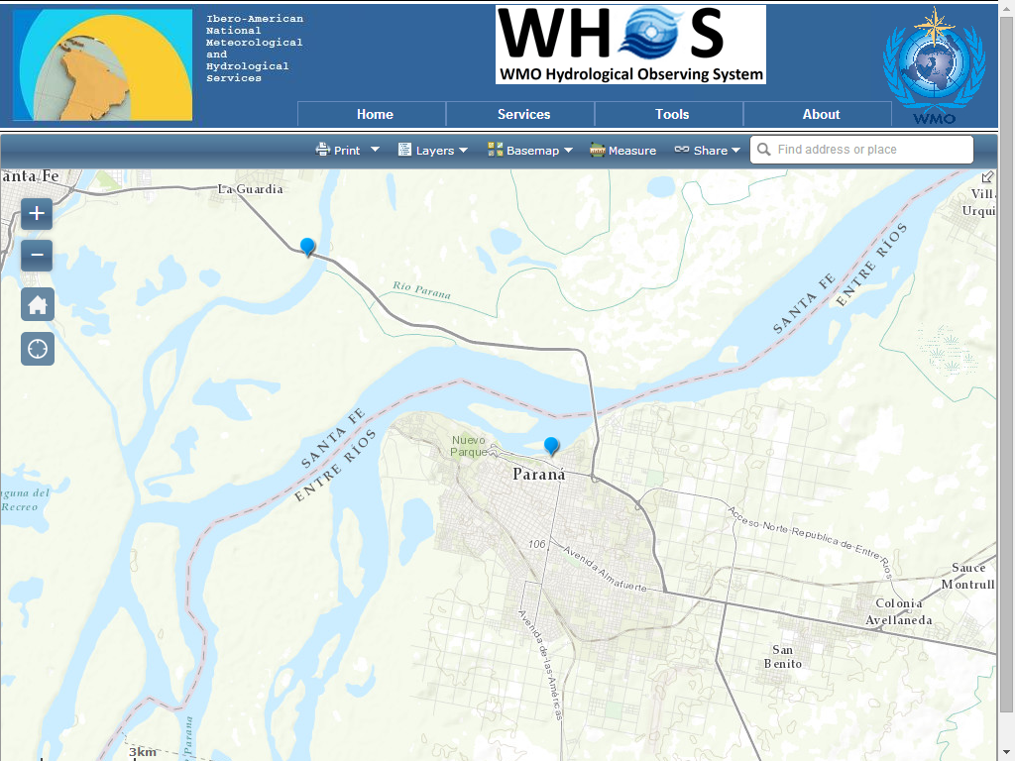
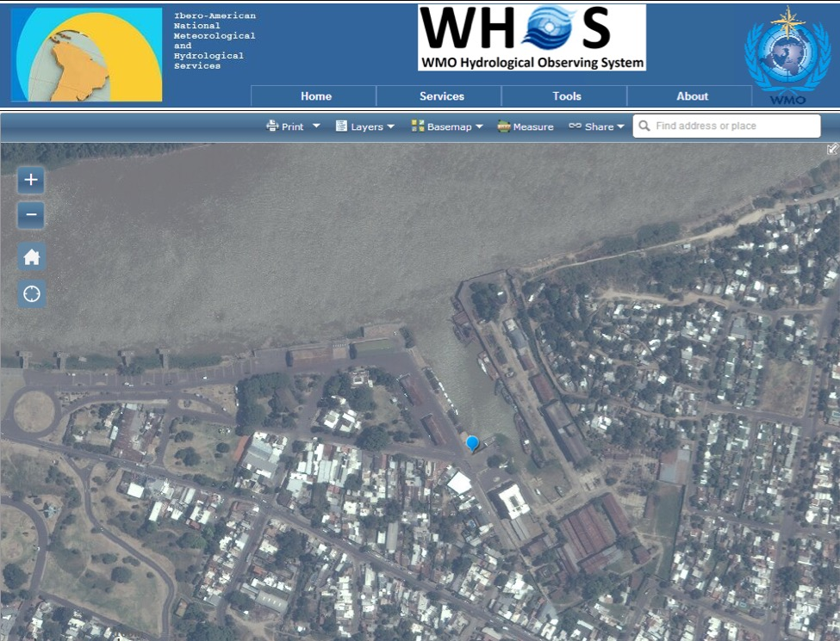
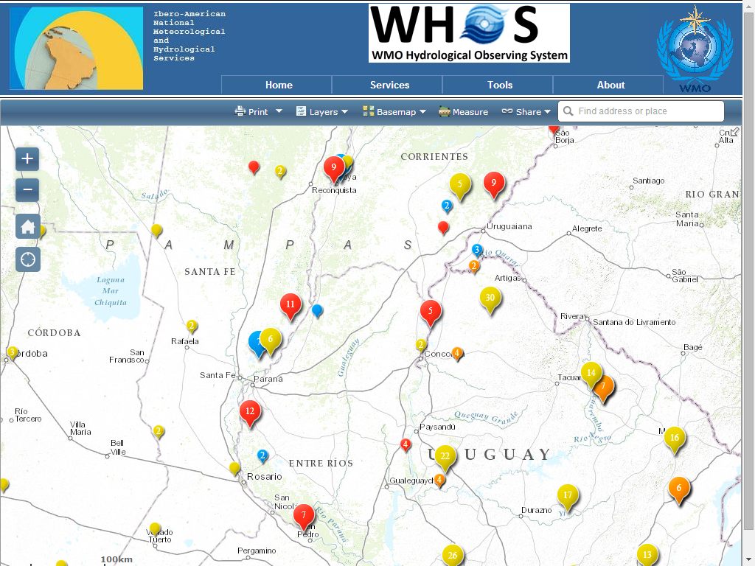
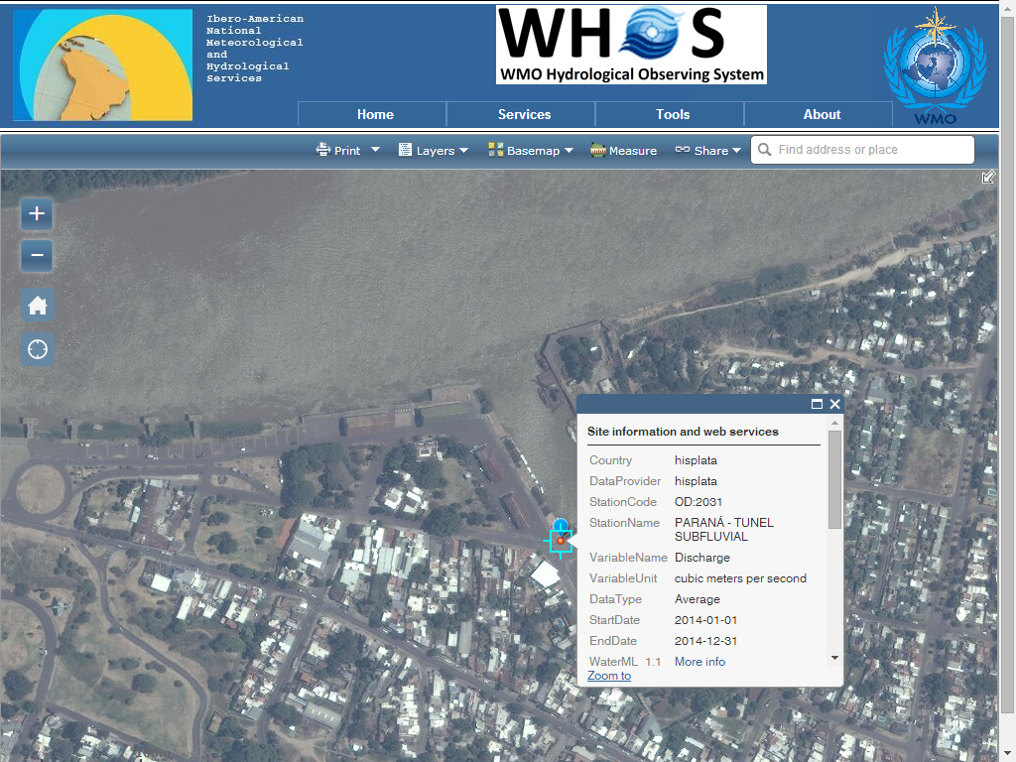
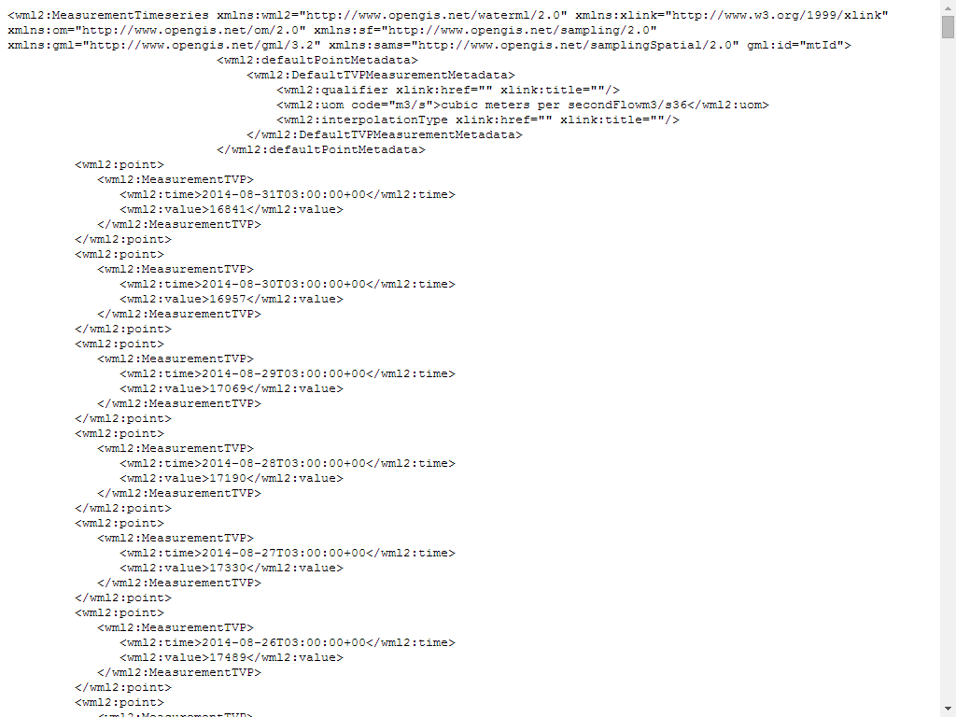
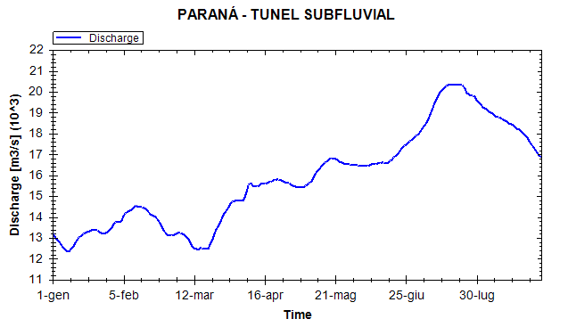

Slide 12
HYDROLOGICAL CENTERS

Slide 13
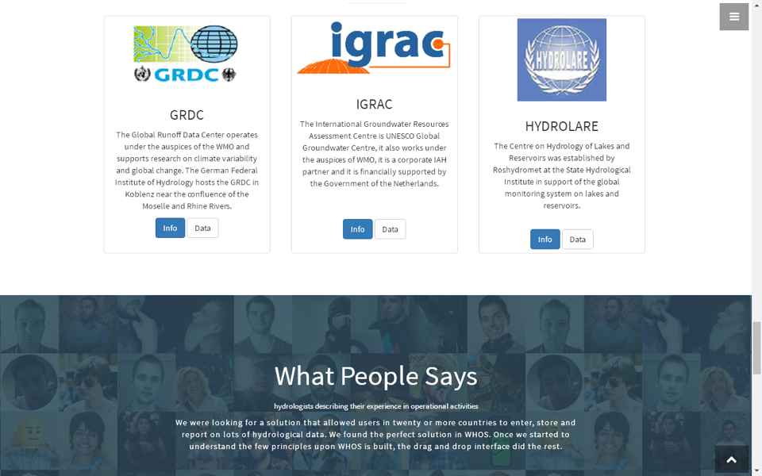

Slide 14
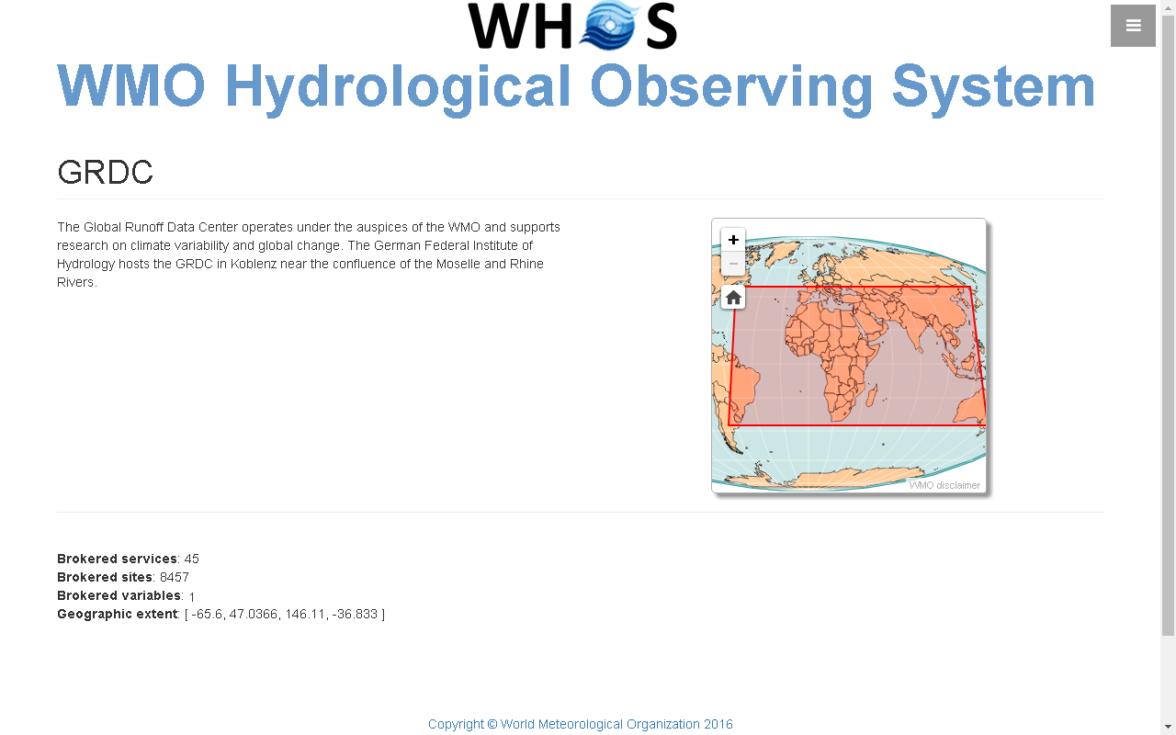

Slide 15
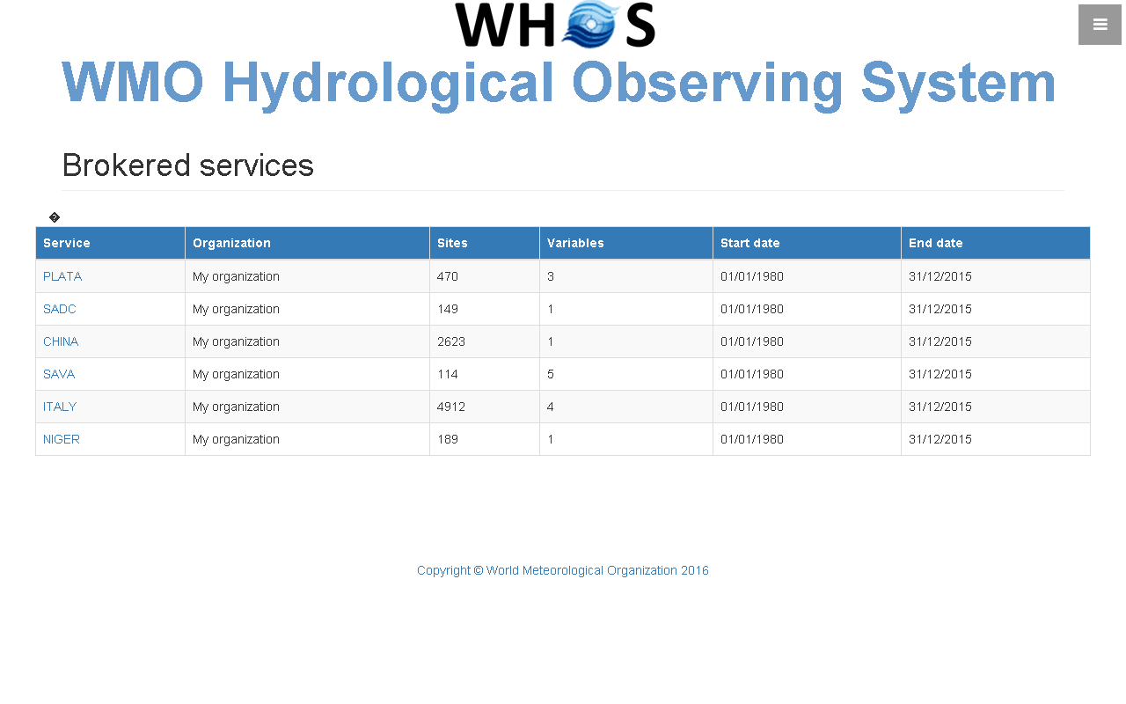

Slide 16
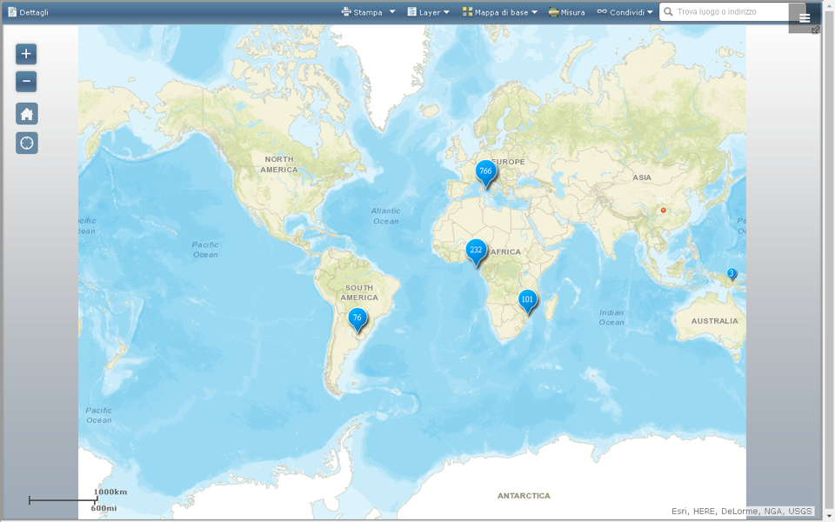

Slide 17
THE ARCHITECTURE

Slide 18
The Road Further Ahead in Hydrology
Using WMO and OGC Standards
HydroCatalog
(register)
CSW
HydroProvider
WFS
SOS2
(WaterML 2)
HydroClient

Slide 19
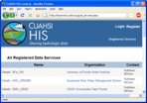
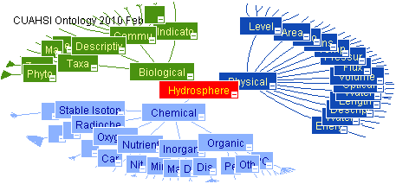
WHOS Architecture Overview
NHS
WHOS
Metadata
Catalog
Data
Web
Service
Registry
Hydrologic Ontology
Data
Registration
NHS
Data
Data Access
Data Discovery
Data Providers
Users (Web & Desktop)

Slide 20
WaterML2 and SOS2
EPA
Locations
GetSites
GetSiteInfo
GetVariableInfo
GetValues
Data
Variables
UT
Date Ranges
USGS
Data
Data
WaterML2
Data
Repositories
SOS2
Web Service
Client
TRANSFORM
EXTRACT
LOAD
SOS2 is how you ask for data
WaterML2 is the format of what comes back

Slide 21
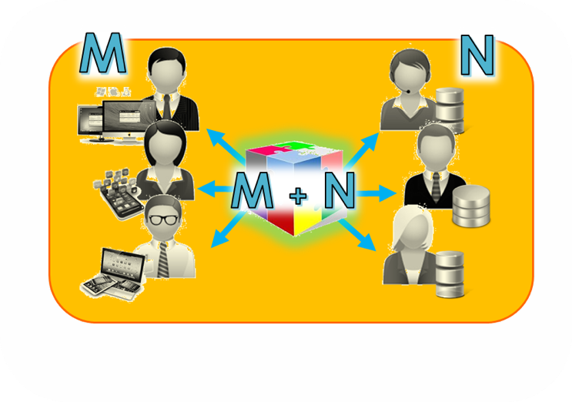
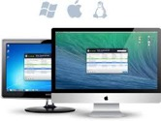













Broker Approach
Service Providers
Service Users
Data Infrastructures
Data Applications
Mediation
Mediation
Mediation
Mediation
Collaborative-Acknowledged Management approach
Mediation
Mediation
[Governance]

Slide 22
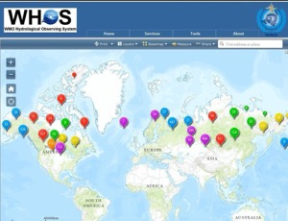
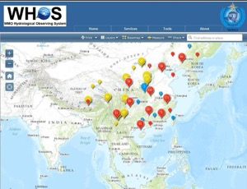
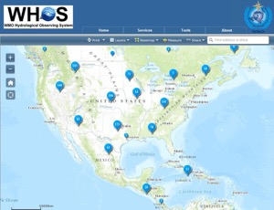
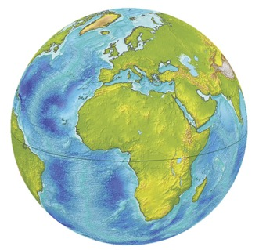
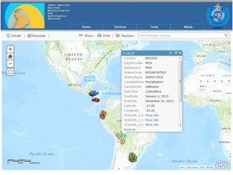
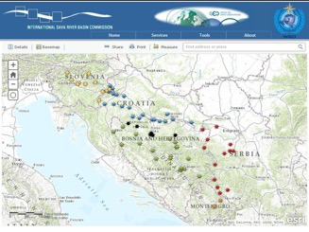
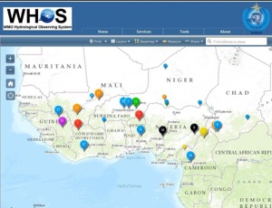
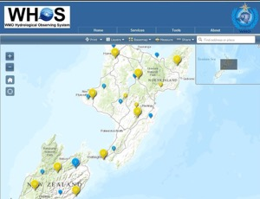
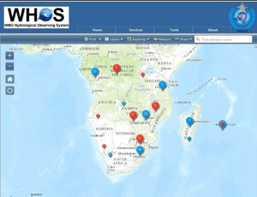
STANDARDIZED DATA EXCHANGE IN HYDROLOGY

Slide 23
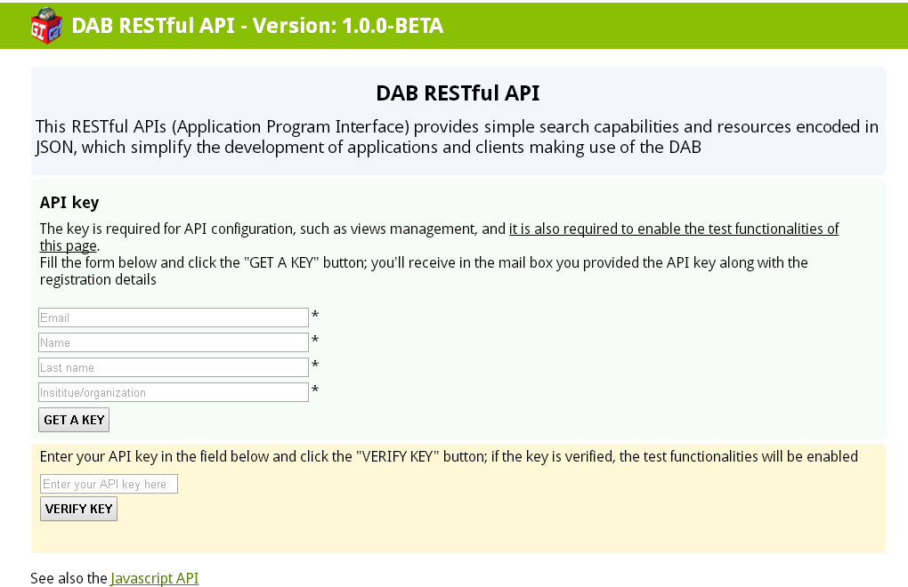

Slide 24
HYDROLOGICAL APPLICATIONS

Slide 25
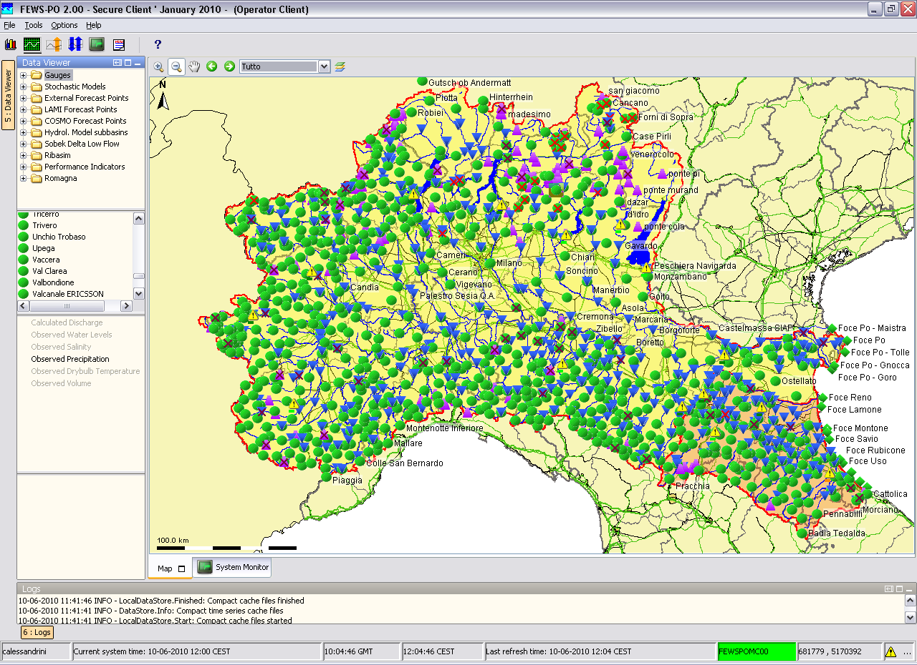

Slide 26
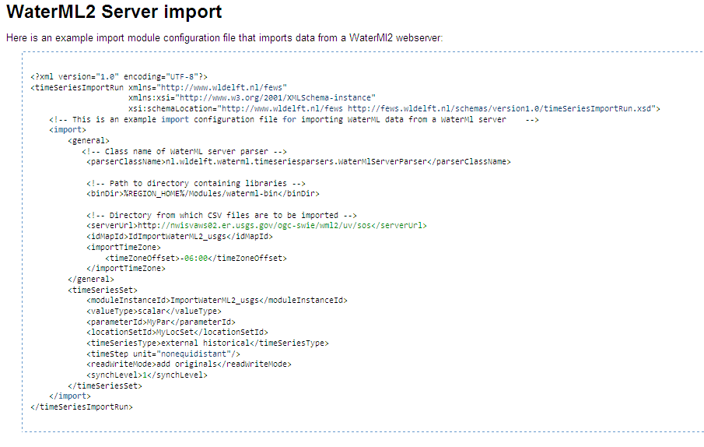
Import data from a WaterML2 webserver
Notes:
26

Slide 27
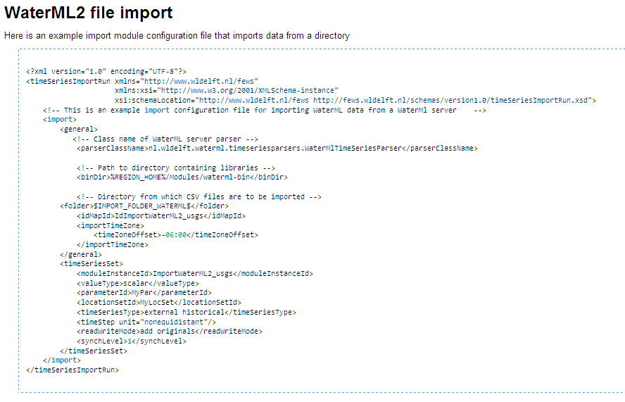
Import WaterML2 data from a directory
Notes:
27

Slide 28

Archive use case analysis
Event analysis
Event review/ inquiry
Simulation results
Post event reports
Forecast Products
Communication notes
Initial model state
Model run settings
NWP forecasts
Rating Curves
Observations
Model setup
docs
Model
verification
Model
calibration
Informative
event
Training
materials
Data types:
Time series
Model data
(native)
Documents
& images

Slide 29
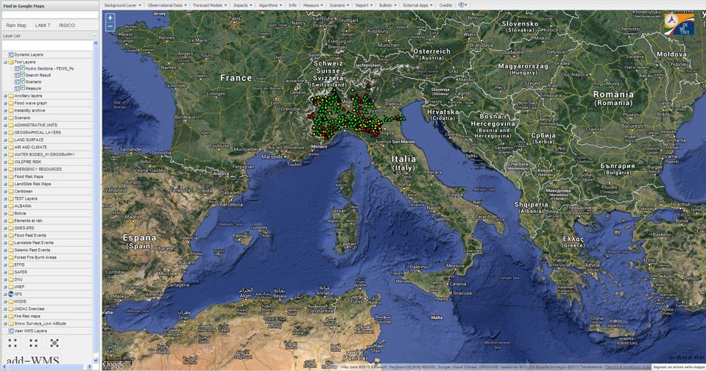
DEWETRA and the Po river basin
Notes:
29

Slide 30
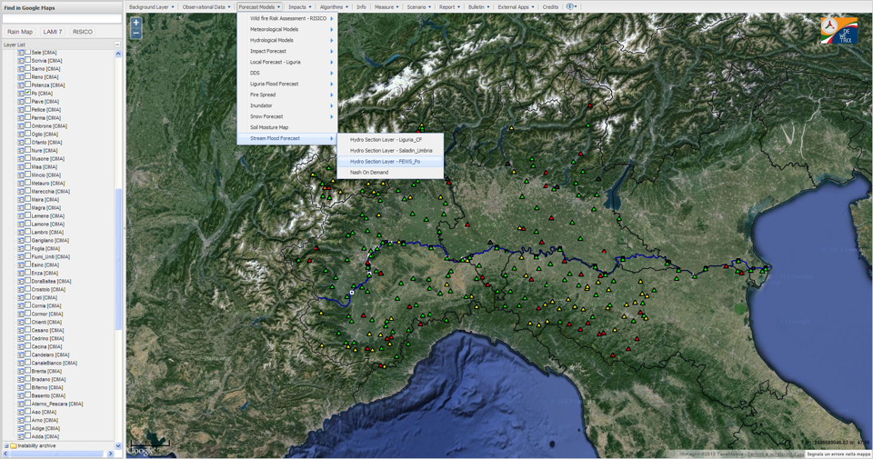
Notes:
30

Slide 31
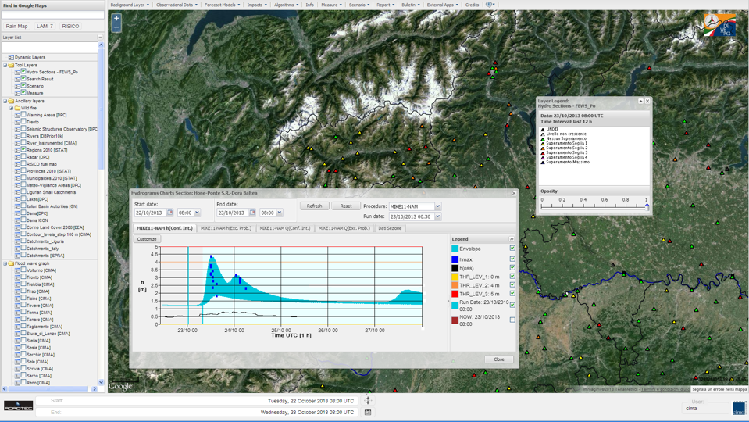
Notes:
31

Slide 32
WHOS
current developments

Slide 33
WIGOS Metadata Standard - Approved at Cg-17 June 2015
Source: https://www.wmo.int/pages/prog/www/wigos/documents/Cg-17/WIGOS_Metadata.pdf

Slide 34
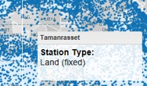



OSCAR quick access & reports
Quick access
&
Map filter
+ click
=
Detailed station report

Slide 35

QGIS and WEBSERVICES

Slide 36

HYDROLOGICAL ANALYSIS BY WEBSERVICES

Slide 37






Slide 38





Slide 39

WHOS IN THE CLOUD
WHOS
Big Data dimensionalities know as V axes
volume
variety
velocity
veracity
visualization

Slide 40


TRAINING on HYDROLOGIC DATA SHARING

Slide 41
THE REAL ESSENCE OF WHOS

Slide 42



Linking people everywhere with hydrologic data, maps and models

Slide 43



looking for
hydrological data?
STAY SUNNY USE

Slide 44

Thank you for your attention

