Slide 1
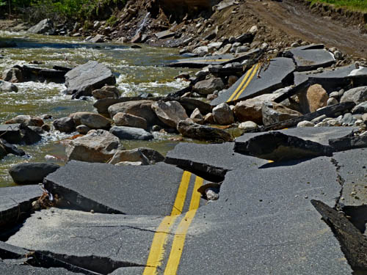
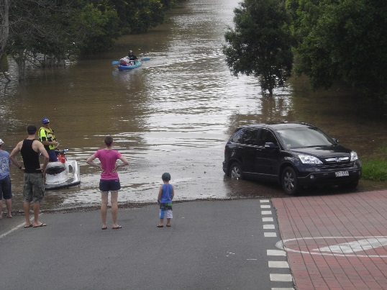
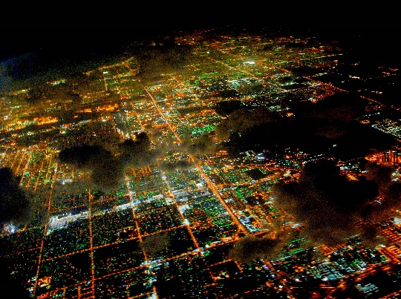
NCHRP 20-59(53) FloodCast: A Framework for Enhanced Flood Event Decision Making for Transportation Resilience April 2017
Presenters:
Siva Selvanathan and Alaurah Moss

Slide 2
Project Overview
The objectives of this research are to develop a strategic framework and a prototype tool for enhanced flood event decision making.
The framework and tool should help state DOTs:
Plan
Manage risks
Mitigate hazards
Respond to flood and flash flood events
Tools & Methods
Gaps
Priorities
Prototype
Capability Maturity Model (CMM)
Requirements
Data Standards & Specifications

Slide 3
Data Sources

Slide 4
Data Sources

Slide 5
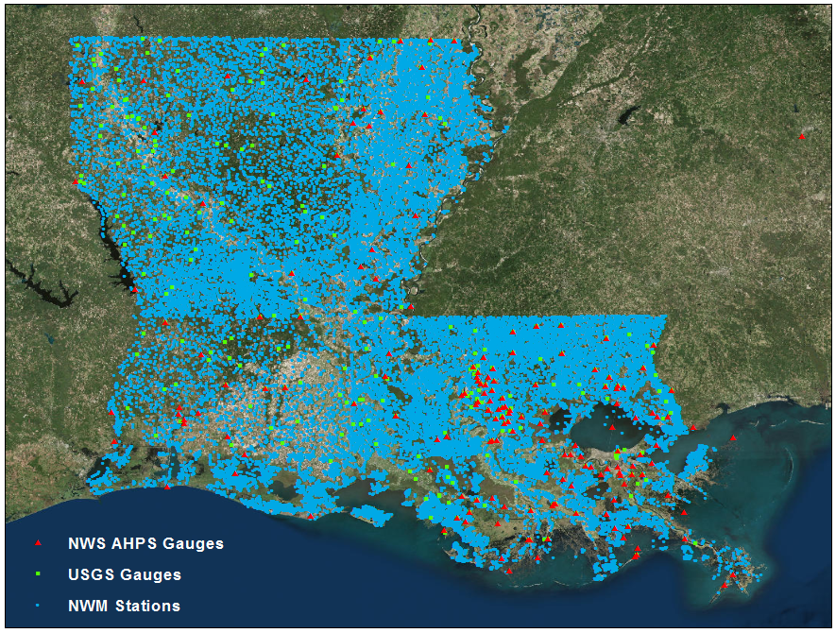
NWM Outputs

Slide 6
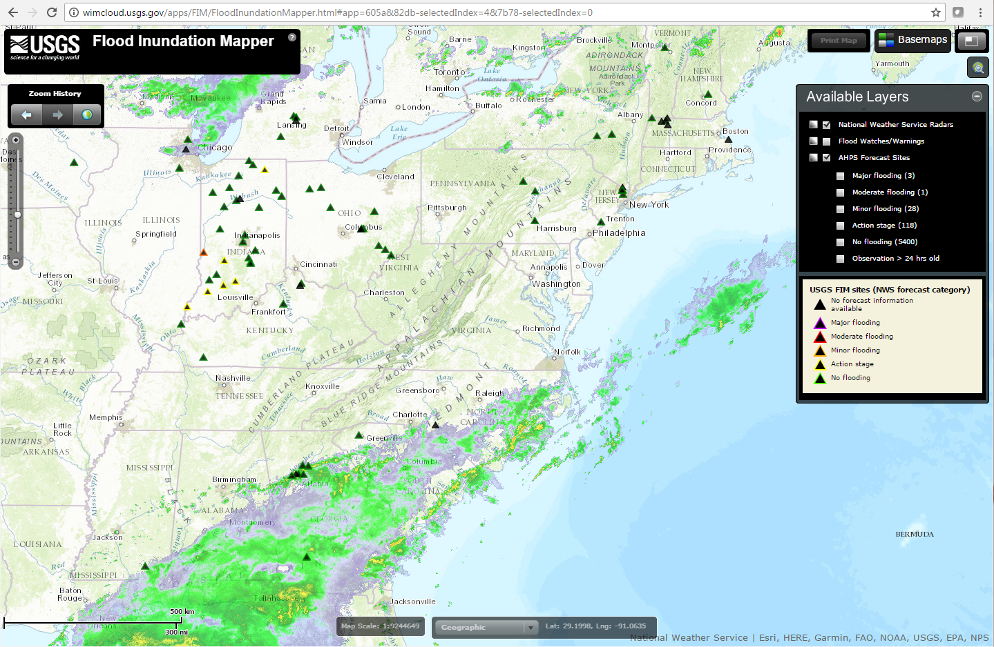
Flood Inundation Extent & Depth Predictions

Slide 7
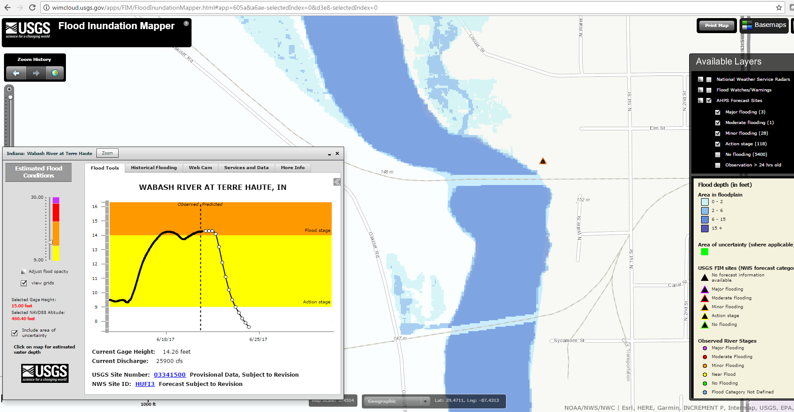
Flood Inundation Extent & Depth Predictions

Slide 8
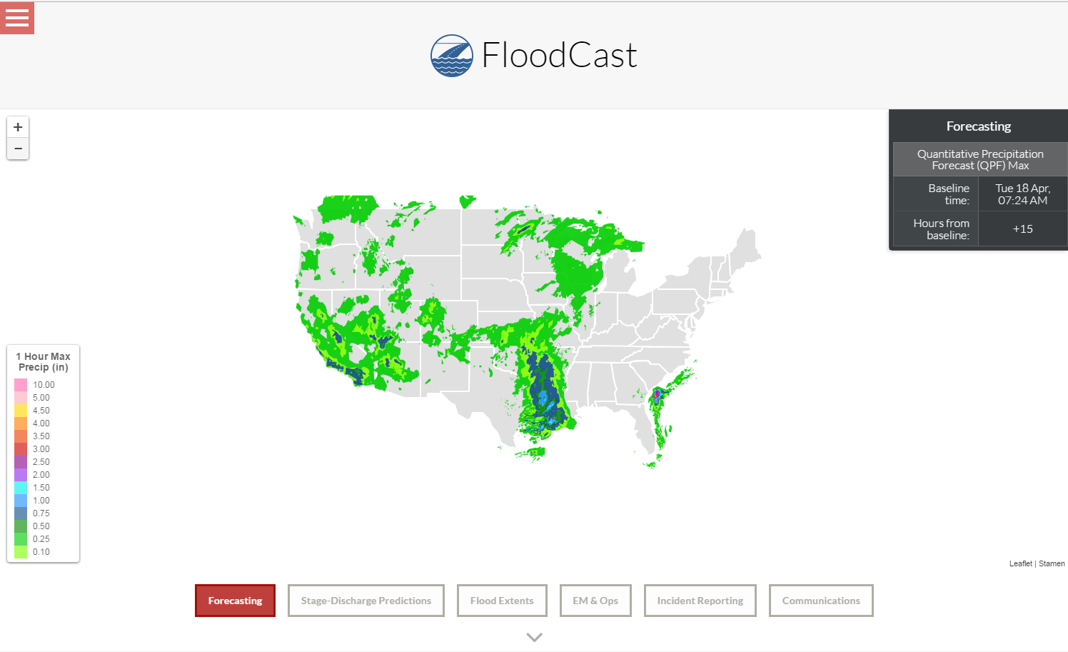
FloodCast Prototype System Modules
Forecasting

Slide 9
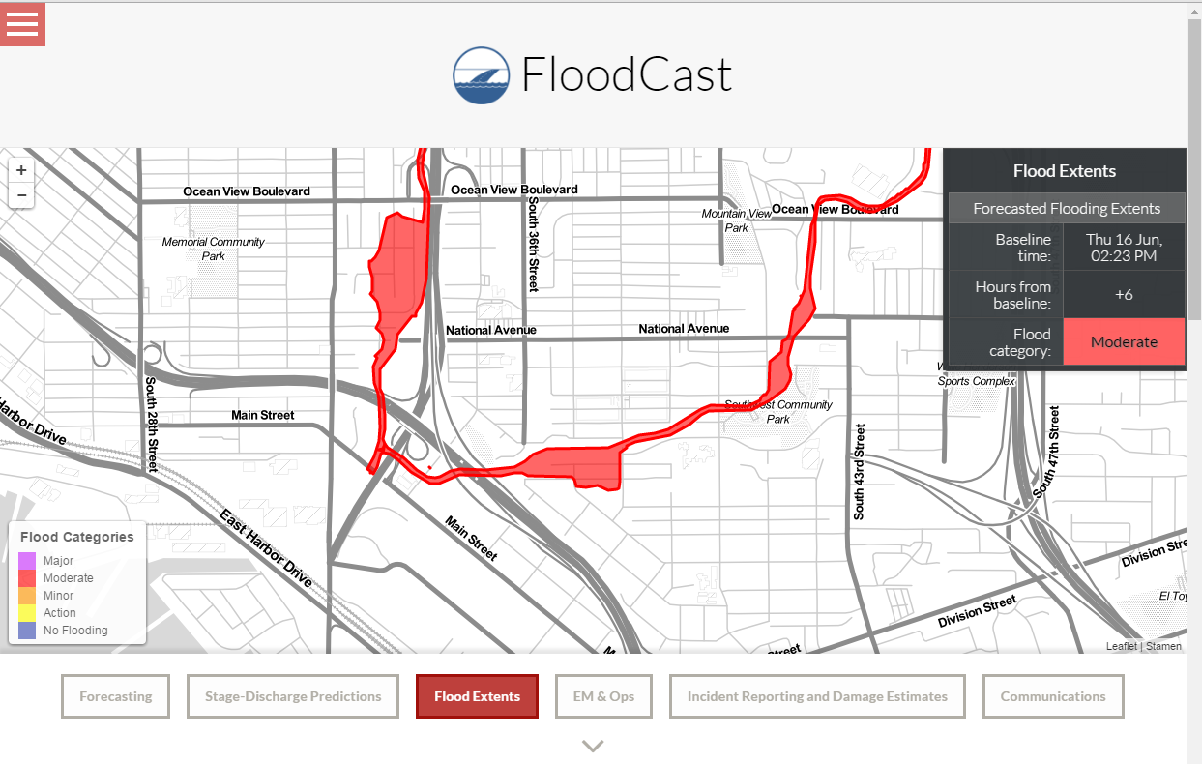
FloodCast Prototype System Modules
Stage Discharge Predictions & Flood Extents
Notes:
Stage Discharge Predictions and Flood Extents:
The system displays floodplain inundation extent predictions based on Advanced Hydrologic Prediction Service (AHPS) river gage stage-discharge forecasts for various NWS-defined flood stages. This module represents the hydrometeorology and flood mapping component of flood forecasting to not only understand how much flooding there might be, but also when and the where.

Slide 10
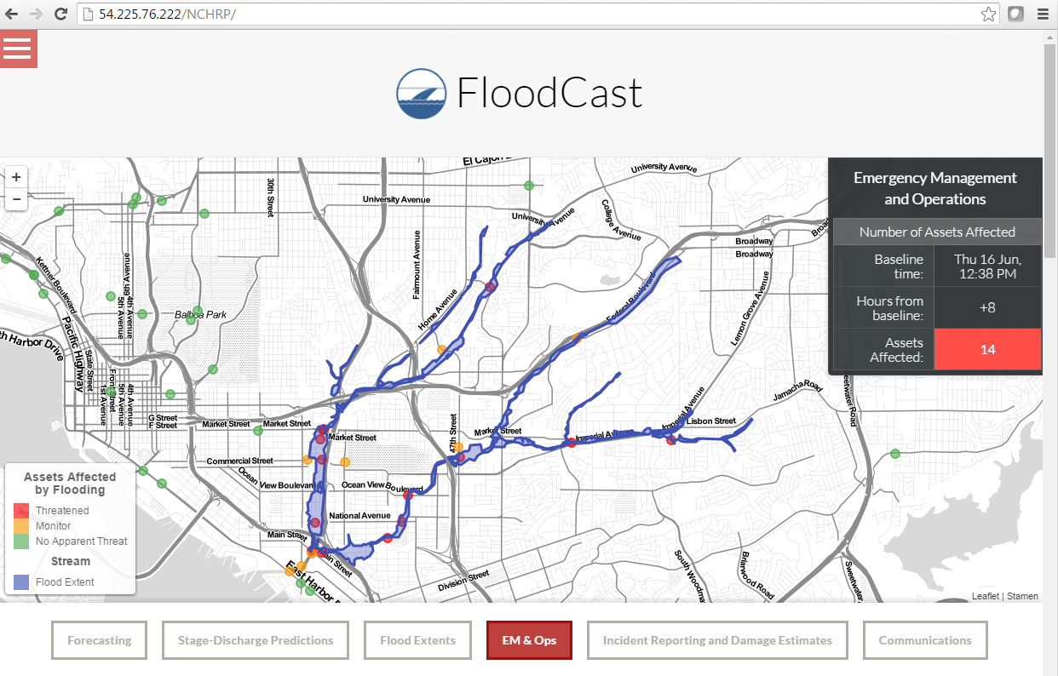
FloodCast Prototype System Modules
Emergency Management & Operations
Notes:
EM & Ops:
The system displays the forecasted riverine flood extents overlaid on critical transportation assets. In 2-hour increments from the baseline flood event, the system shows how the status of assets change as the flood event develops.
.

Slide 11
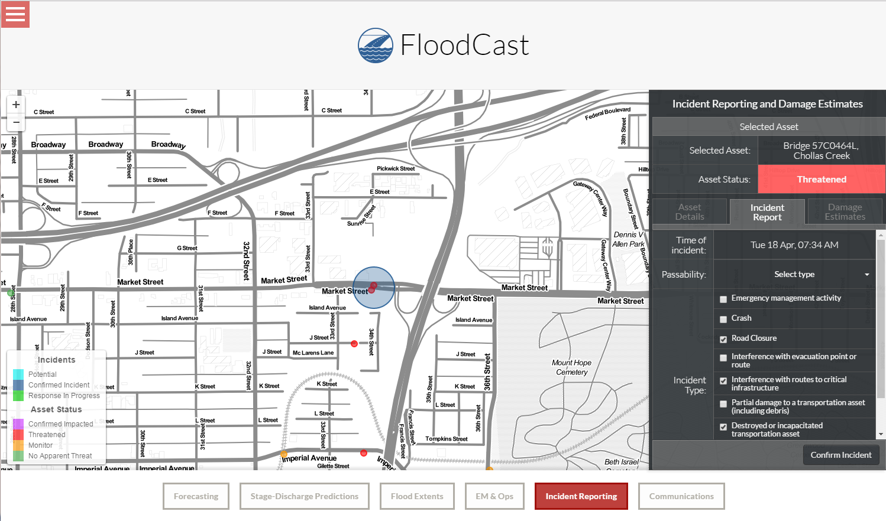
FloodCast Prototype System Modules
Incident Reporting & Damage Estimates
Notes:
Incident Reporting and Damage Estimates:
Incident tracking and summary tools provide streamlined workflows, centralized tracking, and rapid synthesis of flood event analytics to facilitate both active flood event response and assists with post-disaster recovery and reimbursement activities. The system’s incident report features allows users to document attributes of impacted assets.

Slide 12
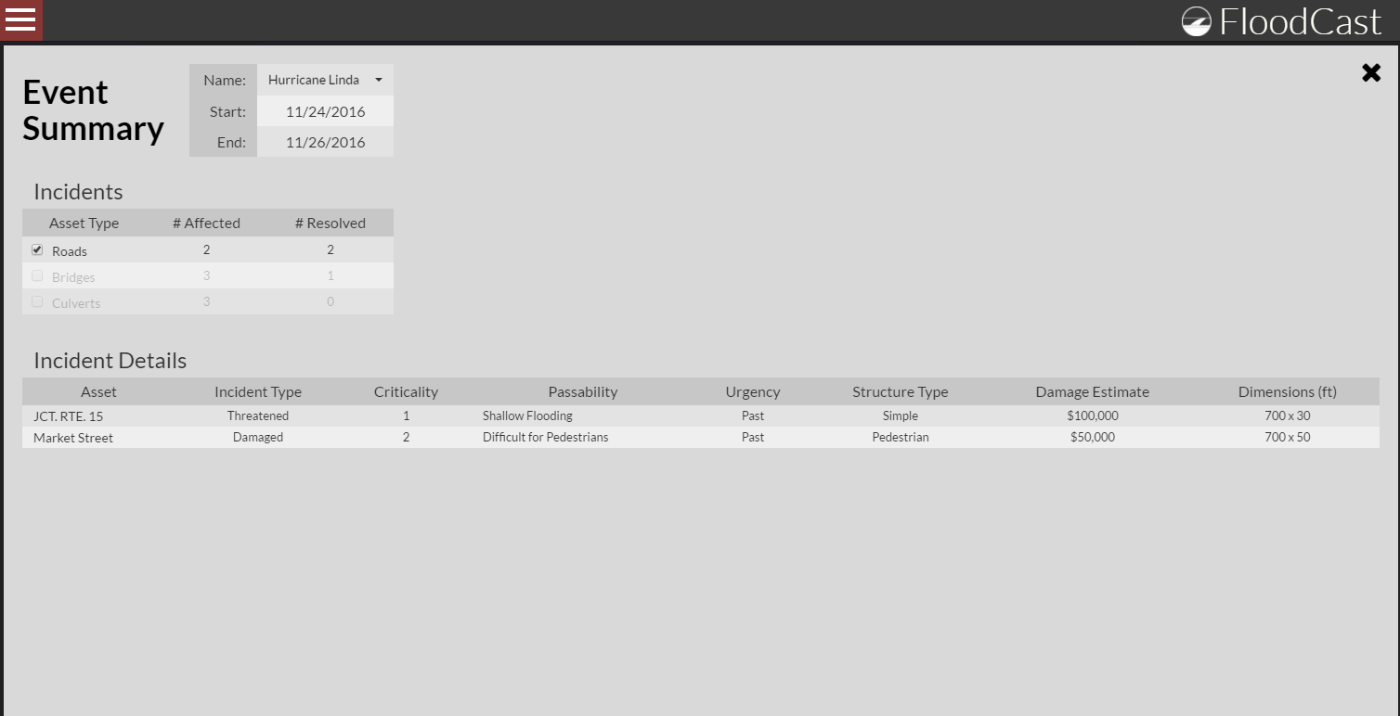
FloodCast Prototype System Modules
Event Summary
Notes:
Event Summary:
The system stores information on historical flood events in the Event Summary record database. This event summarization feature can help DOTs with event debriefing and planning, as agencies can take note of assets that are repetitively flooded to inform mitigation activities and can review event response work flows during debriefing exercises.

Slide 13
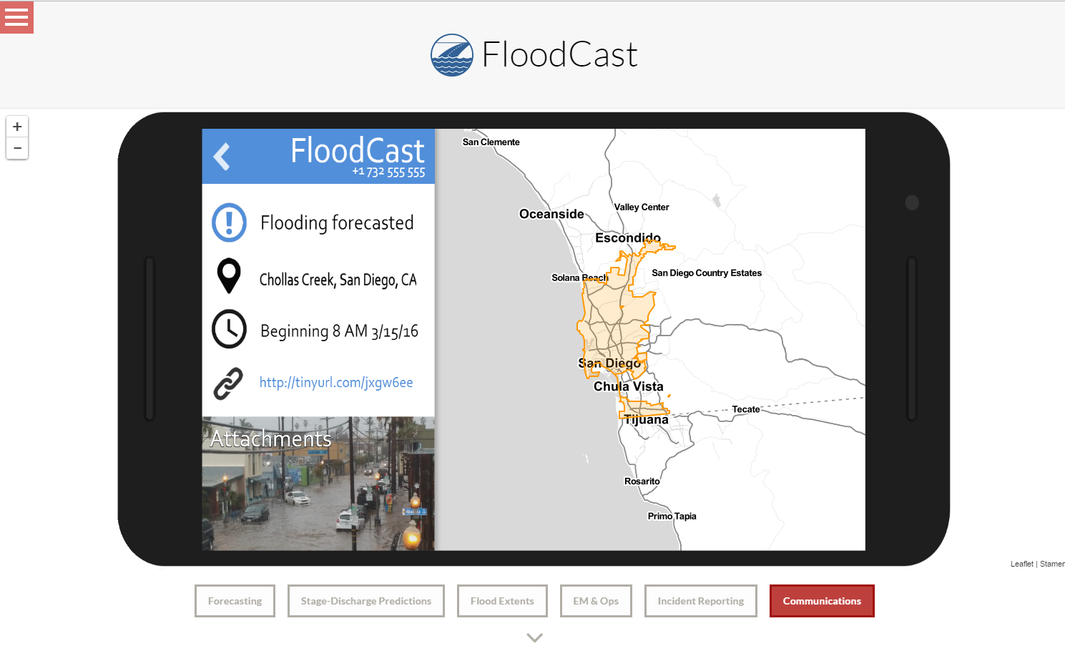
FloodCast Prototype System Modules
Communication
Notes:
Communication:
The communication component is a key functionality of the FloodCast prototype, providing a means to deliver automatic alerts to all registered users of the system via e-mail or SMS message. The communications portion of the tool provides a warning system that allows users to monitor the status, criticality and passability of all assets within their affected municipality. Alerts include a visualization of the predicted floodplain extent and system-generated hyperlink to additional information about the event.

Slide 14
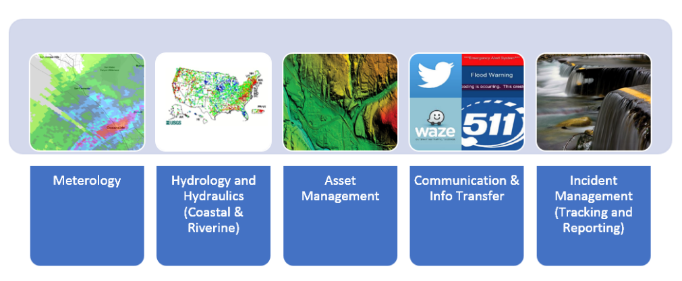
Capability Maturity Model
Notes:
This CMM was developed to help State DOTs define the key data, technologies and practices required to effectively achieve progress towards flood forecasting and response. The CMM was organized into capability dimensions (i.e., Meteorology, Hydrology & Hydraulics, Asset Management, Communication & Information Transfer and Incident Management) with tiers indicating levels of maturity toward that objective. Tiers can then be used by interested entities to identify a pathway toward improving capabilities along each dimension. The research team utilized the FloodCast CMM to identify participant DOTs representing a mix of both early stage and more mature practitioners with respect to the 5 dimensions of the CMM.

Slide 15
Capability Maturity Model
Level 1
-Limited capabilities and participation in developing, maintaining, and disseminating flood forecasting data/information
Level 2
-Beginning to develop capabilities to allow for participation in operational flood forecasting
Level 3
-On the verge of participating in advanced flood event forecasting and decision making
Level 4
-Fairly advanced predictive weather and flood monitoring in place
Notes:
This CMM was developed to help State DOTs define the key data, technologies and practices required to effectively achieve progress towards flood forecasting and response. The CMM was organized into capability dimensions (i.e., Meteorology, Hydrology & Hydraulics, Asset Management, Communication & Information Transfer and Incident Management) with tiers indicating levels of maturity toward that objective. Tiers can then be used by interested entities to identify a pathway toward improving capabilities along each dimension. The research team utilized the FloodCast CMM to identify participant DOTs representing a mix of both early stage and more mature practitioners with respect to the 5 dimensions of the CMM.

Slide 16
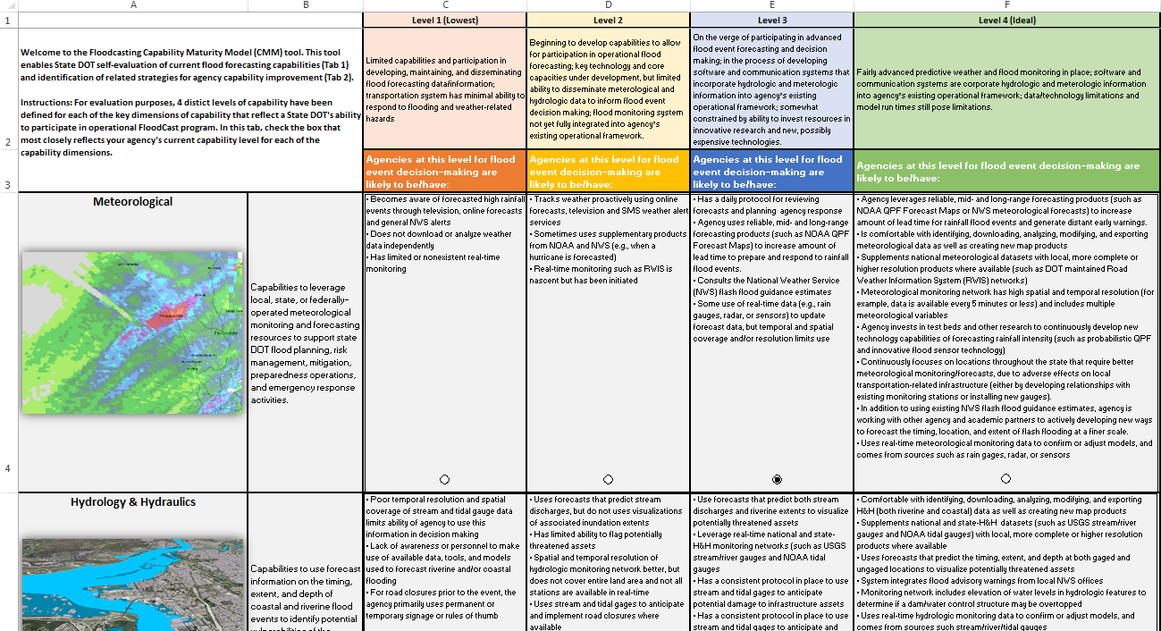
Capability Maturity Model

Slide 17
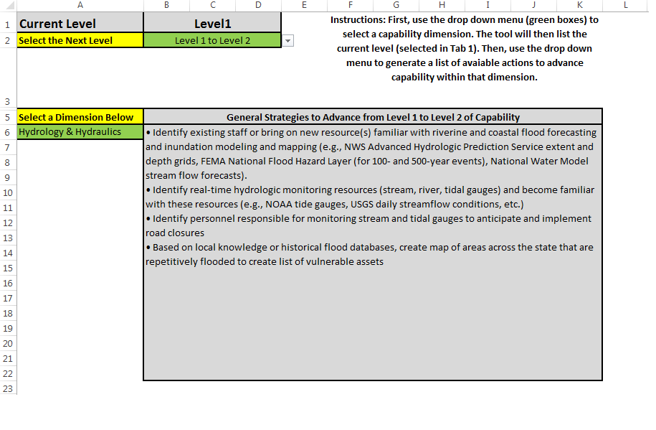
Capability Maturity Model

Slide 18
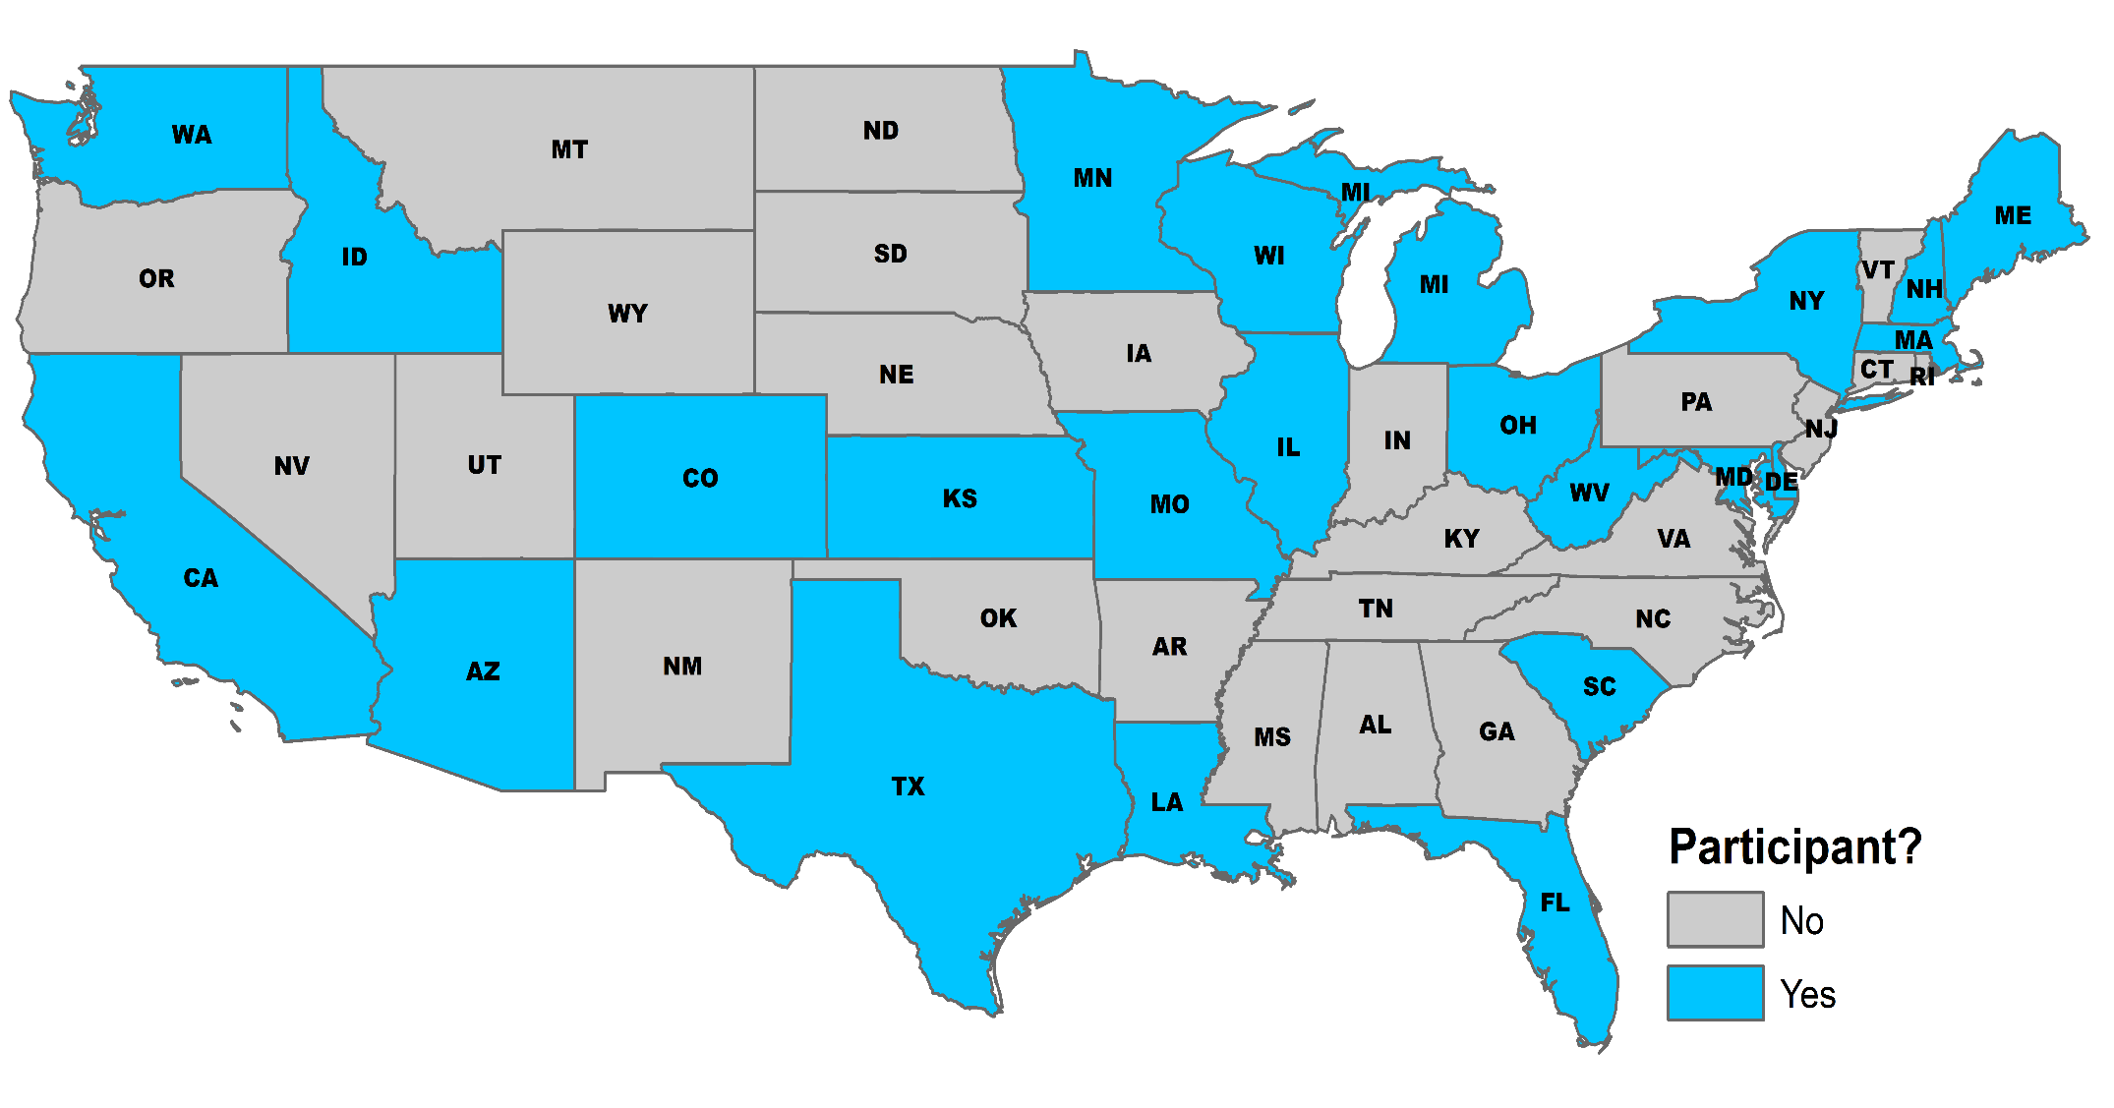
Detailed Requirements Analysis

Slide 19
Project Stakeholders: DOT Job Roles
Job Roles
Sustainability
Drainage
Emergency Management & Operations
Traffic Management
Maintenance & Operations
Hydraulic Engineering
Geospatial Services

Slide 20
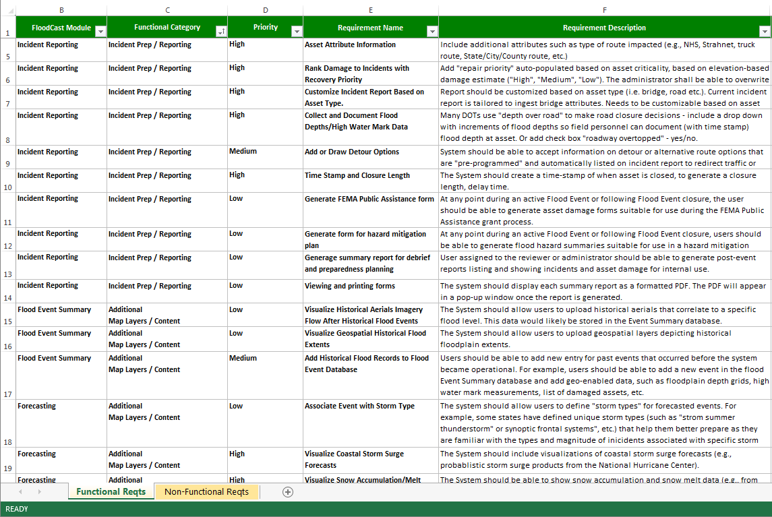
Functional Requirements
Notes:
“functional” requirements that define specific capabilities that the system will perform and provide.
Requirements were organized by functional category (e.g, Incident Pre/Reporting, Additional Map Layers/Content, Analysis and Modeling, Viewing Data, Flood Alerts/Notifications, Data Sharing and Consumption, and Flood Event Record-Keeping) and FloodCast module (e.g., Forecasting, Incident Reporting, Flood Extents & Emergency Operations, Communications, and Event Summary). In some cases, stakeholders provided requirements that do not fit into any of the existing FloodCast modules and would require a new module such as visualizing future Sea Level Rise inundation scenarios.

Slide 21
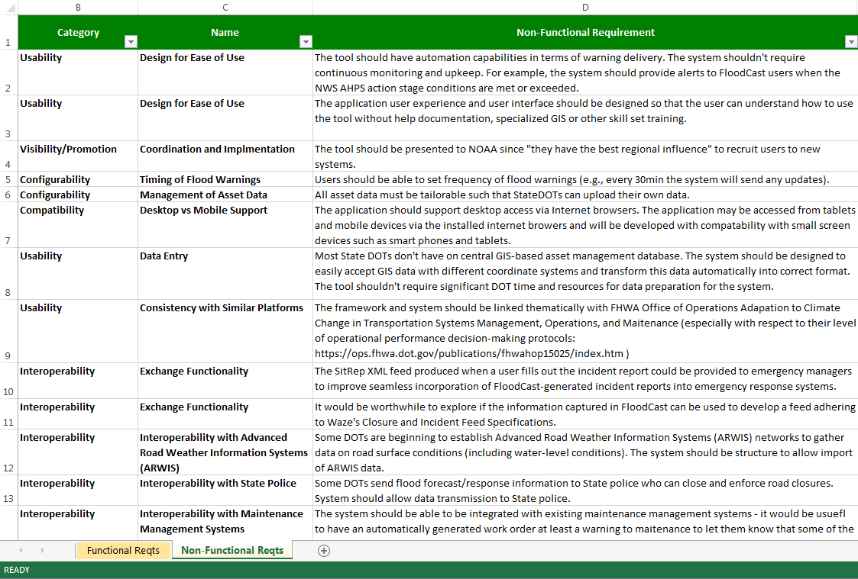
Non-Functional Requirements
Notes:
non-functional” requirements that inform overall system/solution design
Non-functional requirements address application usability, configurability, computability, interoperability and similar qualities

Slide 22
Flood Forecasting Dimension: Meteorology
Existing Capability Summary | Gap/Requirement
The majority of DOTs surveyed for this project actively consult predictive weather forecasts to prepare for flood events, most commonly from resources/alerts produced by NWS, NOAA, USGS, NHC, and FEMA. Most agencies gather precipitation forecast data separately from each source every time they need an update rather than having one central system that stores all weather and hydrologic data in one place. | A flood forecasting system that could serve as a centralized repository for flood forecasts to save time and improve situational awareness.

Slide 23
Flood Forecasting Dimension: Hydrology & Hydraulics
Existing Capability Summary | Gap/Requirement
Several DOTs use the National Flood Insurance Program’s (NFIP) National Flood Hazard Layer (NFHL) for 100-year and 500-year flood events or the NWS’s Advanced Hydrologic Prediction Service (AHPS) depth grids and extents for NWS-defined flood stages. However, it appears that most of this information is being used for long-term infrastructure planning decisions rather than predictive flood risk planning. There are a few DOTs that use USGS rating curves (or similar regression equations) or the USGS StreamStats program to estimate inundation extent and depth predictions for ungauged locations. | Dynamic inundation mapping (i.e. event-based) that allows for rapid translation of stream flow predictions to extent and depth predictions, especially accurate flood modeling at ungauged locations. In particular, multiple survey respondents expressed the need to answer the following key questions in advance of an event: When will it flood? Where will it flood? and How deep will flooding be?

Slide 24
Flood Forecasting Dimension: Asset Management
Existing Capability Summary | Gap/Requirement
Most DOTs have some sort of asset management system, but the majority of these databases are not complete, only show DOT-owned assets, are not in GIS format, do not include information about asset fragility and vulnerability to flood conditions, do not have or only have partial topology enforcement, and are missing asset elevation attributes. | System should facilitate data asset data collection (i.e. field personnel could gather geo-located asset data), could easily update additions and changes to assets, and could interface with H&H data outputs to anticipate asset failure.

Slide 25
Flood Forecasting Dimension: Communication & Information Transfer
Existing Capability Summary | Gap/Requirement
Many DOTs use dispatch lines or state 511 systems to communicate and deliver alerts about traffic incidents, closures, and detours. However, these alerts are rarely automated and occur during or post-event rather than delivering predictive information about potential flood risk pre-event. The majority of existing communication platforms do not enable two-way communication with response crews. Most DOTs do not, or are not aware of the Open Geospatial Consortium (OGS) guidelines for geospatial data dissemination for sharing data. | One-click automated communication tools that can help streamline efforts for DOTs to get the word out internally, to partner agencies, to infrastructure owners, and the public is desirable. The system should be structured to adhere to data standards and specifications so that DOT-collected data can be seamlessly transferred to external users such as partnering agencies and the public.

Slide 26
Flood Forecasting Dimension: Incident Management
Existing Capability Summary | Gap/Requirement
Many DOTs expressed that their agency has a good understanding of locations and assets that are prone to flooding; most of this information is stored as institutional knowledge (i.e. experts who have experience with multiple historical flood events). Only several agencies maintain an incident tracking database in GIS format (extent of flood and location of impacted assets) with associated damage analytics (i.e. high water mark data, how long infrastructure was inundation, damage estimates, repair/cleanup activities, etc.). | System should allow for rapid synthesis of flood event analytics to facilitate both active flood event response s well as assist with post-disaster recovery and reimbursement activities.

Slide 27
Data Standards for FloodCast
Develop data standards for the key data components of FloodCast
Create tool for checking data compliance with the standard.
Notes:
If we develop standards in isolation, won’t be useful
How does HY_features fit in?
Can it be adapted? Can we have another layer that joins with HY?
How does HAND fit in?
How does Water_ML fit in?
Sensors/crowd sourced data? Are there standards?
N American WaterWatch – how do they report AHPS information?

Slide 28
Future of FloodCast
During a flood emergency, information flows through a wide range of channels:
Data suppliers: NWS, USGS, NOAA, sensors, the public
Data consumers: StateDOTs and partnering Emergency Managers
*Key Requirement: State DOTs want flood inundation extent & depth predictions at both gauged and ungauged locations
Major interoperability challenges include:
Need standards for generation & dissemination of flood extent & depth digital data (preferably in real-time rather than inundation libraries).
How do flood extents link to their flooding source?
How do NWM flow estimates link to NHD stream segments?
Notes:
State DOTs receive hydro-met data from multiple state agencies and try to put this info together to increase situational awareness before a flood event, but having high resolution accurate data that is hard to interpret or requires significant manipulation prior to integration within web-based services used to support decision-making is of limited use during emergency events.
**key requirement: DOTs want inundation extents and depth predictions at both gaged and ungagged locations
but there is no standard for how stage/discharge, or flow estimates are translated into inundation extents.
Standardization of this type is essential for internal communication with field crews as well as cross-entity collaboration.
Information flows through a wide range of channels within and across institutional hierarchies. Channels include traditional telecommunication (telephone, television, radio); social media; DOT and emergency management software; and innumerable sensors, some of which are static (e.g., stream gages, RWIS) and some of which are mobile (e.g., smartphones and tablets, Global Positioning System [GPS], aerial photogrammetry). DOT personnel; cooperating agencies; local, county, or national entities; and the public may be sending or receiving information at any given time. Communication tools are used to enhance situational awareness, coordinate response activities, and execute specific actions. Given the large number of channels and users, it can be desirable to employ automation techniques to facilitate communication to appropriate audiences and software platforms.

Slide 29
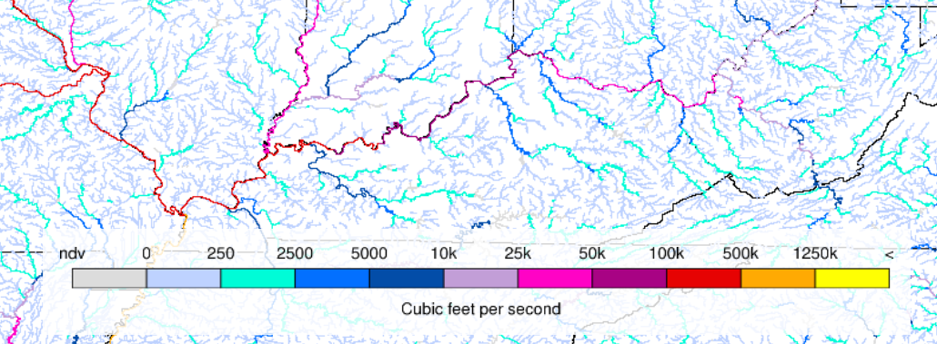
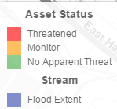
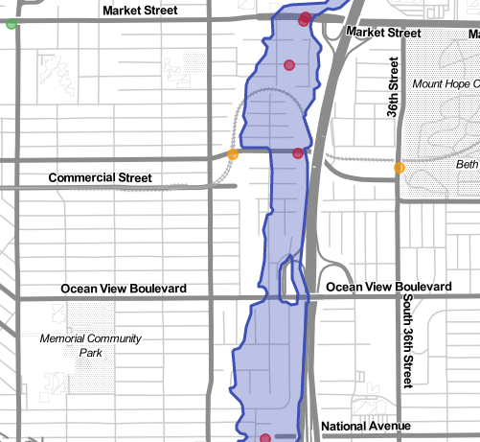
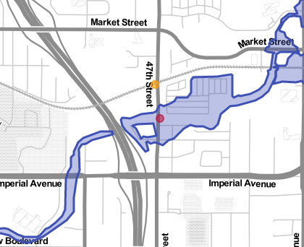
Event-Driven Flood Use Case
Flow Forecasts from NWM
Flood Event 1
Flood Event 2
Gauge
Gauge
River/Stream
Linked features: Gage, flooding source, assets (bridges, culverts)
Linked features: Gage, flooding source, assets (bridges, culverts)
RESPONSE(S)

Slide 30
Future of FloodCast
How do we translate flow forecasts from the NWM to floodplain extents on a real-time or near-real time basis?
Height Above Nearest Drainage (HAND)/Modified HAND method?
Adapt basin-scale hydraulic models to translate flows to floodplain extents?
Notes:
Near-real time

