Slide 1
Environmental Linked Features Interoperability Experiment
An Open Geospatial Consortium Interoperability Experiment
David Blodgett (USGS) HDWG 2017

Slide 2

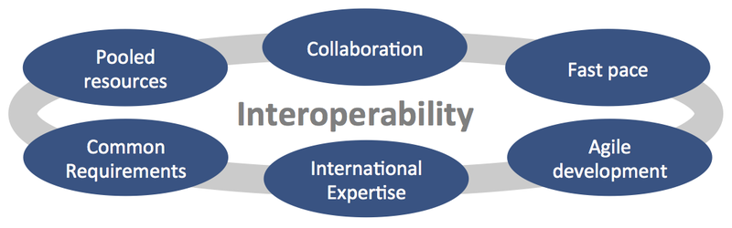
Interoperability
Experiment?

Slide 3
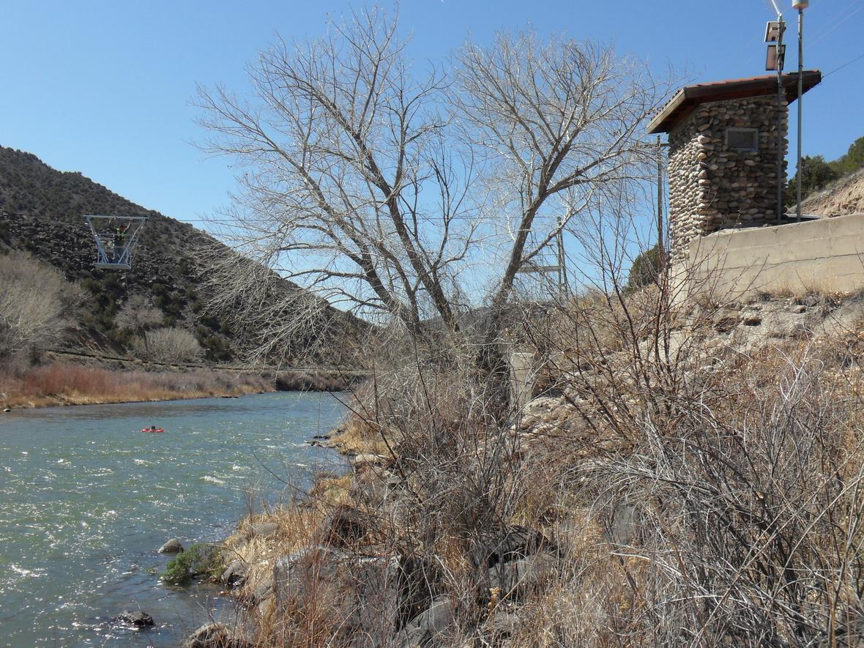
Two Problems:
1) No consistently used pattern to express links between monitoring and modeling data and the “domain” features they monitor or model.

Slide 4
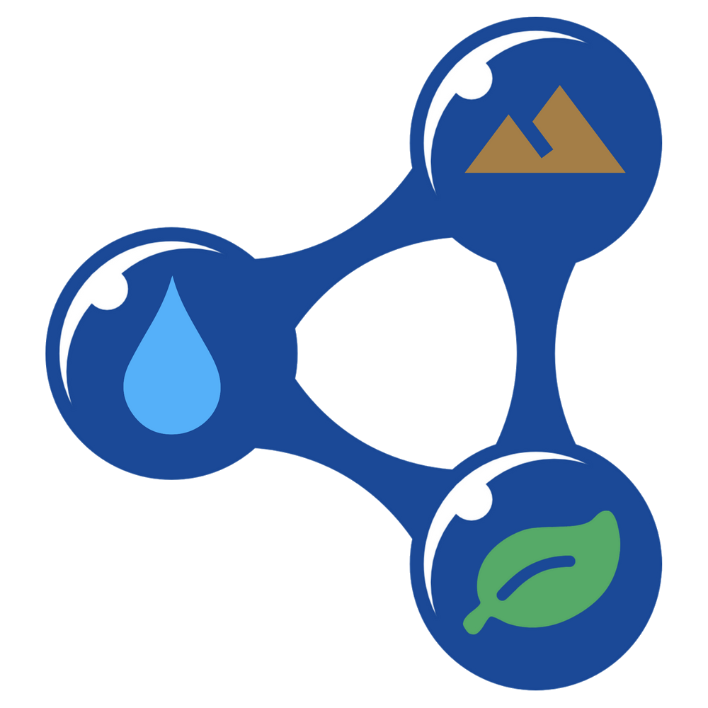
Two Problems:
2) Linked Open Data provides a powerful tool but we need better consistency and simplification to aid adoption and performance.

Slide 5
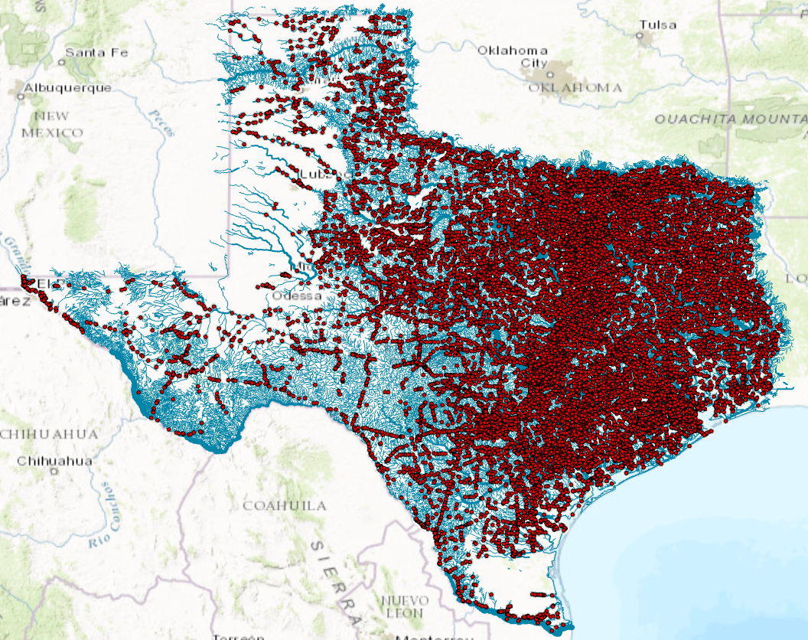
Use Case Driven
27,000 Texas bridges on 15,700 stream reaches forecast by the National Water Model

Slide 6
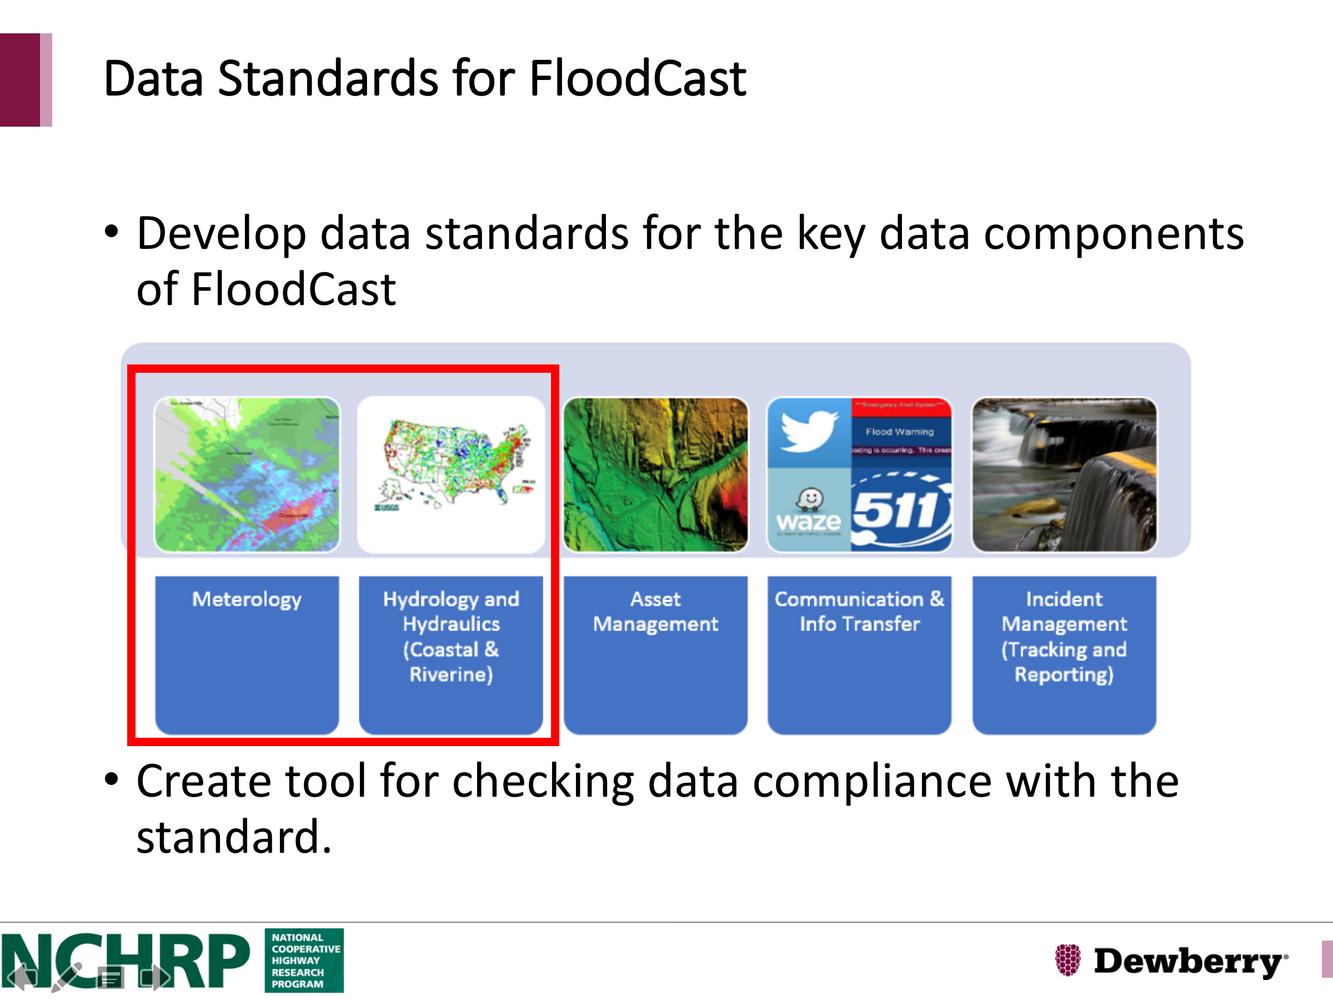

Slide 7
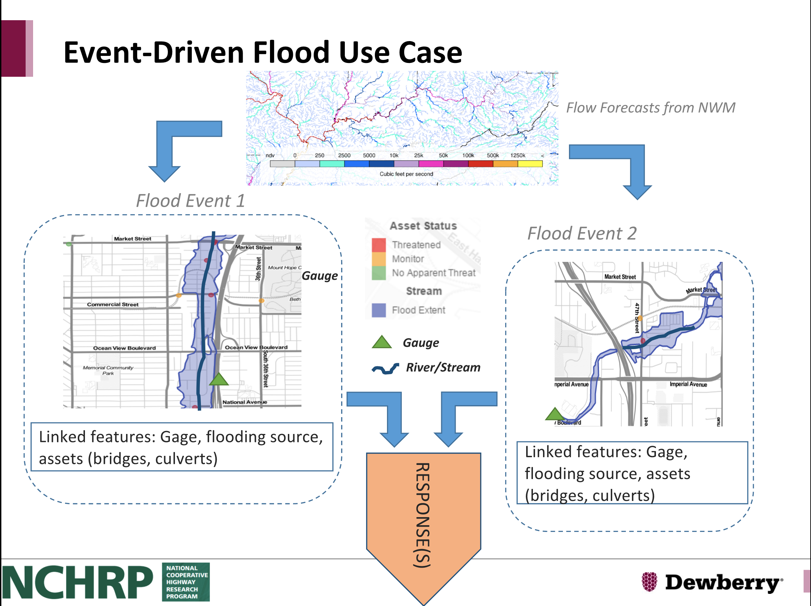
FloodCast:
A flood event as an environmental feature.
What data do emergency managers need associated with a flood event?

Slide 8
ELFIE Deliverables:
OGC engineering report and digital artifacts
Use-case specific static visualizations

