Slide 1

Introduction to the WMO/OGC Hydrology Domain Working Group
Ilya Zaslavsky (USA), Tony Boston (Australia), Silvano Pecora (Italy)
HDWG Co-Chairs

Slide 2
Benefits of open standards
Prevents a single group from controlling a standard
Facilitates competition
Stimulates innovation
Customers benefit from not being locked into a particular supplier
Source: Open Standards, Open Source, and Open Innovation: Harnessing the Benefits of Openness, April 2006. Committee For Economic Development. www.ced.org
Notes:
Prevents a single, self-interested party from controlling a standard
Facilitates competition by lowering the cost of entry
Stimulates innovation beyond the standard by companies that seek to differentiate themselves.
Customers value the interoperability that open standards provide and generally benefit from not being locked into a particular supplier.

Slide 3
What is the OGC?
The Open Geospatial Consortium, Inc. (OGC) is a non-profit, international voluntary consensus standards organization that is leading the development of standards for geospatial and location based services.
The OGC facilitates a consensus process in which government, private industry, NGOs, and academia collaborate to create open and extensible software application programming interfaces for geospatial and other mainstream information technologies
Notes:
The OGC is a not for profit consortium dedicated to the development of specifications that enable geospatial technologies to “plug and play” across any device, platform or network. The OGC consists of 380+ members - geospatial technology software vendors, systems integrators, government agencies and universities - participating in a consensus process to develop, test, and document publicly available interface specifications and encodings for the geospatial industry. Open interfaces and protocols defined by OpenGIS® Specifications are designed to support interoperable solutions that "geo-enable" the Web, wireless and location-based services, and mainstream IT, and to empower technology developers to make complex spatial information and services accessible and useful to all kinds of applications.

Slide 4
OGC Snapshot
A Voluntary Consensus Standards Organization, founded in 1994.
522 members
50+ adopted standards
Hundreds of product implementations
Broad user community implementation worldwide
Alliance partnerships with 30+ standards & professional orgs
OGC Membership Distribution

Slide 5
Standards
An OGC standard is a document, established by consensus and approved by the OGC Membership, that describe rules, guidelines or characteristics for interfaces and encodings aimed at the achievement of the optimum degree of interoperability.
Domain Working Groups (DWG or WG) provide a forum for discussion of key interoperability requirements and issues, discussion and review of implementation specifications, and presentations on key technology areas relevant to solving geospatial interoperability issues.
Standards Working Groups (SWG) have specific charter of working on a candidate standard prior to approval as an OGC standard or on making revisions to an existing OGC standard.

Slide 6
Other Document Types
Best Practices Documents contain discussion of best practices related to the use and/or implementation of an adopted OGC standard and for release to the public. Best Practices Documents are an official position of the OGC and thus represent an OGC Member endorsement of the content.
Discussion Papers (DP) provide discussion of some technology or standards development activity in the OGC approved for release to the public. Discussion Papers are not the official position of the OGC and contain a statement to that effect.
Public Engineering Reports (ER) are documents that report on some technical activity in an OGC Interoperability Program Initiative. A public ER is an ER that the OGC Members have approved for public release. An ER is not an official position of the OGC.

Slide 7
OGC Web Services
Service endpoints
Catalogue Services (CSW)
Web Map Service (WMS)
Web Feature Service (WFS)
Web Coverage Service (WCS)
Web Processing Service (WPS)
Sensor Observation Service (SOS)
etc…
Information Models/Encodings
Geography Markup Language (GML)
CityGML
GML Simple Features
Observations & Measurements (O&M)
Sensor Web Enablement Common (SWE Common)
Sensor Model Language (SensorML)
WaterML2: Part 1, 2,…
TimeseriesML
GeoSciML
GroundWaterML2
KML
NetCDF
etc…

Slide 8
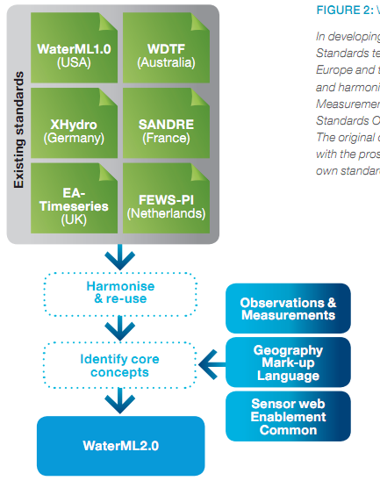
Harmonization

Slide 9
World Meteorological Organization (WMO)
191 Member States and Territories
Mission (summarised):
To facilitate worldwide cooperation in meteorology, hydrology and related fields by:
establishing networks of observing stations
maintaining centres providing meteorological and related services
establishing systems for data exchange
defining standards for observational data and its publication
application of meteorology to aviation, water issues, agriculture, shipping and other human activities
promotion of operational hydrology and cooperation
encouraging research, training and coordination

Slide 10
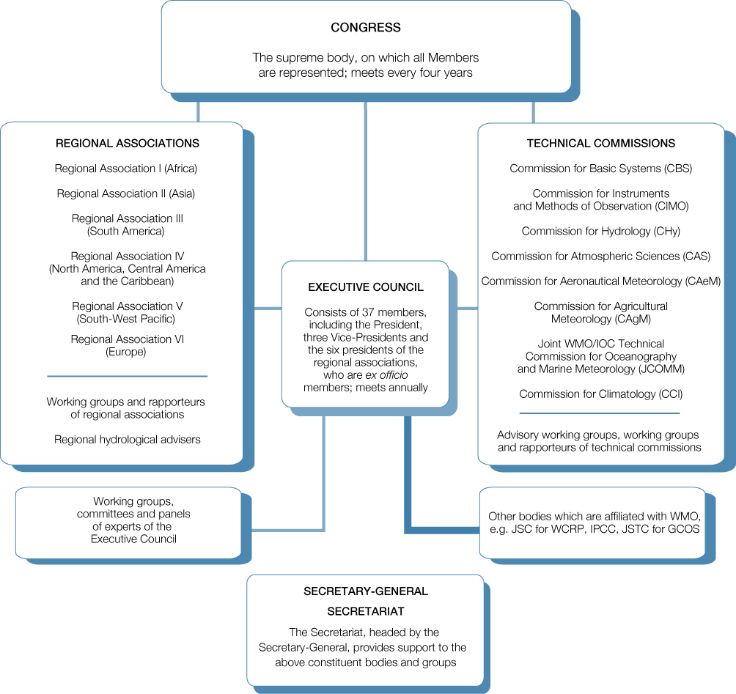

Slide 11
World Meteorological Organization (WMO)
‘... the UN system's authoritative voice on the state and behaviour of the Earth's atmosphere, its interaction with the oceans, the climate it produces and the resulting distribution of water resources’
‘... facilitates the free and unrestricted exchange of data and information, products and services in real- or near-real time ...’

Slide 12
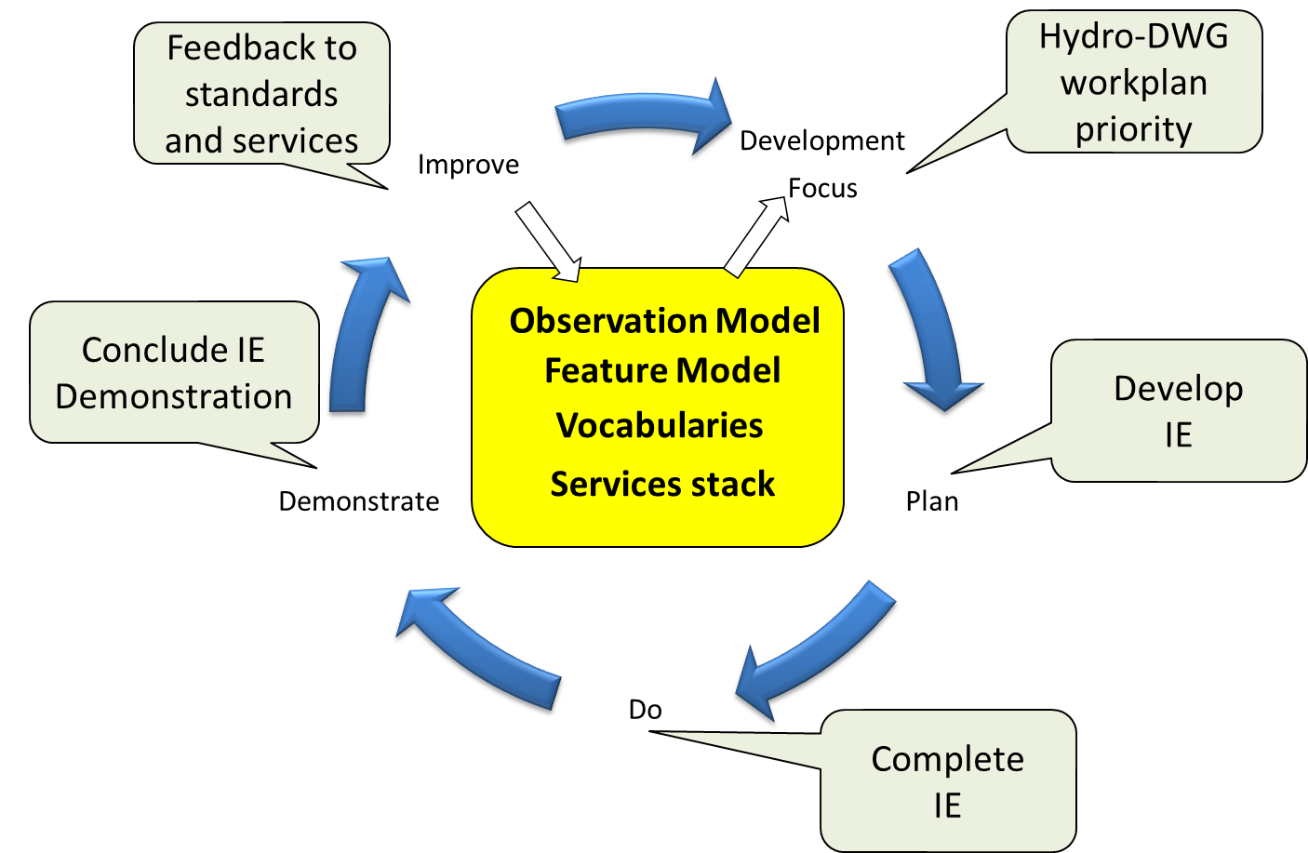
International Standardization for Water Data
Hydrology Domain Working Group
standards for water data: WaterML 2.0 suite
organizing Interoperability Experiments (IEs) focused on different sub-domains of water
Chairs:
Ilya Zaslavsky (USA)
Tony Boston (Australia)
Silvano Pecora (Italy)
Iterative Development
http://external.opengis.org/twiki_public/bin/view/HydrologyDWG/WebHome

Slide 13
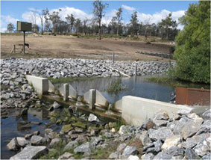
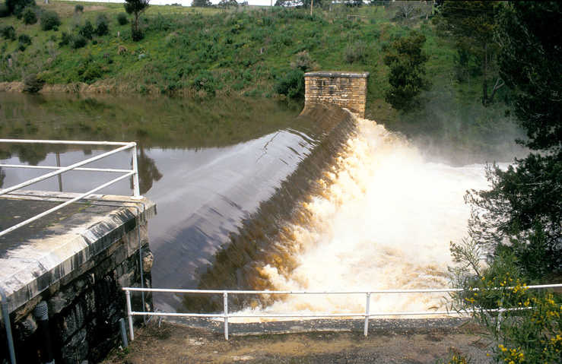
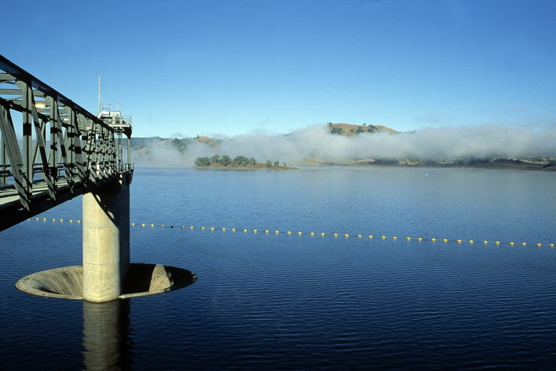
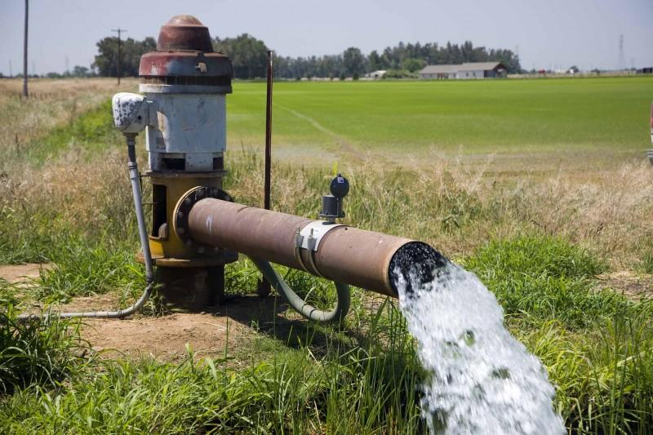
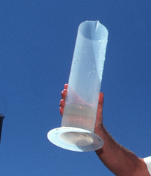
WaterML2.0 standards
Part 1 - Timeseries
Part 2 – Ratings, Gaugings and Sections
Part 3 – Surface water features
Part 4 – Groundwater
Part 5 –
Water quality (best practice)

