Slide 1

Hydrological data - Federated infrastructure
OGC Hydrology DWG Tuscaloosa, 21 June 2017
The New Zealand experience
Brent Watson
Horizons Regional Council
New Zealand
Alistair Ritchie
Landcare Research
New Zealand

Slide 2
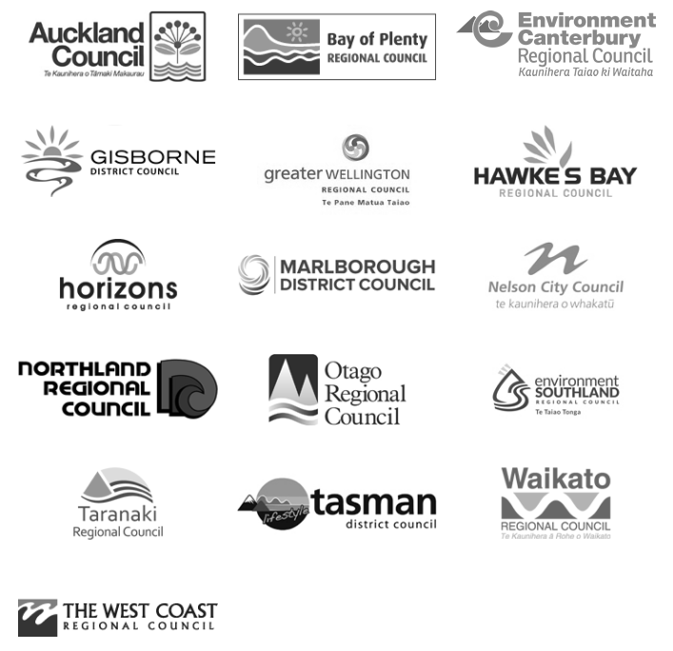

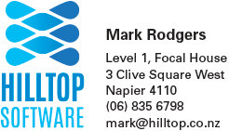










Partners / Providers

Slide 3
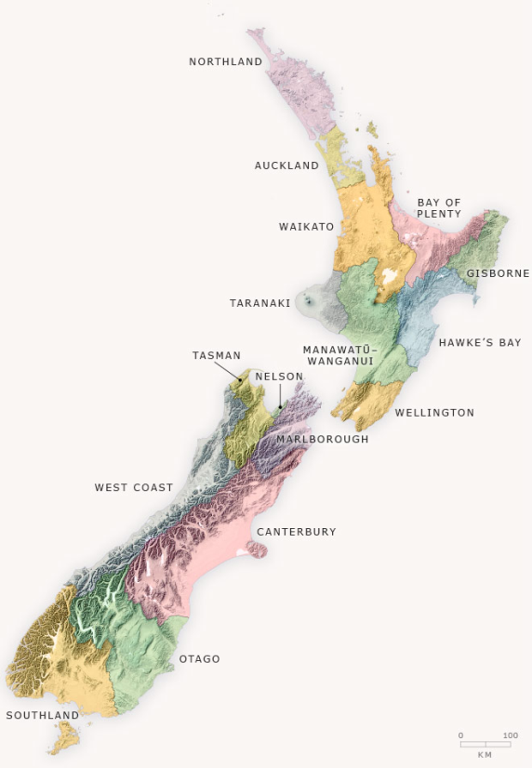
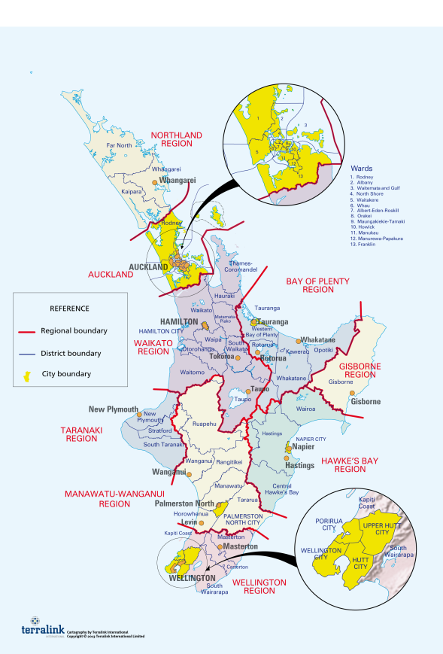
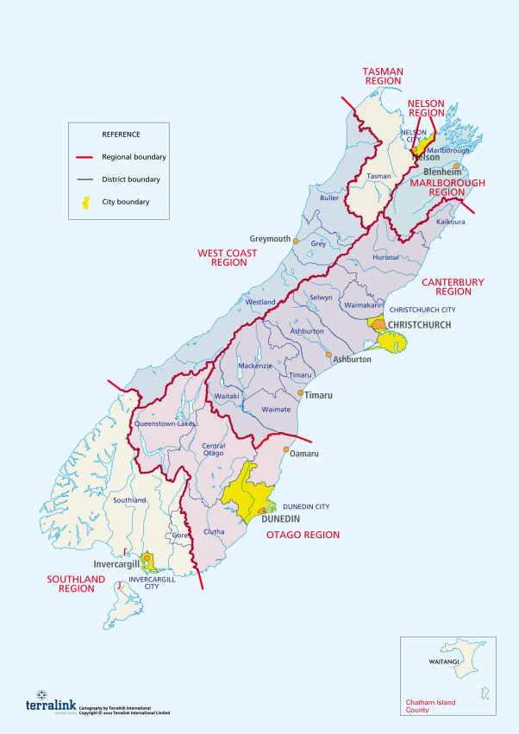
NZ Regional Sector

Slide 4
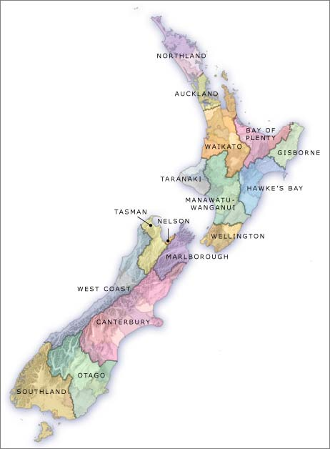

State of Play for NZ
Local Government
National - CRIs
16
3
SOS2/WaterML2
now
SOS2/WaterML2/TimeseriesML
now

Slide 5
Products in use in regional sector
Hilltop (13)
Kisters (2)
Aquatic Informatics / 52 North (1)
ESRI (16)

Slide 6
District & City Councils
Another 64 agencies that hold critical environmental data or require access.
Focus on Three Waters
Drinking water.
Storm water.
Sewage treatment.
New software venders adopting OGC Standards.

Slide 7
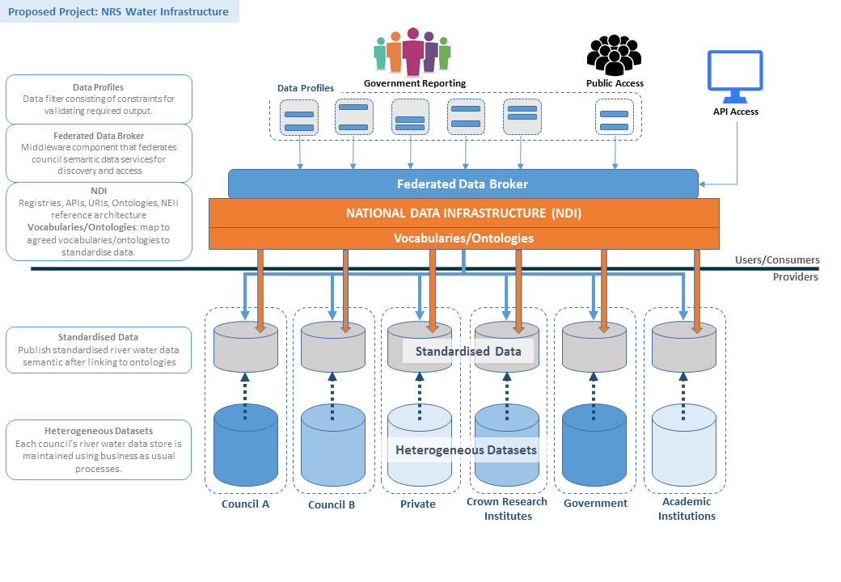
Federated infrastructure

Slide 8
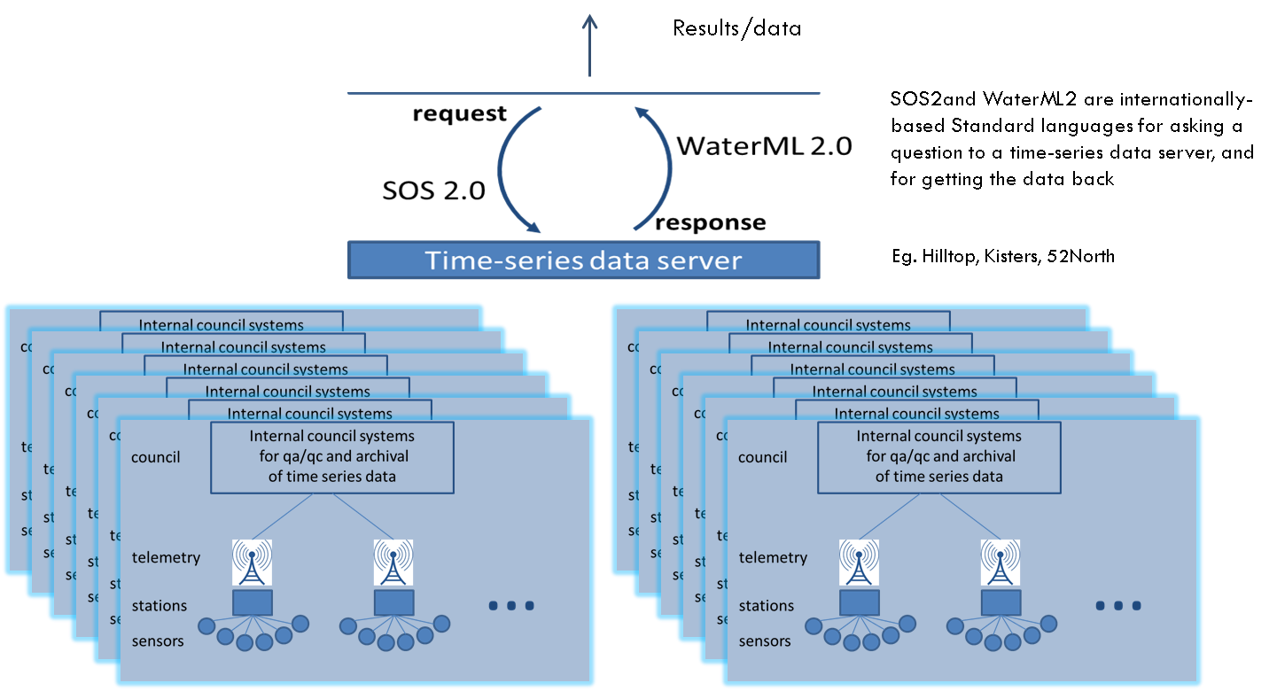
NZ data federation premise
Limitations here
Constraints here – water quality

Slide 9
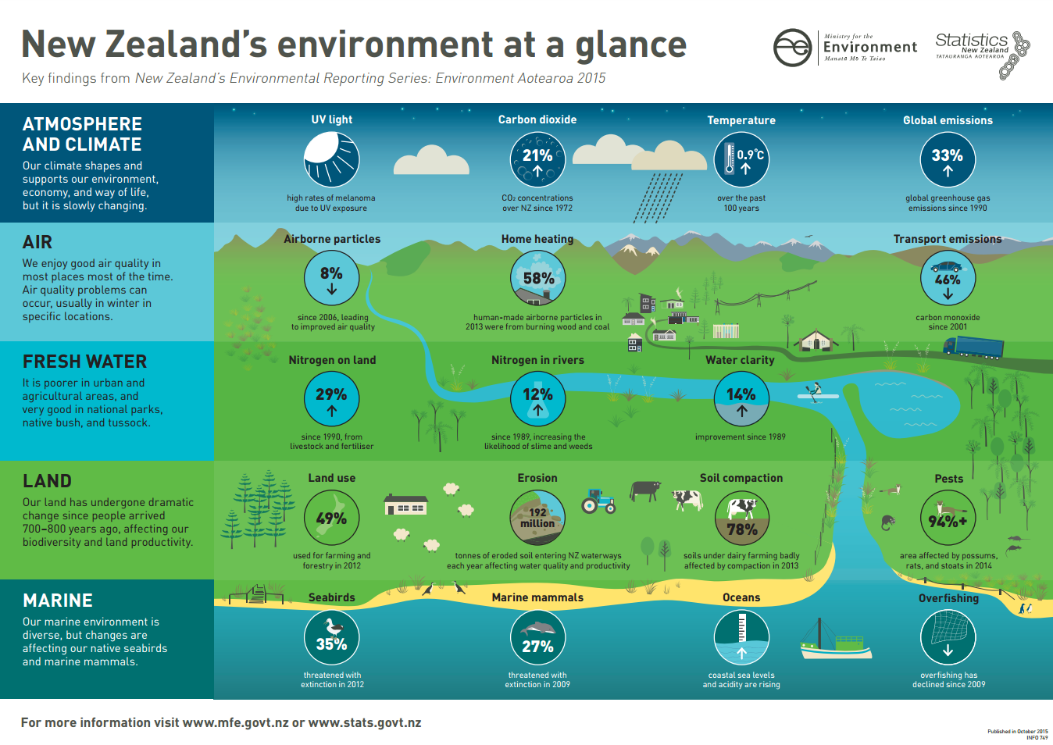

Slide 10
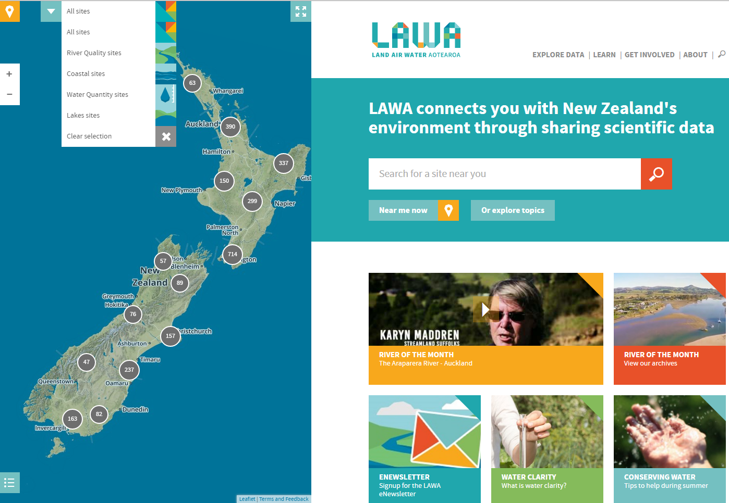
Land Air Water Aotearoa

Slide 11
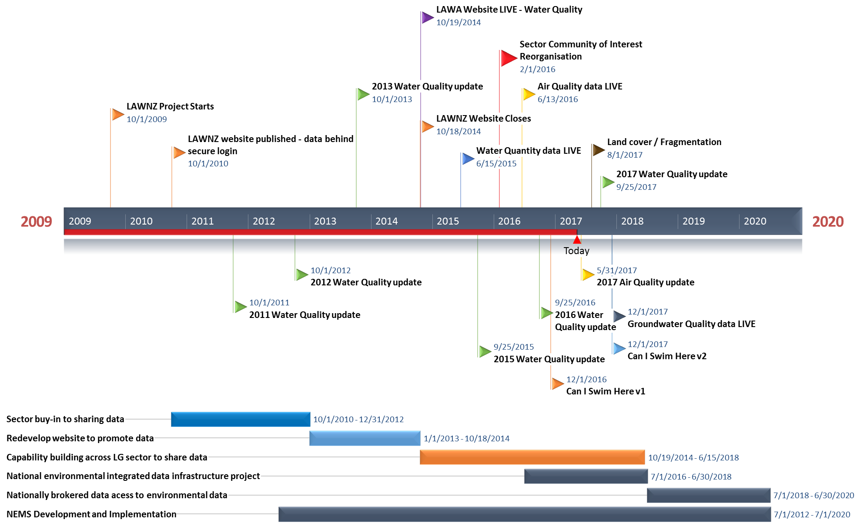
Timeline

Slide 12
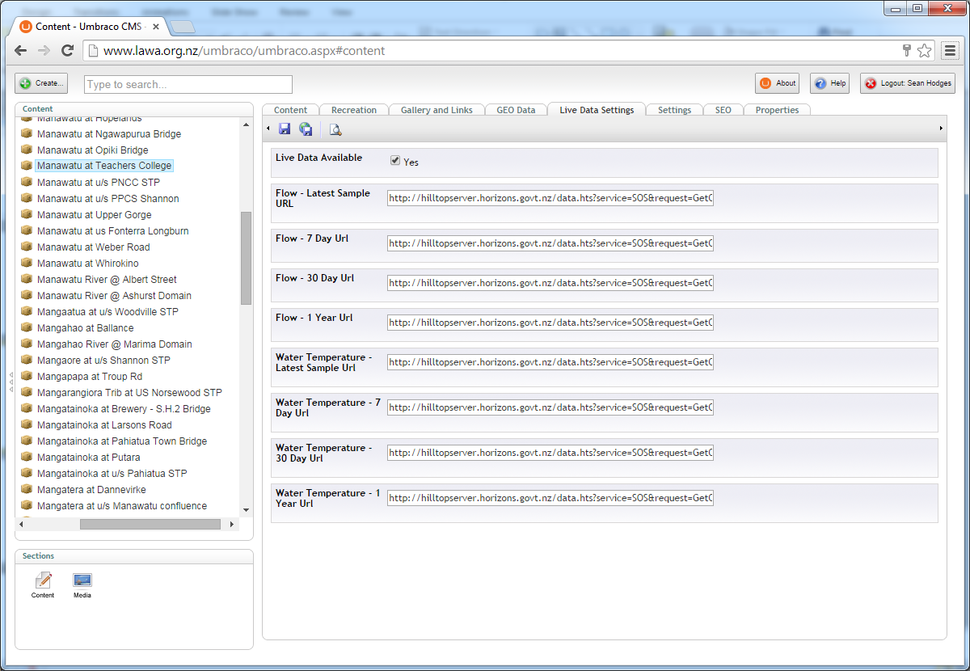
LAWA CMS - Catalogue
Notes:
Agencies provide their sites via a WFS feed:
HRC,web,http://gisdmz.horizons.govt.nz/arcgis/services/Emar/MonitoringSiteReferenceData/MapServer/WFSServer?request=GetFeature&service=WFS&typeName=MonitoringSiteReferenceData

Slide 13
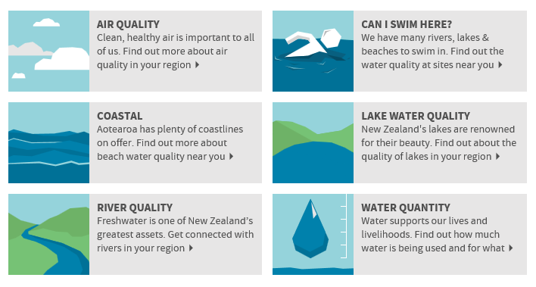
LAWA - Topics

Slide 14
LAWA - Demo
Water Quantity
Water Quality
Safe to Swim
Air Quality

Slide 15
Predictive Modelling 2018
Biological predictive modelling
Safe to Swim
Maybe this will be a driver for a National Water Model.

Slide 16
Possible Quality Management System
Quality Management

Slide 17
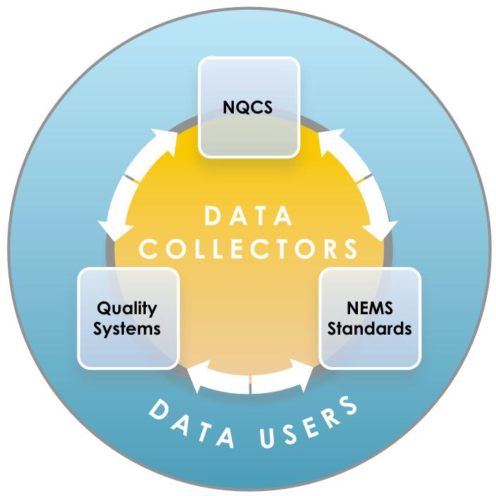
National Environmental Monitoring Standards

Slide 18
Specifications
Business Requirement
LTP Processes
Annual Planning
Resource Requirements
Training & Development
Resource Needs
Standards
NEMS
ISO, WMO, Other
Specifications
Data Collection
Verification
Delivery
LTP Planning
Annual Plan
Analysis
Reporting
Quality Assurance
Quality Control
KPIs – Development & OFIs
Scoping Requirements
Documentation of:
Review Requirements
Standards Adoption
Resource Costings
Specifications
Requirements
Budgets
Customer Interactions

Slide 19
Data Collection
Product Development
R&D Processes
Training Specifications
Operation
Station Inspections (Standards) - PMonP
Calibrations (Standards) - PManP
Performance Monitoring
Non-conforming Product
OFIs
SOP Documentation
Station (Process) Assessment (Standards)
Specifications
Data Collection
Verification
Delivery
LTP Planning
Annual Plan
Analysis
Reporting
Quality Assurance
Quality Control
KPIs – Development & OFIs
Requirements
Documentation of:
Conformance & Validation
Product Specification
Planned Workload
Calibration Criteria
Station Assessments
Non-Conformances
OFIs
Maintenance Records

Slide 20
Verification
Product Development
R&D Processes
Training Specifications
Operation
Process & Monitoring (Standards)
Automation Control (Standards)
Performance Monitoring
Non-conforming Product
OFIs
SOP Documentation
Timeliness (Standards)
Specifications
Data Collection
Verification
Delivery
LTP Planning
Annual Plan
Analysis
Reporting
Quality Assurance
Quality Control
KPIs – Development & OFIs
Requirements
Documentation of:
Conformance & Validation
Product Specification
Planned Workload
Non-Conformances
OFIs
Modifications to Original Records
Preservation of records
Pear Review Process

Slide 21
Delivery
Product Development
R&D Processes
Training Specifications
Operation
Process & Monitoring (Standards)
Performance Monitoring
Non-conforming Product
OFIs
SOP Documentation
Timeliness (Standards)
Customer Feedback
Specifications
Data Collection
Verification
Delivery
LTP Planning
Annual Plan
Analysis
Reporting
Quality Assurance
Quality Control
KPIs – Development & OFIs
Requirements
Documentation of:
Conformance & Validation
Product Specification
Planned Workload
Non-Conformances
OFIs
Modifications to Original Records
Preservation of records

Slide 22
Feedback Systems
Customer Interaction & Strategic Direction
Specifications
Data Collection
Verification
Delivery
LTP Planning
Annual Plan
Analysis
Reporting
Quality Assurance
Quality Control
Quality Assurance.
Continuity.
Operational Performance Capability
Internal Process Control
Performance Monitoring

Slide 23
Partners / Providers

Slide 24
Discovery
This is the next challenge!!!
Profile O&M, not fully implemented yet
GetDataAvailablity.
Stats rather full large volume timeseries.
MORE Focus on PUBLIC CONSUMPTION
>90% users don’t/can’t handle large temporal datasets.

Slide 25
Discussion – questions for HydroDWG
SOS 2.0 capability
Water quality extension?
Describing sample collection and observation metadata as opposed to measurement metadata
Feature data model
GetCapability / GetDataAvailability across a single feature and return everything that might be observed and measured.
Introduction of statistical offering within O&M?
Improved data quality offering
Introducing numeric values?

