Slide 1
Informatiehuis Water and the Aquo standard
OGC Hydro DWG working group
Edwin Wisse e.wisse@ihw.nl
22 June 2017

Slide 2
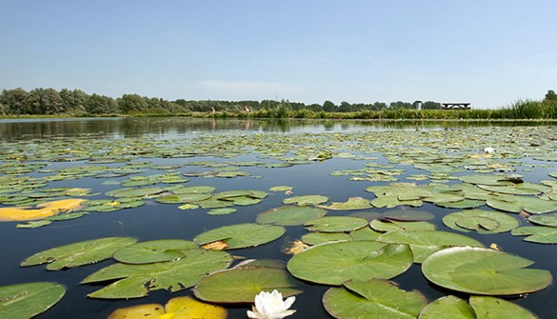


Agenda
Water management in the Netherlands
Organization: regional and national
About IHW (Water Information Centre)
The Aquo standard
Status in NL
IM metingen
Code-lists
Differences Aquo - WaterML
Lab-oriented or time series oriented
From here
Notes:
Agenda. I will briefly say something about water management in the netherlands and its implications for water information management.

Slide 3
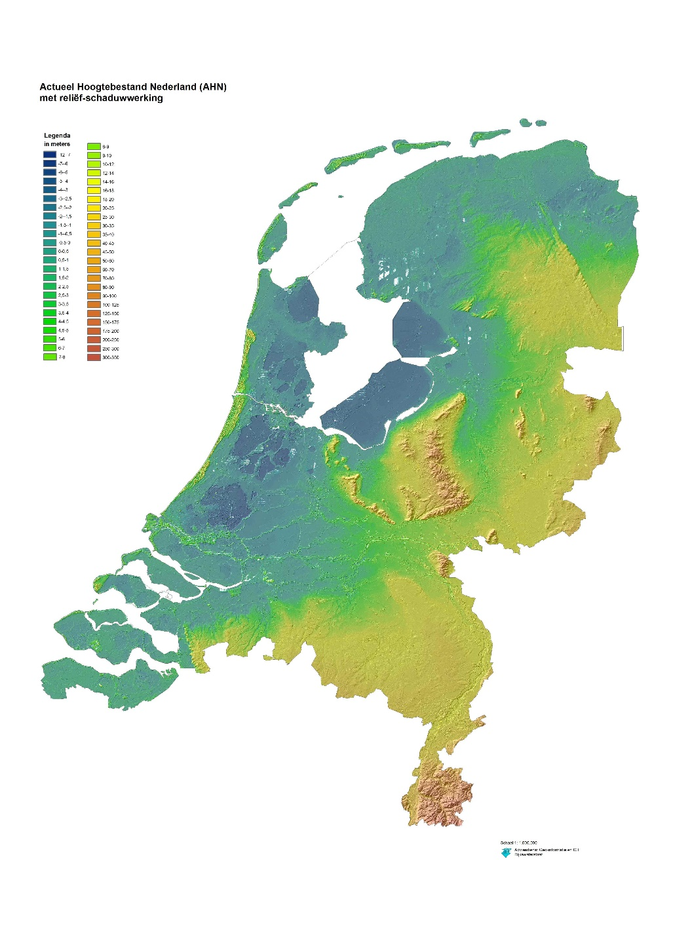
Water management in NL
Ministery I&M is responsible for coastal defence and main waterways.
22 water boards manage water regionally, ensure clean and enough water for users (independent from the ministery)
Groundwater quality, provincial waterways and swimming water are managed by the provinces.
Many watermanagers results in need for standardisation.
Map: blue = below sea level
Notes:
Responsibility for water is divided over a number of institutions.
Water boards are not governed by the ministery but are independent. Farmers traditionally have a large influence on the boards. Boards are like parliaments and are chosen in elections. Evrey water boards has dedicated seats on the board for farmer and nature organisations.
Provinces are part of central government. Responsible for provincial waterways (and canals) and groundwater, swimming water in their province.
All have Reporting responsibilities both towards national government and european institutions.
So how is information management organised with so many water managers?

Slide 4



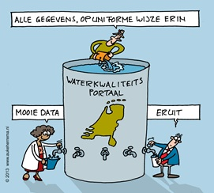
Informatiehuis Water
Cooperation programme of the Ministery of Infrastructure & Environment, the regional Water boards en the provinces, founded in 2010.
Supports information management for the water management bodies in the Netherlands.
Water quality reports for the EU.
Management of the Aquo standard.
Notes:
Now about 14 FTE, 2.5 Meuro
Portals: water quality, water safety
Reporting: EU Water Framework Directive, Inspire.
We use the Aquo standard for reporting from water managers to IHW, IHW then combines the datasets for reporting.
So we are both user and manager of the information standards.

Slide 5
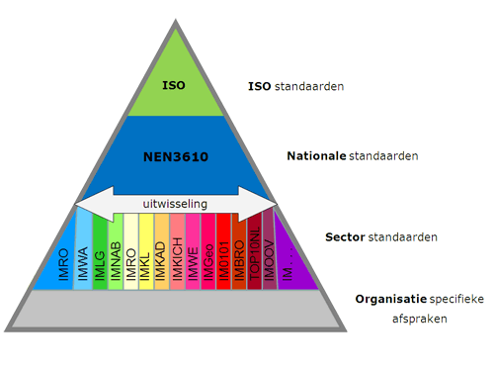
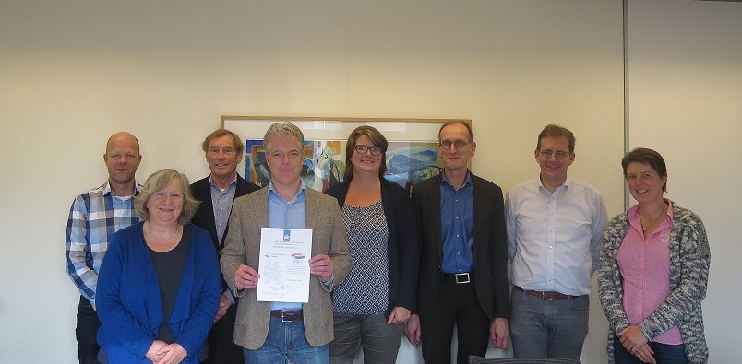

The Aquo standard
National standards for information exchange: built on ISO In NL “apply or explain” standards are established by the Forum for Standardisation
Aquo/IMWA is the standard for water management.
Joint management by IHW and SIKB of the information model measurements.
Notes:
Nationally several different government bodies have been assigned the responsibility for managing an information standard.
Information standards are accredited on a national level with a ”apply or explain” status by national government.
Joint management of Aquo and SIKB standards together with SIKB (soil management standards).
Our model for measurements is a joint model with SIKB.
Stronger cooperation with Rioned (organisation for wastewater management) in 2017. Rioned deals mainly with municipalities but there are strong links with the water boards. Wastewater system on a municipal level is managed by the municipalities but wastewater treatment (for several municipalities) is managed by the water boards.

Slide 6
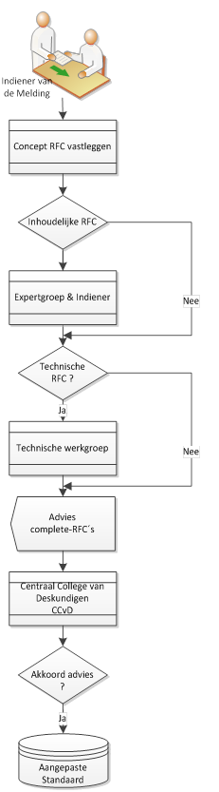
The Aquo standard
Information model & code-lists
Change procedure:
User meetings (informal status)
Users file requests for change
Expert meetings
Technical committees
Board of experts (CCvD)
All changes are proposed by users.
Yearly procedure.
Standards can get a pre-Aquo status (like beta in software)
Notes:
RFCs are filed by users
Expert meetings: experts from different fields (biology, chemistry, quantity) advise on RFCs.
Technical working groups give advice on the applicability of changes and their impact on systems.
Board of experts is the decision making unit.
There are shortcuts in the procedure. Small changes can be carried out by IHW and made official by the board of experts.
RFCs with only technical impact are not advised upon by the experts and vice versa.
IHW does not file change requests.
Yearly procedure with an option for a half yearly change: less is better.
Beta status gives flexibility for new extensions.

Slide 7
Standards around, within Aquo
Observations &
Measurements
(ISO 19156)
Basismodel Geo-information (NEN3610)
IM Geografie (IM Geo)
IM Base Registrations
and Subsoil (IMBRO)
IM Metingen
Information Model WAter
(IMWA)
IMWA
Kern
IM SIKB 0101
IMWA
Watersystem (i.o.)
IMWA
Waterveiligheid
IMWA
Metingen
IMWA
KRW (i.o.)
IMWA
Normen (i.o.)
Aquo domeintabellen
Notes:
Around Aquo:
Joint information model with SIKB. SIKB maintains its own extension on measurements.
Measurements is based on the international OGC standard Observations & Measurements.
IMWA models refer to other information models where possible.
Principle: Bring into high level models when possible.
Most of the work goes into the interaction with other models.
Within Aquo: IMWA measurements elements were moved into the joint measurements model recently.
Different IMWA models for different themes.

Slide 8
IM metingen en O&M
O&M: FeatureOfInterest
Abstractie van een fenomeen in de werkelijkheid...(Geo:) dat direct of indirect geassocieerd wordt met een locatie relatief ten opzichte van het aardoppervlak.
Feature GeoObject
O&M: SamplingFeature: feature which is involved in making observations concerning a domain feature, this feature provides the direct context for the specific observation (spatial, specimen) e.g. station, transect, section or specimen
Meetpunt.csv
SF:SamplingFeature
Measurement Object
Meetobject
IM: MeasumentObject: Meetobject
Aquo: Meetobject: Aanduiding van een fysieke plaats waar een meting is/wordt verricht.
O&M: Procedure
IM: Sample: Een monster van een bepaald matrix/compartiment,of combinatie van verschillende monster, waaraan bijvoorbeeld in het laboratorium als één geheel een meting wordt verricht
Aquo: Monsterobject: Dat deel van de fysieke werkelijkheid dat wordt beschouwd of geanalyseerd.
SamplingProcess
- Bemonsteringsmethode - Bemonsteringsapparaat
Sample
Monster(Object)
relatie met..
O&M: Observation
Observation
Analysis
CalculatedAnalysis
BioObservation
TestingConclusion
Characteristic
O&M: Property
O&M: Observation: an action whose result is an estimate of the value of some property of the feature-of-interest, at a specific point in time, obtained using a specified procedure
Observation- Process
- Meetapparaat - Waardebepalingsmethode
Observation
‘Waardereeks’
Observed- Property
- Grootheid - Parameter - Hoedanigheid
Tijd-/Meetwaarde.csv
Aquo: Waardereeks: een reeks van waarden alleen variërend in geo-object en/of tijd.
O&M: Result
Result,MeasureResult
AnaliticResult
ClasssifiedResult DescriptionResult
TimeResult
LocationResult,DepthResult
RangeResult
Waarde: uitkomst van een meting of toetsing van een grootheid of parameter.
O&M: includes measured, modelled or simulated data
Result
Waarde (TijdWaarde, PlaatsTijdwaarde etc.)

Slide 9
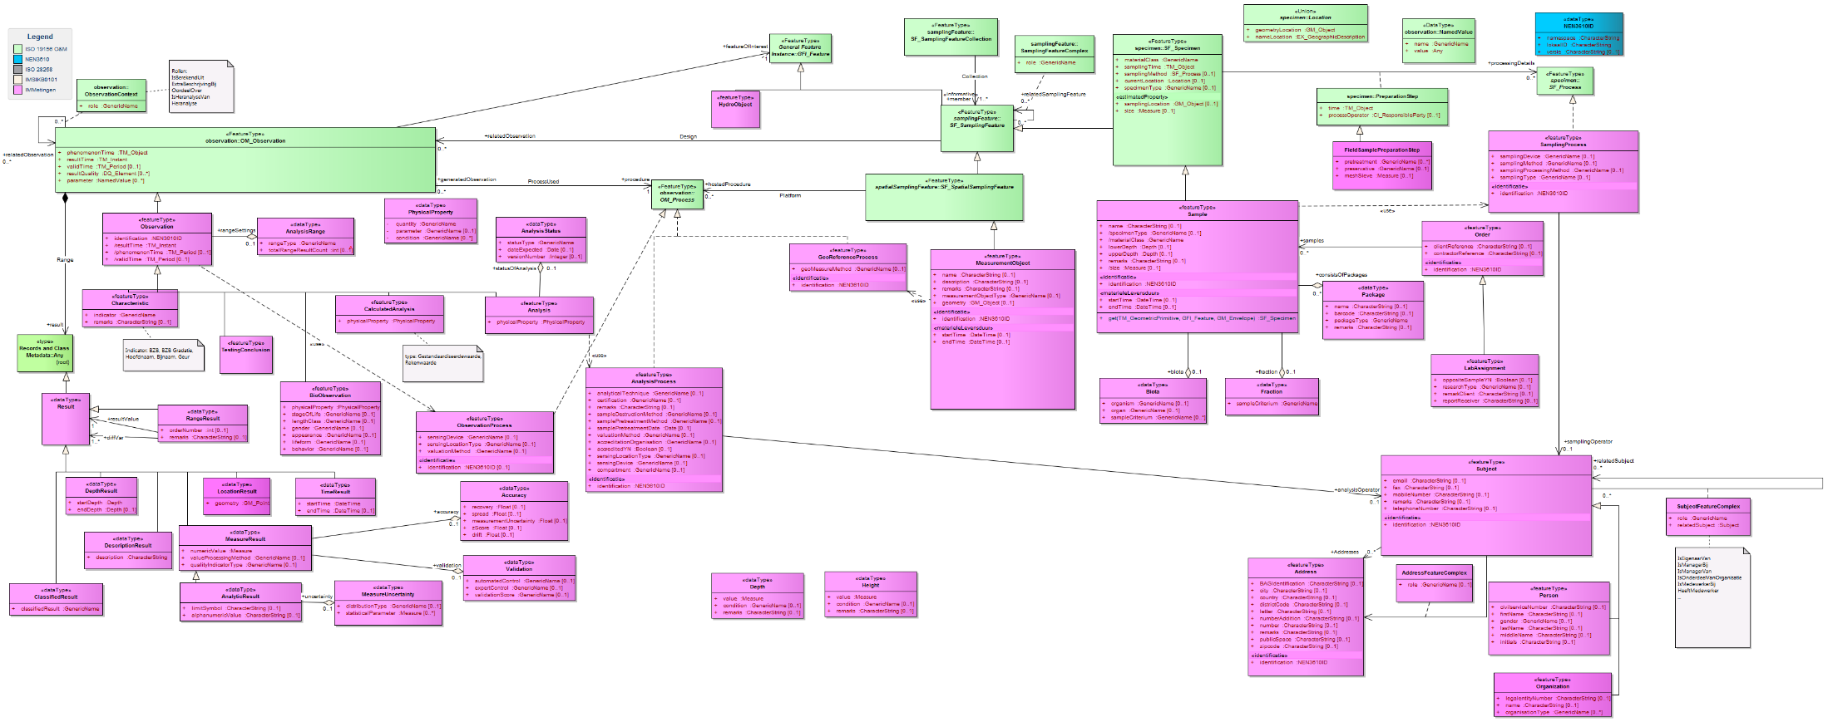
IM measurements
Green: observations & measurements
http://www.aquo.nl/Aquo/uitwisselmodellen/index.htm
Improvement of the standard: more complexity or simplicity?
Does complexity affect adoption?

Slide 10
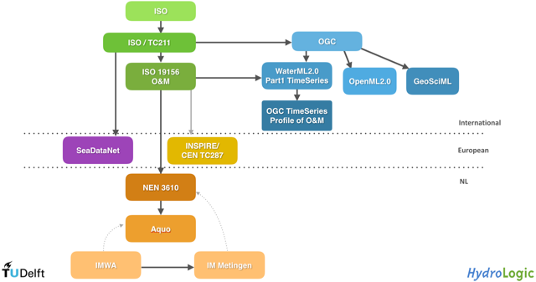
Model relations
From Jade Haayen Questionnaire on Quality of standards
Notes:
From research by Jade Haayen: models building on O&M are developped in different directions.
Her research focusses on how information models overlap and their perceived quality, what choices underlie the different information models. Can we make a jount model for time series?
She has a questionnaire about model integration which is interesting for IHW, please have a look at it.

Slide 11
Choices in the Aquo standards
Aquo/IMWA
Applicable for all water management related themes: safety, hydrology, etc.
water quality part is best developed (current main users).
Result: one measurement, documentation is embedded in the information model. So less applicable for time series.
Semantics is particularly important for water quality information management: biological, chemical code-lists
Timeseries, three options were considered:
SWE common
WaterML (under Coverage)
Within Aquo (more bits)

Slide 12
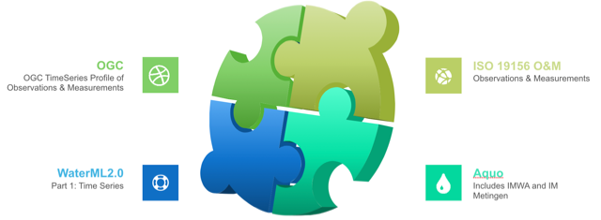


Solving the puzzle
From Jade Haayen Questionnaire on Quality of standards
Notes:
How to solve the puzzle?
In NL our experience is that themes overlap more and more so coordination is vital between different areas.

Slide 13
WaterML-WQ
WQ_Observation object as a child of OM_Observation (as in Aquo), also timeseries
WQ_Observation is equivalent to Observation in Aquo
WQ_MeasurementTimeSeriesTVP has no equivalent in Aquo
Question: O&M profile for time series has more options, how do we deal with those?

Slide 14
Code lists
Values to be used in the information model
To users these are at least as important as the model
Currently standardisation in information models but many code lists
Example:
In Inspire there is a well defined information model, some base code lists, but national extensions are allowed
Result: users have to use several code-lists to fill out their reports.
Next step: presentation on Inspire conference in september
https://themes.jrc.ec.europa.eu/discussion/view/133602/comprehensive-code-lists-and-code-list-management

Slide 15
From here
March
Towards time series in water quality monitoring.
EU:
Service oriented reporting to Inspire (SOS).
Need for well-managed, multi-lingual code-lists for international exchange.
Technological developments: from code-lists to linked data.
Notes:
New sensors for continuous water quality measurement lead to new information demand.
On a national level there is a project for information exchange between water managers: Digitale Delta. DD approach is simple subsets of information model and simple API.
On EU level: need for code lists for water quality (there is seadatanet of course...)
Finally questionaire: your opinion is important for Jade and her results are important for us.

Slide 16
Concluding
Information models often too complicated for users
Users want “flat” models they can use in their GIS software
Unified code lists are important (at least to EU users)
Aquo code-lists move to a linked data platform (november).
Merging with sewage and sewer information standard.

