Slide 1
The Interoperable Watersheds Network
Data Standards in Action

Slide 2
Outline
An Introduction to ‘Standards’: The World is Built on Standards!
What’s the problem we’re trying to solve?
How IWN is a step towards solving these problems
The Data Standards Problem
The Metadata Problem
The Architecture Problem
Demonstration
Next Steps

Slide 3




The World is Built on Standards!
When people agree to do things in a common way it opens up many opportunities for everybody to do things better.
Technology standards: like Bluetooth and Wifi
Data Standards: like financial exchanges
Government Standards: like the Exchange Network

Slide 4


Other Examples of Standards
The IRS has open standards for electronically filing your taxes, enabling a better user experience
Banking: OFX Standards enable you to access your banking information from many 3rd-party applications
Notes:
Imagine if every time you needed to download financial information from your bank you needed to deal with a different formatted file and that required you to download it, import it in Excel, rename column headers, deal with changes in terms and currency before you could even begin to balance your checkbook. We would never tolerate that, which is why the OFX standard exists.
Do you remember filling out IRS forms? Now we can do our taxes in a weekend (what used to take months and required hiring a professional).
All of these life improvements are thanks to standards.

Slide 5
Not a Small Problem
Data that people need is hard to get and hard to use!
How do we connect all of these data to the people who need it and deliver it in the same format?

Slide 6
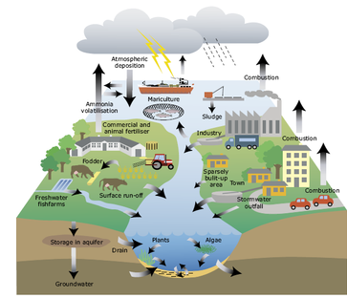
What Would Standardized Sensor Data Enable: Better Modeling
Models need data, a lot of data
Sensors are a great input for models, and can provide necessary ground truth
Imagine being able to run a model without having to first discover and then reformat the data needed to run the model; rather the model can grab the data as it needs it in real time
Notes:
Extreme weather events & spills do not operate on a M-F 9-5. Sensors help us know more about the environment! Which makes for better models

Slide 7

What Would Standardized Sensor Data Enable: Third-Party Applications
Adopting and promoting standards sends a clear signal to the market that there is value in supporting those standards
Enables the market to develop solutions for data storage, data sharing, and data visualization
Allows those outside government to develop applications and tools that are valuable to them and meet their specific needs

Slide 8

What Would Standardized Sensor Data Enable: Quicker and Better Decisions
Having standardized data decreases the amount of time needed to spend in discovering and standardizing data
Reduces errors from hand-entering data values
Allows for MORE data to be used (often can’t use data that’s hard to find or difficult to reformat)
SAVED TIME = SAVED MONEY

Slide 9
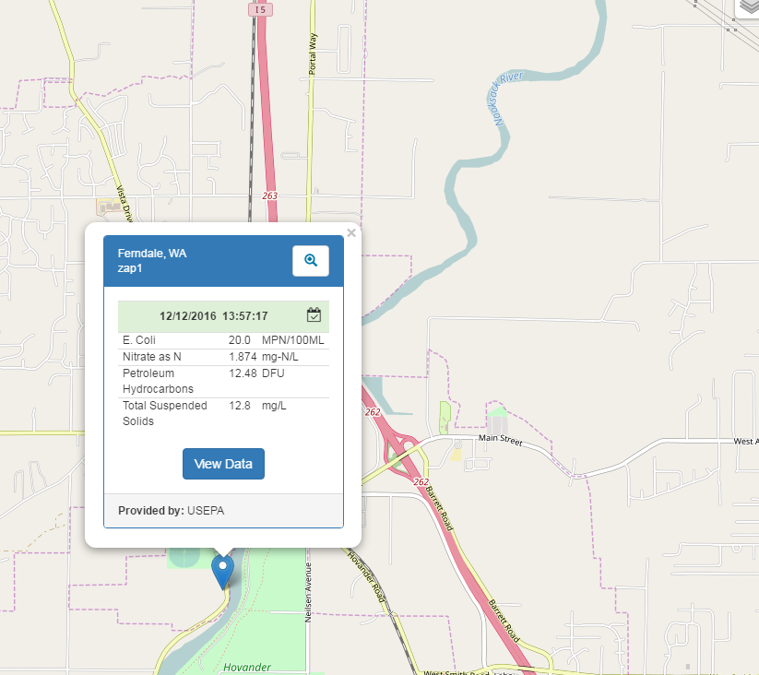
How IWN is a Step Towards Solving These Problems
The Interoperable Watersheds Network was a demonstration project that focused on evaluating approaches to improve sensor data sharing
It was based on knowledge gained from an recommendations report that EPA developed in 2014
The project focused on addressing three major areas:
Data Standards
Metadata
System Architecture

Slide 10

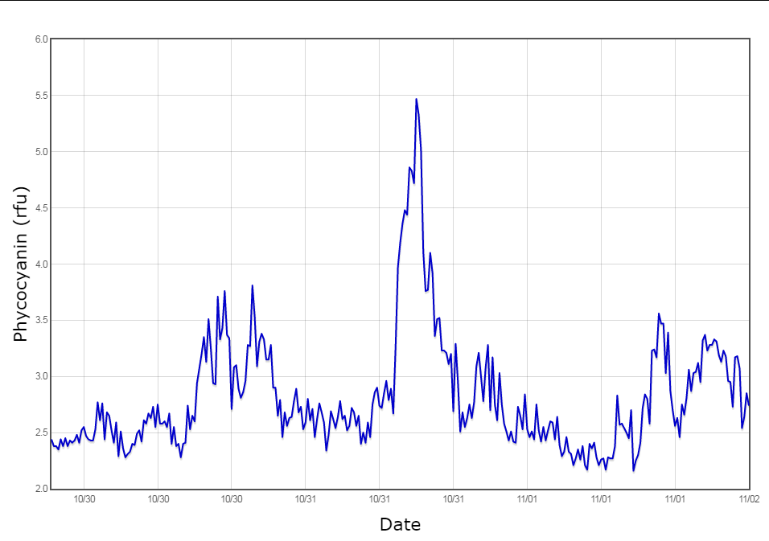
The Data Standards Problem
We needed a common way to represent and communicate the data
Standards for sensor data already exist, there was no need to create new standards
OGC Sensor Observation Service
OGC Water ML 2 and Sensor ML
The Open Geospatial Consortium is an open-source, international standards setting body
Notes:
This would be equivalent to the banking OFX standard in terms of what this accomplishes. These are also, by the way, the same standards that were used in the National Flood Interoperability Experiment

Slide 11
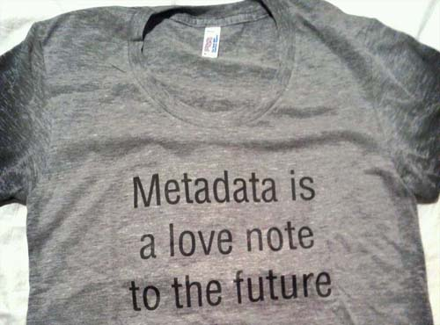
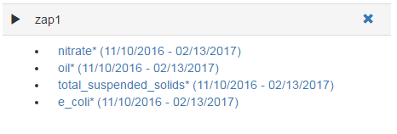
The Metadata Problem
Needed a standard way to answer the following questions:
What data are available and for what parameters?
What data can I use?
What’s the quality of the data?
IWN had to develop standard ways to do this (no existing standard existed)
Further work needs to be done in this area as part of the Advanced Monitoring Team

Slide 12




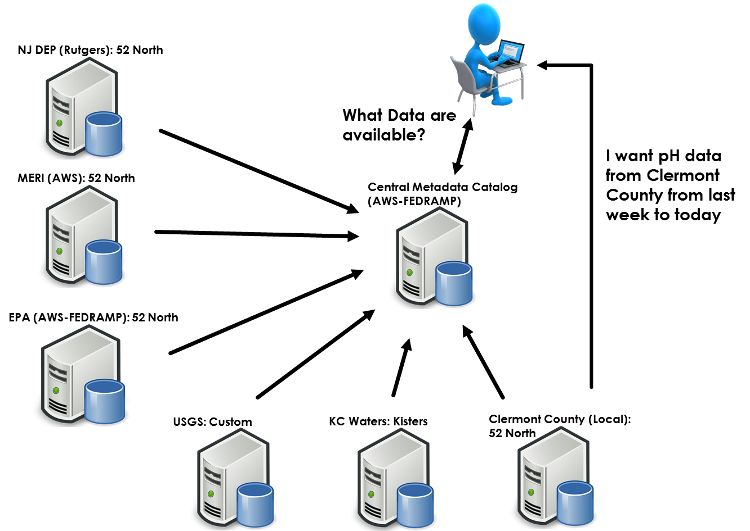



The Architecture Problem
How do you solve the problem of multiple data providers with large amounts of data that have the potential to change every 3-15 minutes?
Used a central catalog/index that references every data owner’s assets with the corresponding metadata for each sensor
Allowed for quick searching and discovery of available data
This approach is similar to how Google allows you to search the internet
Actual data comes from the partners systems in real-time

Slide 13
Underlying Catalog Services
IWN Defined
GetOrganizations: Returns who is providing data with their endpoints
AvailableParameters: What parameters can be queried
GetSensors: Gets the sensor information and provides different methods for querying sensors (i.e. by county, by HUC, by buffer, by a bounding box, upstream, and downstream)
GetSensorParameters: Gets parameters for a sensor, including the period of record
GetOrganizationParameters: Gets the parameters for an entire Organization

Slide 14
OGC Defined Services
(SOS 2)
Each endpoint supports Sensor Observation Service in XML format (WaterML2)
GetObservation: Gets the most recent data or retrieves a collection of data
GetCapabilities: Getting all the metadata from the endpoint
DescribeSensor: Describes the sensor

Slide 15
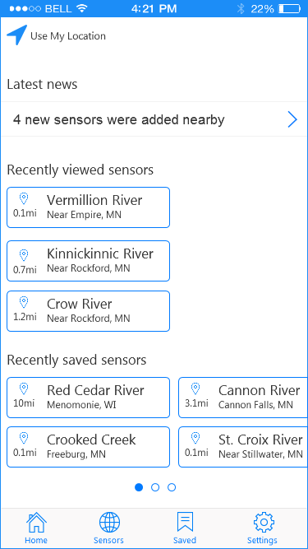
IWN’s Open Architecture Allows Other Possibilities
IWN is built using an open architecture, meaning that all the functionality you see in the demonstration tool is also available as a corresponding Web Service or Application Program Interface (API)
Enables for other apps to be developed (like mobile apps)
Also allows for other third-party applications (like Excel) to be able to directly interact with the data without having to go to a website and ‘download’ the data

Slide 16
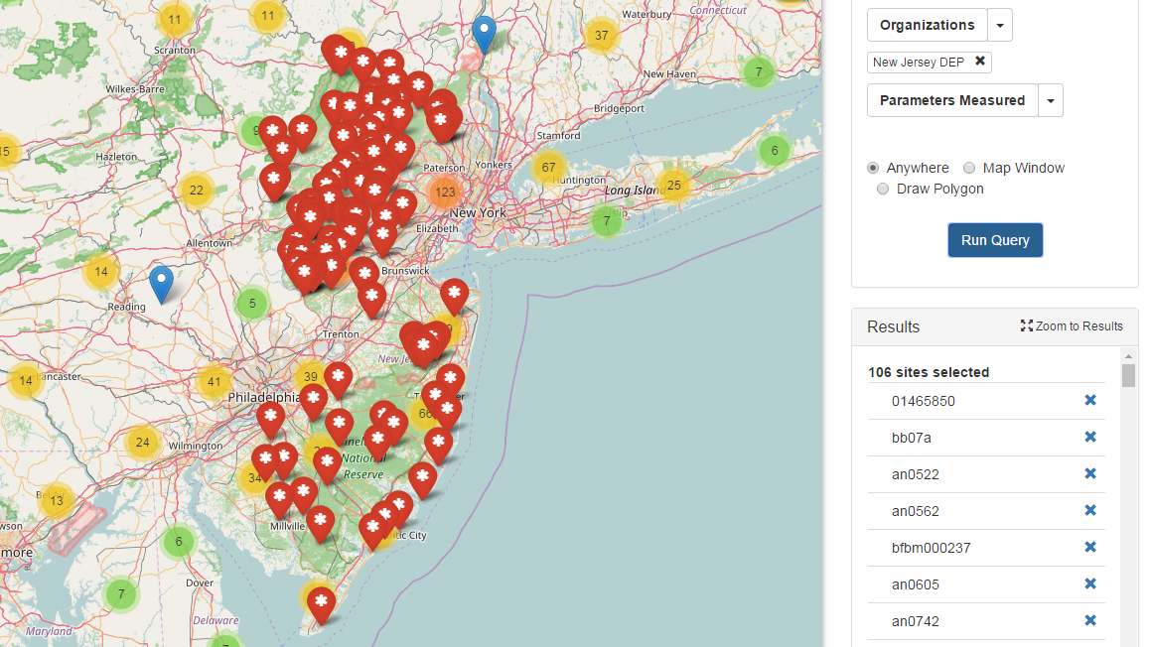
Demonstration
CURRENTS is a demonstration tool
It contains data from:
8 Partners:
EPA Region 1: 2 Sensors
EPA Region 7: 18 Sensors
EPA Region 10: 1 Sensor
EPA ORD: 3 Sensors
NJ DEP: 106 Sensors
NJ Meadowlands: 3 Sensors
Clermont County, OH: 4 Sensors
USGS: 15,541 Sensors (nationwide coverage)

Slide 17
Next Steps
Demonstration project ended in December
A Lessons Learned Report has been completed
Demonstration tool will continue to be available
A mobile app is being developed that leverages the services/API developed as part of this project
Demonstration proved to be very successful
Services worked better than expected
Ease of setting up a data appliance was simpler than anticipated
Ready to move to a production-level system
Advanced Monitoring Team is exploring if the services and standards would work for Air data as well

Slide 18
QUESTIONS?
Dwane Young
Young.dwane@epa.gov
202-566-1214
Britt Dean
Dean.britt@epa.gov
202-566-1020

