Slide 1

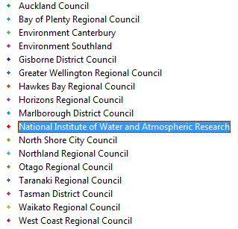
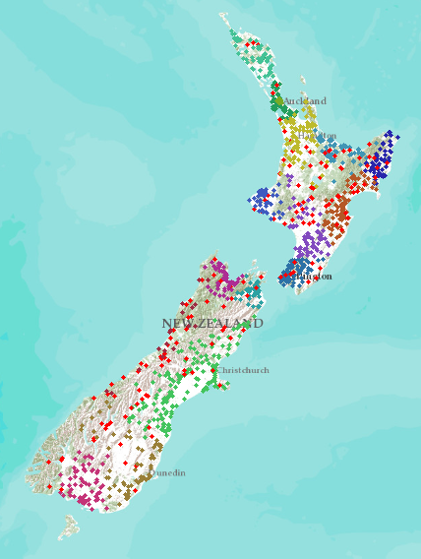
New Zealand – 16 regions
NIWA operates about 20% of 1300 hydrometric stations Regional authorities operate about 80% of stations
Develop a federated hydrological information infrastructure . . .
. . . linking nationally and regionally collected data

Slide 2
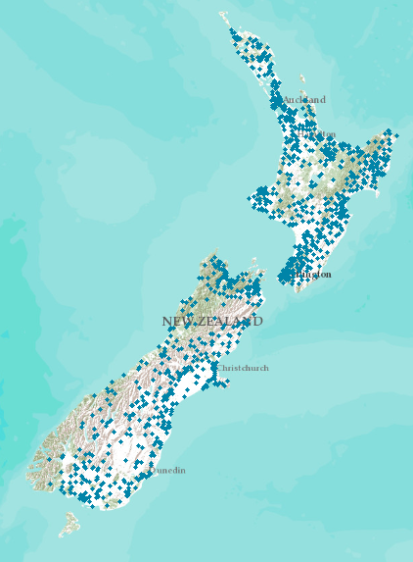
Proposed New Zealand Water Information System
NIWA operates about 20% of 1300 hydrometric stations Regional authorities operate about 80% of stations
New Zealand
Water Information System
Develop a federated hydrological information infrastructure . . .
. . . linking nationally and regionally collected data

Slide 3
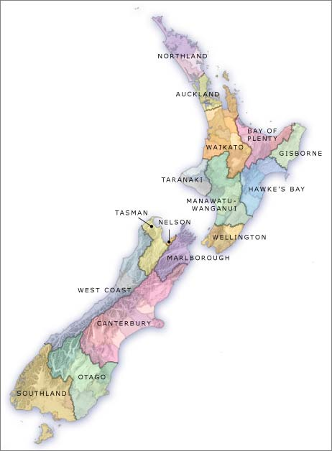

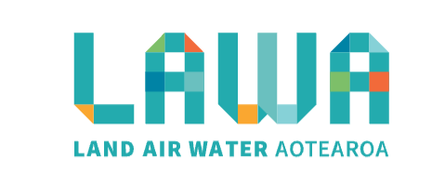
Current State of Play for NZ – all Done!
Local Government
National - CRIs
15
3
SOS2/WaterML2
now
SOS2/WaterML2
now
SOS = Sensor Observation Service
Slide: Brent Watson, HRC

Slide 4
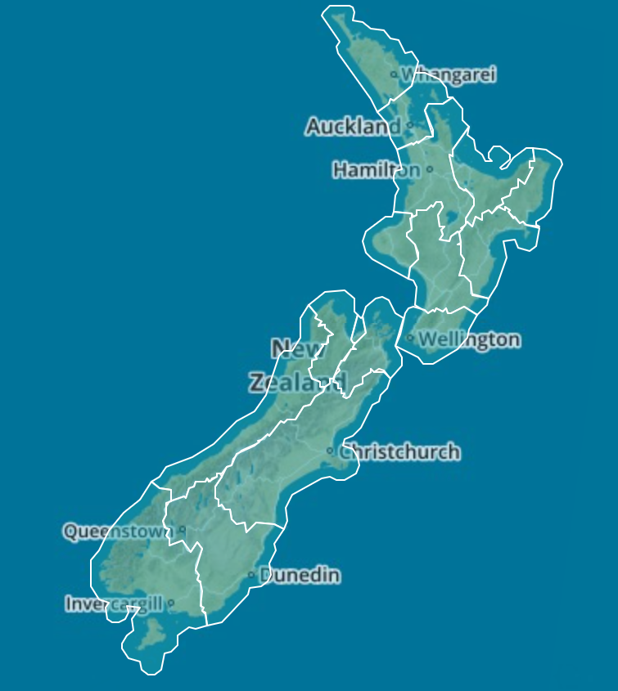
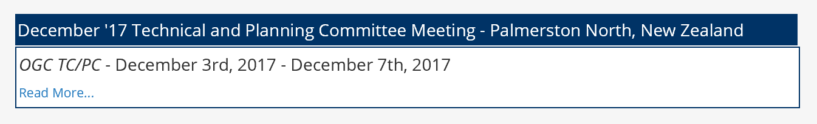

Data Sharing using Open Standards in LAWA
Each region maintains its own data
Data are accessed through “web services”
Common language for water: WaterML2
Open Geospatial Consortium standards
All information “looks the same” to user
A tremendous technological achievement for New Zealand!!!
Credit: LAEMG, especially Horizons Regional Council
Michael McCartney, Jeff Watson, Brent Watson, Sean Hodges
NIWA and Landcare

Slide 5
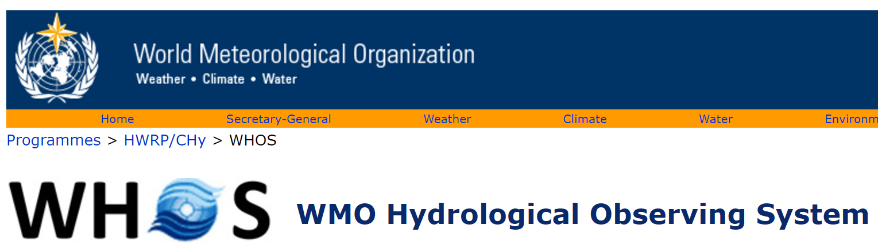
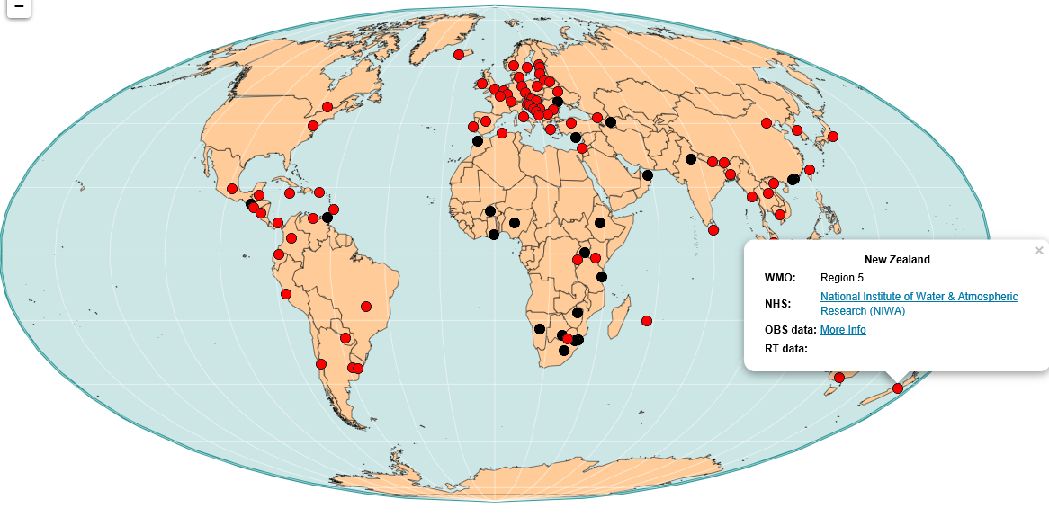
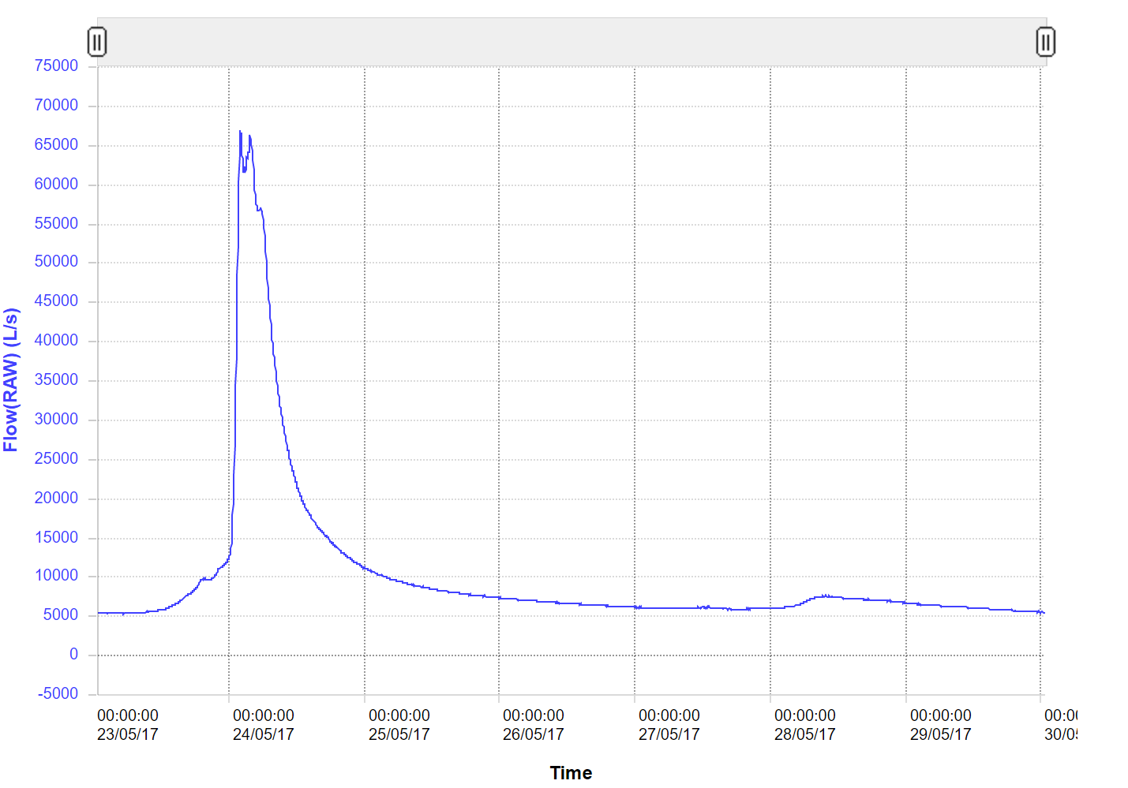
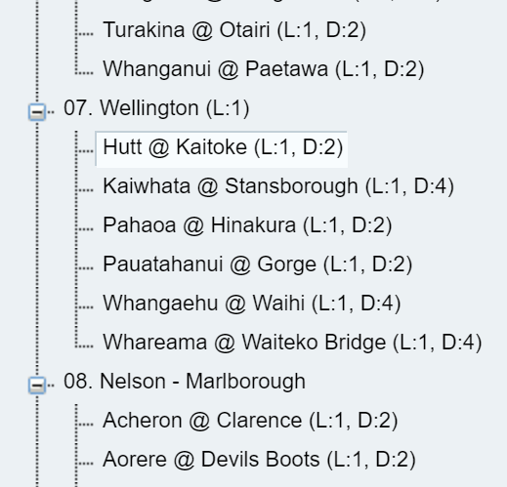
NIWA
New Zealand data globally accessible
Current Flow Data for the Hutt River at Kaitoke
30 May 2017
http://www.wmo.int/pages/prog/hwrp/chy/whos/

Slide 6
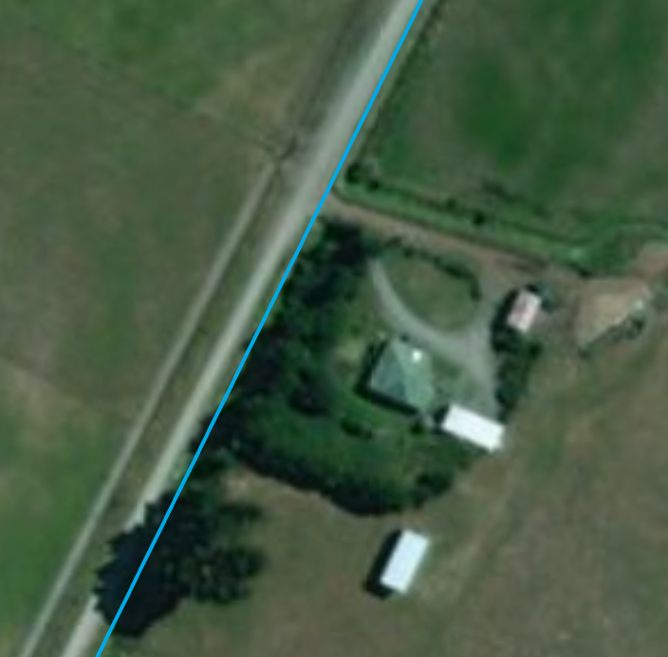
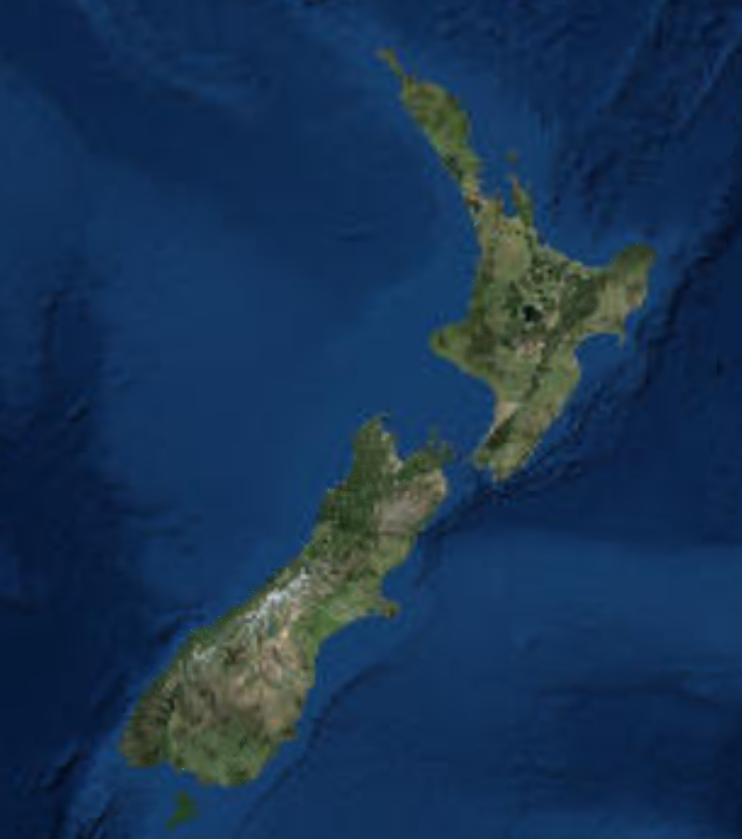
The Drain Running by my Grandmother’s Home

Slide 7
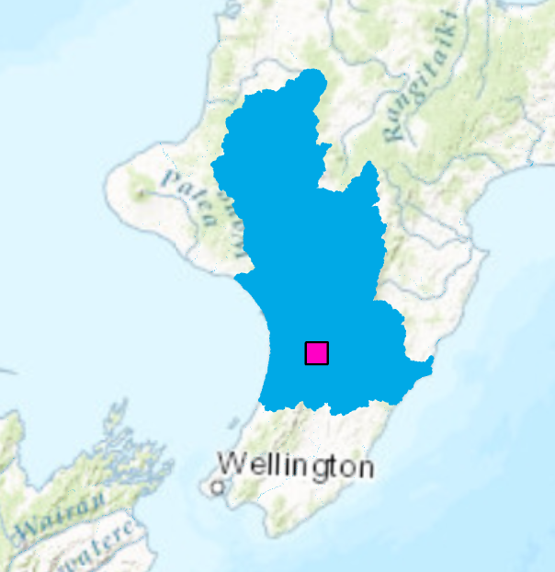
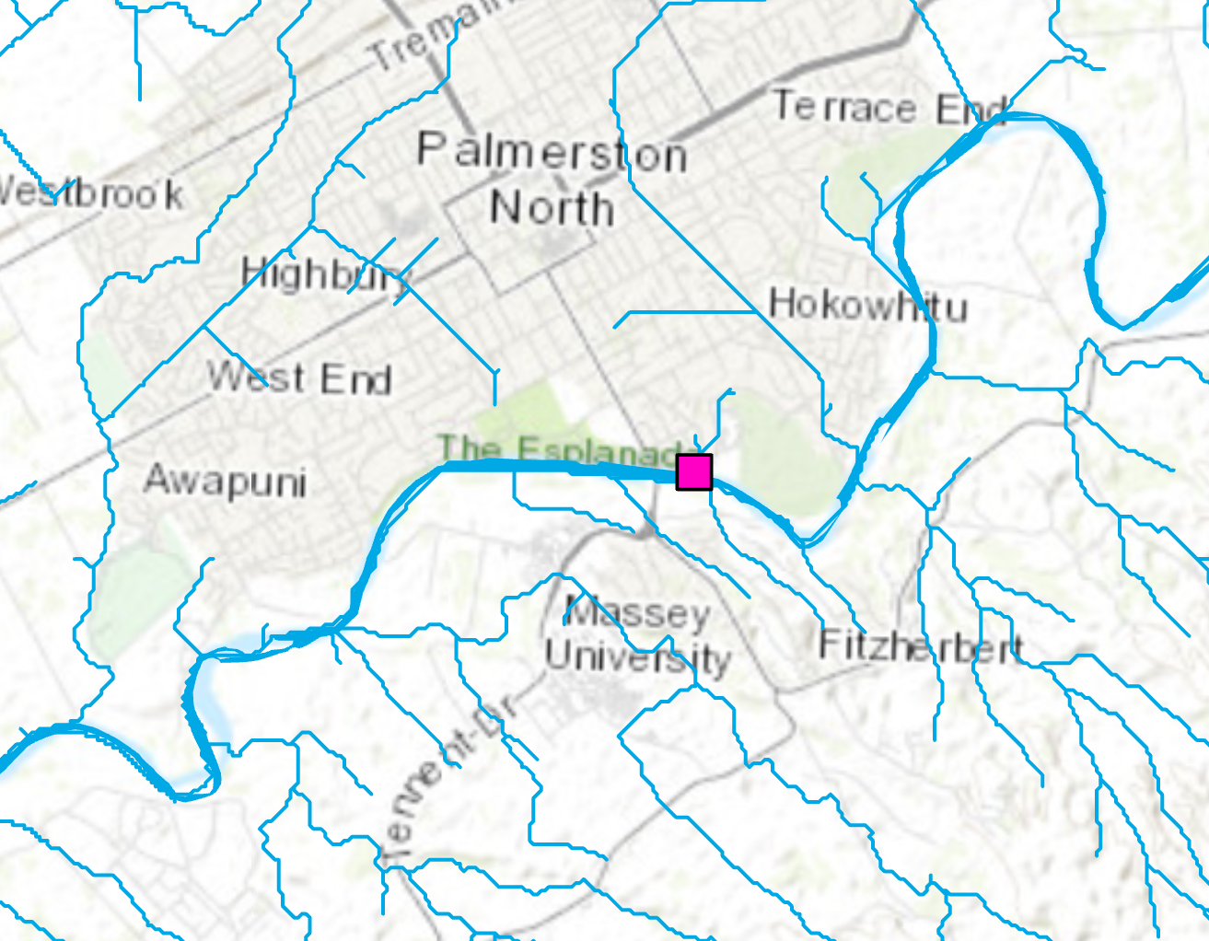
River Environment Classification
Horizons
Region
Council
Manawatu River
at Teachers College

Slide 8
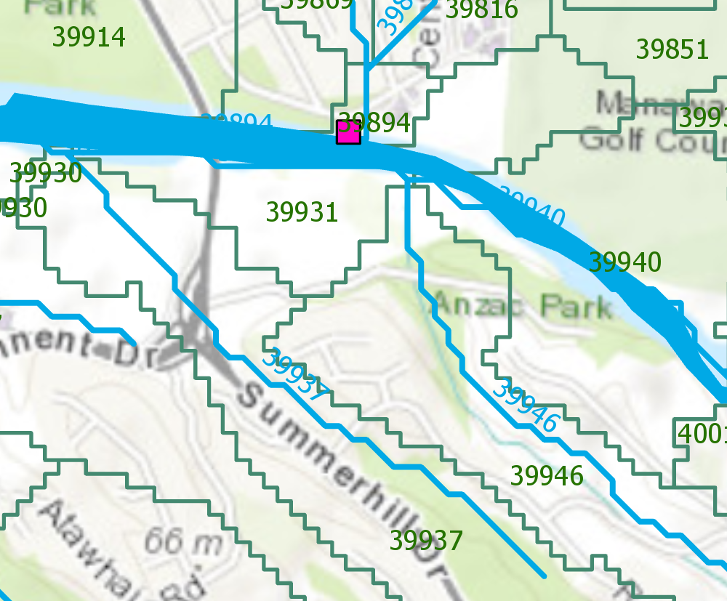
Catchments and Flowlines
Catchment Area = 40 ha
Reach Length = 700m

