Slide 1
RDA Global Water Information IG
Co-Chairs:
Tony Boston, Matt Fry, Sylvain Grellet, Ilya Zaslavsky

Slide 2
Organization
Started in early 2016 after BoF session at RDA P6-Paris
A sister activity of OGC/WMO Hydrology Domain Working Group
RDA Plenary meetings in Tokyo and Denver (not in Barcelona). Planning to be in Montreal

Slide 3
GWIIG charter – value proposition (I)
a) facilitate dissemination and implementation of water data standards being developed through HDWG activities;
b) explore and compare eInfrastructures being developed for water data sharing, with related designs in other domains;
c) address issues that are currently outside of the scope of HDWG;
d) facilitate re-use of eInfrastructure foundation and components recommended by RDA or developed by RDA partners;
e) explore policies for water data sharing as related to the general policy agenda being investigated by RDA groups;
f) leverage RDA work on data publication and dynamic data citation (issues directly applicable to management of hydrologic time series);
g) make water data sharing a component of global data sharing system within the RDA framework;

Slide 4
GWIIG charter – value proposition (II)
h) gain insights from experience and best practices of data systems in other domains, in particular as they address common pain points in eInfrastructure development;
i) coordinate with other RDA groups on addressing common deficiencies of existing data publication and exchange frameworks such as lack of policy level enforcement of a global water data exchange scheme, in the context of each country/continent having its own IT/political approach;
j) organize use cases and get feedback from water data users in other domains;
k) attract academic researchers working on water data sharing and related infrastructure issues, as their participation may be better recognized and aligned with the RDA framework rather than with OGC;
l) widen participation in global water eInfrastructure discussion by attracting members from regions not currently engaged in the development of water data exchange standards through HDWG, in particular from developing countries;
m) identify and coordinate requirements relating to water data standards from the wider research community, as input to the HDWG-led standardization process.

Slide 5
About HDWG
Started in 2008
Regular sessions at OGC TC meetings
Yearly workshops (eg there is one later this month)
Active work on interoperability experiments and specifications:
WaterML 2 family of standards
Overlap in people, themes, communication channels
Parallels between OGC and RDA structures
See OGC-RDA mapping spreadsheet

Slide 6
WMO/OGC Hydrology Domain Working Group WaterML2 suite
TimeseriesML 1.0
Timeseries
(OGC IS 15-042r3)
(OGC IS 15-043r3)
WaterML2Part2: Ratings, Gaugings, Sections
(OGC IS 15-018r1)
WaterML2Part1:
Timeseries
Observation
(OGC IS 10-126r4)
WaterML2Part3: Water Quality Observation (OGC BP 14-003)
SOS 2.0
Hydrology Profile
(OGC BP 14-004r1)
Hydrologic Information Standards:
of hydrologic (water) features
WaterML2Part4: Groundwater Features GroundwaterML2 (OGC IS 16-032r2)
Identification,
Observation,
Representation
…(RiverML)…:
Channel Geometry
(continuation tbd)
WaterML2Part5: Surface Water Features
HY_Features
(OGC IS 14-111r5)
SoilML component:
Soil-water (collaboration tbd)
WaterML2PartX: River Network Topology
(OGC IS YY-XXX)
CSML3 component:
Atmospheric-water
(collaboration tbd)

Slide 7
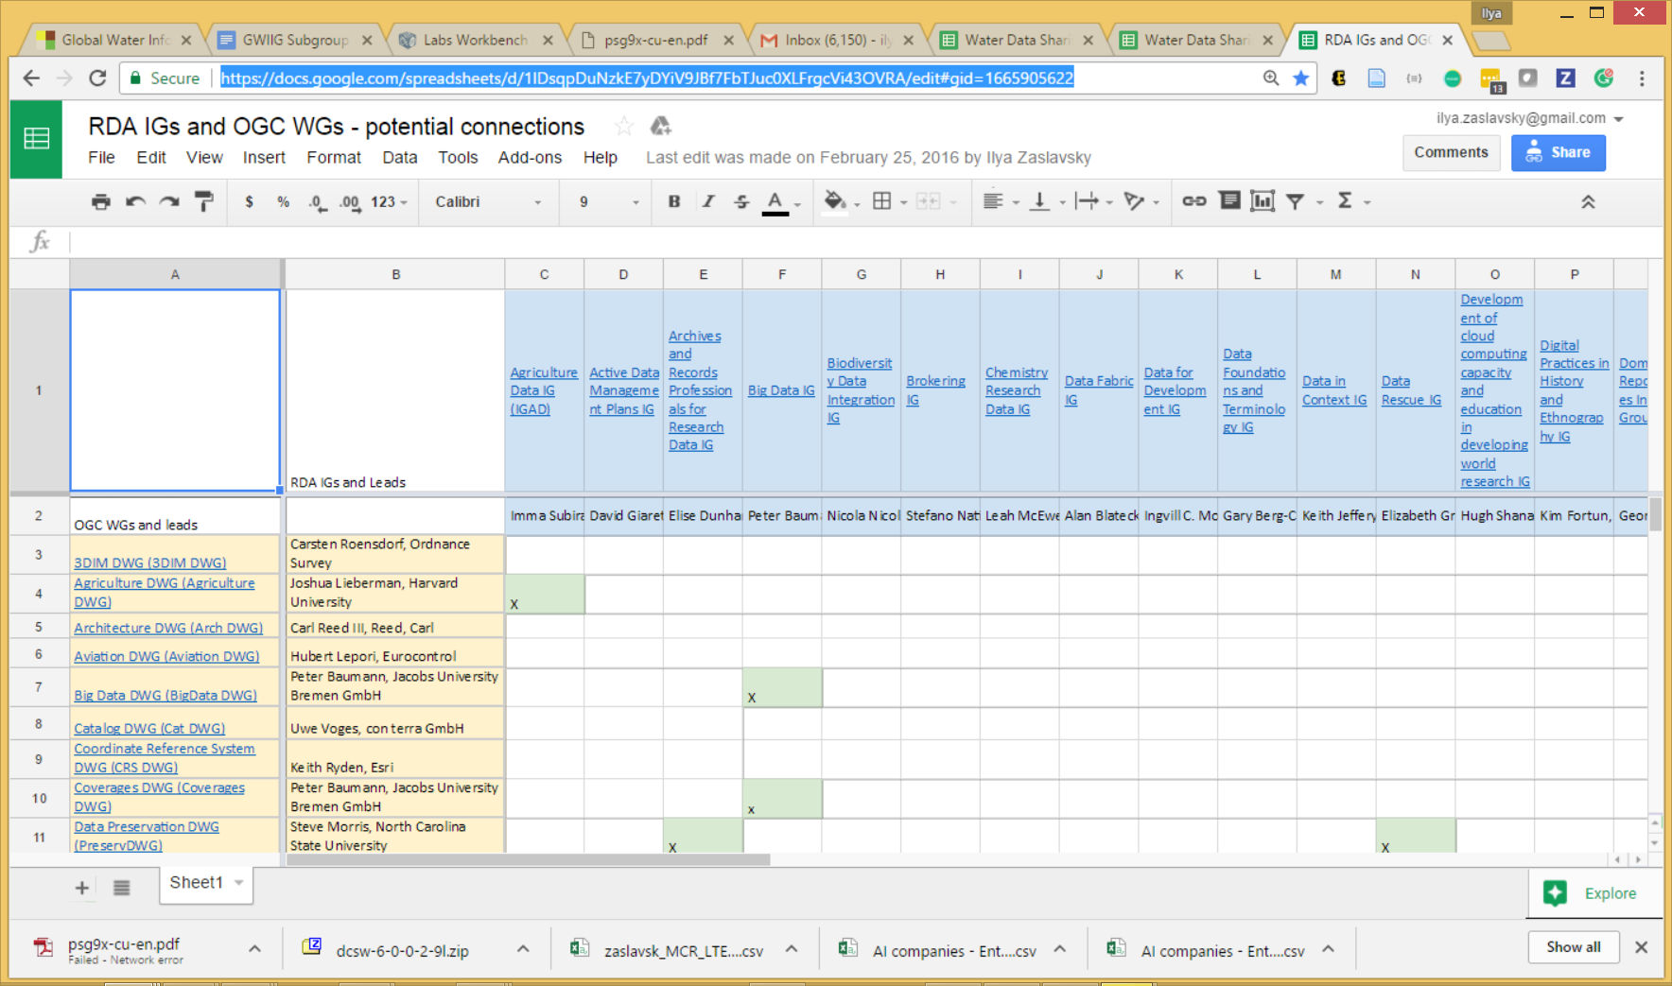
Mapping RDA to OGC groups
https://docs.google.com/spreadsheets/d/1IDsqpDuNzkE7yDYiV9JBf7FbTJuc0XLFrgcVi43OVRA/edit#gid=1665905622

Slide 8
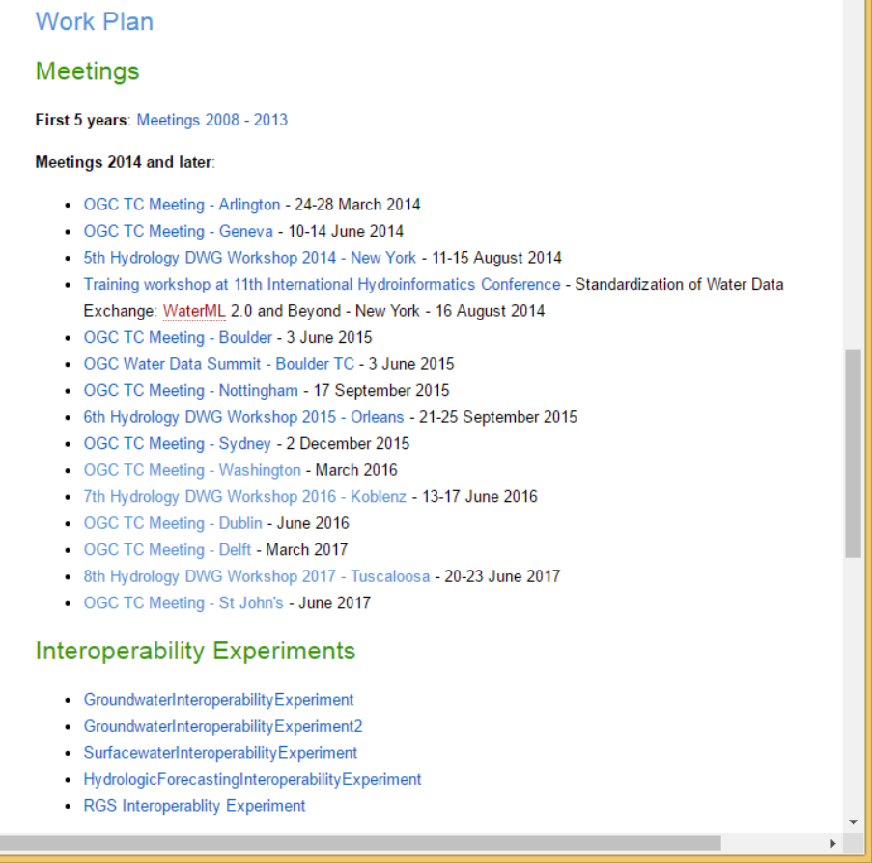
Websites
HDWG
Complements the mailing list
The place where all HDWG activity is
announced / coordinated /reported
Meetings summary
Interoperability experiments
Tools, …
A section dedicated to RDA GWIIG
URL : http://external.opengis.org/twiki_public/HydrologyDWG/WebHome
GWIIG section of RDA website
Summary of GWIIG actions/organisation + link to its specific section under HDWG website
Purpose :
To better intertwine both groups/communities and avoid people being lost between too many websites.

Slide 9
Main themes for GWIIG, currently (for Task forces within IG?)
Dynamic data citation for hydrologic data repositories
Water data portals, discovery and search
Hydrologic vocabularies
Linked data in hydrology

Slide 10
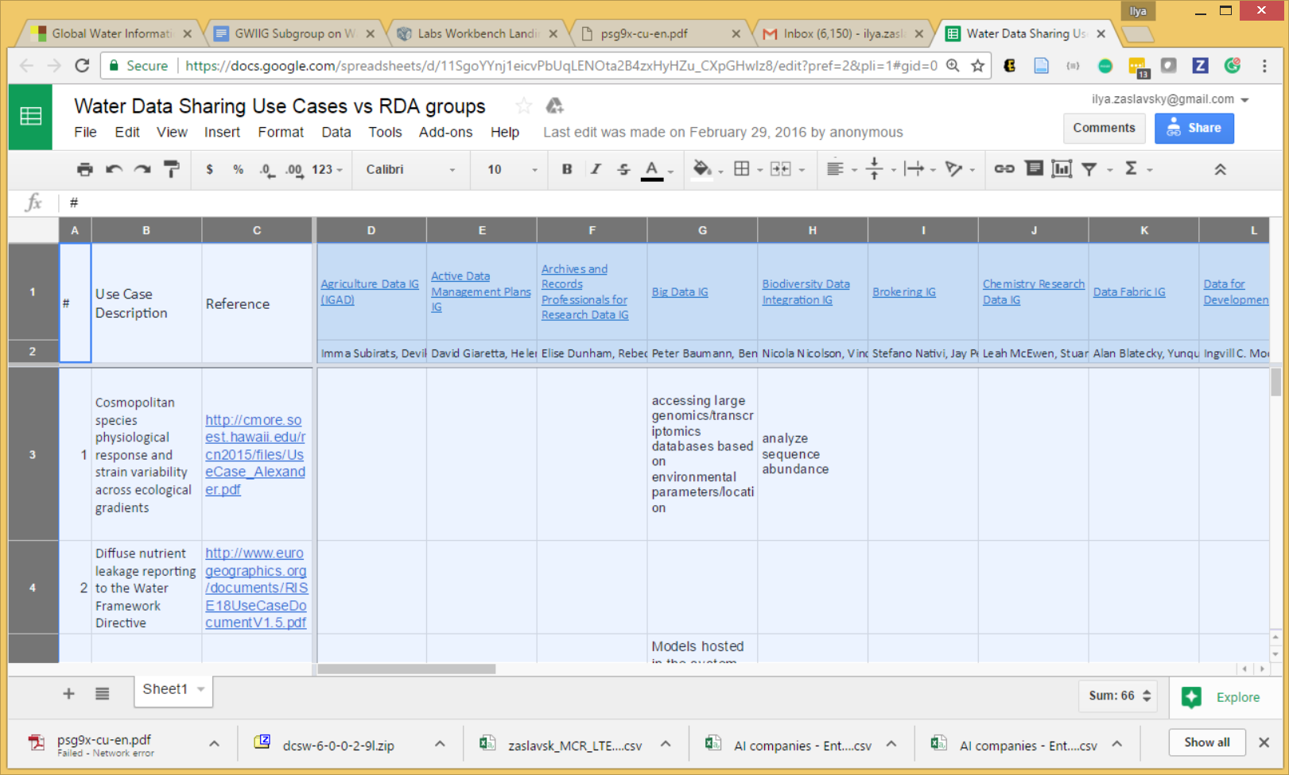
Water information use cases
https://docs.google.com/spreadsheets/d/11SgoYYnj1eicvPbUqLENOta2B4zxHyHZu_CXpGHwIz8/edit?pref=2&pli=1#gid=0
A matrix of use cases vs RDA groups
Avoiding a discussion of what a use case is, and a use case template…

Slide 11
Dynamic Data Citation
Collaboration with the Dynamic Data Citation WG
UK National River Flow Archive:
Developed RDBMS-based versioning system and tested Dynamic Data Citation WG recommendations
Initial work presented at Denver P8 plenary GWIIG meeting
Presented as part of P8 DDC session
Further work hoped to be presented as part of DDC webinar series (TBC)
Call for other GWIIG examples of versioning / dynamic data citation (e.g. CUAHSI HydroShare)

Slide 12
Water data portals and discovery
An initial list of water data portals (from EAWAG, https://osf.io/8mn3q/ )
Compare with what is available from re3data…
A model for describing water portals
query interface (map search; time sliders; full-text; simple and advanced search; facets; semantic rewriting/term expansion; granularity levels; etc.); construction of data discovery workflows; visibility to search engines; presenting search results (relevancy, links, ability to incorporate results into workflows and/or publications, and transform them to other formats; show search results statistics; show provenance; preserve queries and show usage stats; show related queries and/or results; ability to annotate results; provide data previews and introspection; provide APIs into lower granularity levels); letting users subscribe to updates,…
What is specific to water portals
A set of hydrologic features and observations at several hierarchical levels
Special types of relationships (eg upstream, downstream, other relations in a hydrographic network) – may be time-dependent
Additional feature-of-interest relationships (eg parameter proxies) – these are context-dependent
Coordination with the data discovery group

Slide 13
Hydrologic Vocabularies
Not started yet; several people are interested across RDA GWIIG and OGC HydroDWG
Identify water-related ontologies
Engage with RDA Vocab Services IG
Use cases
Service and practice documentation
Recs on vocab publication and APIs
Encourage publication of exemplar water-related vocabularies using best practice methods

Slide 14
Linked data in hydrology
ELFIE: Environmental Linked Features Interoperability Experiment
Demonstrate the use of existing and pending OGC standards for the encoding of environmental observation data in an integrated dataset of features linked according to ReSTful and Linked Data principles.
Prepare an OGC engineering report summarizing the group’s findings with the intention of future development of the relevant policies, best practices or implementation standards.
Provide draft linked data encodings to be considered by relevant standards working groups
Motto : “Interested in defining some best practice "views" of monitoring and domain features that give a "just enough" annotation to connect and use these data. Also worth noting is that we largely see use of a resource oriented approach (urls go to well-described instances, not services).”
A call to other groups to coordinate (contacts: Dave Blodgett, Sylvain Grellet)
An RDA recommendation based on the Eng. Report?

Slide 15
Data Rescue Use Cases in hydrology
Initiated discussion with Elizabeth Griffin of DR IG
DR IG is considering thematic focus on data rescue, with water being an option for a theme
GWIIG will identify past successes and future need for data rescue in hydrology
To be presented at DR IG in Montreal

Slide 16
Next Steps - 1
Vocabularies - Tentative work plan
Identify use cases and audiences for semantic dataset annotation and discovery; explore varying "annotation depth" as required for different use cases;
Create a list of available vocabularies and ontologies for water data, and their metadata model;
Explore overlaps and complementarity of available vocabularies and ontologies, identify gaps;
what belongs and what doesn't belong in a water ontology;
standards-compliance, and relationship with Hy-Features/WaterML2
tools for efficient semantic annotation;
Additional use cases beyond discovery, eg reasoning use cases and tools, and requirements to the data model
Telecon?

Slide 17
Next Steps - 2
Water data portals – Tentative work plan
Update the list of WDPs; coordinate with RE3data
Create structured descriptions of WDPs (both general and water-specific)
Query interface and types of search supported, incl semantic rewriting
Support for data discovery workflows;
How results are presented, incl relevancy, additional functions and aggregate measures;
Provenance handling, and preserving/analytics on queries;
Ability to annotate results; provide data previews and introspection;
Passing requests to other search systems (brokering, esp to lower granularity levels);
Subscriptions to updates
Integration with models and analytical tools (workbench functionality)
Support for collaboration, knowledge sharing
Support for water-specific semantic relationships between features defined in HY-Features (related features and proxies; upstream/downstream/etc.)
Figure out types of WDPs and develop best practices
Telecon – sometime in July, then P10 in Montreal

Slide 18
Deadline tomorrow for P10 sessions
GWIIG session: mostly on water portals; vocabularies; data citation implementations
Potential joint sessions and BOFs
BOF on vocabularies (?)
Joint session with Data Discovery (?)
Joint session with Data Rescue (?)
If you consider attending – let us know.

