Slide 1
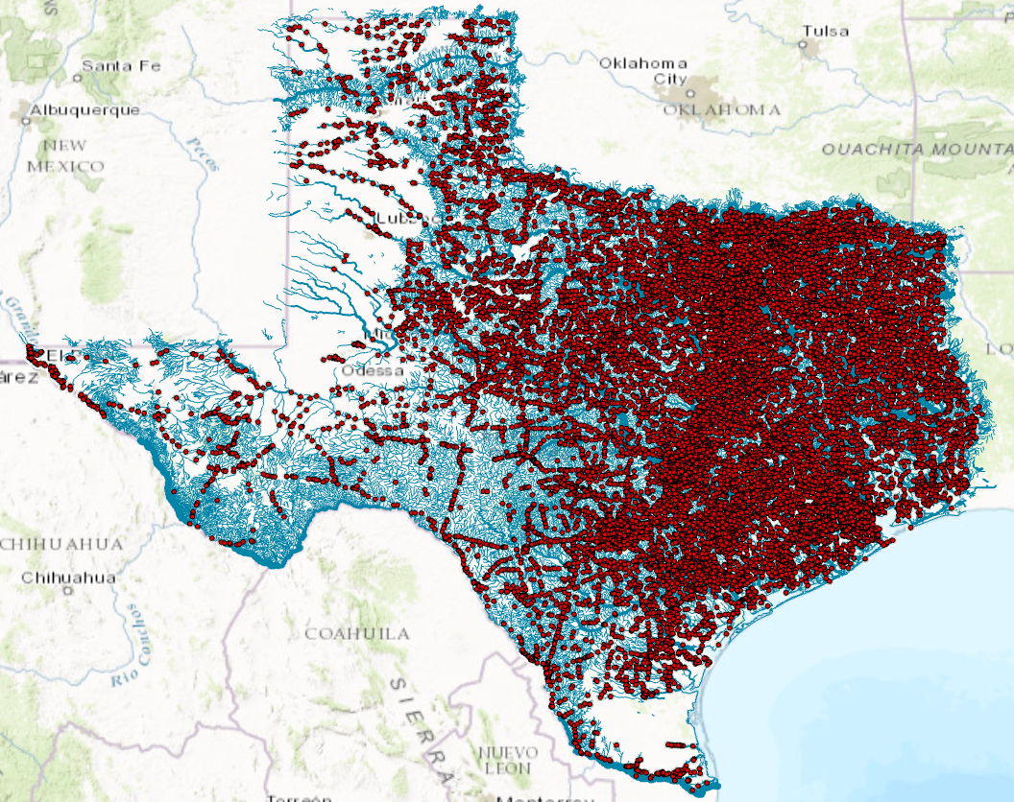
27,000 Texas bridges on 15,700 stream reaches forecast by the National Water Model

Slide 2
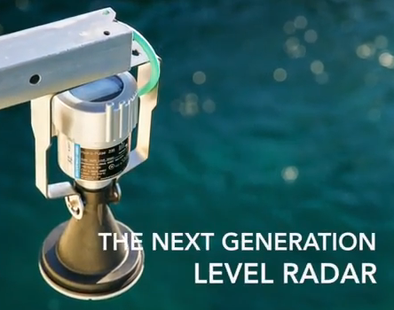
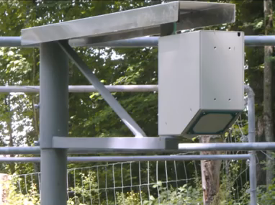
Radar Measurement Technologies
Measures surface velocity ($12,000)
Measures water level ($5000)
Densified forecasting requires densified measurement

Slide 3
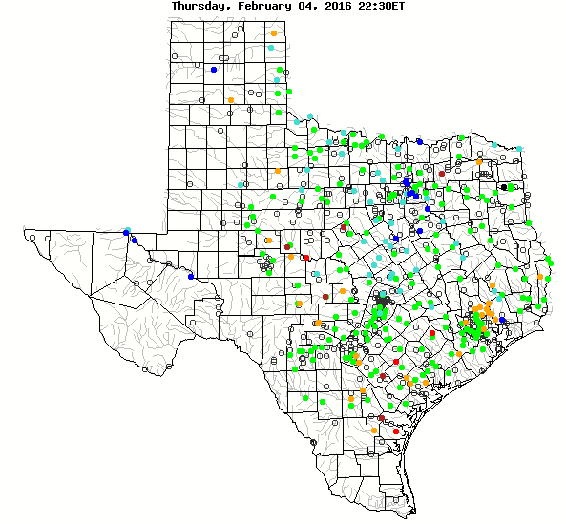

Stream Measurement in Texas
550 USGS Gages
27,000 TxDOT Bridges
Gold Standard
Potential Sensor Platforms

Slide 4


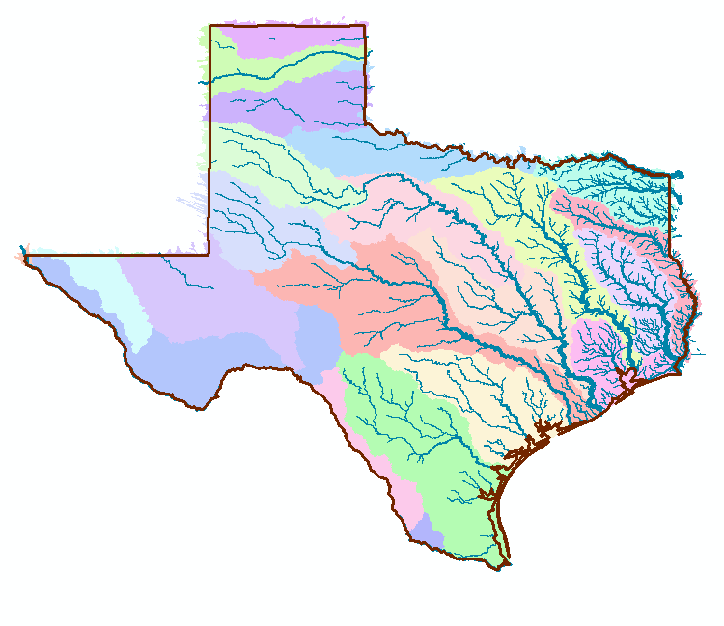
Streamflow Observation and Modeling in Texas
1:
USGS Stream gage sites (~ 550) (Level and Flow)
Gold standard
Water Level and Surface Velocity
Water Level
:185
National Water Model Computation
(102,000 in Texas)

Slide 5
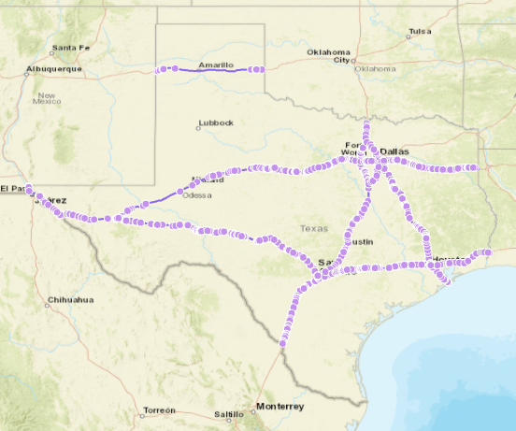
Potential Sensor Locations on Interstate Highways

