Slide 1
Building a Water Intelligence Network Using Hydro Network Linked Data
Al Rea
Dave Blodgett
June 15, 2017

Slide 2
Overview
NHDPlus V2 (Medium Resolution)
NHDPlus HR
HydroLink, HEM, and ScienceBase
Services for network-based search (NLDI)

Slide 3
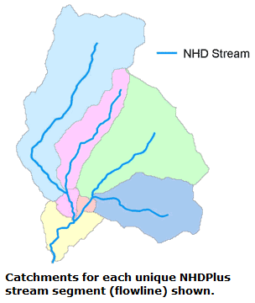
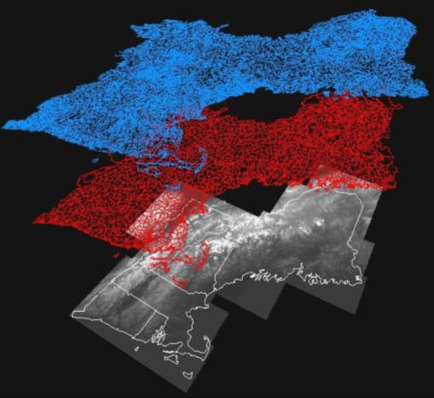
National Hydrography Dataset Plus - NHDPlus
Medium Resolution created for CONUS
High Resolution in work for CONUS and AK
NHD
WBD
Incorporates
Hydrography
Boundaries
Elevation
Elevation

Slide 4
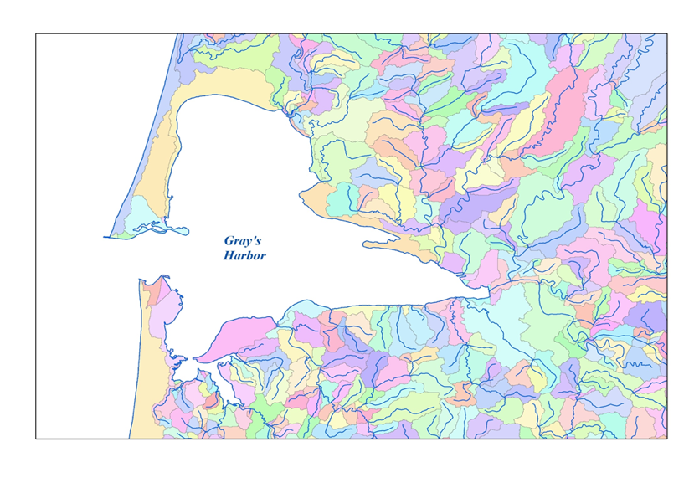

Catchments
Notes:
Here is a picture of some catchments. You can see there is a catchment for each line segment in the NHD network. There are catchments for each coastal line segment, too. The catchments in NHDPlus cover the entire continental US. If you drop a hypothetical drop of water anywhere in the 48 states, you can know instantly where in the stream network that drop of water would go simply by intersecting the point where it falls with the catchment dataset.

Slide 5
NHDPlusHR
Taking NHDPlus v2 (MedRes) to a new level
NHD
100K
2000
The best of 24K+ data and NHDPlus
Addresses the need for a single hydrographic frame of reference
Link data to one network and generalize to many different scales
NHD HR
24K
Local/State
applications
2007
NHDPlus
100K
Regional/National applications
2006
NHDPlus
High Resolution
Local/State applications AND scalable applications
Started 2015

Slide 6
NHD Data Suite Comparison
NHDPlus (both resolutions) is made from the combination of elevation data, hydrography data (NHD), and watershed boundaries (WBD)
NHDPlusHR uses higher resolution input data
 | NHDPlus v2 (Med Res) | NHDPlus - High Res
Number of features | 3 Million nationally | 26 Million nationally
Elevation Input | National 1 Arc-Second Seamless DEM (30 meters) | National 1/3 Arc-Second Seamless DEM (10 meters)
NHD Input | Medium Resolution NHD 100K | High Resolution NHD 24K - Local
WBD Input | Composite 2010-2012 | Updated WBD
Tile size | HUC-2 (with exceptions) (avg. XX square miles) | HUC-4 (avg. XX square miles)
Flow estimates | Mean annual, mean monthly | Mean annual
Component Datasets
Notes:
NHD+ is combination of NHD, WBD, and elevation
NHD – no WBD, no elevation
HUC2 – couple hundred square miles
HUC4 – 20k square miles
NHD+HR does NOT use 3dep at native resolution – has to downgrade to 10m
Features increased 3M in NHD+ to 33M in NHD+HR
Catchment size decreased from 2 sq. mi. to 2/10 of square mile

Slide 7
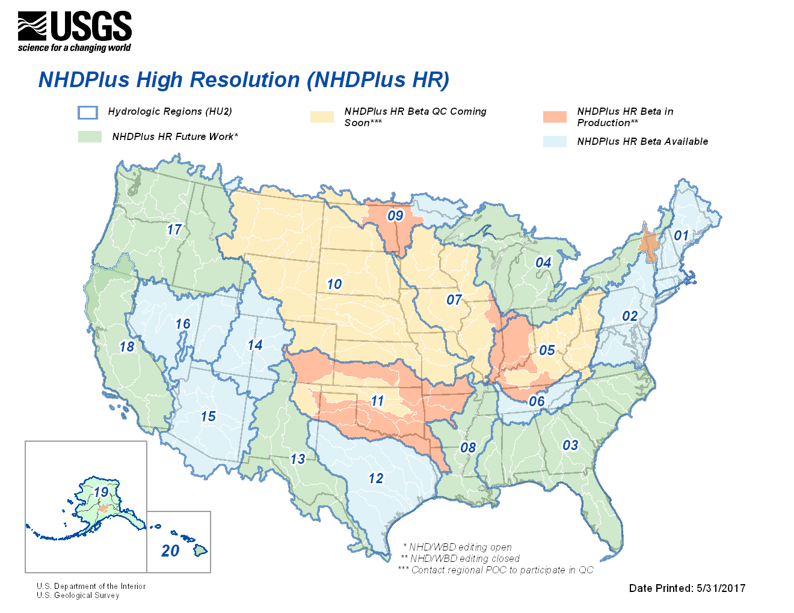
Notes:
Note two focuses 1. Data Availability, 2. Partner / User Engagement
25% CONUS HU4s available… 40% by end of FY
Blue areas - NHDPlus HR Beta is currently available and review/QC may be in process. Please see the NHDPlus HR Beta review/QC section below for more information.
Green areas - NHDPlus HR Beta will be produced at a later date. Please see the general processing schedule below for more information. These areas are currently open for NHD and WBD editing.
Orange areas - The NHD and WBD in these areas are being prepared for NHDPlus HR production and are closed for NHD and WBD editing.
Yellow areas - The USGS is seeking volunteers to for the NHDPlus HR Beta review/QC for these areas. Please see the NHDPlus HR Beta review/QC section below for more information. Please contact the NHD Point of Contact in your area for more information on the status of NHD and WBD editing in these areas.

Slide 8
NHDPlusHR Current Processing Order
WBD HU2, HU4, or HU6 | Hydrologic Region | Additional Information | # of HU4s
06 | Tennessee | Mississippi 1 of 6 | 4
01 | Northeast |  | 10
12 | Texas |  | 11
14 | Upper Colorado | Colorado 1 of 2 | 8
15 | Lower Colorado | Colorado 2 of 2 | 8
02 | Mid-Atlantic |  | 6
16 | Great Basin |  | 6
0903 | Canadian Pilot (0903) | Pilot (Rainy River Lake of the Woods) | 1
10 | Missouri | Mississippi 2 of 6 | 29
07 | Upper Mississippi | Mississippi 3 of 6 | 14
041504 | Canadian Pilot (041504) | Pilot (Lake Champlain) | 1
05 | Ohio | Mississippi 4 of 6 | 14
09 | Souris, Red, Rainy | Souris, Red, Rainy (less pilot) | 3
1902 | Alaska Pilot (1902) | Pilot (MatSu) | 1
11 | Arkansas, Red, White | Mississippi 5 of 6 | 14
1801 | Klamath River Basin | Klamath Dam Removal Project | 1
3 | South Atlantic |  | 18
17 | Pacific Northwest | Pacific Northwest | 12
13 | Rio Grande |  | 9
4 | Great Lakes | Complete Drainage Area (less pilot) | 15
8 | Mississippi | Mississippi 6 of 6 | 9
18 | California | California (less Klamath Priority) | 9
19 | Alaska | Alaska (less MatSu Pilot) | -
20 | Hawaii | - | -
21 & 22 | Virgin Islands & Puerto Rico | - | -
Italicized text indicates partial subregion (HU4).
Notes:
This is our current program of work (not necessarily in priority order), there were a number of considerations in determining this sequence
This sequence represents A. start with some successes, Region 06, good opportunity for us to start, B. wanted to ensure we could complete connected networks with the upper and lower colorado, so by the time we got to the Mississippi we knew our process would work in more complex areas C. Coastal data in Region 1
This gave other priority areas, such as California to prepare the source data for NHDPlus HR
We knew there would be some challenges in areas such as the great lakes, so we focused on some other areas first to stabilize the process
Items shown in Blue represent the FY16 program of work, the following colors represent our current and future plans, including pilots in Alaska and Canada
Also found on NHD website

Slide 9
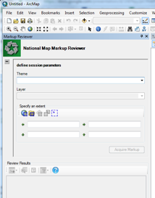
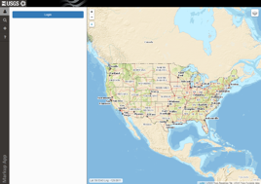
Markup Application
Desktop Application - ArcGIS Add-on
Web Application
Users: public, non-trained NHD and WBD editors, academia, etc.
Purpose:
Viewing NHD and WBD layers, and submitting markups
Creating new markups
Users: Internal NGTOC editors, trained NHD and WBD partners only
Purpose:
View markups submitted through web application
Update markup status: resolved, won’t fix, in progress

Slide 10
Water Intelligence Network System (WINS)
HydroLink
Fish locations
Wetlands
Fish
App
Example Apps:
National Water Model
HydroLink
SPARROW
StreamStats
National Water Census
etc.
NHD
Dams
NHDPlus
API
net-
work navi-
gation
Levees
App
WBD
Linked Data
Registry
App
ser-
vices
3DEP
NWIS
Water Quality Portal
Water Quality
STORET
etc.
Notes:
Locations such as fish sampling locations are input to HydroLink, which makes calls to the API to link to the NHDPlus geospatial framework.

Slide 11
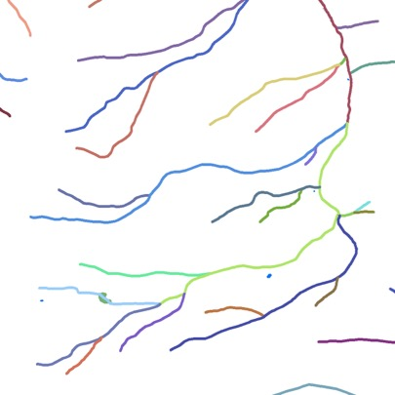
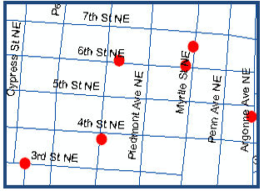
Stream Addresses are like street addresses
14010002000421
0
50
25
100
75

Slide 12
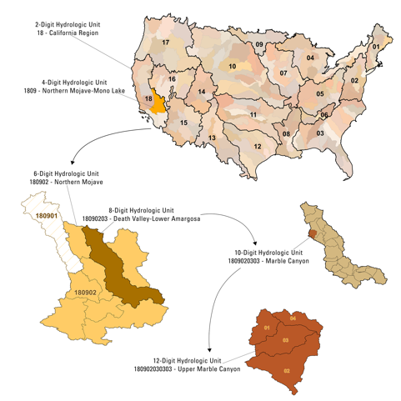
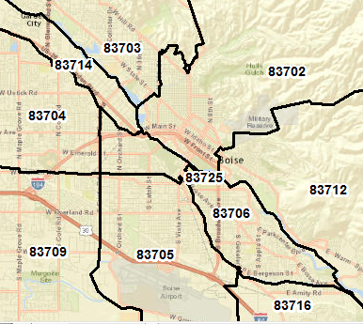
HU codes are like ZIP codes

Slide 13
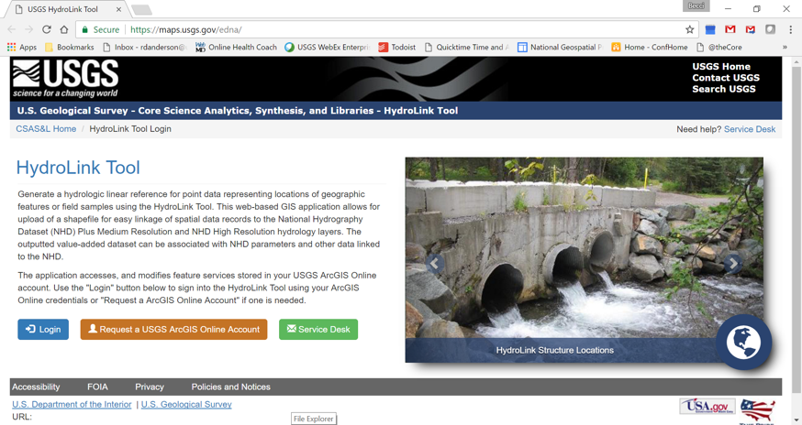
Linking Data Online
HydroLink Tool

Slide 14
Linking Data to NHD
Hydrography Event Management (HEM) Tool
Desktop ArcGIS tool
Point, Line, Area “Events” (hydro linked data)
Batch mode
“Sync” of events linked to NHD Flowlines that have been edited
“Built in events” in NHD
Dams
HUC-8 outlets
Streamgages
Water Quality Stations
USGS ScienceBase for sharing linked data
“NHD Linked Data Registry“
Can host linked data services
Can reference your linked data services
Contact mdtinker@usgs.gov for info

Slide 15
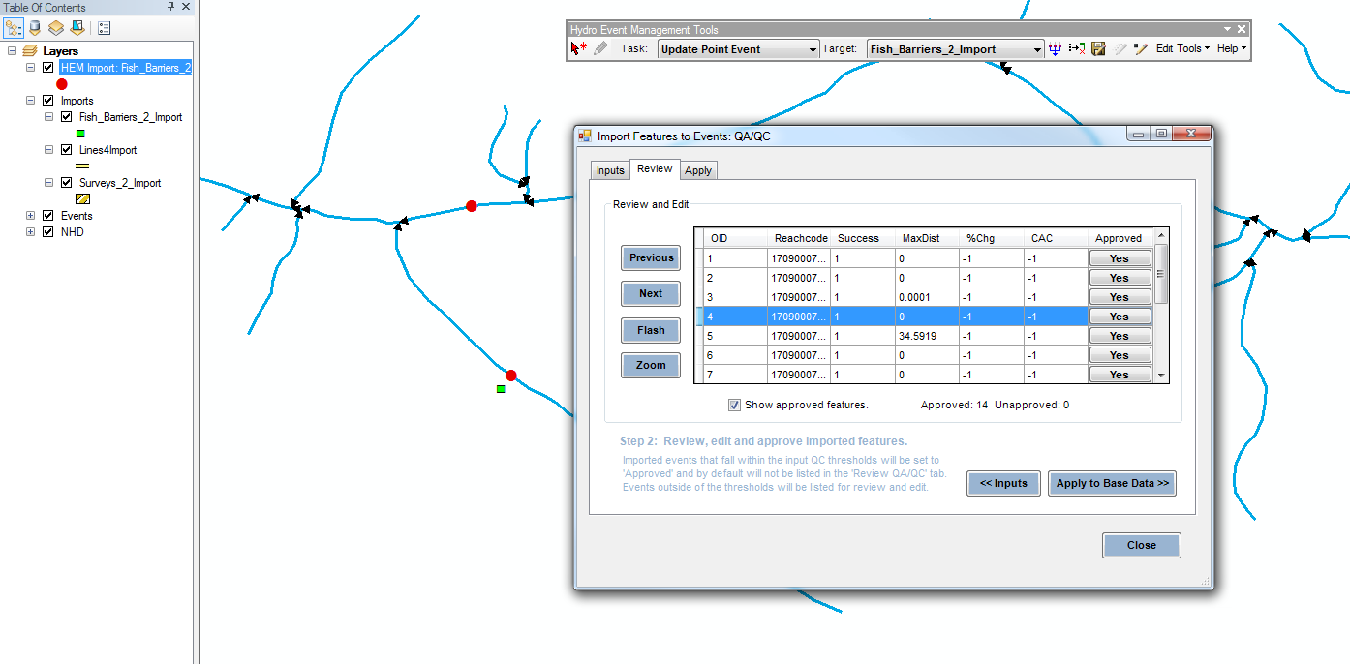

Slide 16
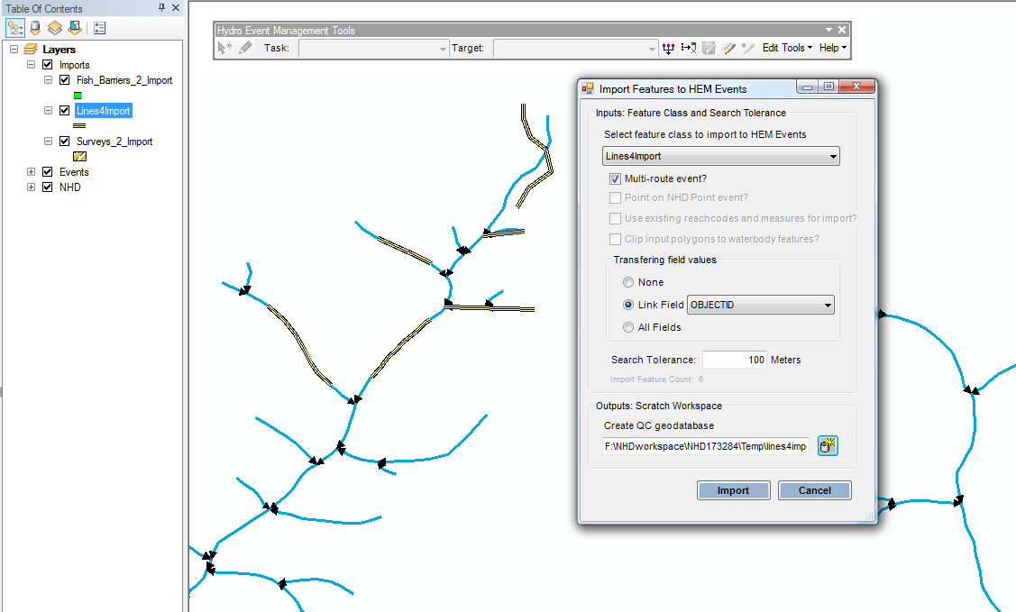

Slide 17
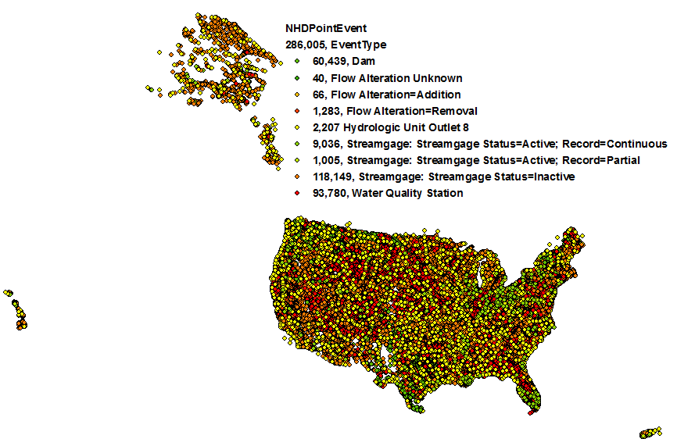
Notes:
NHDPointEvent As of 7/1/2016

Slide 18
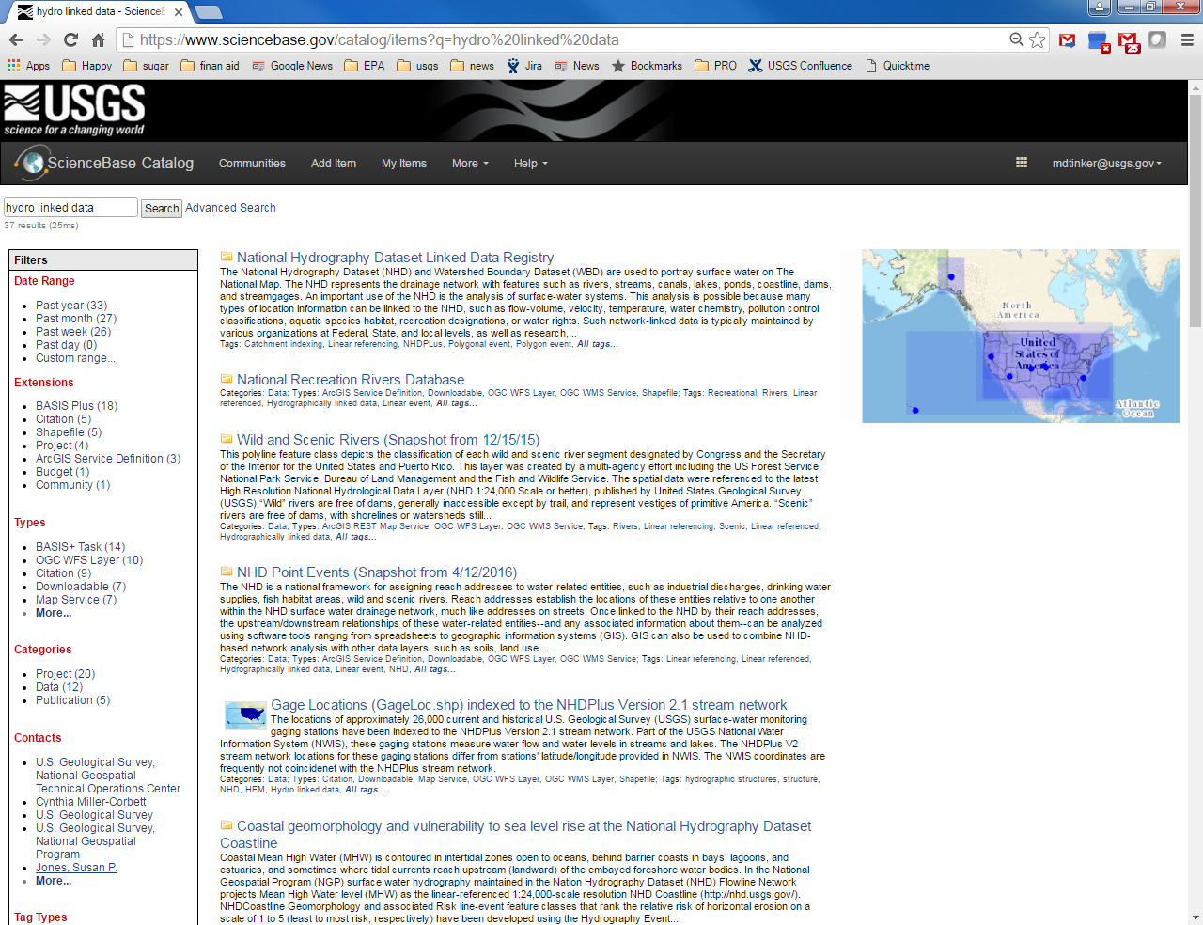

Slide 19
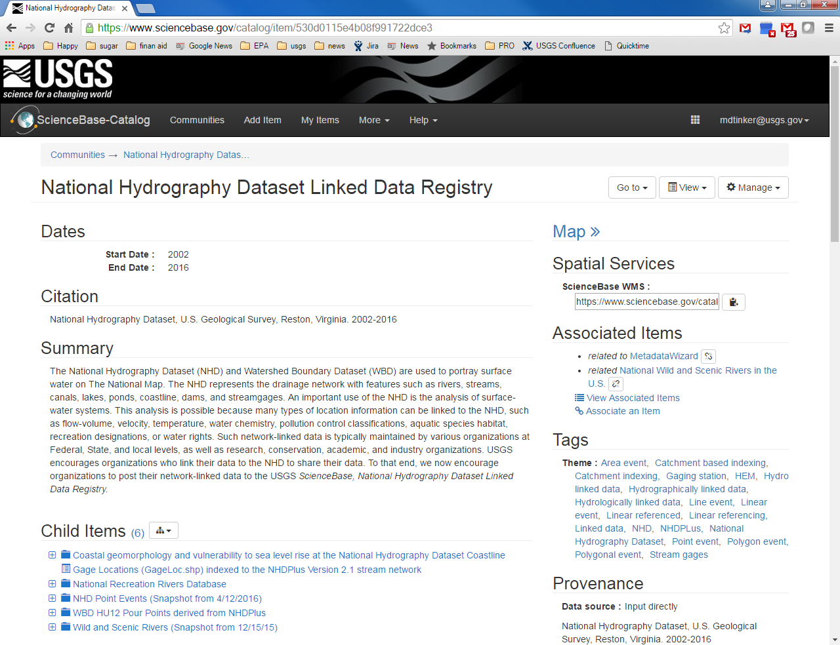

Slide 20


Slide 21
Network Linked Data Index Use Cases
Network Master Tools: As a system manager responsible for data connected to the river network, I need a way to register my data with the index, so the network swimmer can index my data.
Actors: Person responsible for network linked data, external content management system. Information: Network linked data owner provides the system with various metadata elements as well as network linked data or metadata pointing to a supported service. The system saves this information into a content management system. Computation: The network master tools perform verifications that ensure the information passed in is sufficient and valid.
Network Swimmer: As the network linked data index system user, I need the system to ‘swim’ registered network linked data on a regular basis and update the index accordingly, so the content is correct and current.
Actors: Network linked metadata store and data. Information: The network swimmer retrieves metadata for each registered data source. Computation: If data from a given datasource is non-static or has been changed since last checked, the network swimmer retrieves data and incorporates it into the current index.
Network Linked Data Services: As a user of network linked data, I need a service that allows me to search for network linked data, so I can find my own and others’ data on the network.
Actors: Network linked data clients / users. Information: An external application passes in a stream reach or a location near a river and additional information to configure the desired features and other characteristics of the request. Computation: The network linked data service traverses the network according to the passed-in query, performs the query and formats the result to send back to the user.

Slide 22
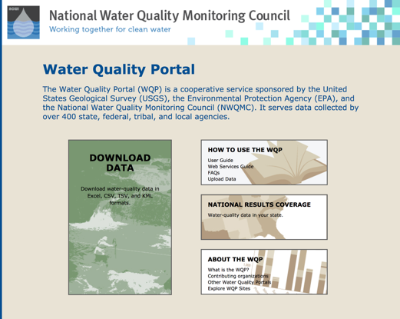
Water Quality Data Discovery
Using the Hydro-Network Linked Data Index

Slide 23
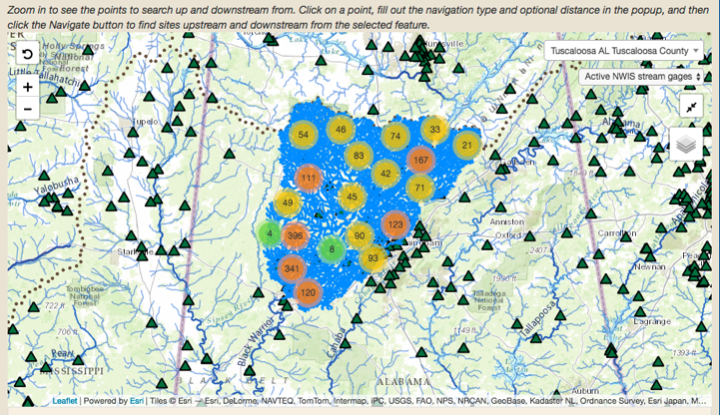
Water Quality Data Discovery
Using the Hydro-Network Linked Data Index

Slide 24
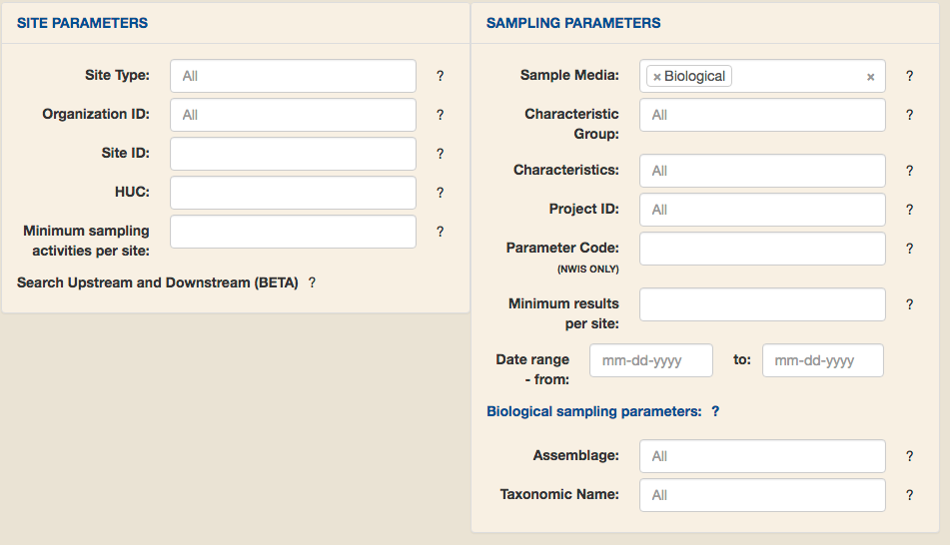
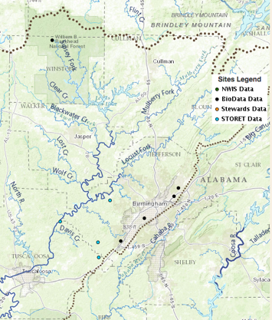
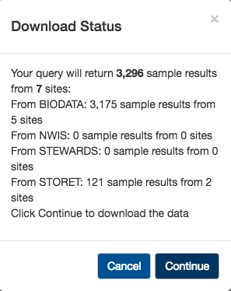
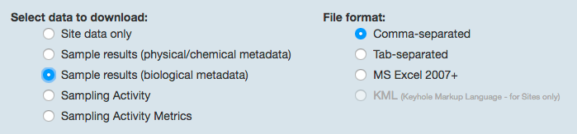
Water Quality Data Discovery
Using the Hydro-Network Linked Data Index

Slide 25
Network Linked Data System Use Case Diagram
Network Linked Data Index System
Network Master Tools
System Manager
(WQP manager)
Network Swimmer
ScienceBase Content Management System
Network Linked Data Source (WQP, etc.)
Network Linked Data Services
Client Applications

Slide 26
Network Linked Data System Use Case Diagram
Network Linked Data Index System
Register
Network Master Tools
System Manager
(WQP manager)
Index
ScienceBase Content Management System
Network Swimmer
Network Linked Data Source (WQP, etc.)
Search
Network Linked Data Services
Client Applications

Slide 27
Network Linked Data System Use Case Diagram
Create
Network Linked Data Index System
Curate
Register
Network Master Tools
System Manager
(WQP manager)
Index
ScienceBase Content Management System
Network Swimmer
Network Linked Data Source (WQP, etc.)
Search
Network Linked Data Services
Serve
Client Applications
Use

Slide 28
Water Intelligence Network System (WINS)
Create
HydroLink
Fish locations
Wetlands
Register
Fish
App
Example Apps:
National Water Model
HydroLink
SPARROW
StreamStats
National Water Census
etc.
NHD
Dams
Index
Curate
NHDPlus
API
net-
work navi-
gation
Levees
App
Search
WBD
Linked Data
Registry
Serve
App
ser-
vices
3DEP
NWIS
Use
Water Quality Portal
Water Quality
STORET
etc.
Notes:
Locations such as fish sampling locations are input to HydroLink, which makes calls to the API to link to the NHDPlus geospatial framework.

Slide 29
How can we all contribute?
Create: HydroLink, HEM, ??
Curate: ScienceBase, ??
Register: ??
Serve: WQP, NWIS, ScienceBase, ??
Use: WQP, StreamStats, R-Script, General User GUI??
Index: Point in catchment, reach code / measure, ??
Search: Navigate, ??
More linked datasets; compelling user stories

Slide 30
Take-away points
Geospatial Hydrographic Framework
NHDPlus at its core, provides services for many applications
NHDPlus V2 - now
NHDPlus HR - future
NLDI
App using the Framework: Water Quality Portal
Flexible index, services, data discovery.
Additional data and services
Catchment boundaries and characteristics.
Streamflow observations and modeling.
Streamflow statistics and analysis tools.

Slide 31
Resources/Links
NHDPlus V2
services in a web map: http://arcg.is/2cRsjgK
national seamless gdb: https://www.epa.gov/waterdata/nhdplus-national-data
NHDPlus HR info: https://nhd.usgs.gov/NHDPlus_HR.html
NLDI: https://cida.usgs.gov/nldi/about
https://owi.usgs.gov/blog/nldi-intro/
WQP: https://www.waterqualitydata.us/

Slide 32
Extra Slides
Following slides are for possible reference, if needed

Slide 33
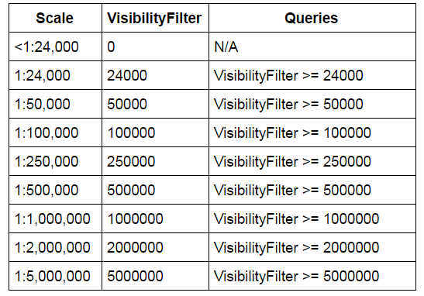
VisibilityFilter - Scale Representation
Available for Region 1 and 6
Provides filtering of vector features at 8 approximate scales.
Coded-values indicate that the feature is appropriate for use at approximately the defined scale and all larger scales.
Available for NHDFlowline, NHDWaterbody, NHDArea, and NHDLine feature classes.
Notes:
Ariel / Ryan
The VisibilityFilter attribute currently is in a testing phase. VisibilityFilter attribute population will be updated to become an automated process prior to NHDPlus HR creation. The new process will allow the VisibilityFilter attribute to be populated on NHD source data, NHDPlus HR data and when a geometry change to any of the NHD feature classes with the VisibilityFilter attribute is detected, ensuring NHD and NHDPlus HR data VisibilityFilter attributes are maintained and current.

Slide 34
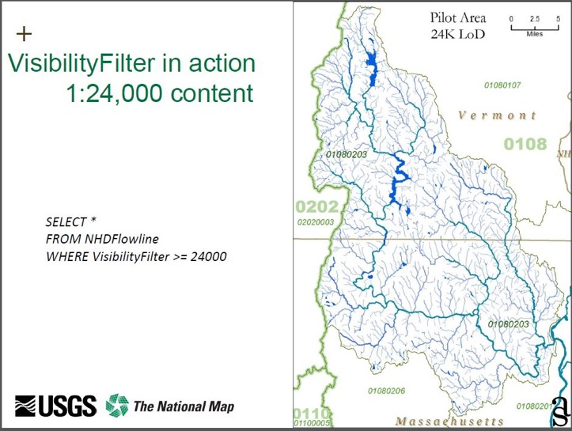
Sample Data
Batch Pruning NHD Data to Smaller Scales, Stauffer, A. J., Finelli E. L., Stanislawski J.V.

Slide 35
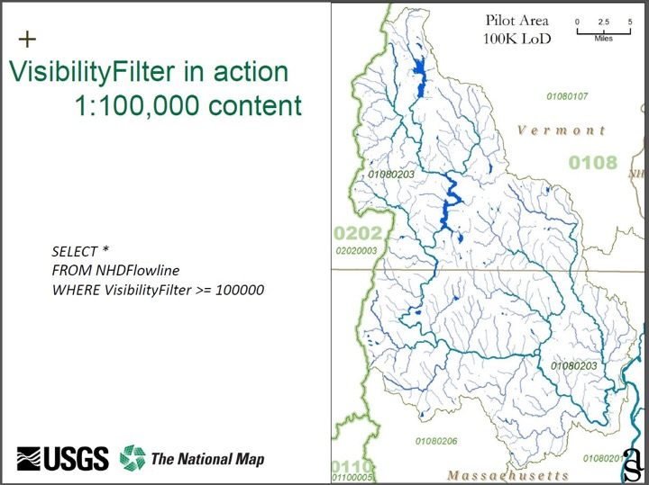
Sample Data
Batch Pruning NHD Data to Smaller Scales, Stauffer, A. J., Finelli E. L., Stanislawski J.V.

Slide 36
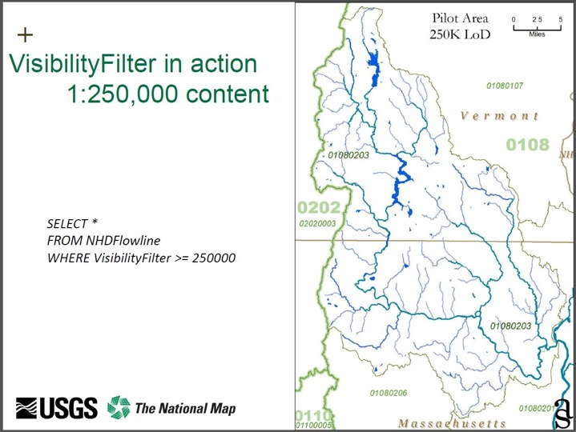
Sample Data
Batch Pruning NHD Data to Smaller Scales, Stauffer, A. J., Finelli E. L., Stanislawski J.V.

Slide 37
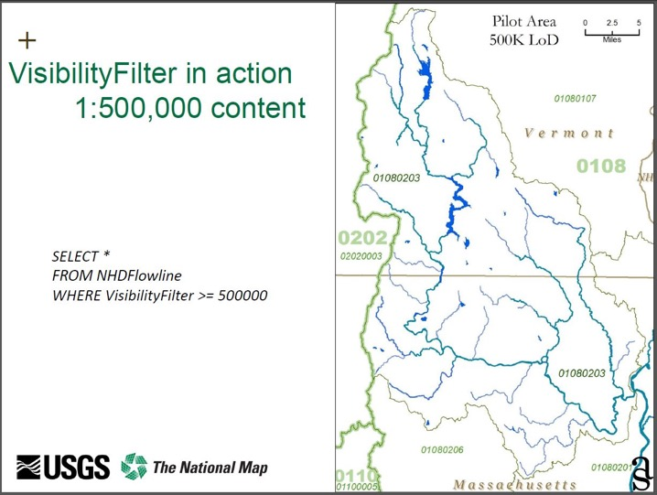
Sample Data
Batch Pruning NHD Data to Smaller Scales, Stauffer, A. J., Finelli E. L., Stanislawski J.V.

Slide 38

Sample Data
Batch Pruning NHD Data to Smaller Scales, Stauffer, A. J., Finelli E. L., Stanislawski J.V.

Slide 39
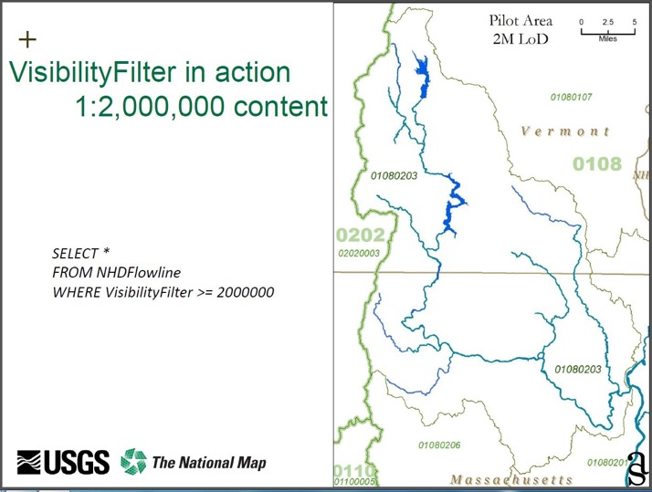
Batch Pruning NHD Data to Smaller Scales, Stauffer, A. J., Finelli E. L., Stanislawski J.V.

Slide 40
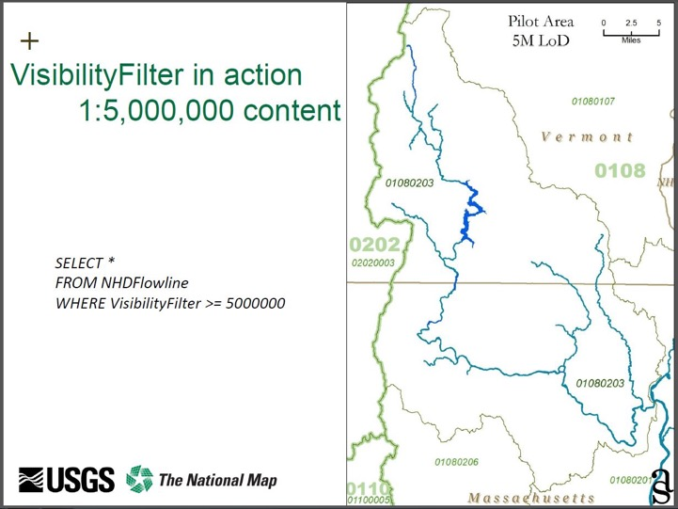
Batch Pruning NHD Data to Smaller Scales, Stauffer, A. J., Finelli E. L., Stanislawski J.V.

Slide 41
Transition from NHDPlus V2 to
NHDPlus HR
How/when does this happen?
What are key requirements before this can happen?
Pilots?

Slide 42
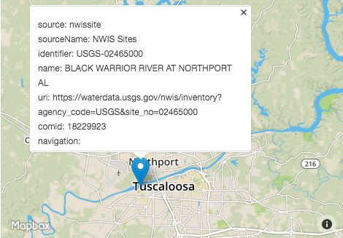
NLDI NWIS Site
https://cida.usgs.gov/nldi/nwissite/USGS-02465000

Slide 43
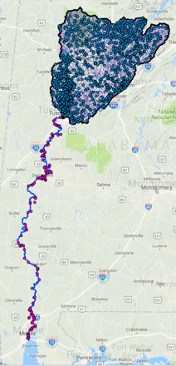
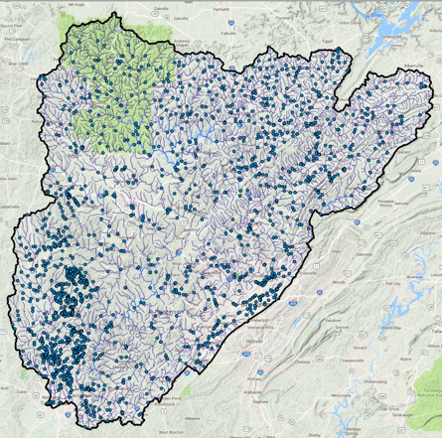
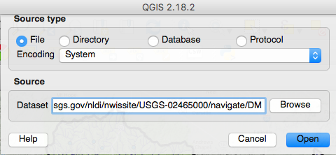
https://cida.usgs.gov/nldi/nwissite/USGS-02465000/navigate/UT https://cida.usgs.gov/nldi/nwissite/USGS-02465000/navigate/UT/wqp https://cida.usgs.gov/nldi/nwissite/USGS-02465000/basin https://cida.usgs.gov/nldi/nwissite/USGS-02465000/navigate/DM

Slide 44
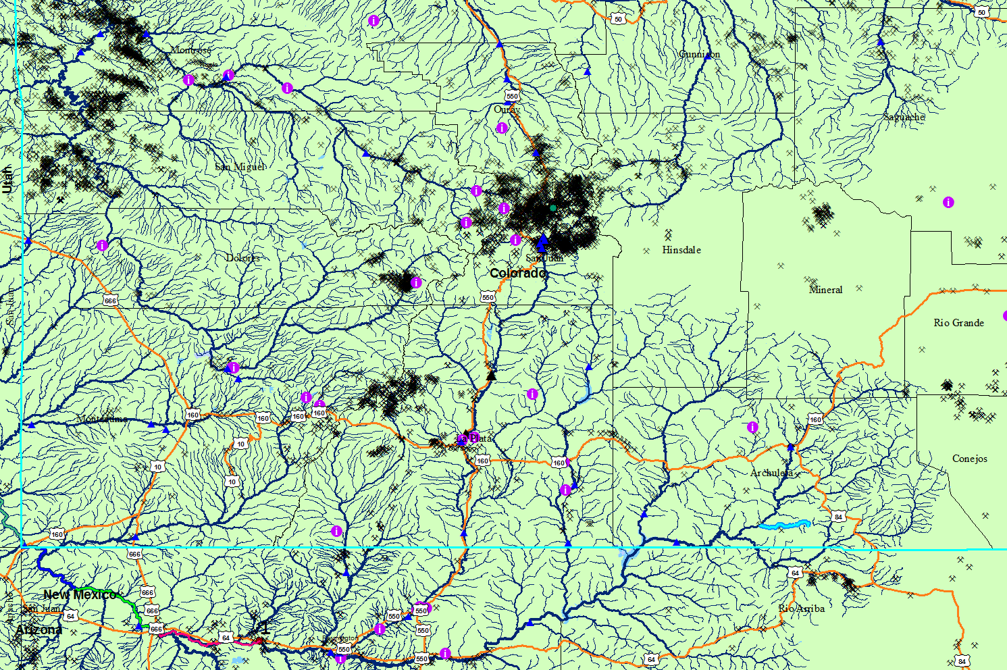
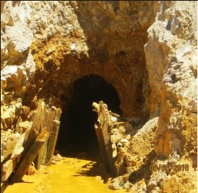
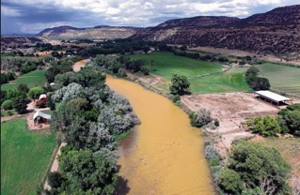
Gold King Mine Spill ICWater Preliminary Results
Gold King Mine
Slide courtesy of Bill Samuels, Leidos
Notes:
Preliminary ICWater results provided by William B. Samuels, samuelsw@leidos.com

Slide 45
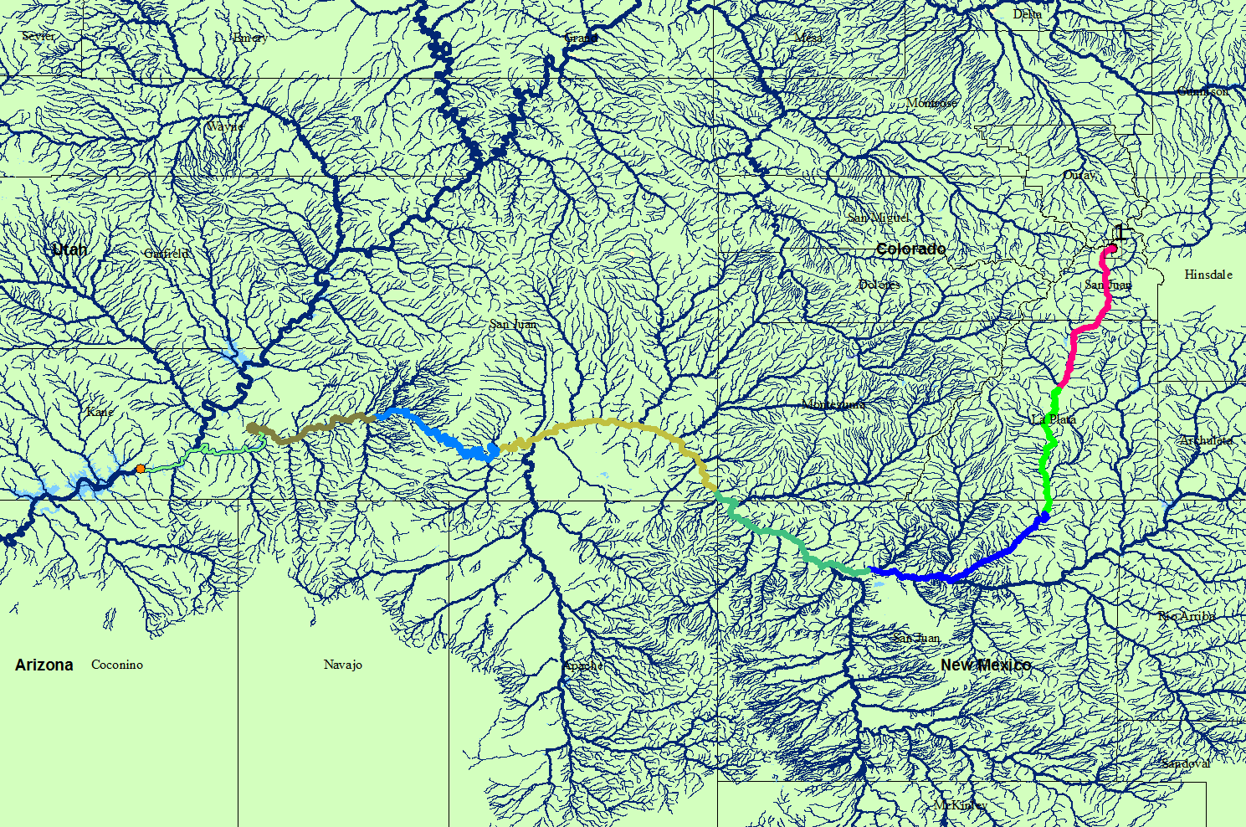
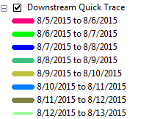
ICWater QuickTrace – 8 day travel time
Gold King Mine
Lake Powell
ICWater Preliminary Results: Slide courtesy of Bill Samuels, Leidos
Notes:
Preliminary ICWater results provided by William B. Samuels, samuelsw@leidos.com

Slide 46
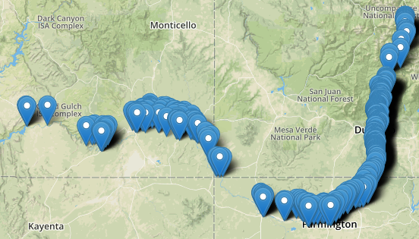
https://cida.usgs.gov/nldi/huc12pp/140801040102/navigate/DD/wqp?distance=500
(WQP sites 500 km downstream of Gold King Mine)

