Slide 1
Environmental Observation Systems Soil and Landscapes Perspective
Alistair Ritchie, Informatics Team
Lincoln, New Zealand

Slide 2



Environmental Observation Systems National EnvironmentPerspective
Alistair Ritchie, Brent Watson, Sean Hodges, Adrienne Bonnington, Jochen Schmidt, David Medyckyj-Scott , Alex Kmoch, Byron Cochrane

Slide 3
Overview
New Zealand Crown Research Institutes
Landcare Research as an example
Research Motivation
Open(-ish) data services and standards
Profiles of O&M
Interoperability Experiments

Slide 4
Crown Research Institutes
Corporate Crown (government) entities charged with conducting scientific research for the public good
Landcare Research NZ Ltd
National Institute of Water and Atmospheric Research (NIWA)
Institute of Geological and Nuclear Sciences (GNS Science)
New Zealand Pastoral Agriculture Research Institute (AgResearch)
New Zealand Institute for Plant and Food Research
Institute of Environmental Science and Research
New Zealand Forest Research Institute Limited (Scion)

Slide 5
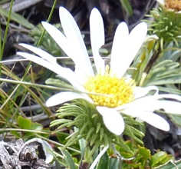
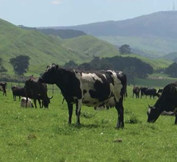
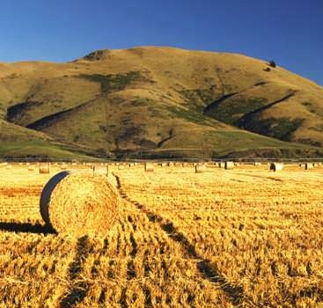

Landcare Research
Drive innovation in the management of terrestrial biodiversity and land resources
Protect and enhance the land environment and grow the country’s prosperity
Informatics team of 40
Research and operations
Technical support for a set of Nationally Significant Collections and Databases

Slide 6
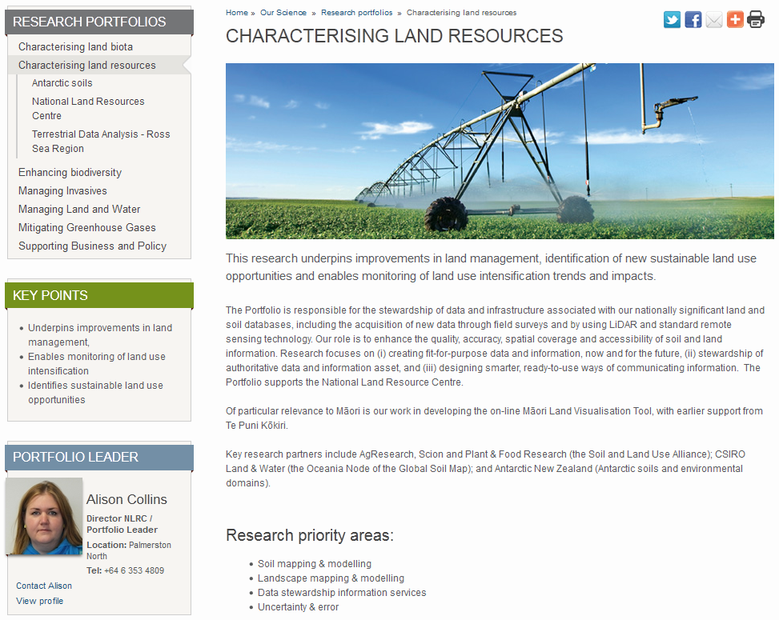
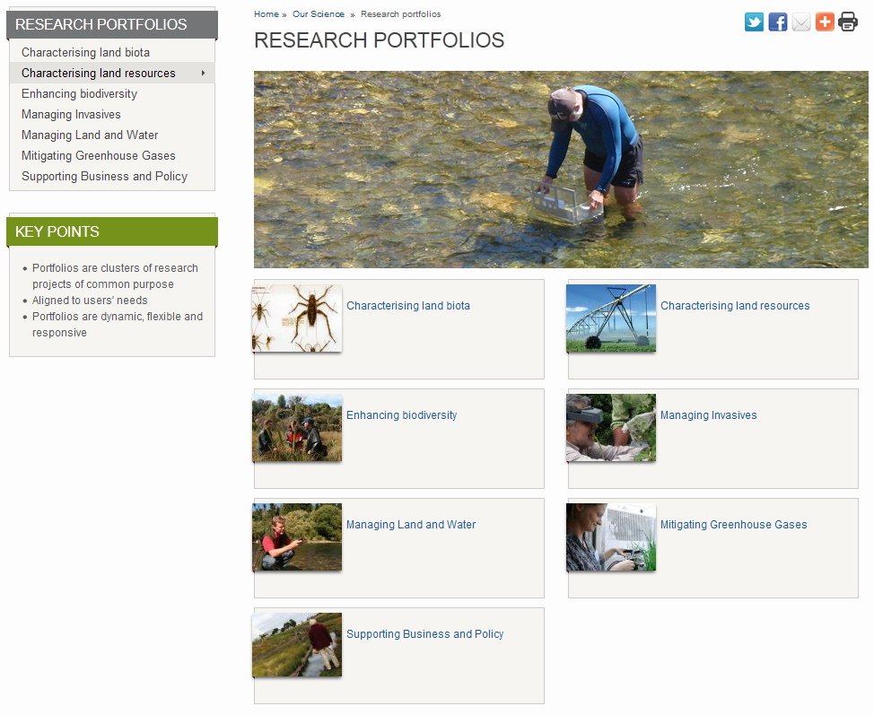
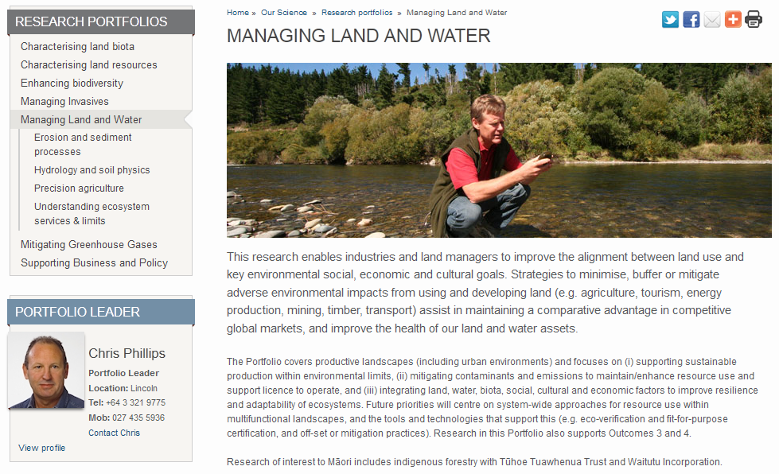

Slide 7
Open(-ish) Data
(Why open-ish? The CRIs commercial imperative.
A whole ‘nother story …)
Our science sits at the intersection of the earth and life sciences
Not only need to publish data
Need to integrate data across domains
Need as much interoperable common ground as possible

Slide 8
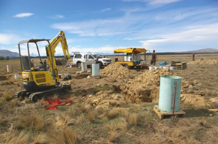
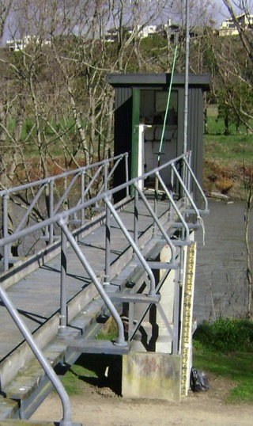
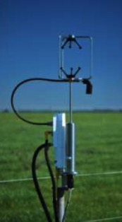
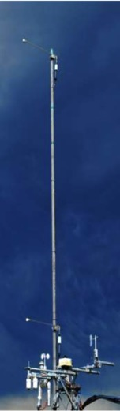
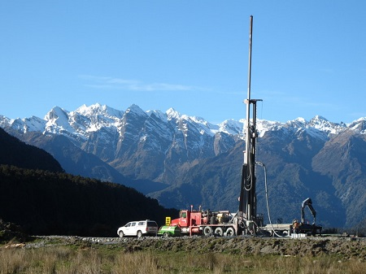
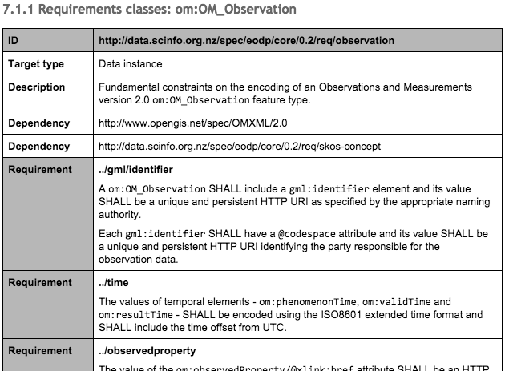
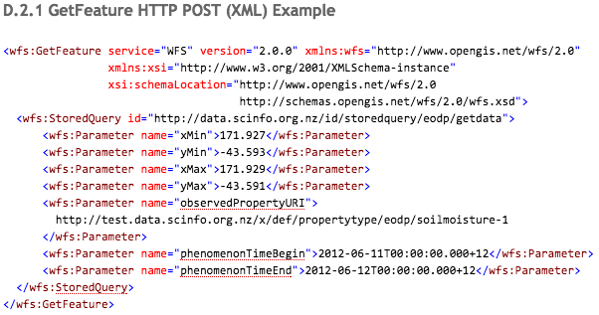
Environmental Observation Data Profile

Slide 9
Environmental Observation Data Profile
AKA EODP
Lock down app schema
O&M
WaterML 2.0
Defined content
Vocabularies
Support discovery
GetDataAvaliability for WFS

Slide 10
Environmental Observation Data Profile
Modular specification for O&M based services
First modules:
Core – O&M ‘register’
Hydrology - WaterML 2.0 SOS
Future modules
Soil (TimeseriesML, ‘SoilML’)
Water Quality
Biodiversity data integration …
eodp-core
eodp-hydro
eodp-water-quality
eodp-bio
eodp-soil

Slide 11
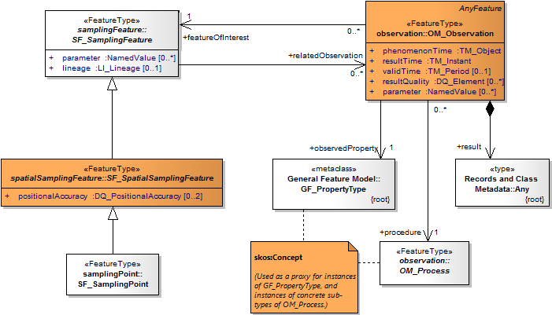
Observations and Measurements
Core information model for all monitoring data

Slide 12
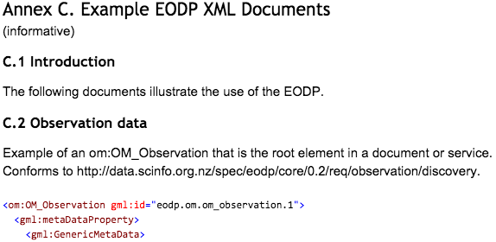
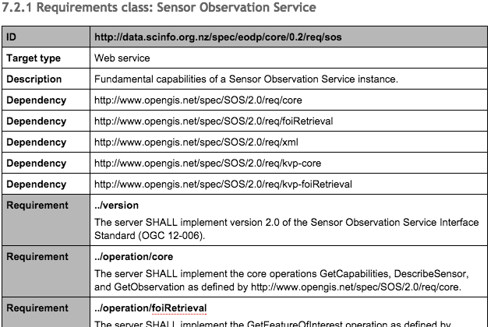
Environmental Observation Data Profile
Formal definition of requirements
Documented according to the OGC modular spec.

Slide 13
Soil Data Interoperability Experiment
Initiated by the International Union of Soil Sciences Working Group on Soil Information Standards
Agriculture Domain Working Group
Participants:
IE Initiators: CSIRO, Landcare Research, IRSIC
USDA, USGS, Federation Uni (Aus), CRA-ABP (Italy), Horizons
6 months to implement; 6 months to write up
Deploy a set of demonstrators; engineering report

Slide 14
Soil IE Use Cases
Use Case 1: soil data integration & publication
Publication of heterogeneous soil data from different data stores
Use Case 2: soil sensor data
Publication of data from sensors monitoring dynamic soil properties
Use Case 3: soil property modelling and predictions
Provision of high resolution estimates of functional soil properties
Use Case 4: pedo-transfer functions
Process observed and interpreted soil properties using of pedo-transfer functions - algorithms that calculate additional interpreted soil properties

Slide 15
Soil IE Exchange Standard
Reviewed five existing standards
Australia and New Zealand Soil Mark-up Language
e-SOTER Soil and Terrain Mark-up Language
INSPIRE D2.8.III.3 Data Specification on Soil
ISO 28258:2013 Soil quality – Digital exchange of soil-related data
IUSS/ISO ‘Wageningen Proposal’ (effort to reconcile 1. and 4.)
No clear candidate from this work

Slide 16
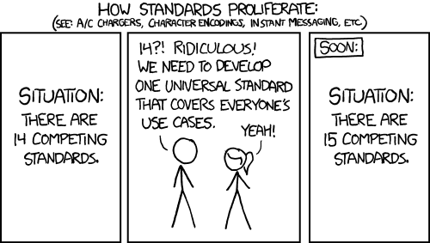
UH OH
Not quite … point to prove … can use existing standards
Back to basics using as much existing work as possible

Slide 17
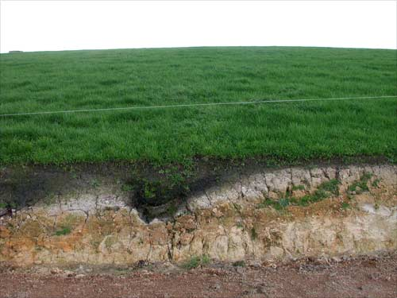
Soil IE Candidate Standard

Slide 18
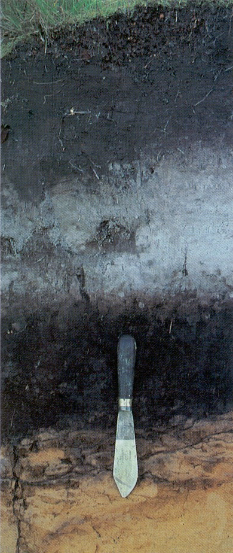
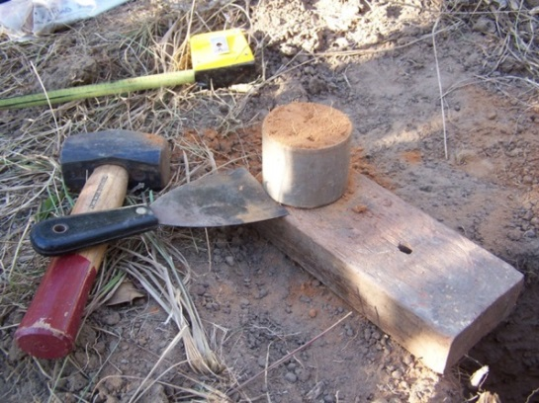
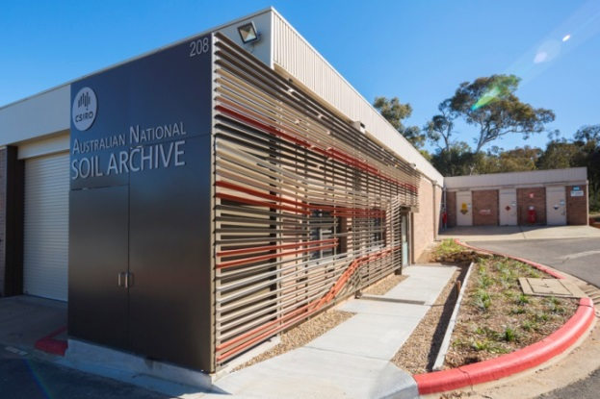
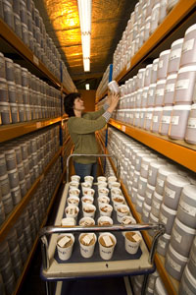
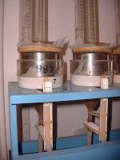
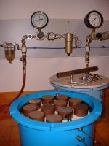
Soil Observations
ISO19156/OGC10-004r3 - Observations and Measurements

Slide 19
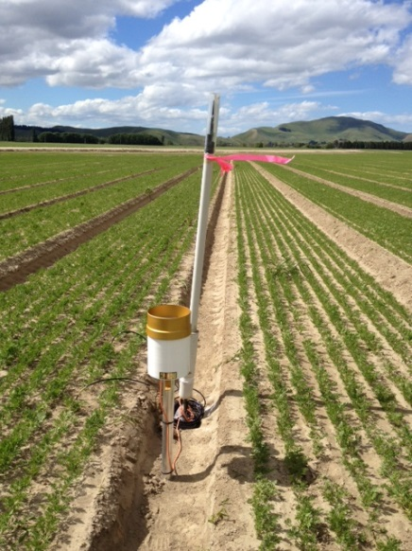
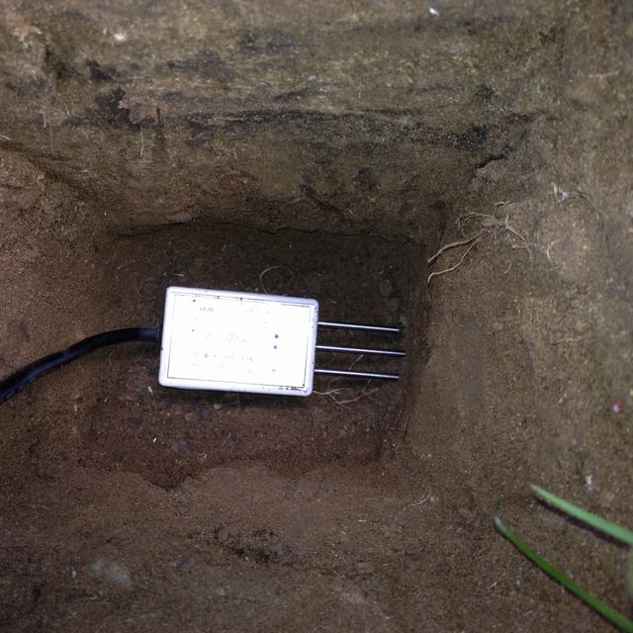
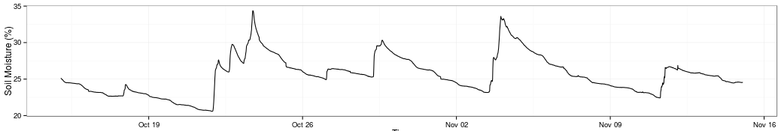
Soil Sensors
OGC15-043r3 – Timeseries Profile of Observations and Measurements

Slide 20
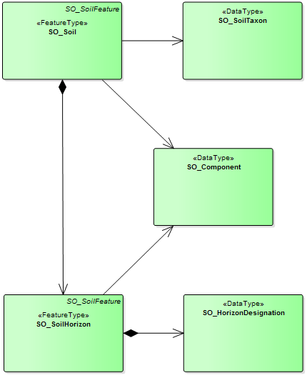
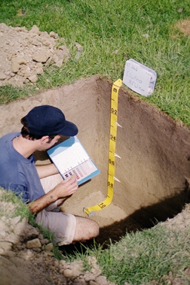
Soil Descriptions
OGC16-088r3 - OGC Soil Data Interoperability Experiment
Podzol Soil (Z)
[NZSC]
Ah
E
texture
bulk density
organic carbon
particle size distribution
…
Bh
C

Slide 21
Soil IE Implementation
Soil Data
WFS
WPS
Execute PTFs
SOS
Vocabularies
Soil Taxonomies
Observable Properties
Sensor
Data
Registry
PID Service
Client
HTTP URIs
(conneg)
Gridded Data
WCS
WMS
Maps

Slide 22
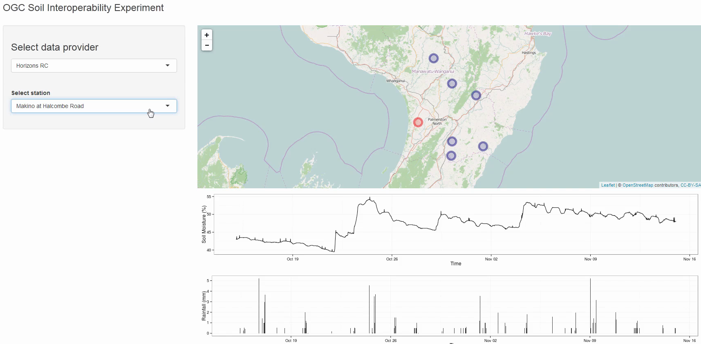
Demonstration: Soil Sensors
Use Case Two
Provision of soil moisture
and rainfall data
Contributors
Landcare Research;
Horizons RC; USGS

Slide 23
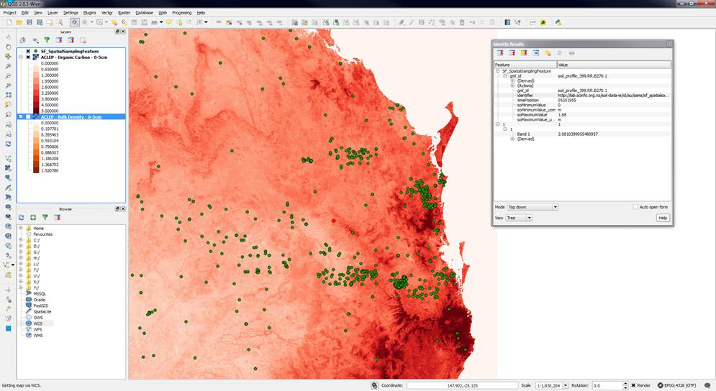
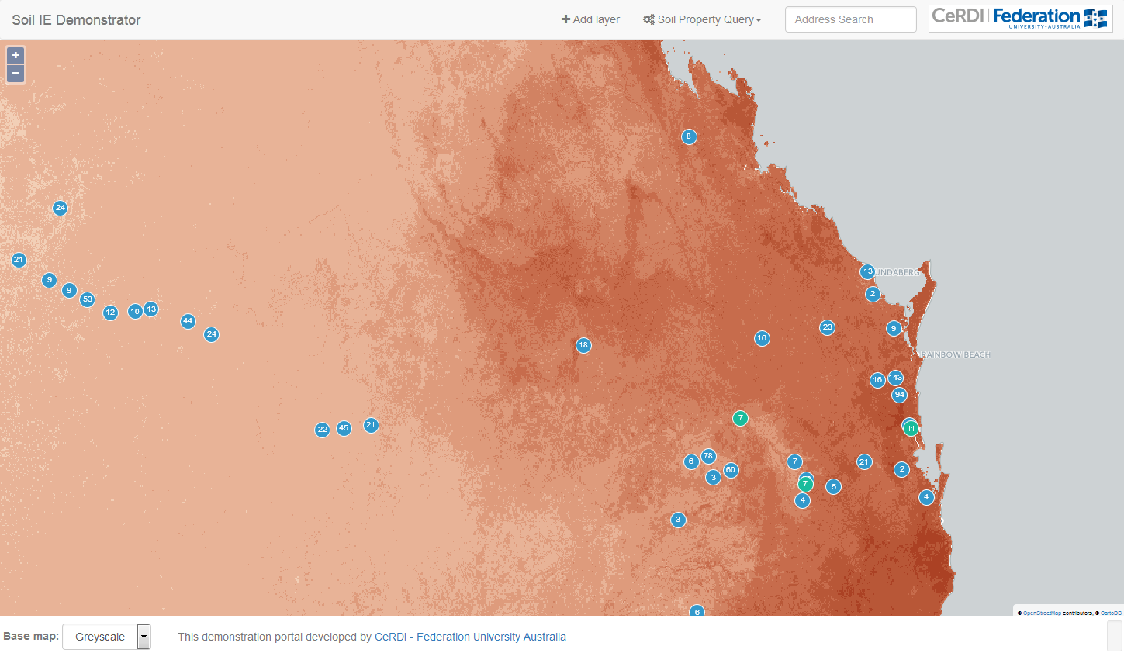
Demonstration: Soil Properties
Use Case Three
Provision of soil property
models and predictions
Contributors
CSIRO Land and Water (AU); Federation University of Australia (AU)

Slide 24
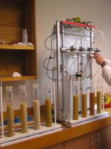
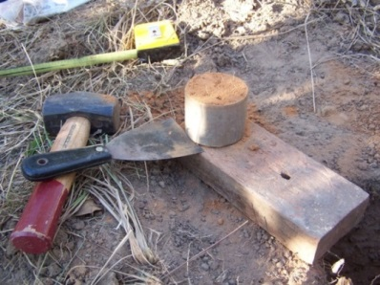
Demonstration: Soil Descriptions
Use Cases One and Four
Field observations, sampling, and laboratory analyses
Pedo-transfer functions
Contributors
Landcare Research (NZ)
CSIRO Land and Water (AU)
Federation University of Australia (AU)
ISRIC World Soil Information (NL)

Slide 25
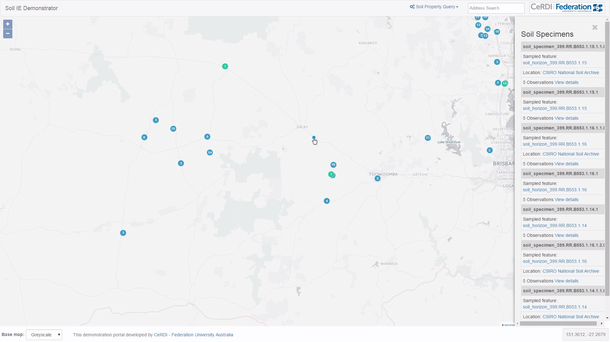
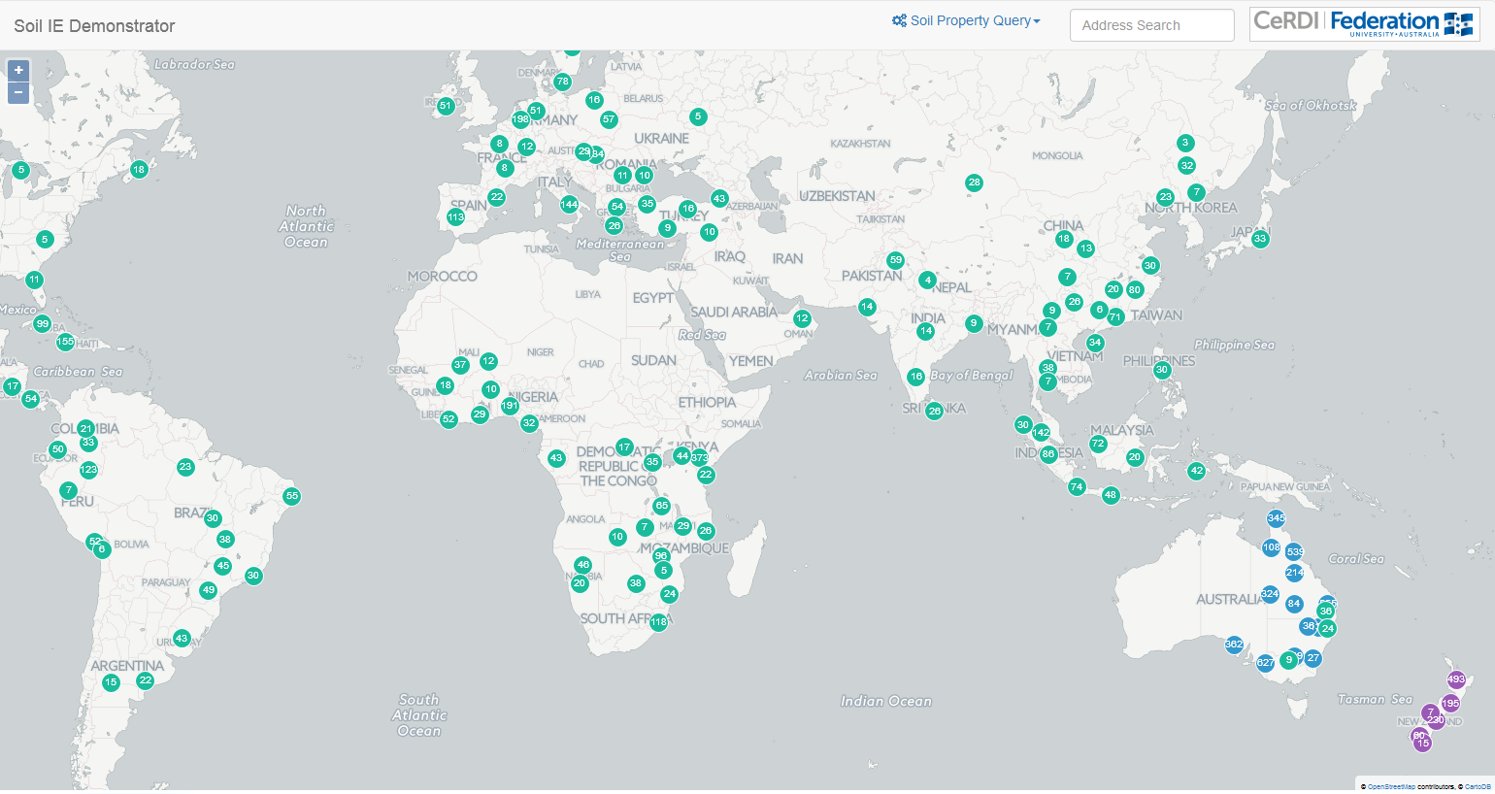
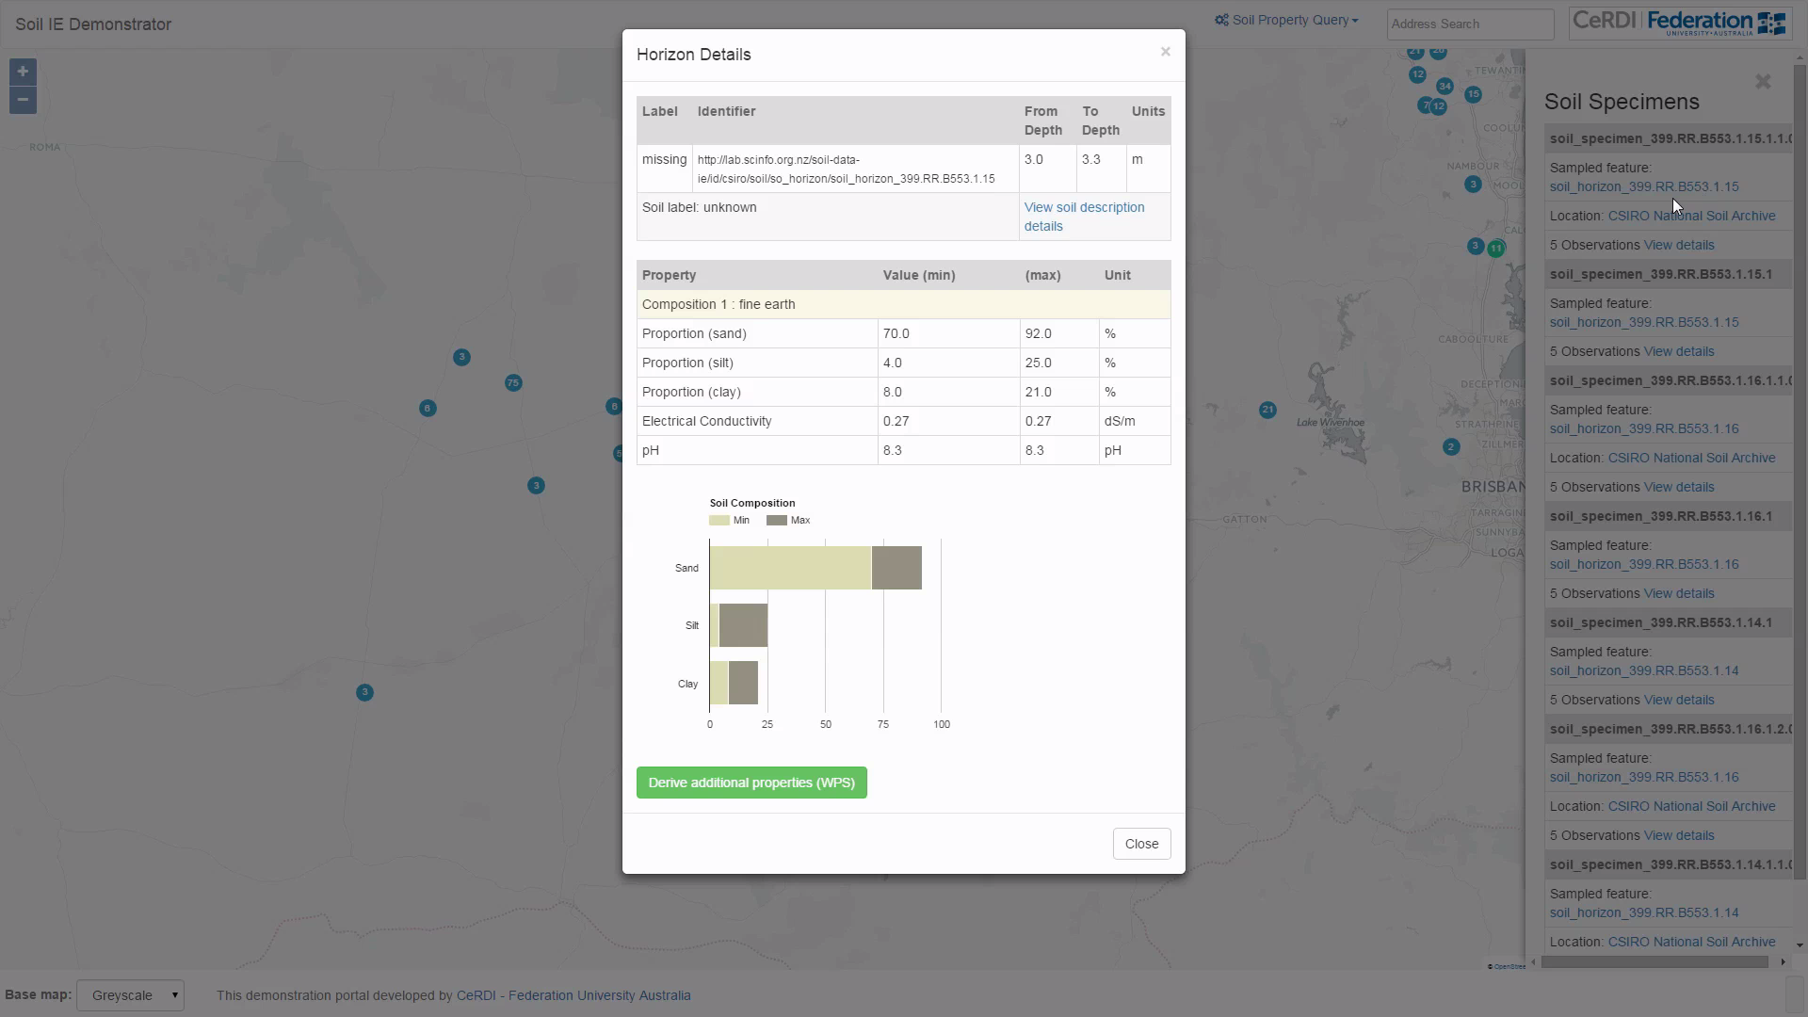
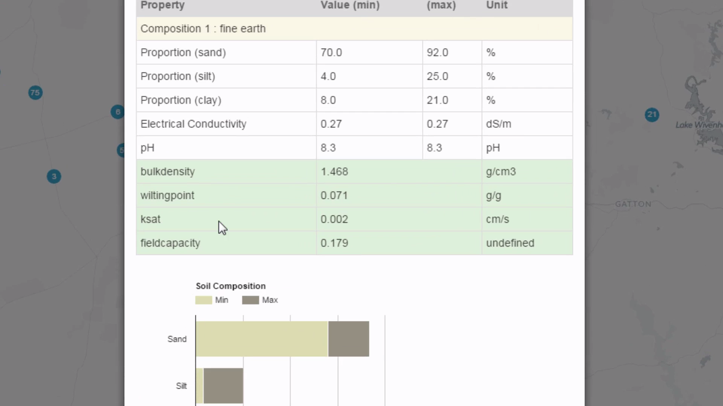
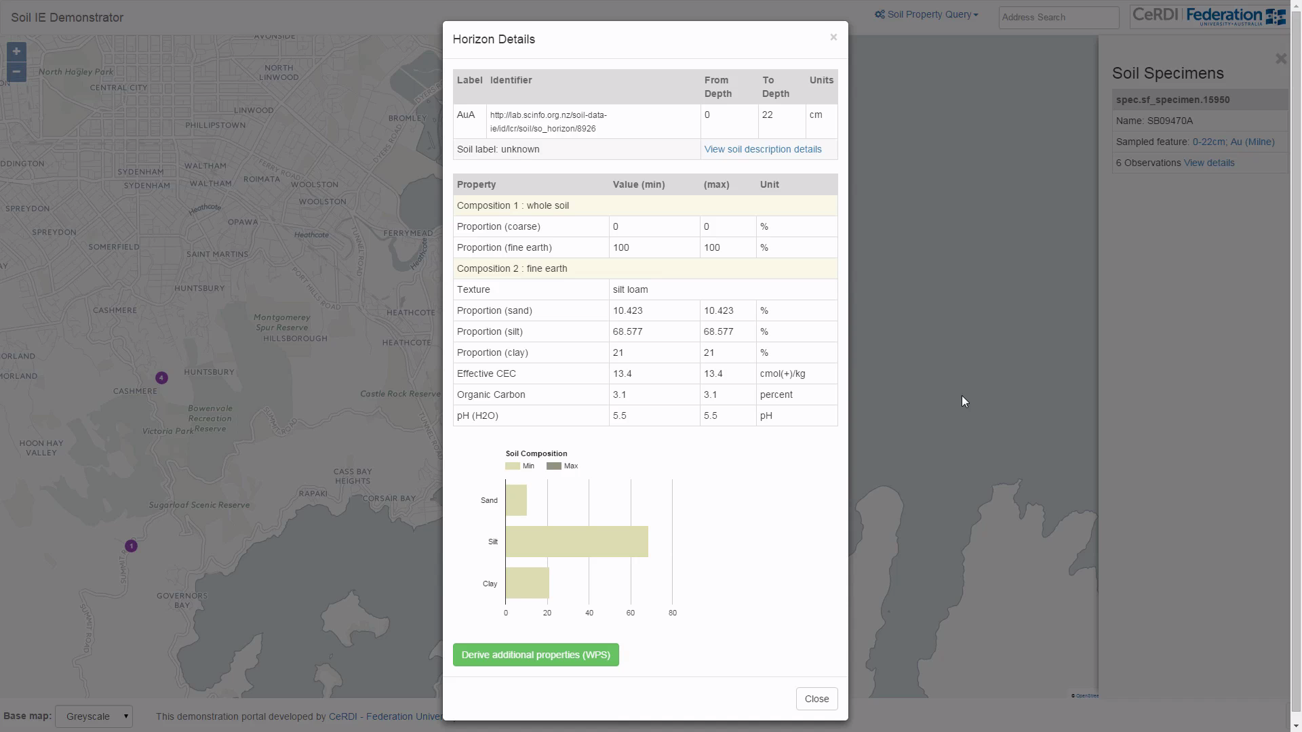
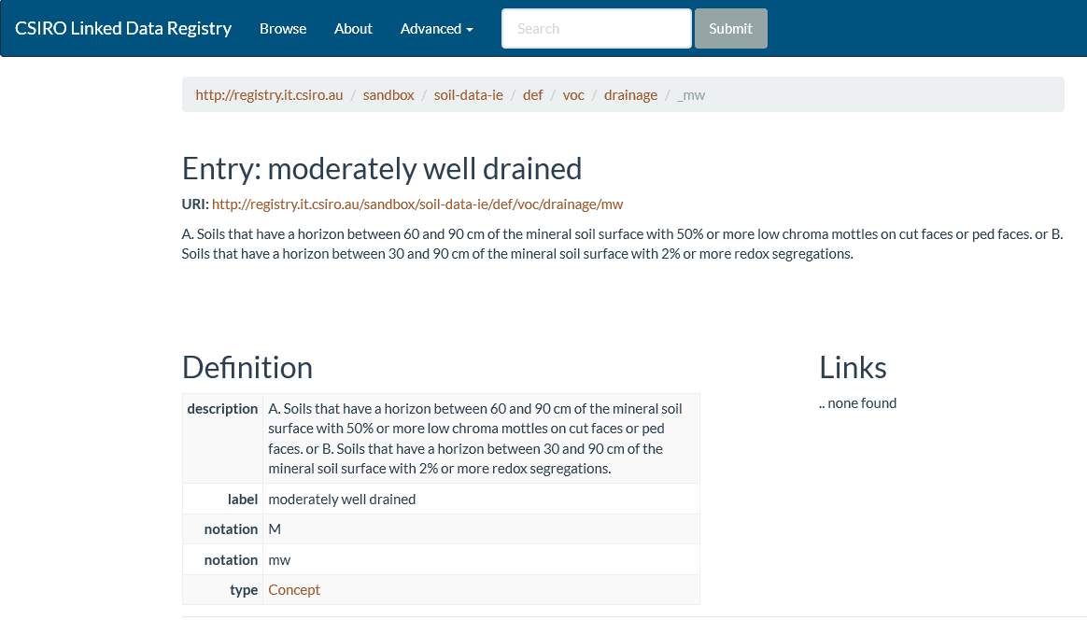

Slide 26
Soil IE and ELFIE
WFS
WPS
SOS
Registry
PID Service
Client
WCS
WMS

Slide 27
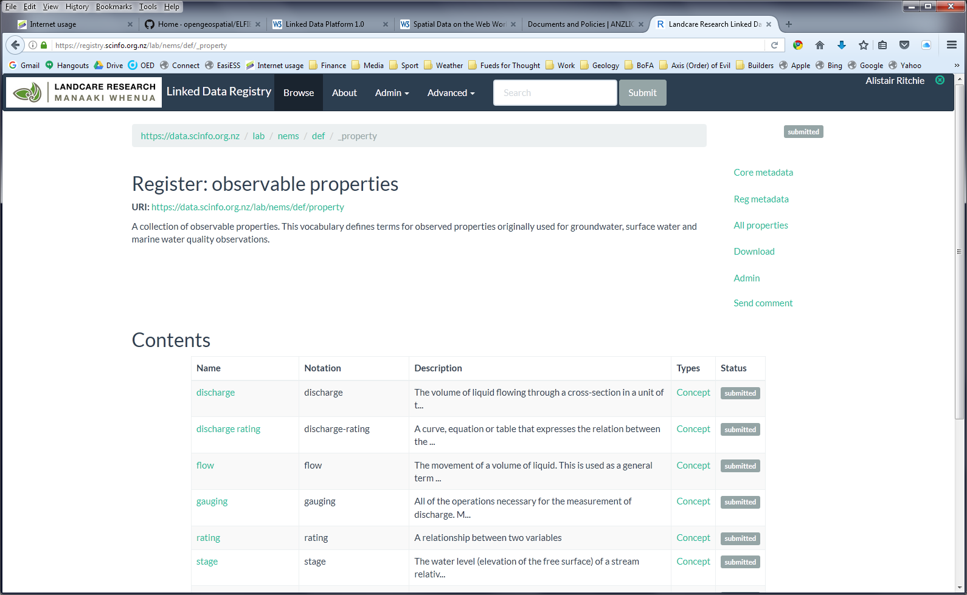
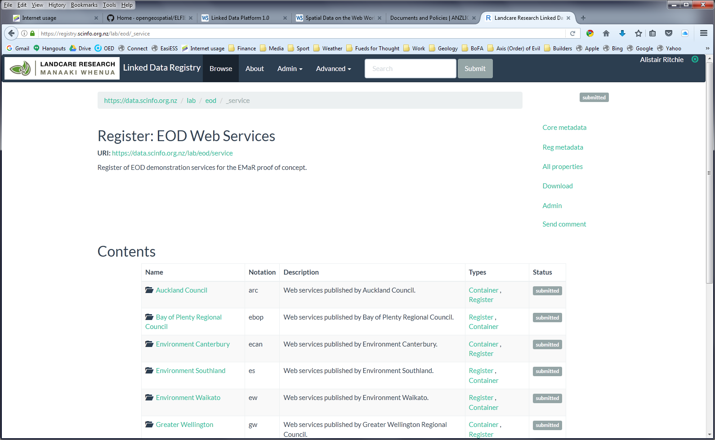
EODP and ELFIE

Slide 28
Application in New Zealand
Over to Brent …

