Slide 1
ATMOSPHERIC INVERSION METHODS
Optimising dyadic basis partitions with stochastic local search
TAC/MHD proof of concept
July 2026

Slide 2
Basis partitions decide where resolution is spent
A fixed grid treats every location as equally worth resolving.
fixed grid
adaptive partition
A data-informed partition can reserve state-vector capacity for regions where footprint–flux sensitivities support it.
→
Question: can local search improve a useful, physically structured starting partition?
2

Slide 3
This POC tests one narrow claim
It demonstrates
It does not claim
Deterministic TAC/MHD design construction Proxy-greedy K=32 initialization Stochastic improvement of Gaussian benchmark DFS Reproducible traces and partition visualisation
Posterior inference over partitions An optimal or inferred number of regions A Bocquet-consistent projected prior covariance Production-equivalent observation error treatment
3

Slide 4
TAC/MHD footprints and CH₄ flux build the design
1
2
3
4
23 MHD + 24 TAC hourly observations
Annual CH₄ flux field
Gᵢc = footprintᵢc × fluxc × 10⁹
Sum-coarsen ×8 47×293×391 → 47×37×49
Benchmark observation covariance
min_error is a minimum-mismatch floor, not the inferred production total-error process.
R = diag{max(error, min_error)²}
Method: demo_data.py; frozen TAC/MHD fixtures under tests/data.
4

Slide 5
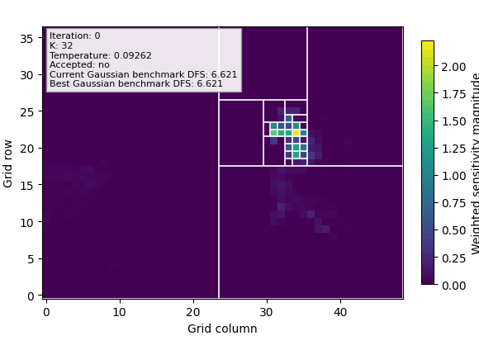
Proxy-greedy splitting creates the K=32 start
For candidate tile v
hᵢᵥ = Σc∈v Gᵢc
sᵥ = (1/aᵥ) Σᵢ Rᵢᵢ⁻¹ hᵢᵥ²
Cells are summed before squaring.
The initializer applies the split with the largest proxy gain until 32 active regions remain.
Background: log(1 + √Σᵢ Gᵢc²/Rᵢᵢ). It is context, not the complete tile score.
Method: initializers.py, objectives.py; visual: tac_mhd_sls.gif.
5

Slide 6
Fixed-K search changes partition shape
MERGE
SPLIT
ACCEPT
One active sibling pair
Another compatible active tile
Improve, or accept loss L with exp(−L/T)
Gaussian benchmark DFS
100
pilot proposals
D(P) = K − tr[(Bₚ⁻¹ + HₚᵀR⁻¹Hₚ)⁻¹ Bₚ⁻¹]
300
search evaluations
154
accepted moves
Stochastic optimisation, not posterior sampling.
Method: proposals.py, search.py, tac_mhd_sls_manifest.json; DFS inspired by Bocquet, Wu & Chevallier.
6

Slide 7
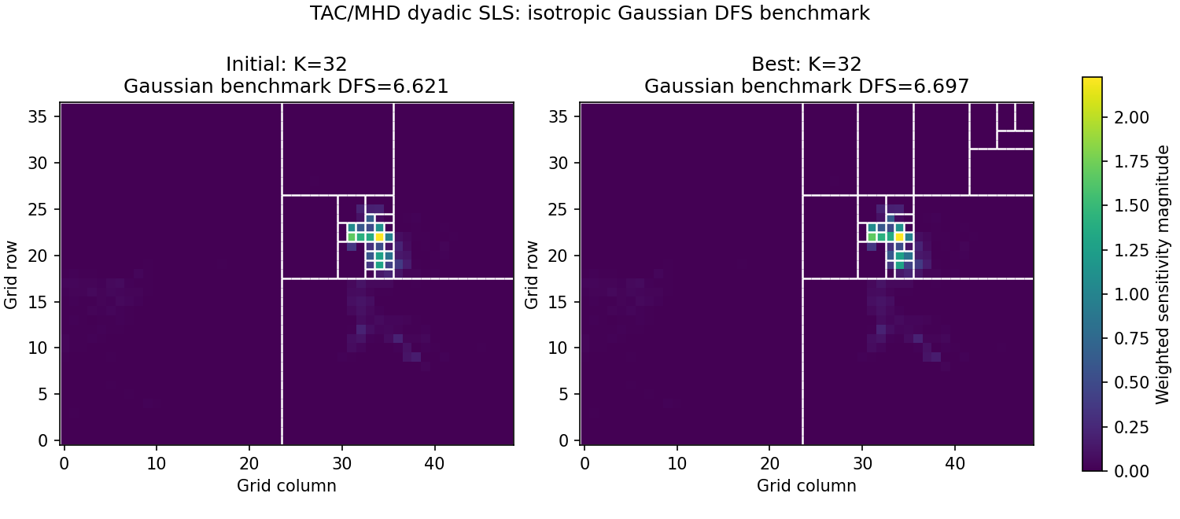
Local search improves the Gaussian DFS benchmark
6.6213868511 → 6.6969787847
2.2306430146 → 2.2599799610
4.7197859243 → 4.7464773740
combined TAC/MHD
MHD-only diagnostic
TAC-only diagnostic
Source: tac_mhd_sls_summary.png and tac_mhd_sls_manifest.json. Site-only DFS values are separate, non-additive recomputations.
7

Slide 8
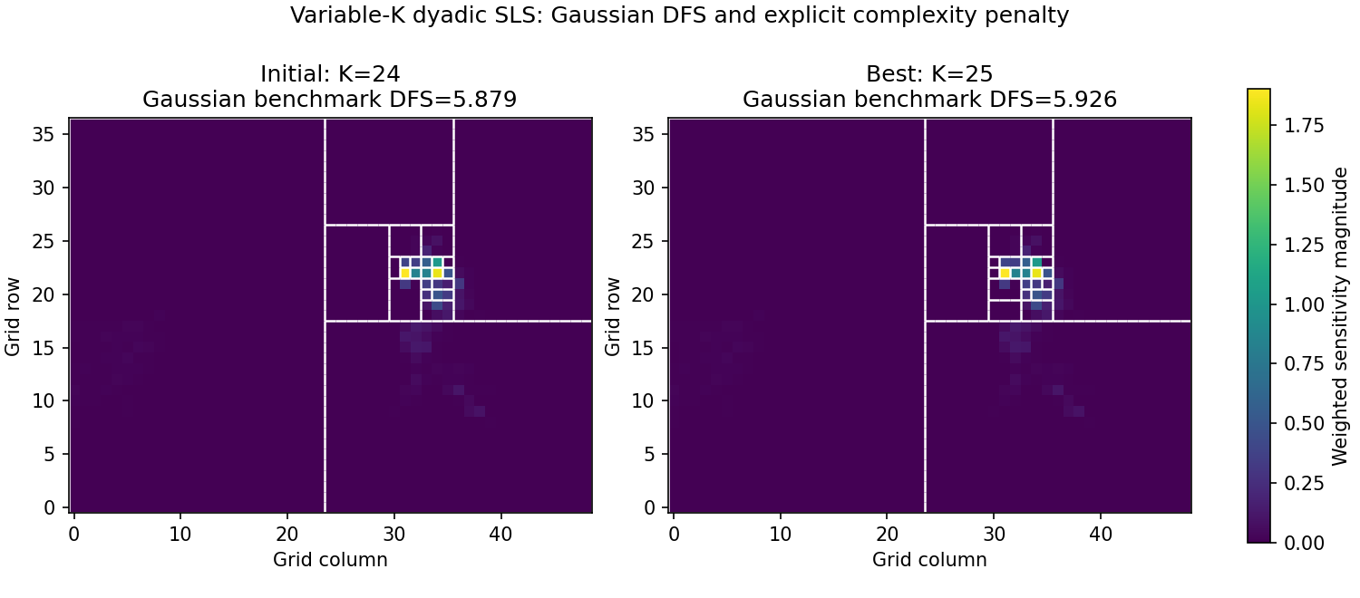
Full-week data scale variable-K search to 333 observations
FULL-WEEK LONGER RUN
333 hourly rows
K 24 → 25
DFS 5.878766 → 5.926013
2,000 evaluations · 927 accepted 2.36 s excluding rendering
SCHEDULE
ACCEPTANCE
U(P) = D(P) − λ max{0, K(P)−32}
pilot 300 · median-loss acceptance 0.50→0.01 hold 5% · final 20% (400 iterations) greedy
454 downhill (48.98%) · K visited 24–35 loss median 3.34e−7 · p95 0.0300 · max 0.06727
Many accepted downhill moves were numerically tiny; the final 400 iterations were zero-temperature greedy polishing.
GIF/trace: current and best penalized utility, K, and cellwise-I DFS (not bound). The selected floor defines R for all 333 rows; hourly error differences do not affect this run.
Source: full-week variable-K summary + manifest; fixed hourly covariance remains non-production.
8

Slide 9
Cellwise-I DFS uses an incomparable prior
CURRENT PROVISIONAL PRIOR
SCALE-CONSISTENT TARGET
Bₚ = τ² Iₖ
Bₚ = P B Pᵀ
reduced regions K=25 DFS 5.9260 cellwise-I K=1,813 DFS 4.9420
Project fine-grid covariance B with consistent prolongation and normalization.
Reduced: τ²I per region + summed columns. Cellwise-I: independent τ²I per cell.
Reduced signal covariance contains cross-cell terms, so 4.942 is neither a bound nor a maximum. Bₚ=PBPᵀ plus consistent projection, prolongation, and normalization are required before a meaningful no-reduction upper reference exists.
Source: full-week manifest; covariance design inspired by Bocquet, Wu & Chevallier.
9

Slide 10
The POC now covers fixed and variable K
WORKING NOW
NEXT EXPERIMENTS
Dyadic tree + multiscale design Proxy-greedy and random starts Fixed-K paired search (47 rows) Variable-K independent split/merge 2,000-evaluation full-week run
1
Projected covariance
Implement Bₚ=PBPᵀ with consistent mapping and normalization
2
Land / sea
Diagnose boundary crossing or impose an explicit constraint
3
Search robustness
Multiple seeds, longer runs, decoupled schedule calibration
4
Posterior integration
Combine partition updates with continuous inference
Status: dyadic_sls_hackathon.md; background: dyadic_partition_inference.md.
10

Slide 11
TAKEAWAY
The longer search improves DFS at K=25; retained-information claims must wait.
Next: Bₚ=PBPᵀ with consistent mapping, then multi-seed robustness, land/sea treatment, and posterior integration.
11

