Slide 1


QFieldCloud
12th Swiss QGIS user group meeting
November, 24th 2020

Slide 2
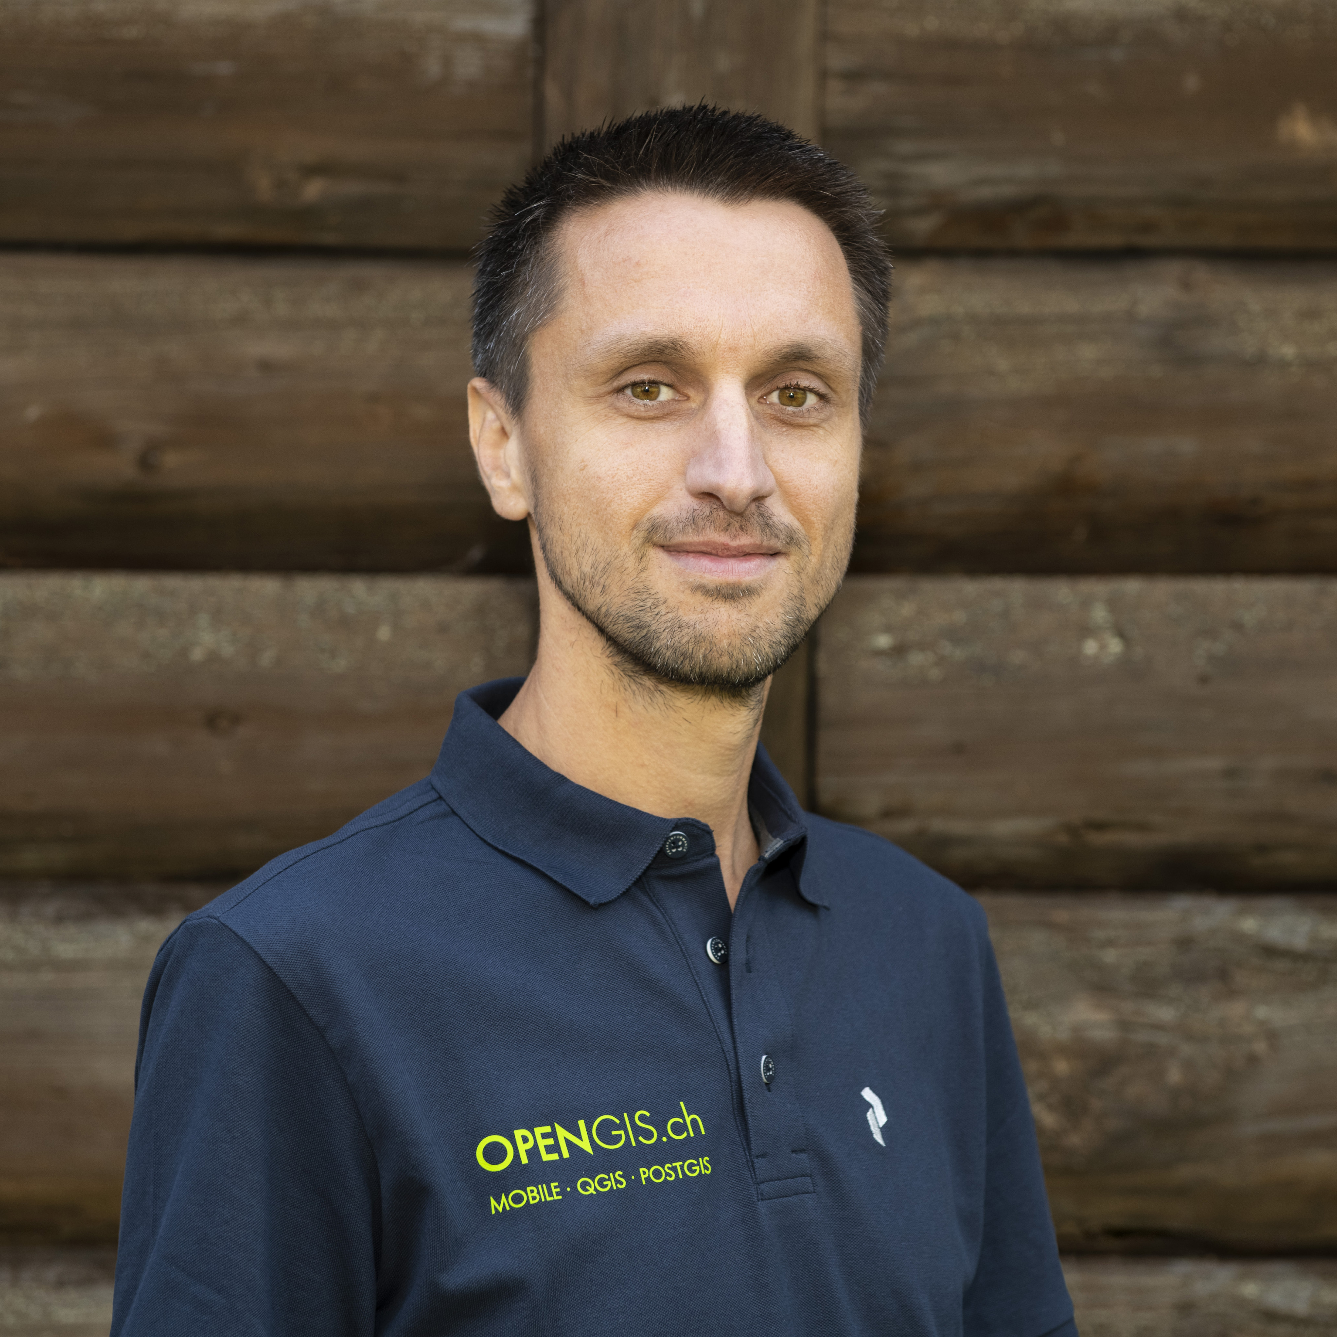
Who Am I?
Mario Baranzini
BSc Computer Science
Developer, consultant, coordinator @ OPENGIS.ch

Slide 3
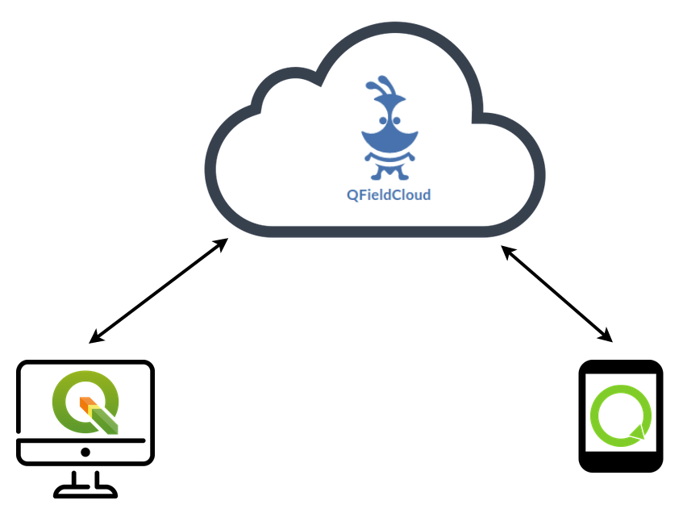
What is QFieldCloud?

Slide 4
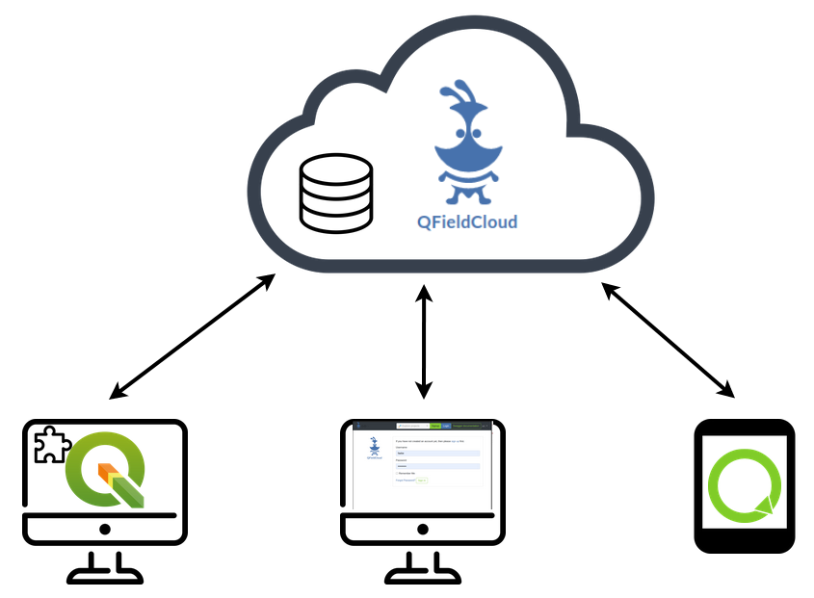
Architecture

Slide 5
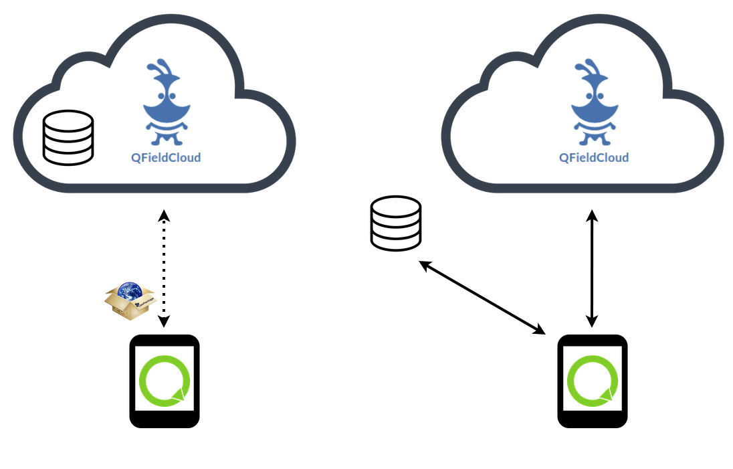
Online and offline synchronization

Slide 6
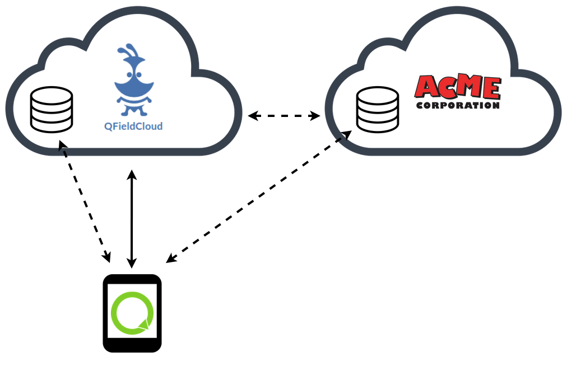
Data Storage

Slide 7
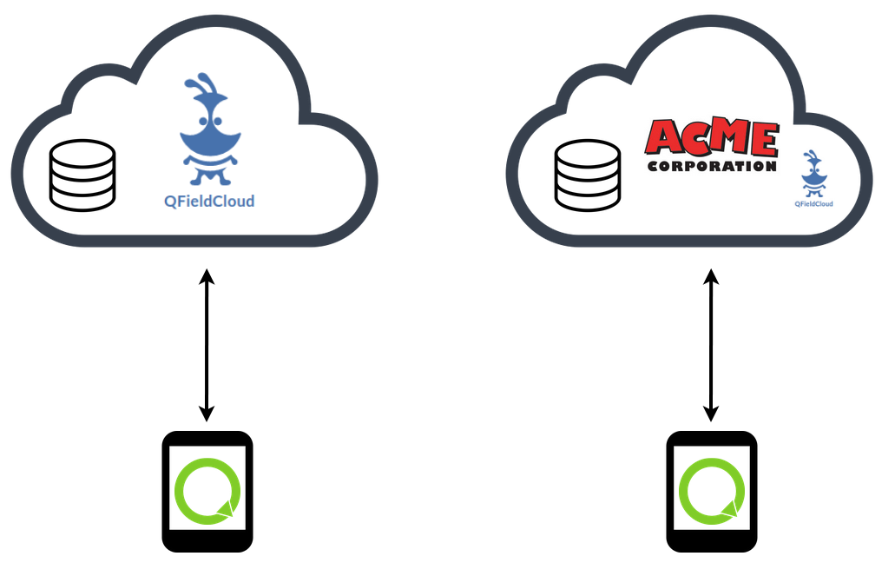
Hosted …or in your own cloud

Slide 8
Team Management
Users
Organizations
Projects collaborations
Granular permissions management

Slide 9



Secure and Sustainable Hosting

Slide 10

Open-source

Slide 11
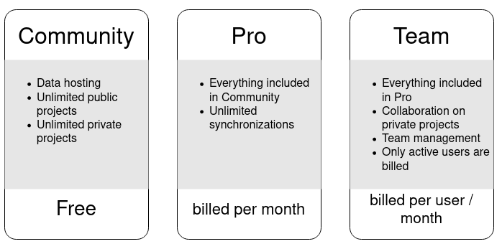
Subscriptions

Slide 12
Releases
Internal alpha: Now
Selected external users Alpha: December 2020
Public Beta: February 2021
First release: April 2021

Slide 13

Be Informed

Slide 14
Future
WebGIS
Processing Algorithms
...
… Your custom development

Slide 15
Thanks for your attention
Take home messages:
  coming very soon
  open source
  integrated with your infrastructure
Questions?

