Slide 1
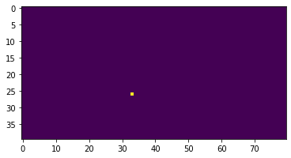
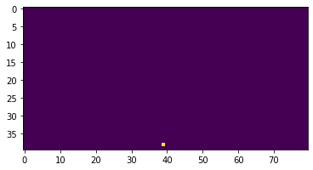
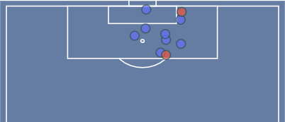
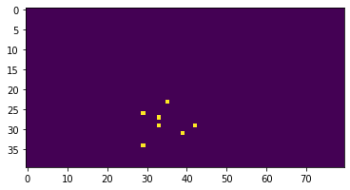
Channel 0 – Shot Location
Channel 1 – GK Location
Defender locations
Channel 2 – Defender Locations
Teammate locations
Shot location

Slide 2
