Slide 1
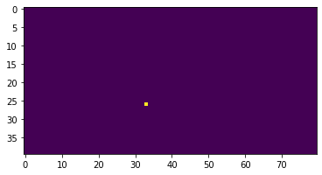
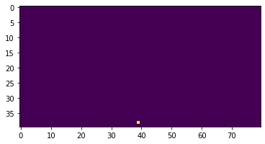
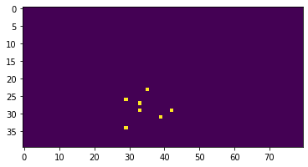
CNN Model Final Architecture
(40,80,3)
(32, (9,9))
(2,2)
(64, (5,5))
(2,2)
(64, (9,9))
(2,2)
(48)
(1)
Input
Out
Convolution 2D
Max Pooling
Convolution 2D
Max Pooling
Convolution 2D
Max Pooling
Dense

Slide 2
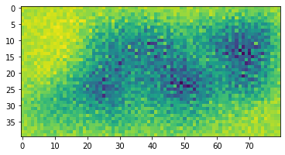
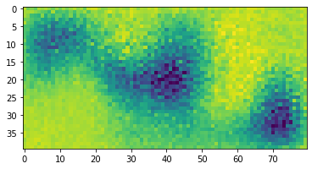
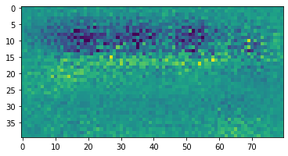
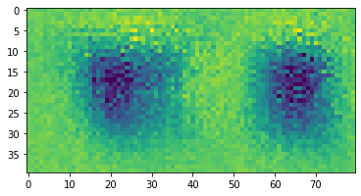
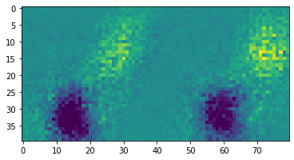
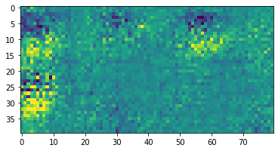
A sample of 6 (out of 64) inputs to maximise the associated filter activation
Convolution layer 3 – channel 2 (defender location)

