Slide 1
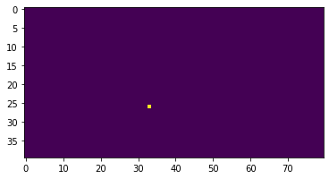
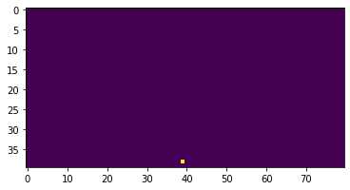
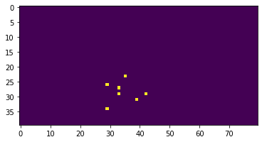
CNN Model Final Architecture
(40,80,3)
(32, (9,9))
(2,2)
(64, (5,5))
(2,2)
(64, (9,9))
(2,2)
(48)
(1)
xG
Input
Convolution 2D
Max Pooling
Convolution 2D
Max Pooling
Convolution 2D
Max Pooling
Dense

Slide 2
xG Playground Model Architecture
(40,80,3)
(32, (9,9))
(2,2)
(64, (5,5))
(2,2)
(32, (9,9))
(2,2)
(30)
(20%)
(10)
(20%)
(1)
3-channel Binary Image
xG
Input
Convolution 2D
Max Pooling
Convolution 2D
Max Pooling
Convolution 2D
Max Pooling
Dense
Dropout
Dense
Dropout
Cconcatenate
(4)
(1)
Shot Distance
Shot Angle
GK Distance
Input
Dense
GK Angle

Slide 3
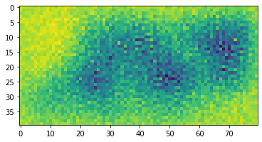
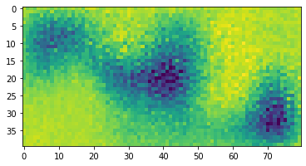
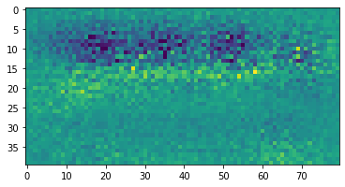
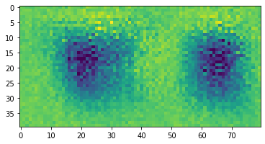
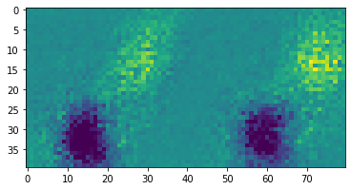
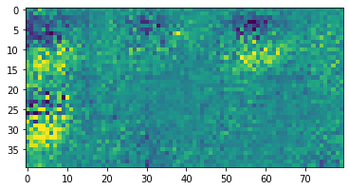
A sample of 6 (out of 64) inputs to maximise the associated filter activation
Convolution layer 3 – channel 2 (defender location)

