Slide 1
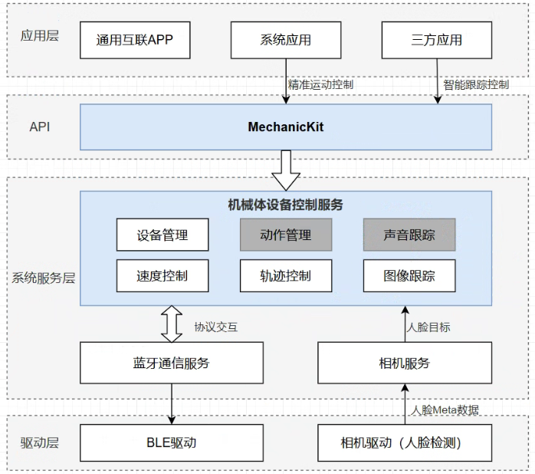
Application layer
Common applications
System applications
Third-party applications
Precise motion control
Intelligent tracking
API layer
Mechanic Kit
Mechanic Manager
Device management
Action management
Audio tracking
System service layer
Speed control
Trajectory tracking
Image tracking
Protocol interaction
Face target
Bluetooth service
Camera service
Face metadata
Driver layer
BLE driver
Camera driver (face detection)

