Slide 1
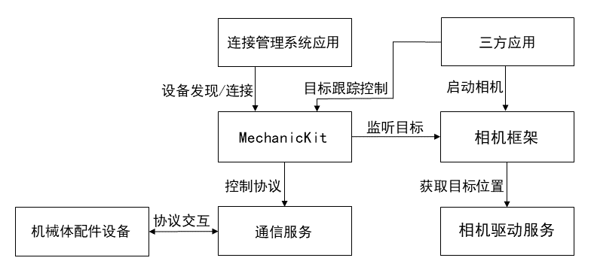
Connection management system application
Third-party application
Device discovery/connection
Object tracking control
Start camera
Mechanic Kit
Tracking object
Camera framework
Control protocol
Obtain the object’s position
Protocol interaction
Mechanic device
Communication service
Camera driver service

