Slide 1

Open Source Communications Tools
bit.ly/contact-open-hatch

Slide 2


What is open source/free software?
Four Freedoms:
  Run it for any purpose
  Understand + change it
  Share copies
  Share modified copies

Slide 3





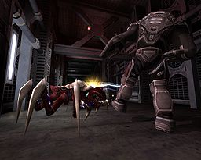

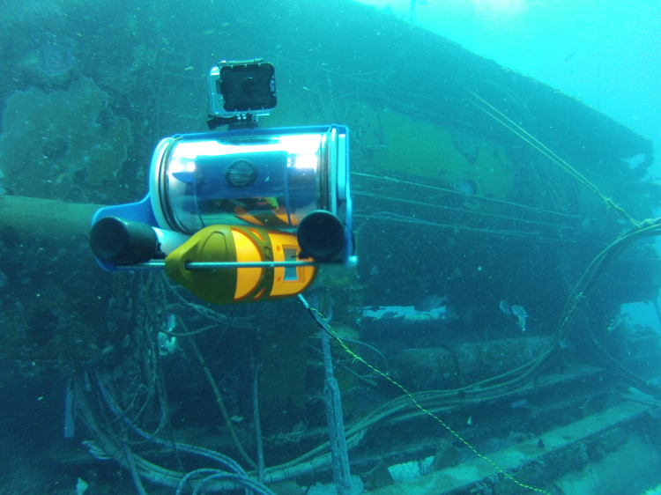

What are some open source projects?
Notes:
Ask if attendees know any projects, and let them explain those they recognize. Explain those they don't recognize. Ask attendees if they know of any others.
Cool facts to add: There are 6 million public repositories on Github.com. OpenHatch tracks 437 projects.
Images above: Blender (3D computer graphics software for simulation, modeling, animating); Ubuntu (Operating System); Sugar Labs (makes Sugar, an educational desktop environment for children, with OLPC); Firefox (browser); OpenMRS (medical records system for underserved communities); Python (programming language – general); Tremulous (open video game – uses open source game engine ioquake3); R (programming language – statistical); Raspberry Pi (open source/open hardware credit card sized computer); OpenROV (low cost remote operated mini submarine)

Slide 4
Ways to contribute...
Code
Documentation
Translation
Testing and quality assurance
User interface design
Logos and branding
Creating demos
Maintaining servers
Maintaining websites
Project management
Community management
Triaging and reproducing bugs
… and more
Notes:
Ways to contribute:

Slide 5

Photo by zzpza on
flickr; CC BY 2.0

Slide 6
bit.ly/laptop-setup

Slide 7
bit.ly/communication-oh

Slide 8

By Matt Cornock, CC BY 2.0

Slide 9
bit.ly/diff-tutorial

Slide 10
By Matt Cornock, CC BY 2.0

Slide 11
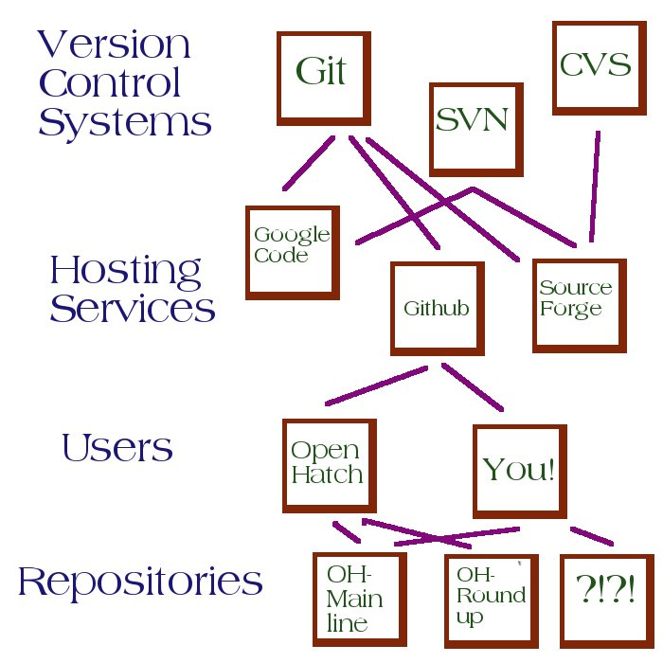

Slide 12

bit.ly/contact-open-hatch

