Slide 1

Getting started with free software development

Slide 2



Me, briefly
@shauna_gm
shaunagm@gmail.com

Slide 3








What is open source?
Notes:
Ask if attendees know any projects, and let them explain those they recognize. Explain those they don't recognize. Ask attendees if they know of any others.
Cool facts to add: There are 6 million public repositories on Github.com. OpenHatch tracks 437 projects.
Images above: Blender (3D computer graphics software for simulation, modeling, animating); Ubuntu (Operating System); Sugar Labs (makes Sugar, an educational desktop environment for children, with OLPC); Firefox (browser); OpenMRS (medical records system for underserved communities); Python (programming language – general); Tremulous (open video game – uses open source game engine ioquake3); R (programming language – statistical); Raspberry Pi (open source/open hardware credit card sized computer); OpenROV (low cost remote operated mini submarine)

Slide 4
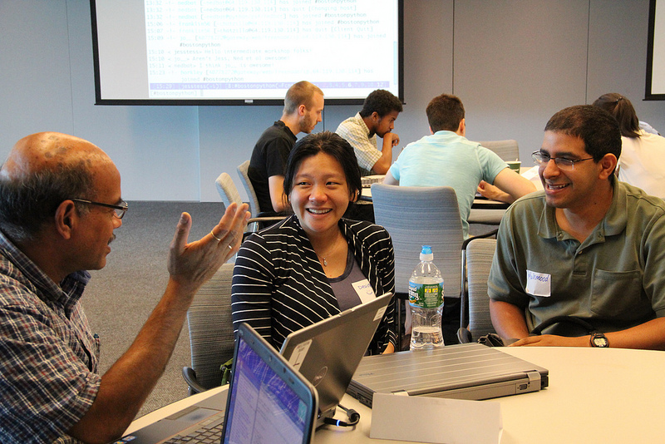
Why contribute?
Ideals
Community
Education
Career
Fun
Notes:
ideals – Take some time to come up with your own brief explanation of why open soure as an idea is meaningful to you.
community – if you have particularly good friends you've met or know of couples that met through the OSS community
education – gives you practical, real world experience to help you grow and learn
career – many hiring managers say they look for open source contributions

Slide 5
Ways to contribute...
Code
Documentation
Translation
Testing and quality assurance
User interface design
Logos and branding
Creating demos
Maintaining servers
Maintaining websites
Project management
Community management
Triaging and reproducing bugs
… and more
Notes:
Ways to contribute:

Slide 6
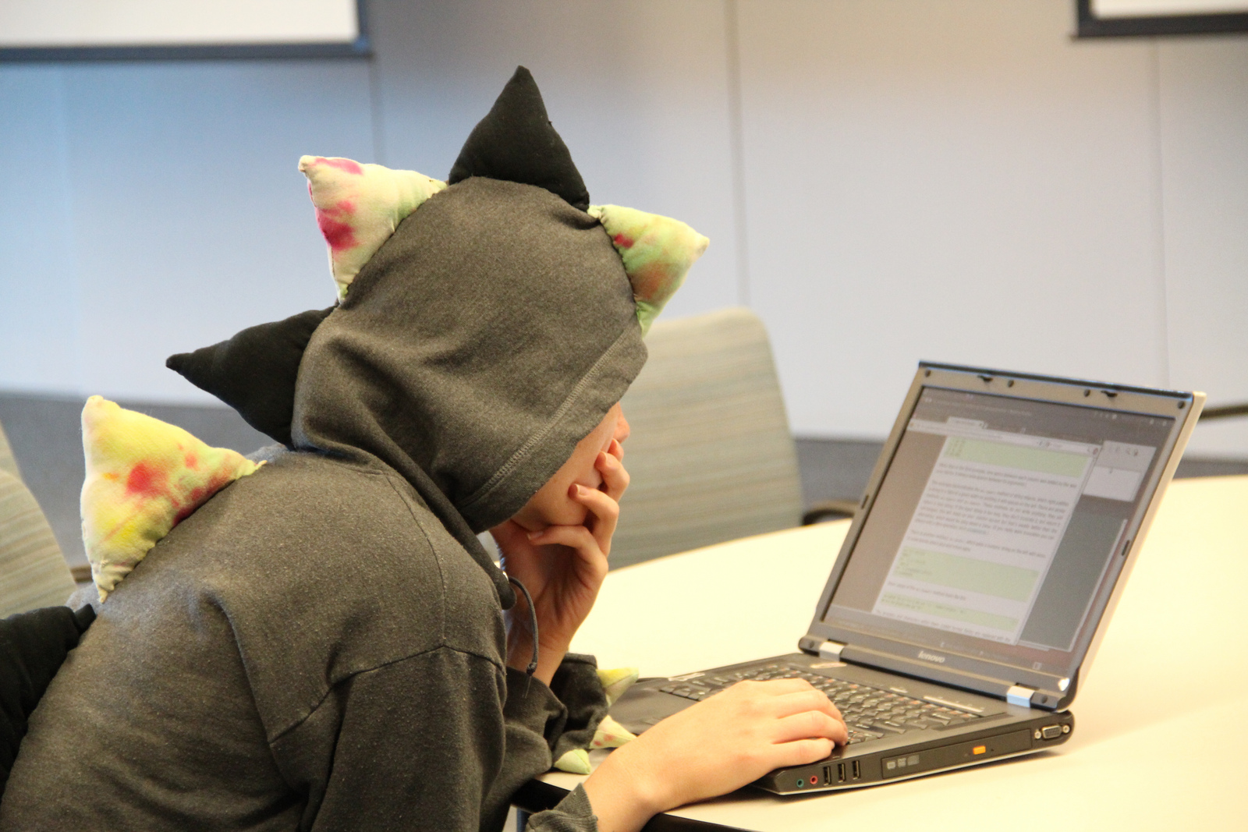
The tools of free software development

Slide 7

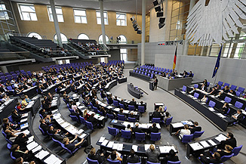
Revision control
Demo!
Tracks changes over time
Allows multiple users to work at the same time
Lets you revert to the good old days
Notes:
Do revision control demo (see overview page – it's the Wikipedia one)
Talk about other uses for version control. For instance, I mention my housemate uses it to keep track of her novel, and there's a group that uses is to keep track of German laws, hence the picture in the slide (https://github.com/bundestag/gesetze)

Slide 8
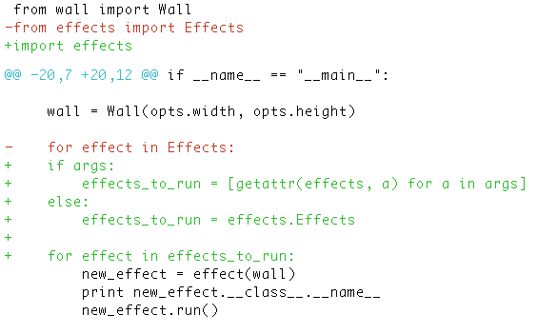
Sharing changes: diff and patch
Demo!
Notes:
Do diff + patch demo (see overview page)

Slide 9





Code Repositories
Notes:
Repositories! A place to host things!
Distinguish between version control & code repository: – Github is a repository that uses Git version control
– Bitbucket is a repostiroy that uses Git and Mercurial
We use Github because it is popular and we like being popular.
You may come across other repositories or version control systems in the workshop section, we'll help you get the hang of them.

Slide 10
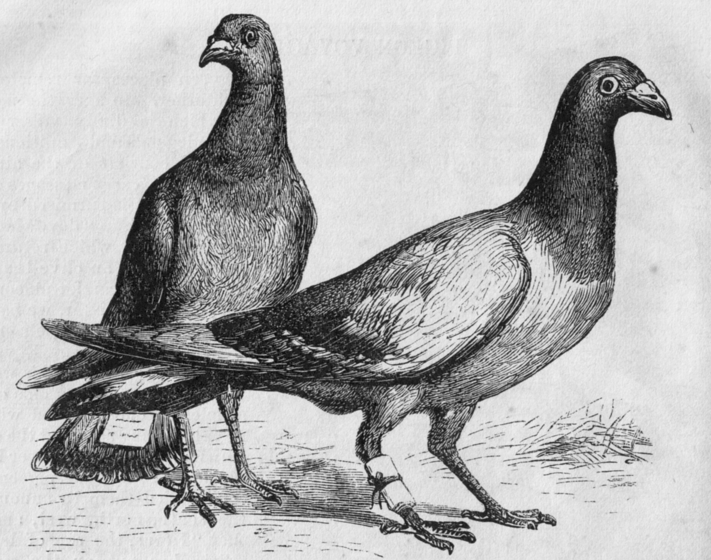
Communication
Issue trackers
Mailing lists
IRC
Notes:
Those are homing pigeons, just in case it's unclear.

Slide 11
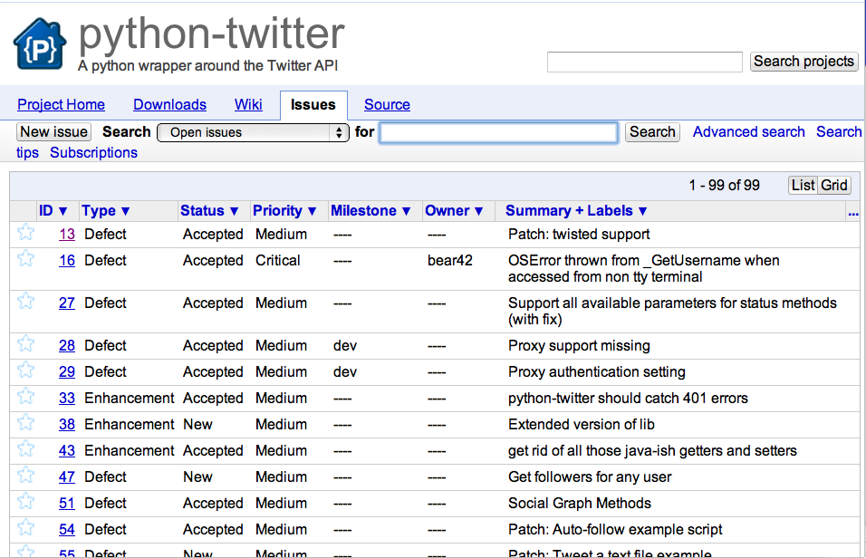
Issue trackers
Demo!
Notes:
Do issue tracker demo (see overview page)

Slide 12
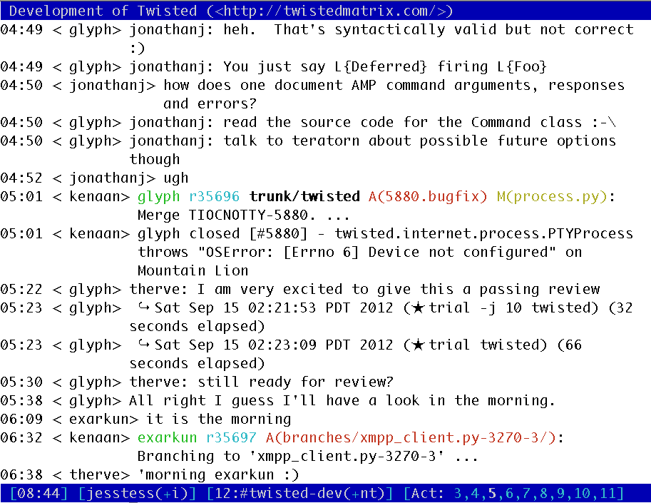
IRC
Installing IRC: bit.ly/15erPsF
Notes:
Get people set up on IRC, log into #openhatch, show them also: private messages, using nicks to highlight, etc.
The link above goes to one of our wiki pages with instructions on how to install IRC. Attendees should already have done this though during setup. Ask anyone with problems to raise their hands and staff will help.

Slide 13
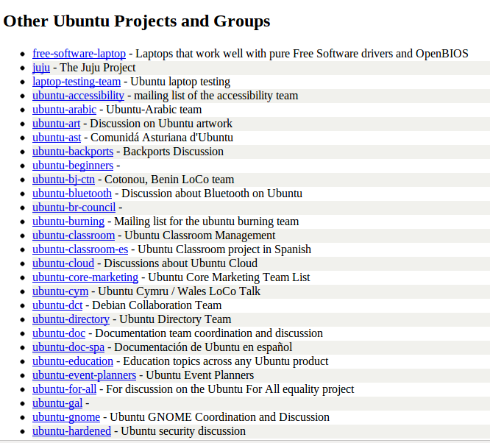
Mailing lists
Some projects have many lists, some have none.
Many have “users” and “developers” lists.
Notes:
Distinguish between user lists and developer lists.
The image above is from this page:
https://lists.ubuntu.com/
Ubuntu, being very large, has hundreds of lists.
If you need help navigating, just ask!

Slide 14
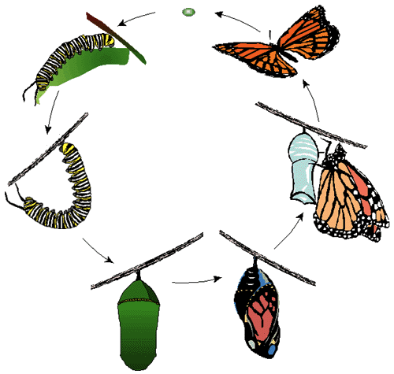
Life cycle of a bug
Report
Triage
Patch
Testing
Review
Resolution

Slide 15
Places to look for answers
Project documentation
  Installation guides, tutorials, FAQ
Googling for error messages
StackOverflow, LinuxQuestions.org
Issue tracker
Mailing lists
IRC (pastebin!)
School computing club & local user groups
OpenHatch!
Notes:
Things I like to add:
Re: project documentation – because it may not even be a bug.
Re: IRC – remember to be patient, this won't necessarily be faster than a mailing list

Slide 16

How to effectively ask for help
A Short, Self Contained, Correct, Example
Steps to reproduce
Input
Expected output
Actual output
Software and operating system versions

Slide 17

How to write a good bug report
A Short, Self Contained, Correct, Example
Steps to reproduce
Input
Expected output
Actual output
Software and operating system versions
Notes:
Haha! They are the same!

Slide 18

Issue tracker
Search for existing issues
Read contributor documentation on categorizing and triaging tickets
Notes:
It may be useful, if you have time, to go back to an actual issue tracker and explore the different stages the bugs are in – reported, reproduced, fixed, resolved. I'm attempting to find a real world bug that showcases all stages – will edit this to include if I ever find one.

Slide 19
What's next?
Work in groups or by yourself:
http://openhatch.org/wiki/Communication
https://openhatch.org/missions/diffpatch
Thanks to Jessica McKellar for the original version of these slides.

