Slide 1

Getting Started
In Free and Open Source Software

Slide 2
“How do I pick a project?”
“How can I talk to the people already working on the project?”
“Where can I find ways to contribute?”
“How do I get the 'source' and how do I change it?”
“What is free/open source software?”

Slide 3
“What is free/open source software?”

Slide 4













Notes:
Ask if attendees know any projects, and let them explain those they recognize. Explain those they don't recognize. Ask attendees if they know of any others.
Cool facts to add: There are 6 million public repositories on Github.com. OpenHatch tracks 437 projects.
Images above: Blender (3D computer graphics software for simulation, modeling, animating); Ubuntu (Operating System); Sugar Labs (makes Sugar, an educational desktop environment for children, with OLPC); Firefox (browser); OpenMRS (medical records system for underserved communities); Python (programming language – general); Tremulous (open video game – uses open source game engine ioquake3); R (programming language – statistical); Raspberry Pi (open source/open hardware credit card sized computer); OpenROV (low cost remote operated mini submarine)

Slide 5
What do all of these projects have in common?
Four Freedoms:
  Run it for any purpose
  Understand + change it
  Share copies
  Share modified copies

Slide 6
“How can I talk to the people already working on the project?”

Slide 7
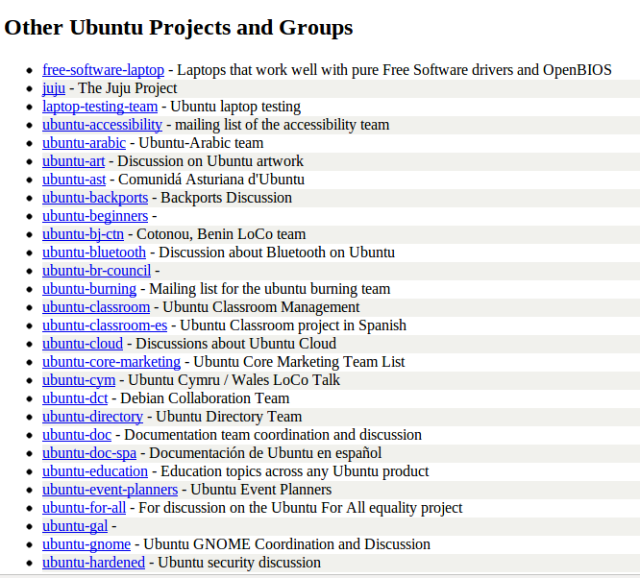
Mailing lists
Some projects have many lists, some have none.
Many have “users” and “developers” lists.
Notes:
Distinguish between user lists and developer lists.
The image above is from this page:
https://lists.ubuntu.com/
Ubuntu, being very large, has hundreds of lists.
If you need help navigating, just ask!

Slide 8
http://bit.ly/install-IRC

Slide 9
IRC Tips
Not sure what to say? Introduce yourself.
Be patient. No one may be paying attention to the channel.
If you want to share code, error messages, or anything more than a line or two, use something like pastebin.com
Don't ask to ask: if you have a question, just ask it.

Slide 10
“Where can I find ways to contribute?”

Slide 11
First off... contributions come in many forms
Code
Documentation
Translation
Testing and quality assurance
User interface design
Logos and branding
Creating demos
Maintaining servers
Maintaining websites
Project management
Community management
Triaging and reproducing bugs
… and more
Notes:
Ways to contribute:

Slide 12

The Issue Tracker basically a “to do list” for open source projects
Let's go explore some!

Slide 13
“How do I get the 'source' and how do I change it?”

