Slide 1
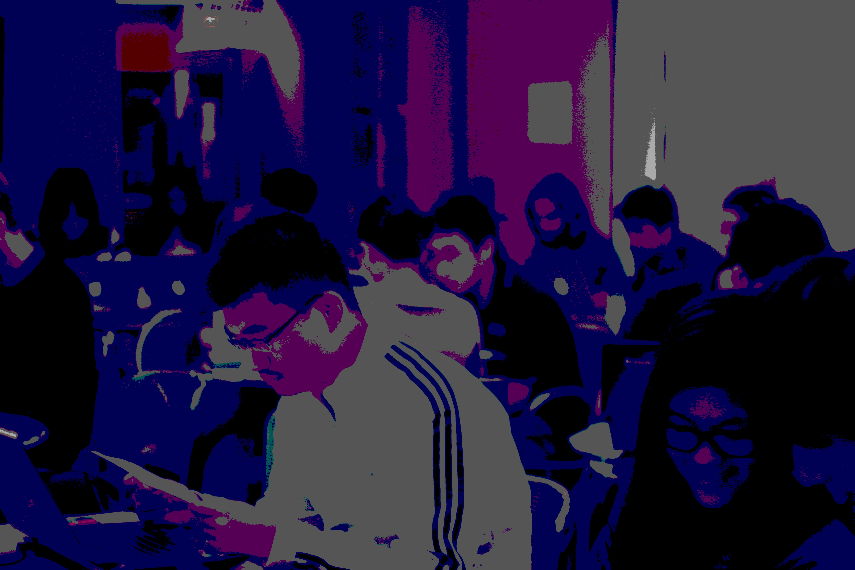
Getting Started
In Free and Open Source Software

Slide 2
“How do I pick a project?”
“How can I talk to the people already working on the project?”
“Where can I find ways to contribute?”
“How do I get the 'source' and send my changes back?”
“What is free/open source software?”

Slide 3
“What is free/open source software?”

Slide 4










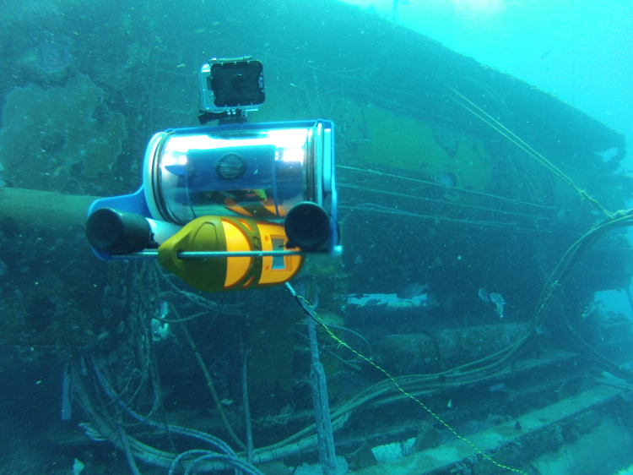


Notes:
Ask if attendees know any projects, and let them explain those they recognize. Explain those they don't recognize. Ask attendees if they know of any others.
Cool facts to add: There are 6 million public repositories on Github.com. OpenHatch tracks 437 projects.
Images above: Blender (3D computer graphics software for simulation, modeling, animating); Ubuntu (Operating System); Sugar Labs (makes Sugar, an educational desktop environment for children, with OLPC); Firefox (browser); OpenMRS (medical records system for underserved communities); Python (programming language – general); Tremulous (open video game – uses open source game engine ioquake3); R (programming language – statistical); Raspberry Pi (open source/open hardware credit card sized computer); OpenROV (low cost remote operated mini submarine)

Slide 5
What do all of these projects have in common?
Four Freedoms:
  Run it for any purpose
  Understand + change it
  Share copies
  Share modified copies

Slide 6
“How do I pick a project?”

Slide 7
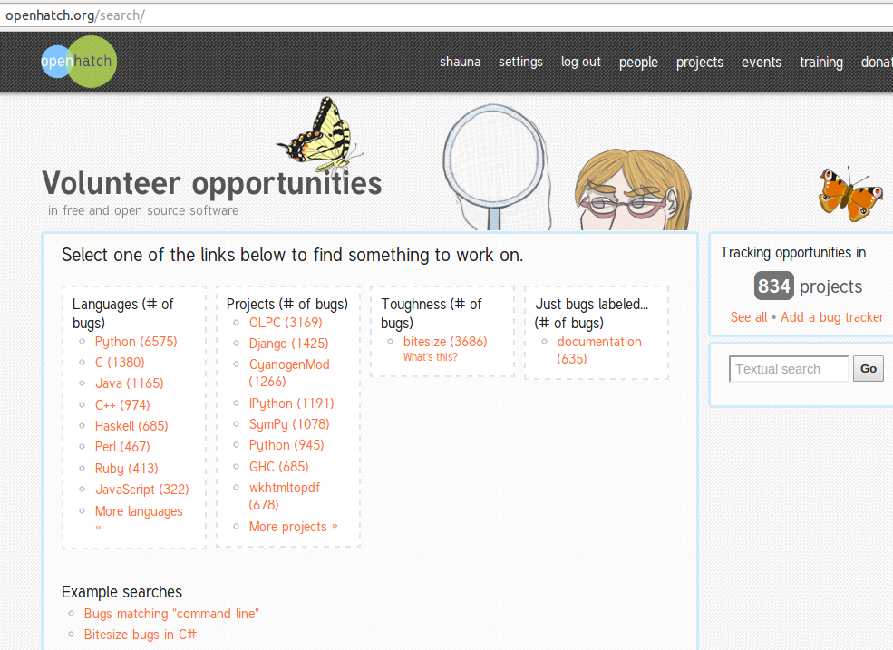

Slide 8
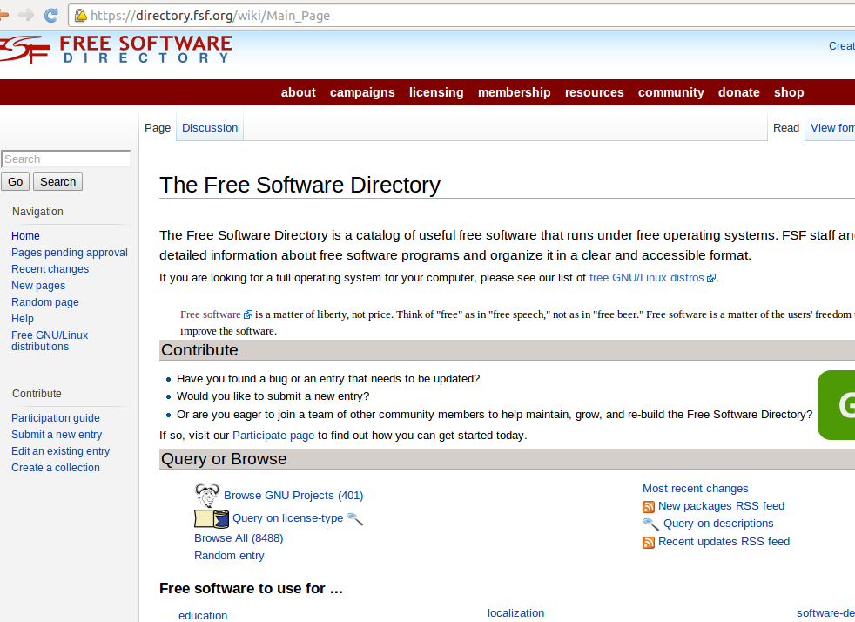

Slide 9
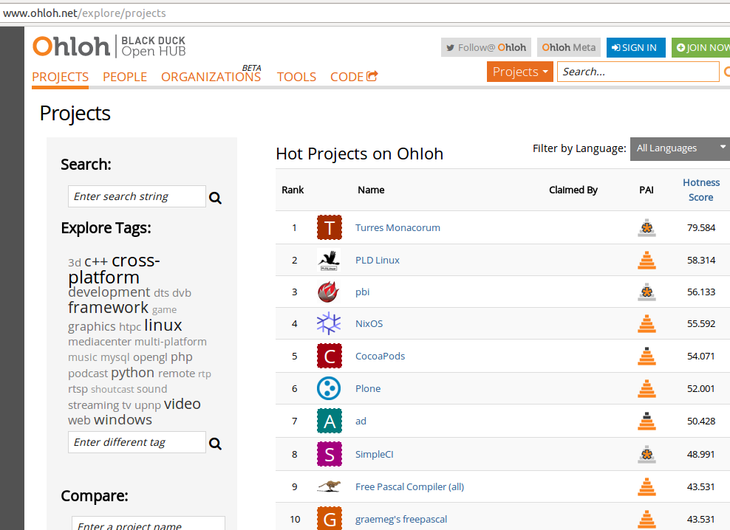

Slide 10
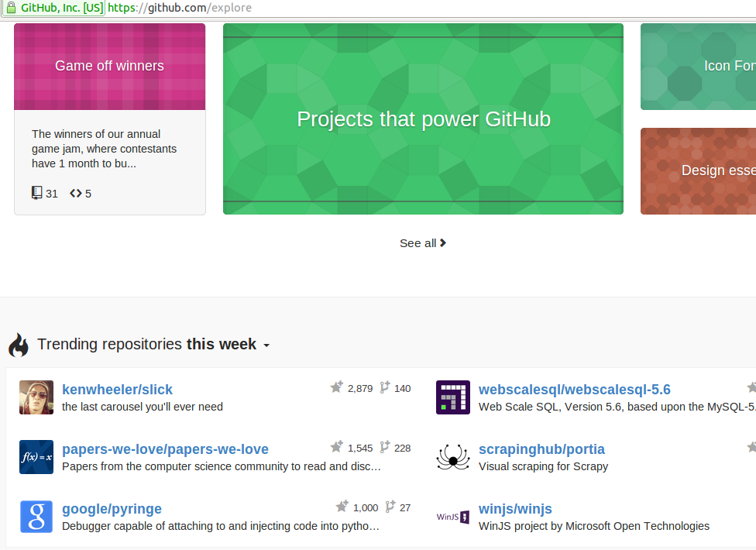

Slide 11
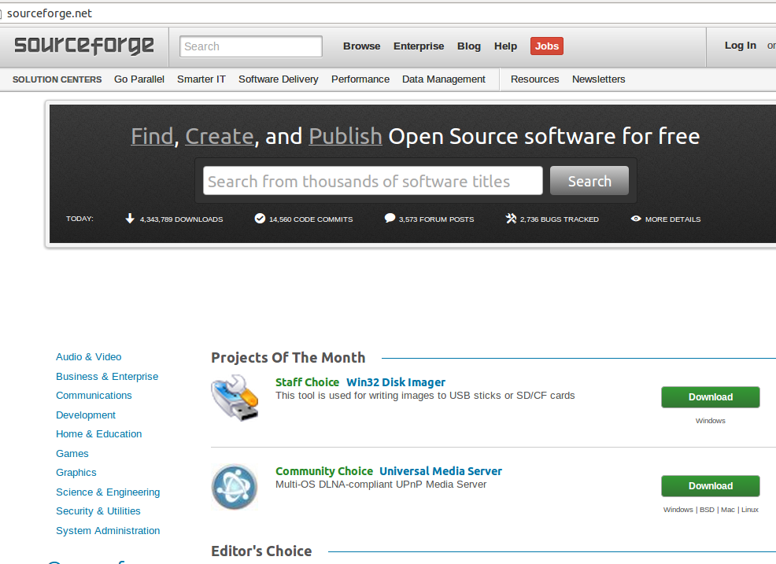

Slide 12


Slide 13
"What topics interest you?"
"What projects do your friends contribute to?"
"What projects do you use?"

Slide 14
An activity we don't have time for right now...
http://bit.ly/finding-a-project

Slide 15
“How can I talk to the people already working on the project?”

Slide 16
http://bit.ly/install-IRC

Slide 17
“Where can I find ways to contribute?”

Slide 18
Tip #2: Contributions Come In Many Forms
Code
Documentation
Translation
Testing and quality assurance
User interface design
Logos and branding
Creating demos
Maintaining servers
Maintaining websites
Project management
Community management
Triaging and reproducing bugs
… and more
Notes:
Ways to contribute:

Slide 19
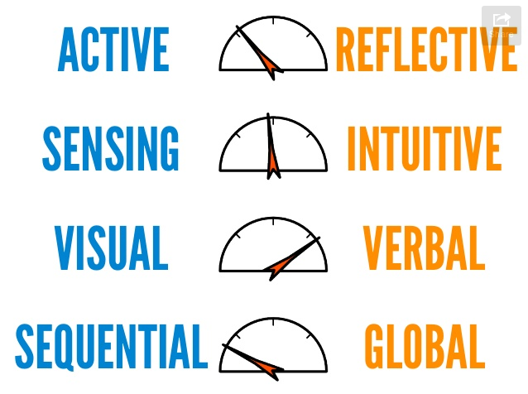

Slide 20
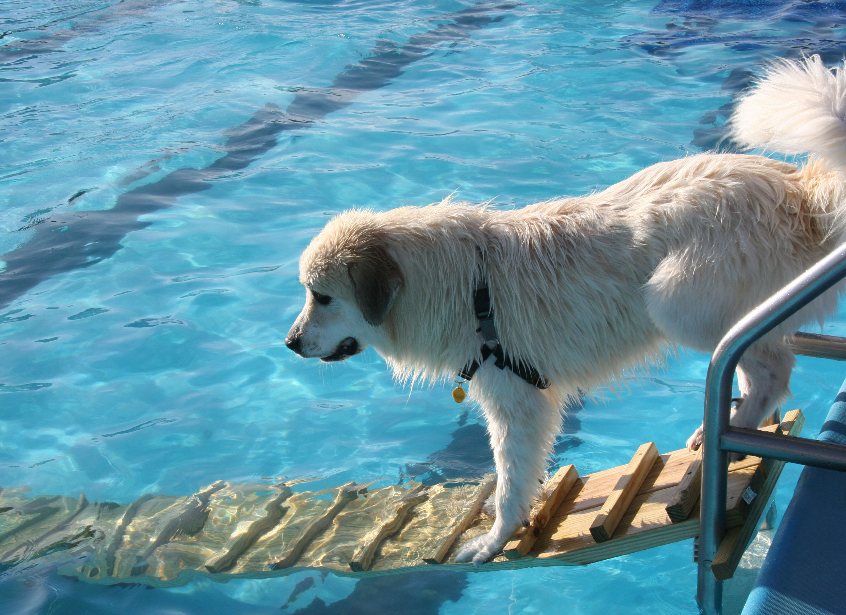
But I'm not a programmer...
I'm no good at this...
I want to do something big...

Slide 21
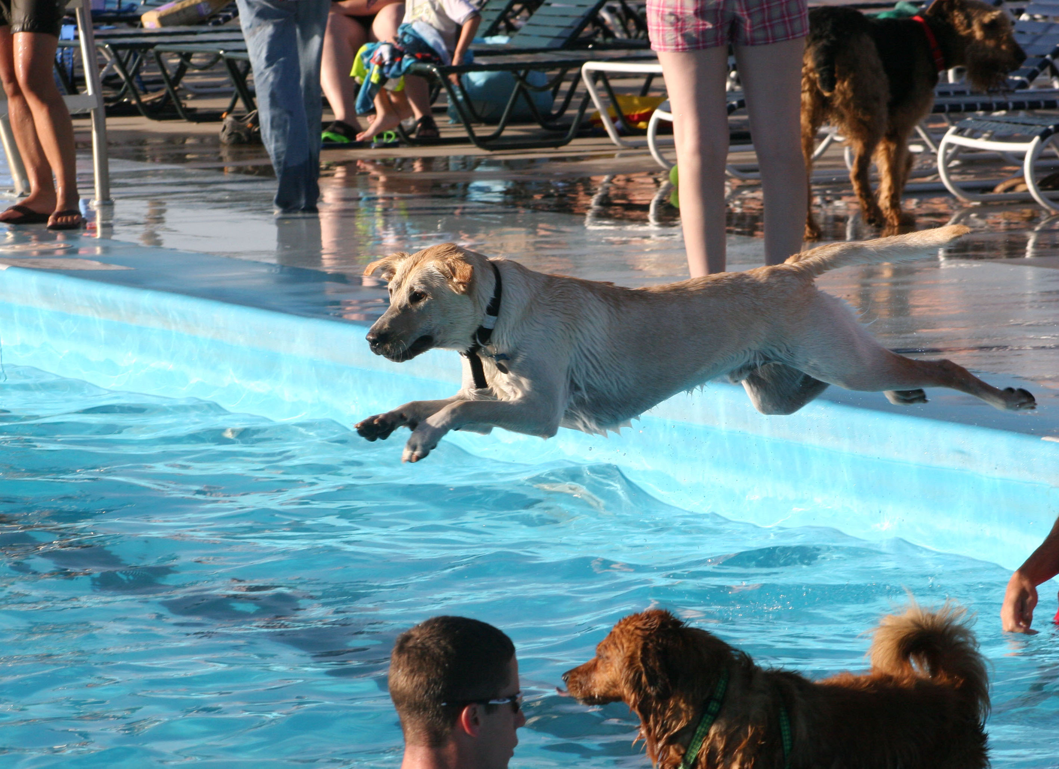

Slide 22
http://bit.ly/feedback-oh
hello@openhatch.org

