Slide 1
Welcome!
Get started with: http://bit.ly/laptop-setup
Schedule:
  9:30 – 10:30 Snacks!, laptop setup, intros
  10:30 – 11:15 Communications Tools
  11:15 - 12:15 Git
  12:15 – 1:00 Lunch!
  1:00 – 1:30 Career Panel
  1:30 – 4:30 Projects Time

Slide 2


What is open source/free software?
Four Freedoms:
  Run it for any purpose
  Understand + change it
  Share copies
  Share modified copies

Slide 3






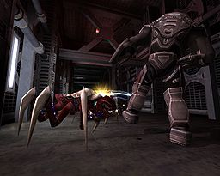

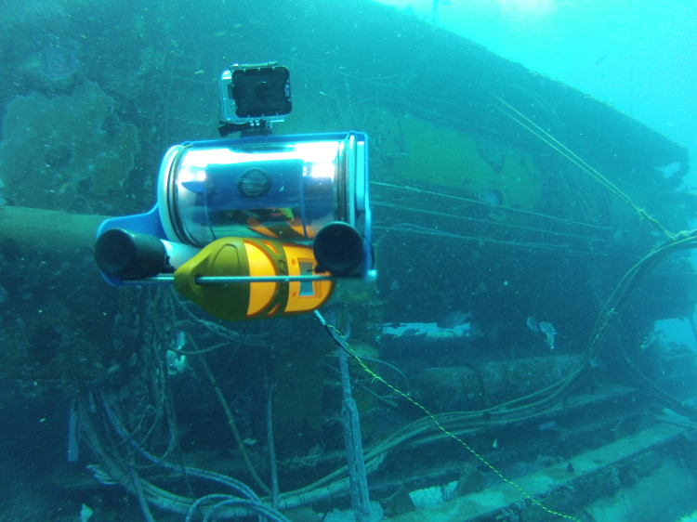

What are some open source projects?
Notes:
Ask if attendees know any projects, and let them explain those they recognize. Explain those they don't recognize. Ask attendees if they know of any others.
Cool facts to add: There are 6 million public repositories on Github.com. OpenHatch tracks 437 projects.
Images above: Blender (3D computer graphics software for simulation, modeling, animating); Ubuntu (Operating System); Sugar Labs (makes Sugar, an educational desktop environment for children, with OLPC); Firefox (browser); OpenMRS (medical records system for underserved communities); Python (programming language – general); Tremulous (open video game – uses open source game engine ioquake3); R (programming language – statistical); Raspberry Pi (open source/open hardware credit card sized computer); OpenROV (low cost remote operated mini submarine)

Slide 4
3 Tips

Slide 5
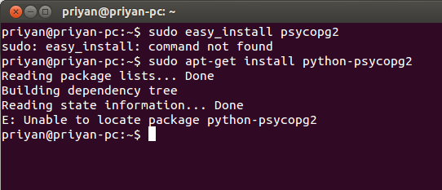
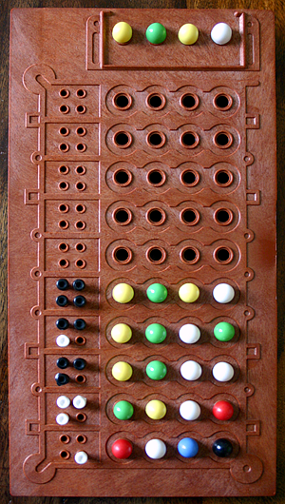
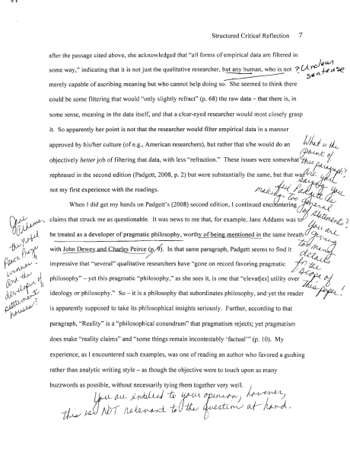

Tip #1: Give and Get Feedback
Feedback is an important part of our lives:

Slide 6
Lots of ways to give feedback in open source, we'll go over them shortly.
In the meantime:
bit.ly/openhatch-feedback

Slide 7
Tip #2: Contributions Come In Many Forms
Code
Documentation
Translation
Testing and quality assurance
User interface design
Logos and branding
Creating demos
Maintaining servers
Maintaining websites
Project management
Community management
Triaging and reproducing bugs
… and more
Notes:
Ways to contribute:

Slide 8
Tip #3: Be Patient!

Slide 9
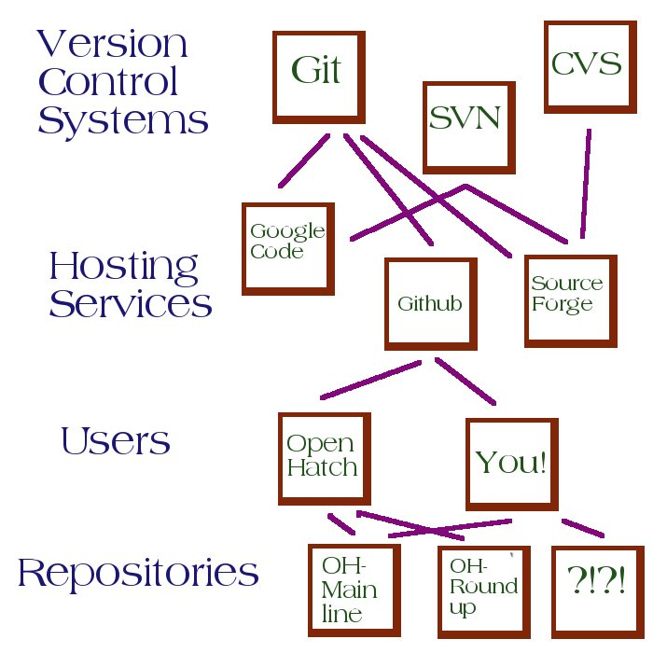

Slide 10
Practicing Git
bit.ly/git-activity

Slide 11
Projects Time
You can work on projects with help from maintainers & guides on IRC:
  OpenHatch - https://openhatch.org/wiki/First_Tasks#OpenHatch
  Oppia - http://bit.ly/oppia-first-tasks
  MouseTrap – talk to Heidi
  Open Science Collab. blog - http://bit.ly/oscblog-first-tasks
  WelcomeBot - http://bit.ly/wb-first-tasks
You can learn more about gnome OPW/Google Summer of Code, and start exploring projects with Terri and Marina (IRC).
Explore: http://openhatch.org/search

