Slide 1
Python + Qt Quick
Dojo introduction
Róbert Čerňanský

Slide 2

Python

Slide 3
Python – description
„Python is an interpreted, high-level, general-purpose programming language.“
– Wikipedia

Slide 4
Python – Object Oriented
type(100)
<class 'int'>

Slide 5
Python – Dynamicly Typed
z = 100
print(z)
z = "hello"
print(z)
100
hello

Slide 6
Python – Parenthesis
n = "cool"
print("Begin:", n)
for z in range(3):
s = n * z
print(z, s)
print("End")
Begin: cool
0
1 cool
2 coolcool
End

Slide 7
Python – Functional Aspects
lambda x: 10 * x
def l(x):
return 10 * x
d = l
d(100)
[s.upper() for s in "abcde"]

Slide 8

Python – Other Properties
Interpreted
Open Source
Easy to start to work with
Extensive built-in library
Good documentation
Popular

Slide 9
Python – Usage
Mozilla (Sync. server)
Google
YouTube
CERN (LHC)
Industrial Light & Magic
...web, desktop, science, education

Slide 10

Qt

Slide 11
Qt – Description
„Qt is a free and open-source widget toolkit for creating graphical user interfaces as well as cross-platform applications...“
– Wikipedia

Slide 12
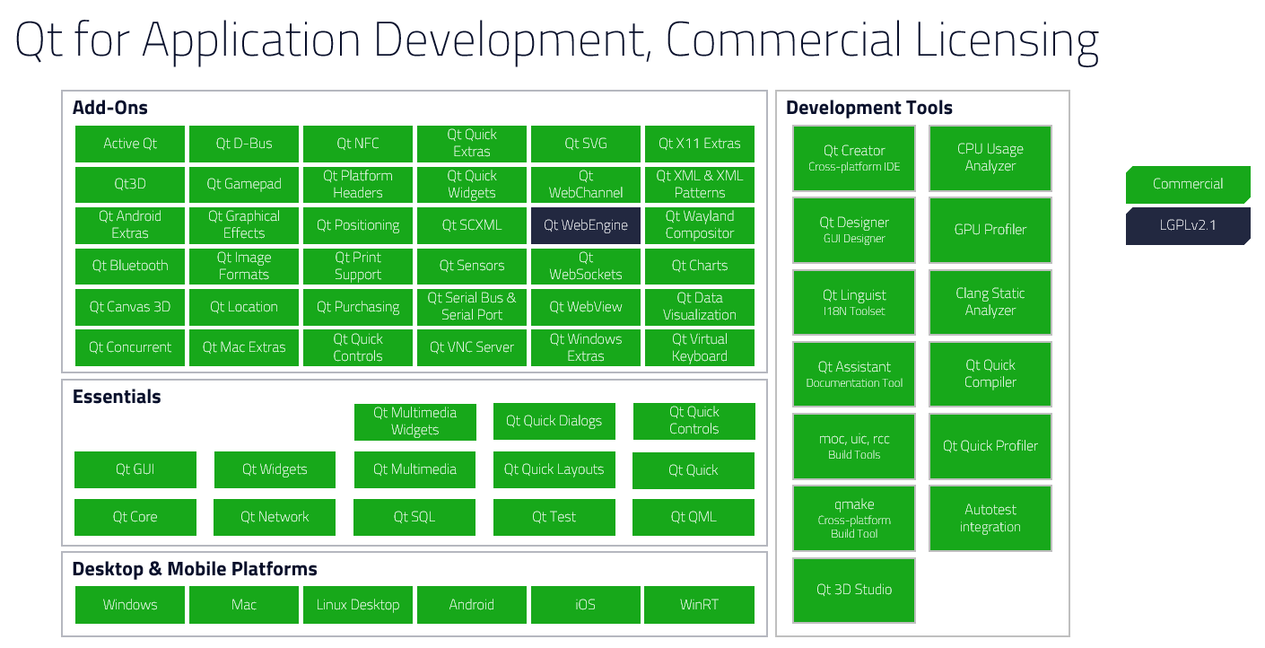
Qt – Modular

Slide 13

Qt – Broad Usage

Slide 14
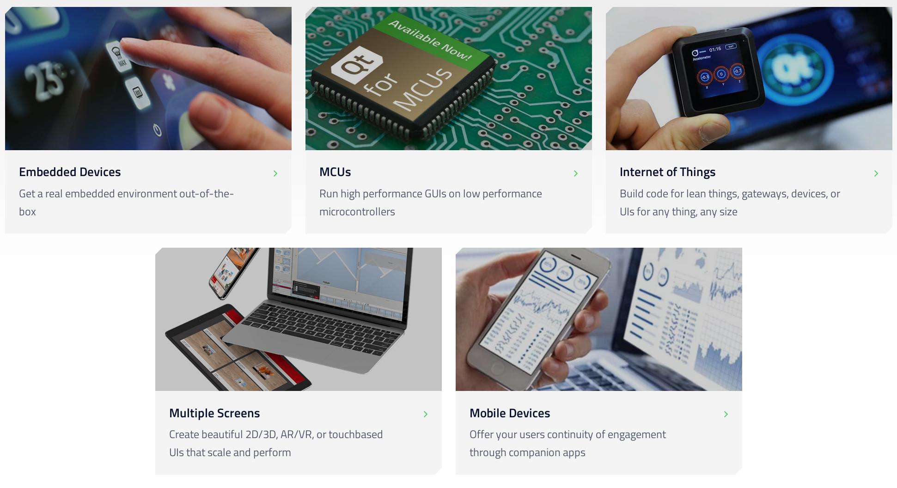
Qt – Multi-platform

Slide 15
Qt – Other Properties
Primarily C++ framework
Many other languages supported
High performance
Free (libre) and commercial licensing
Good documentation
Own development tools

Slide 16

Qt – Usage in Medical

Slide 17
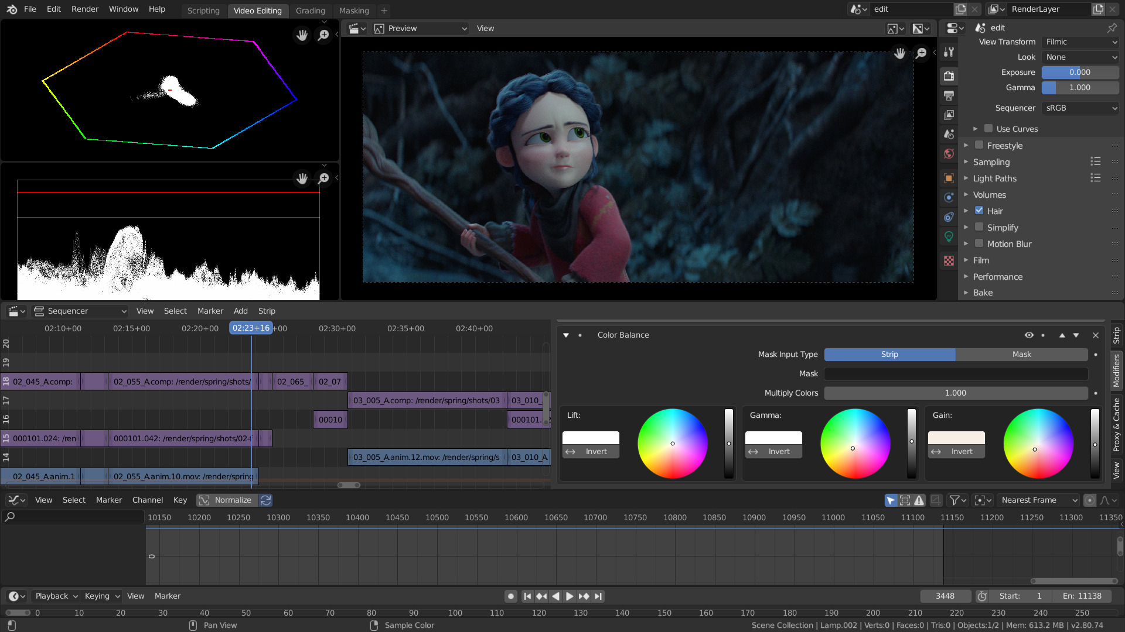
Qt – Blender

Slide 18
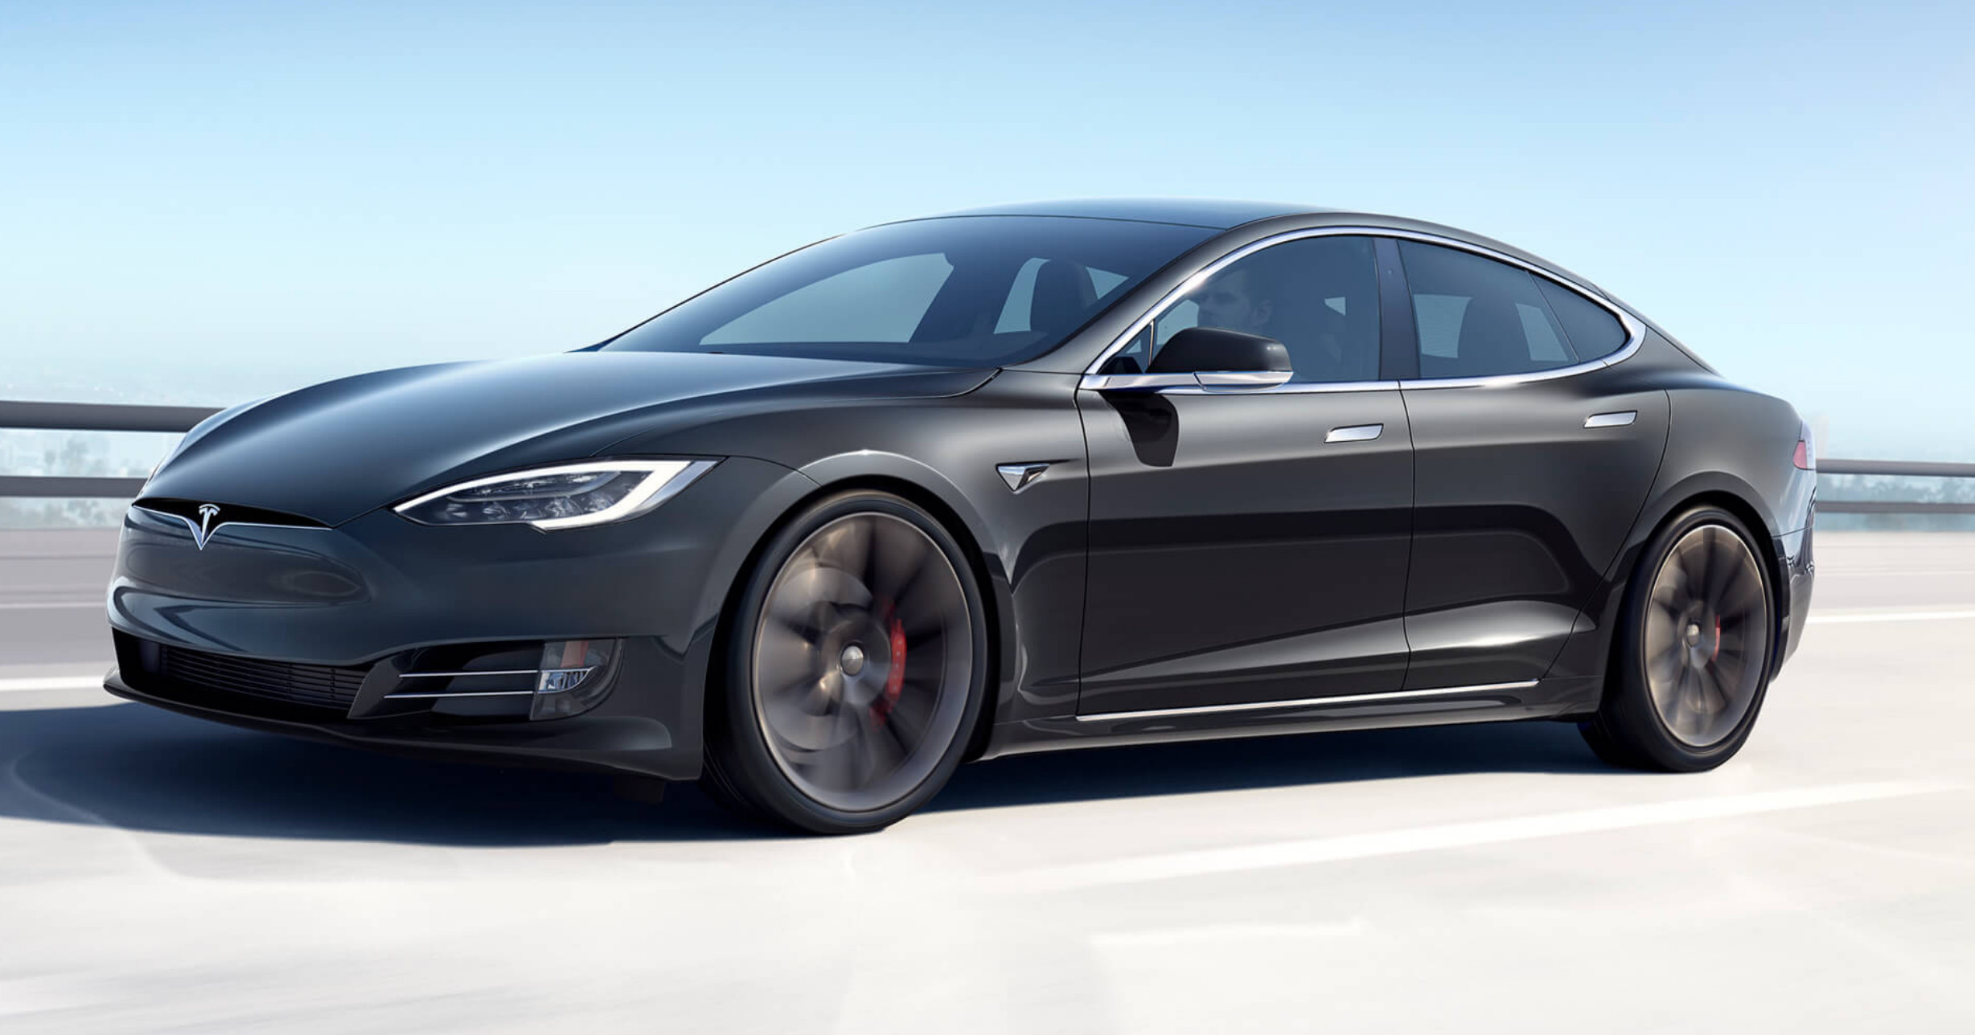
Qt – Tesla Model S

Slide 19
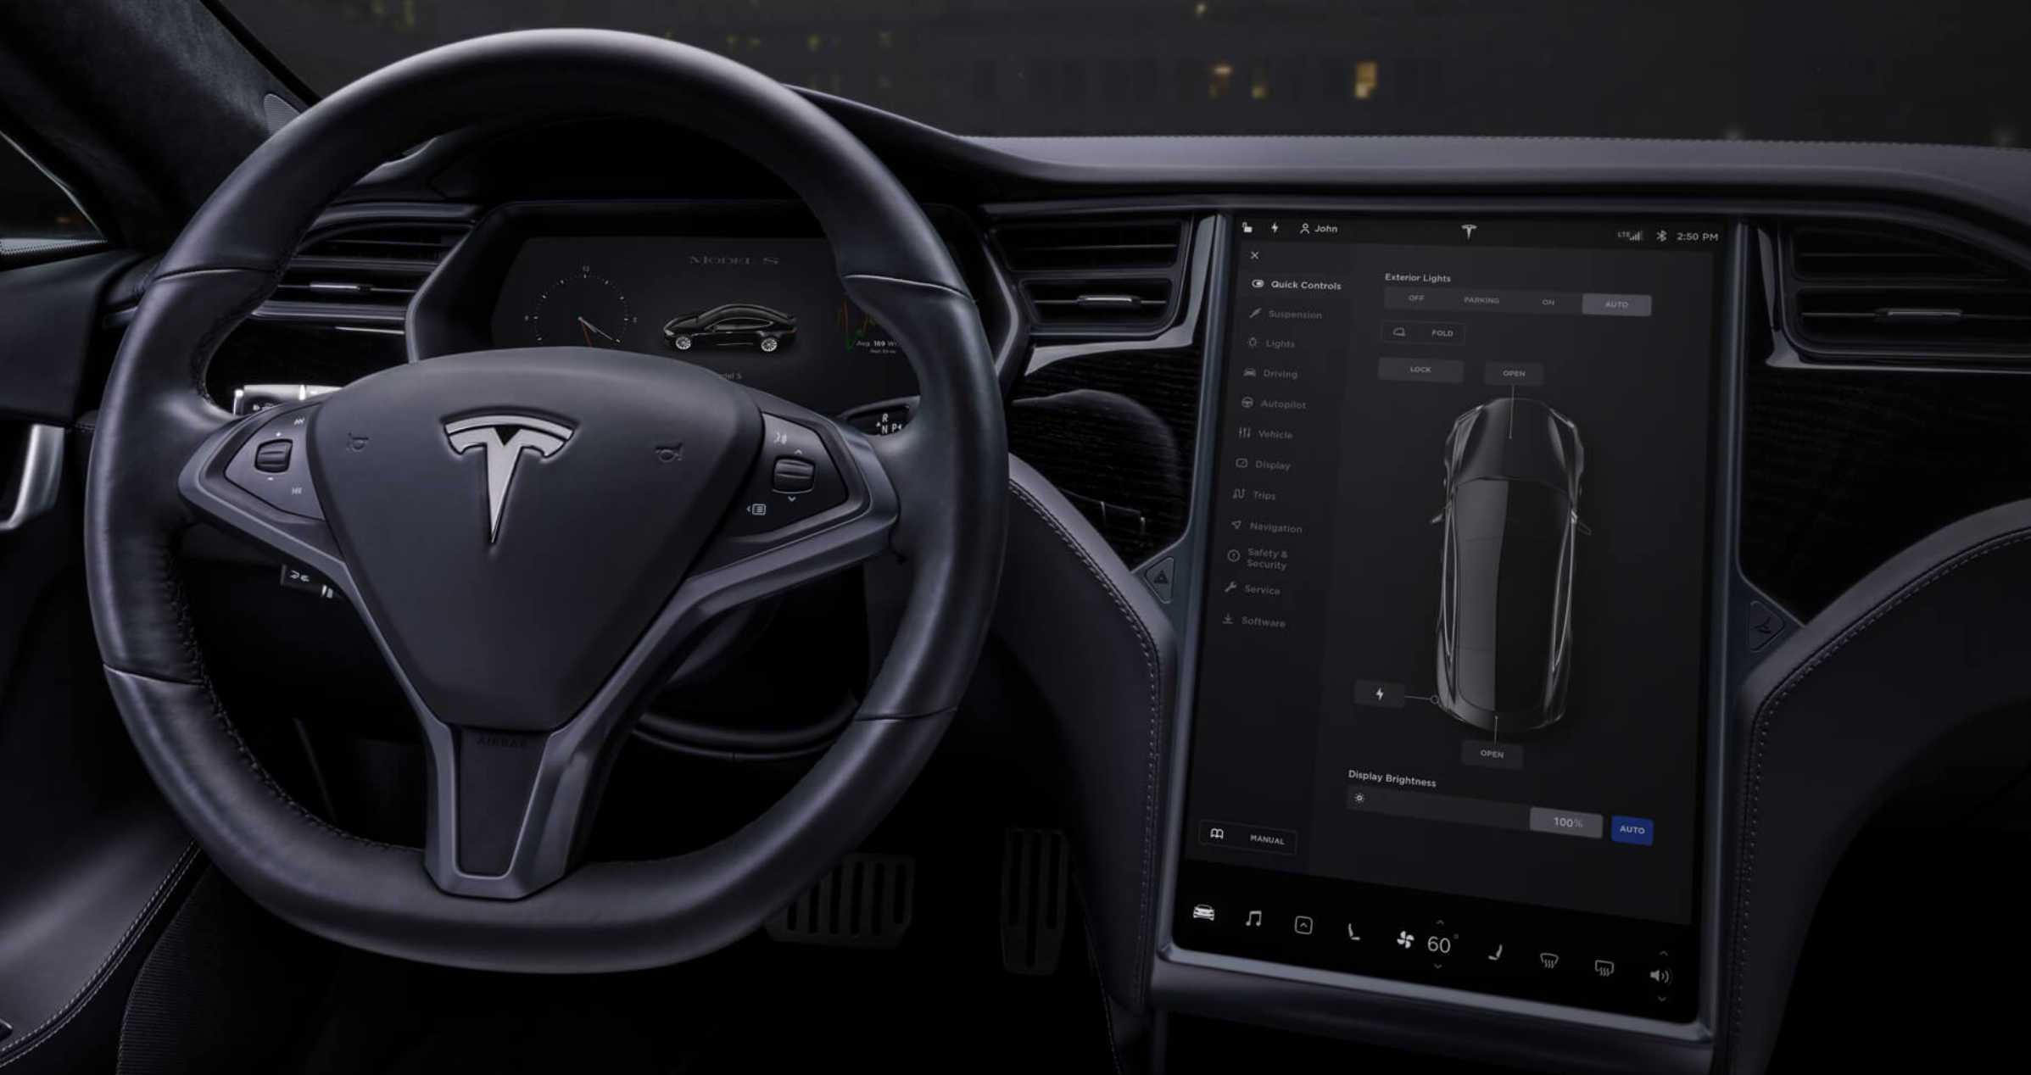
Qt – Tesla Model S

Slide 20
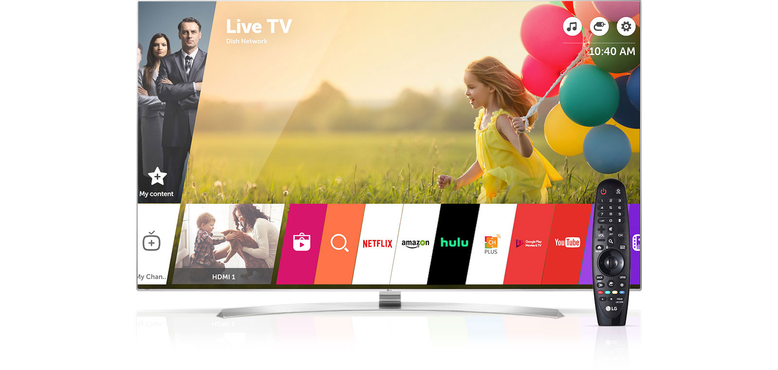
Qt – LG WebOS

Slide 21
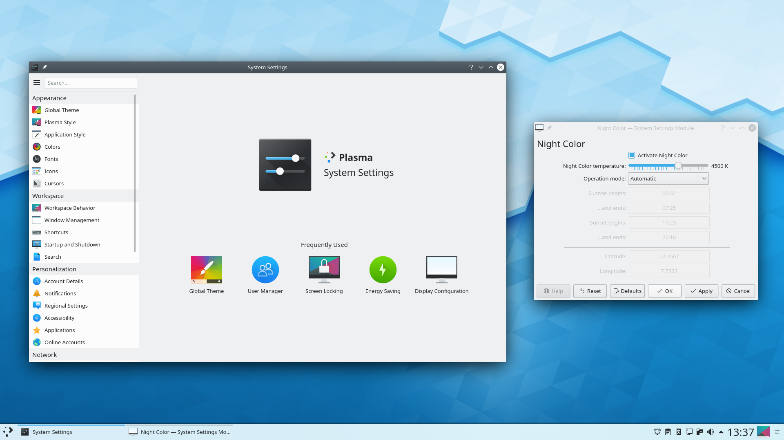
Qt – KDE Plasma

Slide 22
Qt – Other Uses
Autodesk 3ds Max, Maya
VLC
VirtualBox
Teamviewer

Slide 23
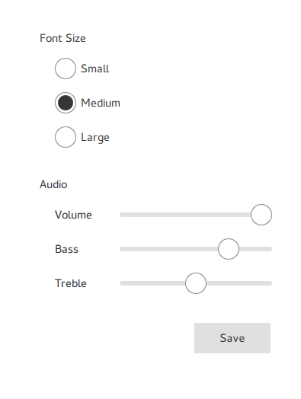
Qt Quick – Description
Library for modern UI creation with animation and graphical effects support.
Sutable also (or mainly?) for mobile devices
Created next to already existing UI library Qt Widgets
Declarative language QML

Slide 24
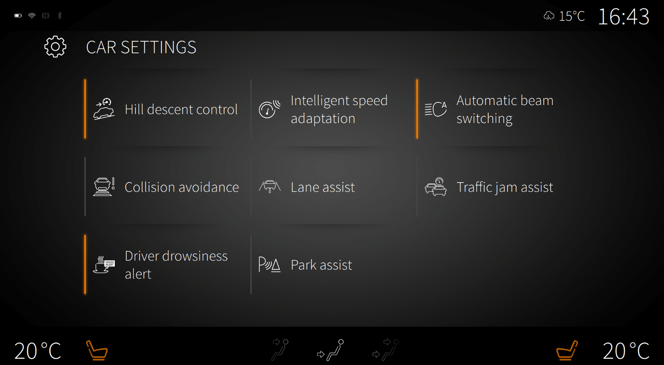
Qt Quick – Automotive Suite

Slide 25
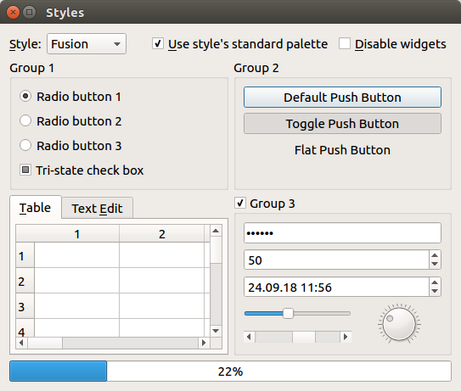
!Qt Quick – Qt Widgets

Slide 26
QML – Description
Declarative language for creation of Qt Quick UIs and applications.
Highly readable
Assignment to a property is automatically a property binding
Imperative JavaScript expressions supported

Slide 27
QML – Example
Rectangle {
width: 200
height: 100
color: "red"
Text {
anchors.centerIn: parent
text: "Hello, World!"
}
}

Slide 28
Links
python.org
qt.io
github.com/pydicom/pydicom
python-pillow.org
www.youtube.com/watch?v=mIg1P3i2ZfI (QtWS17 - Qt Wayland Compositor: Creating multi-process user interface, Johan Helsing, The Qt Company)

Slide 29
Dojo Time!

