Slide 1


OpenHW Group EVK Options
QuickLogic Engineering Group
© OpenHW Group
July 21, 2021
1

Slide 2
Considerations
Standard form factor to take advantage of available modules for feature expansion
Large enough size to contain main functions: power, CORE-V-MCU-SOC, Wireless modules (example: Silicons Lab WGM160P), USB communication (example: SILAB), Flash device and expansion connections (IO)
PCB Cost: Small enough with 4-layers to keep bare board cost below $0.50 (in quantity of 1000)
Simple setup for out of the box evaluation (example: no expansive JTAG modules – only need USB cables)
Easy to add new HW functions (standard connector such as PMOD)
Support Battery? (non rechargeable)
© OpenHW Group
July 21, 2021
2

Slide 3
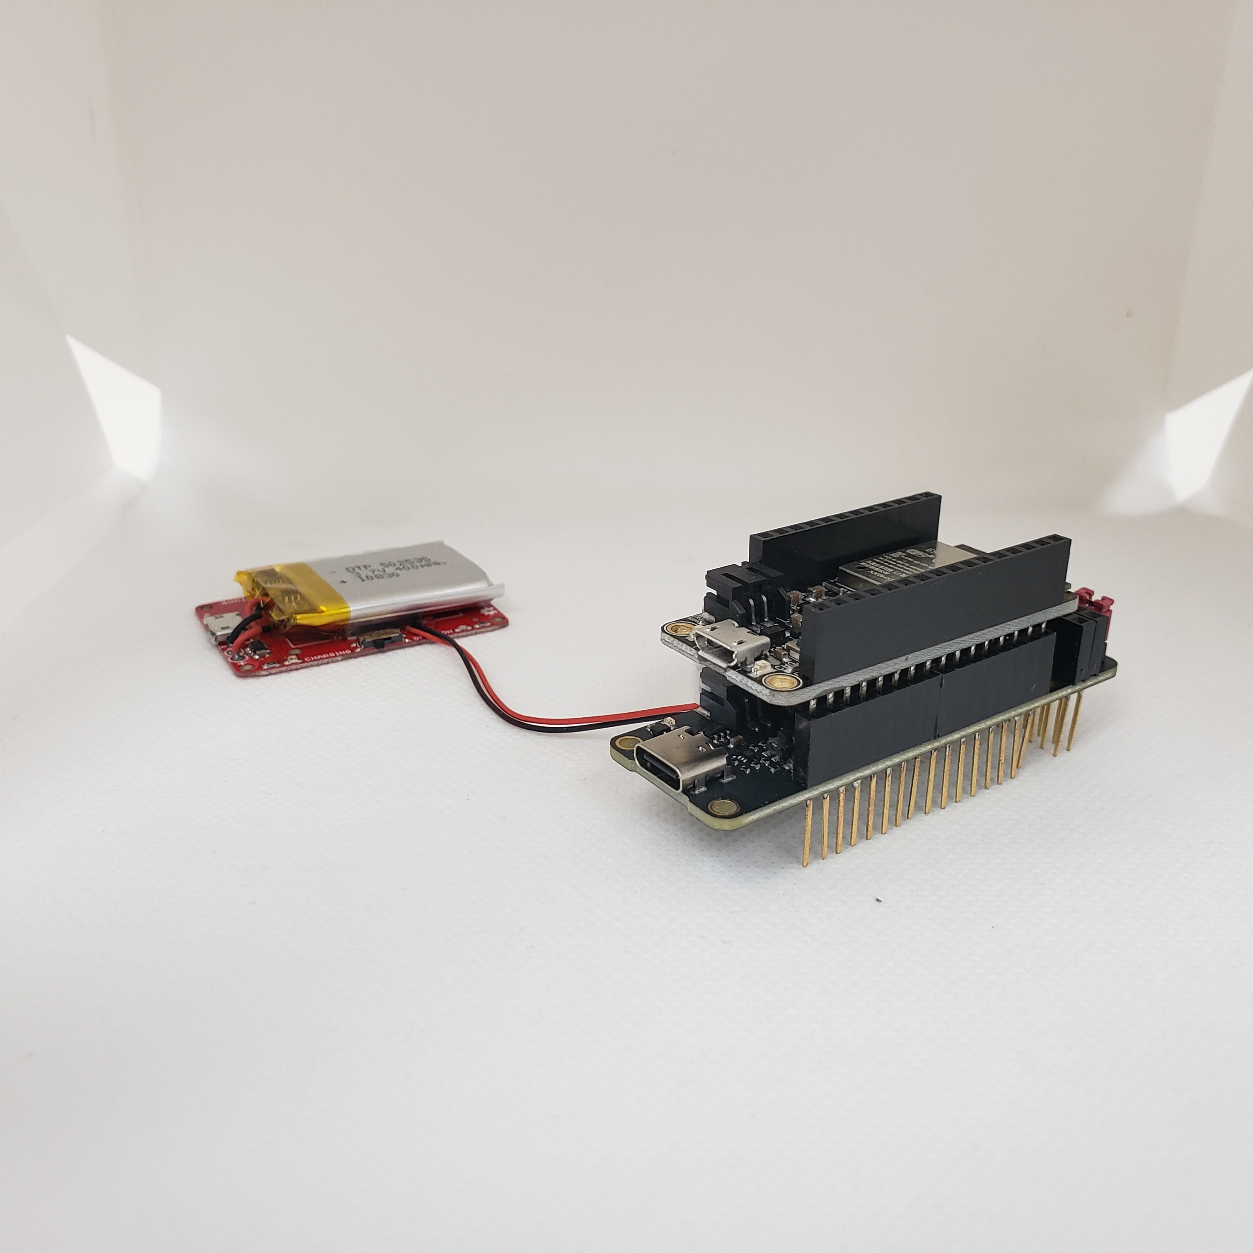
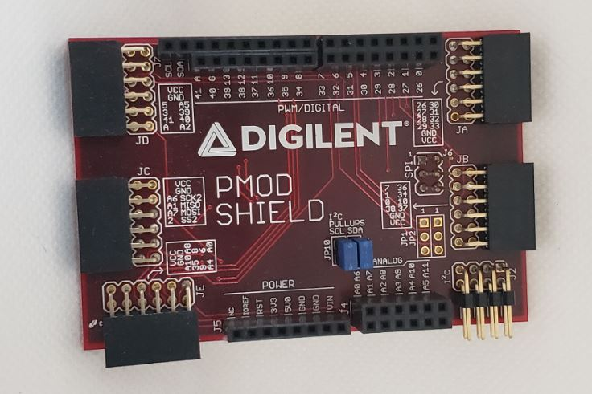
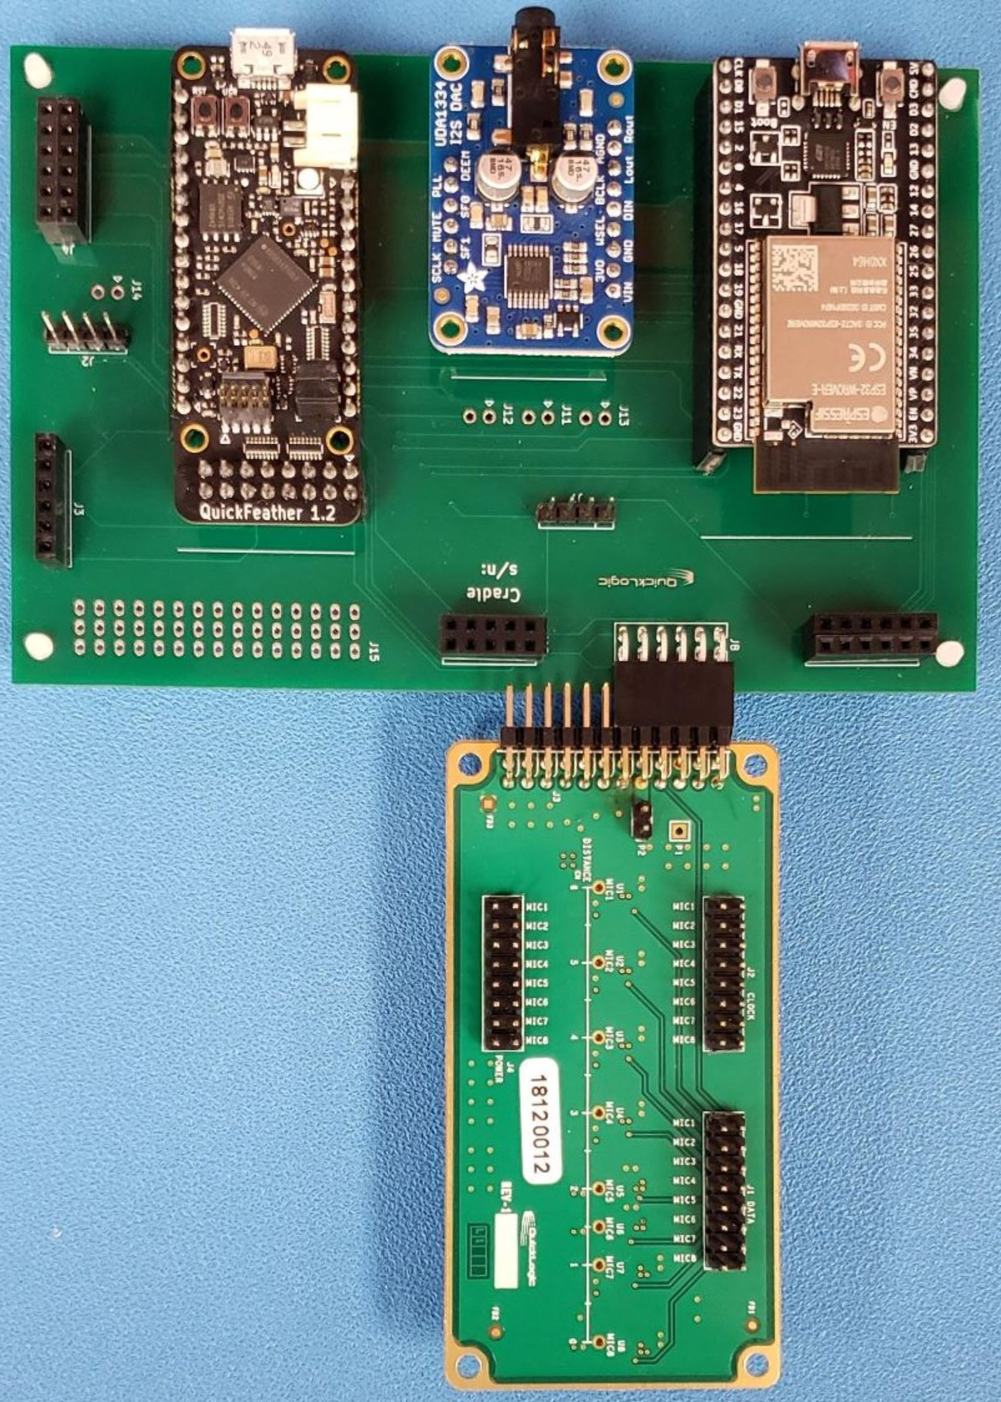
Example of Sizes
custom size
(82mm x 127mm – 2 layers)
Arduino form factor
(55mm x 80mm – 4 layers)
CORE-V-MCU-SOC + WIFI module
Feather form factor
(22mm x 60mm – 4 layers)
CORE-V-MCU-SOC only
© OpenHW Group
July 21, 2021
3

Slide 4
Examples of based EVK block diagram
5V -> 3.3V
LDO
CORE-V-MCU-SOC
RGB LED
5V
IO
FLASH
SPI
WGM160P
(WIFI)
I2C
USB
UART
IO
HEADERS
NOTE: include JTAG module on board? This increases the cost of PCB
NOTE: what standard applications beyond toggling LED to include (for I2C, SPI, UART, IO)?
© OpenHW Group
July 21, 2021
4

Slide 5
OpenHW Group EVK PCB Cost & Options
QuickLogic Engineering Group
© OpenHW Group
June 15, 2021
5

Slide 6
Cost Factors
Exotic parts: hard to find parts or specialize parts such as IC socket, high-speed ADC, high speed (giga Hz connectors) and special assembly instructions
# of Parts (functions): Number of parts contributes to total BOM cost plus assembly cost
Assembly cost – items that contributed to assembly cost are:
Special assembly instructions (density of parts or special temp profiles)
Components on both side of the boards
Mix of surface mount and thru-hole parts
Total # of solder pins
PCB cost – items that contributed to PCB cost are:
Special materials (impedance control / high speed)
Special making process (buried via, BGA fine pitch (< 0.5))
Size
# Layers
© OpenHW Group
June 15, 2021
6

Slide 7
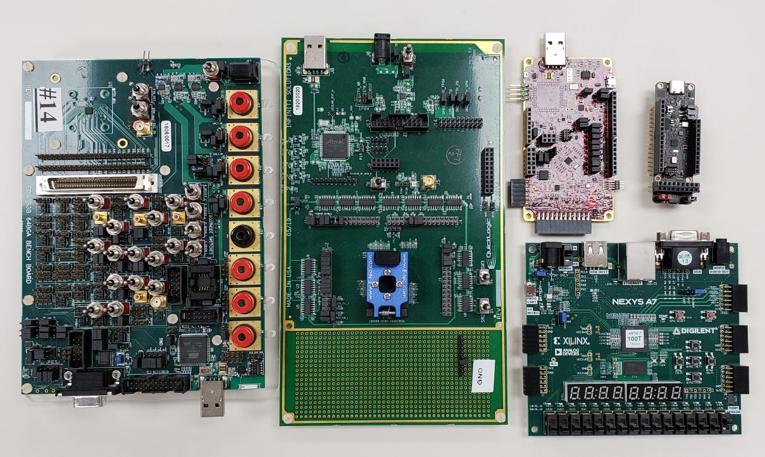
Some examples
S3 Arduino form factor
(52mm x 95mm – 6 layers)
S3 Characterization Bench Board
(128mm x 150mm – 10 layers)
Thing+ Feather form factor
(22mm x 70mm – 6 layers)
Arnold1 EVK
(128mm x 220mm – 6 layers)
Nexys A7
(110mm x 122mm)
© OpenHW Group
June 15, 2021
7

Slide 8
PCB and Assembly Cost (no Parts)
Board | PCB | Assembly | Note
Thing + | $1.00 | $2.00 | Expect assembly cost $1.30 for S3 QFN; minimum thru hole components installation
S3 Arduino | $2.20 | $20 | 2 passes assembly + thru holes parts
S3 Bench | $40 | $120 | 4 passes assembly + thru holes parts
Arnold 1 | $15 | $40 | Thru holes parts
Nexys A7 | N/A | N/A | Expected to be similar to Arnold1 cost
Assumption
Volume: 250
No additional cost due to procurement
Cost does not include manufacturing setup, making stencil, handling
© OpenHW Group
June 15, 2021
8

Slide 9
Benefits Analysis
Board | Plus | Minus
Thing + | Inexpensive, small size, support of Feather wings and Feather boards; standard battery connector | Difficult to implement power separation in small spaces; no IO isolation; no test mode; support only 1 IO voltage level
S3 Arduino | Less expensive, small size, support Arduino shields | No IO isolation; no test mode
S3 Bench | Full IO isolation, individual control of IO including test modes; individual power controls | Big board; very expensive
Arnold 1 | Full IO isolation | Big board; fairly expensive
Nexys A7 | Lots of standard PMOD connectors; some flexible in IO controls | No IO isolation
© OpenHW Group
June 15, 2021
9

Slide 10
Potential Candidates
Size: Arduino or Feather
Power: isolation for CORE-V-MCU-SOC Core and IO power measurement header
Connectors for expansion:
USB Type C
QWIIC: I2C sensor modules
Breakout headers: using form-factor modules or blue-wiring to available IO
Arduino only: PMOD for SPIm, UART, Selected Parallel Camera Interface
On board devices:
SPI Flash device
I2C Accel sensor
LED
© OpenHW Group
June 15, 2021
10

