Slide 1


CV32E40P* Verification Schedule Status Sprint #5
Mike Thompson
www.openhwgroup.org
© OpenHW Group
September 28, 2020
1

Slide 2
Administravia
Attendance is now being tracked for all OpenHW Task Group meetings:
This meeting qualifies as an OpenHW Group Task Group meeting.
Eligibility to vote in each committee depends on meeting attendance, as described in the OpenHW bylaws.
Congratulations to the CORE-V CVA6 and FORCE-RISCV ISG passing Preliminary Project Launch:
CVA6 is a 6-stage “Application” core. Specification is at: https://cva6.readthedocs.io/en/latest/
FORCE-RISCV is an Instruction Stream Generator at: https://github.com/openhwgroup/force-riscv
“RTL Freeze” is coming:
Thanks to all who contributed to the Checklist to define a comprehensive set of milestone criteria.
Still looking for a few others to chip-in.

Slide 3
Risks & Mitigation
The status of Exception Verification:
One Spin efforts continue:
Issue from last week (#509) now resolved.
Integrating tests from em-micro into CV32E40P environment.
Verification Plans reviews progressing:
Overall state of Vplans is good, except for Micro-architecture features.
More (final?) reviews this week.
Sunil Kakkar has ramped up quickly on Performance Counter features.
CSR verification is not currently staffed.

Slide 4
Sprint #5: 2020-09-07 to 2020-09-25
Simulation Verification:
Completion and reviews of all required Vplans.
“Complete” verification of all major features:
RV32IMCZ
Debug
Interrupts
CSRs
Completion of the “test spec” updates:
Full Metrics support for new directories
Script generation of .metrics.json
Integration of Exception tests from em-micro
Ability to collect/report Functional and Code coverage data with both MetricsCI platform and with Cadence Xcelium.
Coverage collection support for other simulators will rely on Member interest.
Formal Verification:
Reset behavior
RV32IMCZ
Exception mechanism:
Illegal instructions
Breakpoints
ECALL

Slide 5
Simulation Status as of 2020-09-28 (1 of 2)
Vplans:
Pending reviews for Interrupts (9/29) and Debug (9/30) Vplans.
CSRs and OBI reviews outstanding.
RV32IMCZ verification:
No specific work this past week.
Active tracking of Functional and Code Coverage:
Little additional work this week.
Debug:
Directed test(s) integrated and all passing.
Random testing on-going.
PR to update coverage model is “in”.
Interrupt verification:
ENV and testcase development work essentially done.
Updates to functional coverage plan (as defined by Vplan) needed to measure completeness.
CSR verification:
Sunil started on Performance Counters.

Slide 6
Simulation Status as of 2020-09-28 (2 of 2)
Integration of Exceptions tests from em-micro:
Integration of tests from em-micro into CV32E40P environment delayed.
OBI:
Updated RAM stall model working thanks to Steve Richmond:
Random stalls on grants and rvalid for Instruction and Data buses.
Creates RTL-vs-ISS step-and-compare mismatches of GPRs (see core-v-verif issue #248).

Slide 7
Formal Status as of 2020-09-28
One Spin Plan: (bold items are updates from last week)
RV32IC unprivileged: “almost done”
RV32M: MUL progressing well, DIV on-going
Zicsr: complete except for counters
Zifencei: flush not fully verified
Counters: still open
Reset: covered RISC-V spec requirements for CSR reset
Exceptions: debug mode started
Illegal, ecall, ebreak ad mret done
Interrupts: on-going
OBI: misaligned stores complete, working on misaligned loads.
Axiomise RISC-V Toolkit:
Toolkit re-run on a clone of the cv32e40p repository.
ADDI proofs are now converging to an unbounded proof.

Slide 8
Tasks from Previous Sprints (which we are not forgetting about)
Verification Planning
Almost...
RV32IMCZ coverage closure
Expect to get to this for another week
Closure of SymbioticEDA “mutation” finding
Can I book a meeting to discuss this?

Slide 9
Thank You

Slide 10
Background
&
Additional Topics

Slide 11
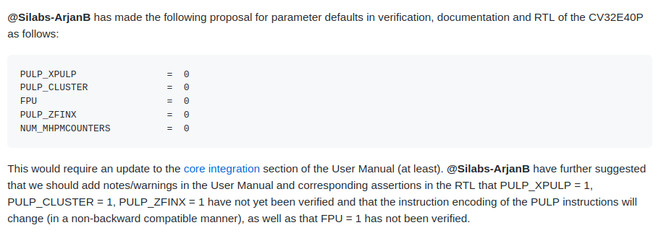
Hot Topic #1: Default parameters
CORE-V-DOCS GitHub Issue #189: Default parameter configuration for CV32E40P
Latest update to this Issue recommends NUM_MHPMCOUNTERS = 1

Slide 12
Hot Topic #2: CSR Updates
Several read-only unprivileged shadow CSRs of machine mode CSRs introduced:
cycle(h), instret(h), hpmcount(h)[3..31].
These are not modeled in Reference Model – are directed tests sufficient to cover these?
CV32E40P Performance Counters:
Until last week, these were not captured in DV plans.
Significant hole in our verification project plan.
Arjan has donated a directed test which Mike will integrate today.

Slide 13
Hot Topic #3
The Interrupt and Debug testcases rely on features of GCC 9.3.0 as this is used by SiLabs.
Specifically, attributes for writing an interrupt handler:
__attribute__((interrupt ("machine"))) void m_software_irq_handler(void);
This tells the compiler to insert stacking calls around the C function so that it can be used in C as an interrupt handler.
The PULP toolchain is based on GCC 7.1 which does not have complete support for this attribute.
The SiLabs team wishes to continue using the up-to-date toolchain.
OpenHW does not want to support multiple toolchains for CORE-V functional verification.

