Slide 1


Verification Task Group July 1, 2021
Steve Richmond steve.richmond@silabs.com
Robert Chu robertchu@futurewei.com
Mike Thompson mike@openhwgroup.org

Slide 2
Outline
Administration
RVFI/RVVI Update
ISACOV Update
Imperas ISS Organization
Core Configuration
Open Issues

Slide 3
Administration
Reminder that attendance will be taken at all meetings
Attendance ensures voting eligibility per OpenHW bylaws
Active project engagement – please reach out to get involved
CVA6 (Jerome Quevremont/Mike Thompson)
Force ISG (Robert Chu)
CV32E40X/CV32E40S (Steve Richmond)

Slide 4
RVFI/RVVI Update
Current work has been consolidated into the CV32E40X writeback-controller branch
https://github.com/openhwgroup/core-v-verif/tree/wb_controller_e40x
USE_RVVI is now deprecated on this branch
Module-based step and compare is removed
Feature complete – debugging testcases now
CSR checks are added
Debug signaling fixed
All ISS interaction encapsulated in interfaces

Slide 5
RVFI/RVVI Documentation
Verification Strategy Document updated with RVFI/RVVI
Under Step and Compare 2.0
https://core-v-verif-verification-strategy.readthedocs.io/en/master/cv32_env.html#step-and-compare-2-0
Overview of RVFI and RVVI signals
Block diagram of UVM
Review of logs emitted
Waveforms of step and compare with RVFI/RVVI
General ALU instruction, interrupt, debug, trap

Slide 6
RVFI/RVVI Update – E40P
Still open issue to port to CV32E40P
https://github.com/openhwgroup/core-v-verif/issues/524

Slide 7
Coverage Update
Current work has been consolidated into the CV32E40X writeback-controller branch
https://github.com/openhwgroup/core-v-verif/tree/wb_controller_e40x
ISACOV is now connected to RVFI
Legacy ISA coverage model is removed
ISACOV is now configured via common configuration object
Added filtering of legal/illegal CSRs based on modes, extensions supported
Individual cores may override

Slide 8
Imperas ISS Reconfiguration
Current work has been consolidated into the CV32E40X writeback-controller branch
https://github.com/openhwgroup/core-v-verif/tree/wb_controller_e40x
The Imperas ISS is now a single installation under core-v-verif/vendor_lib
Ease support burden for Imperas
Variants tuned by integrator testbench
Encourage consistent methodology across cores
Backwards compatible to cv32e40p

Slide 9
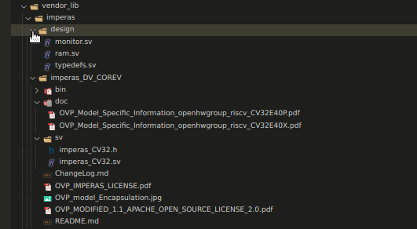
Imperas ISS Reconfiguration
All signal I/O in interfaces
For RVVI
iss_wrap specifies the variant core as a string parameter
.VARIANT(“CV32E40X”)
PDF documentation for each core contained here
No core-specific infrastructure for Imperas now

Slide 10
Common Core Configuration Agent
With new core agent releases information was becoming repeated (extensions, modes, CSRs)
RVFI, RVVI, ISACOV
Core configuration object existed within each core with no commonality of inheritance
No or ad-hoc methodology for:
Configuring bootstrap pins (*_addr_i)
Communicating parameters to testbench
Specifying extensions and modes
Core environment being active or passive

Slide 11
Common Core Configuration Agent
Solution: umva_core_cntrl
UVM “virtual” agent to provide framework for configuring a core and communicating that to a testbench
lib/uvm_agent/uvma_core_cntrl
Agent class (abstract class)
Configuration class (abstract class)
Common typedefs for ISA (CSRs)
Will migrate ISA infrastructure from ISACOV so is available to entire testbench
Common data structures for CORE-V cores (PMP, PMA)
Overview in following slides, more documentation to come in Verification Strategy document

Slide 12
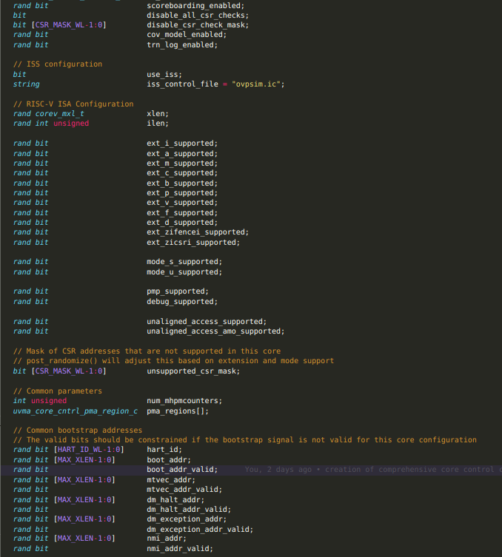
Common Core Configuration Class
ISA support (extensions, modes)
Common switches
ISS, scoreboard enabled, CSR scoreboard checks
Common parameters
Common bootstrap pins

Slide 13
Common Core Configuration Class
Supports randomization with common constraints
post_randomize() will disable CSRs based on extension/mode support switches
Must override:
sample_parameters() : virtual interface will be core-specific

Slide 14
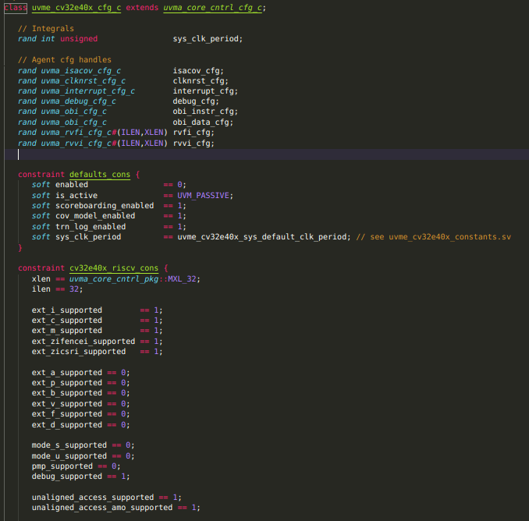
Common Core Configuration Class
Example of core-override class
Add agent configs
Constrain extensions
Provide sample_parameters() implementation

Slide 15
Common Core Driver Class
Drive bootstrap pins at reset
Provide virtual sequences for misc I/Os (e.g. fetch_en)
Core must also provide a context for the core-specific control agent
Parameter wires
Bootstrap pins
Misc I/O

Slide 16
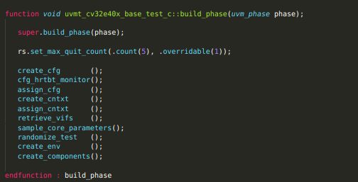
Core-Test Integration
Common Core Control configuration can now be randomized with all contextual information about the core instance before any downstream agents
From uvmt_cv32e40x_base_test_c
randomize_test() randomizes the environment configuration

Slide 17
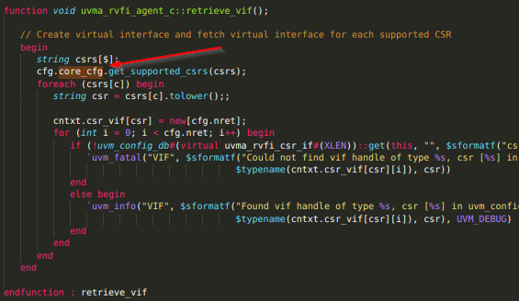
Reuse in Agents
RVFI, RVVI, ISACOV agents expect handle to a uvma_core_cntrl_cfg_c object (i.e. the base class)
Enables the downstream agents to automatically configure:
Extensions supported
CSRs supported
Modes supported

Slide 18
Open Issues
Will create proposals on MM for further discussion
Logging control
RVFI/RVVI emits a lot of logs
Example: hello-world now emits 18M of logs (cv32e40p -> 2M of logs)
Need to create control mechanism to control logs
Regression – no logs by default?
Recreate logs locally or in rerun (Metrics)
Plusarg registrations
Validate that user supplied plusargs (YAML or make command line) are supported to avoid misspellings
Documentation for supported plusargs
Singleton class definition to register, parse and fetch plusargs

