Slide 1


Verification Task Group August 13, 2020
Steve Richmond steve.richmond@silabs.com
Jingliang (Leo) Wang jingliangwang@futurewei.com
Mike Thompson mike@openhwgroup.org

Slide 2
Outline
Attendance and Voting
Simulation Control Update
Strategy Document Updates
Simulation vs. Formal
Open Issues

Slide 3
Attendance and Voting
Attendance at VTG meetings will be tracked for voting eligibility
https://github.com/openhwgroup/core-v-docs/blob/master/program/TGVerification_Attendance_2020.md

Slide 4
Simulation Control Update
Phase 1
Xcelium PR and Questa merged
https://github.com/openhwgroup/core-v-verif/pull/173
https://github.com/openhwgroup/core-v-verif/pull/184
Max Giacometti of Hensoldt Cyber is working on VCS version
Phase 2 (of 2 hopefully)
Regression updates
Test specification

Slide 5
Regression Updates
Initial PR – In discussion only
https://github.com/openhwgroup/core-v-verif/pull/189
https://github.com/strichmo/core-v-verif/tree/strichmo/cv_regress/
This PR introduces
CWD robustness
bin/ directory
make wrappers
YAML regression testlist directory
cv_regress utility
Converts YAML regression testlist(s) to regression platforms
Shell scripts
.metrics.json
Add Jinja2 templates to extend

Slide 6
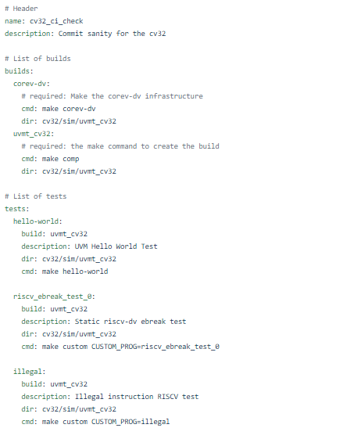
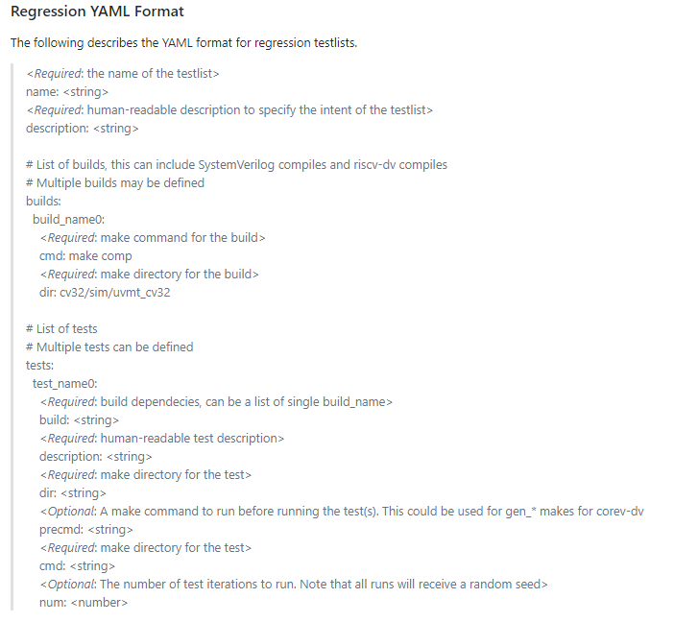
Regression Updates

Slide 7
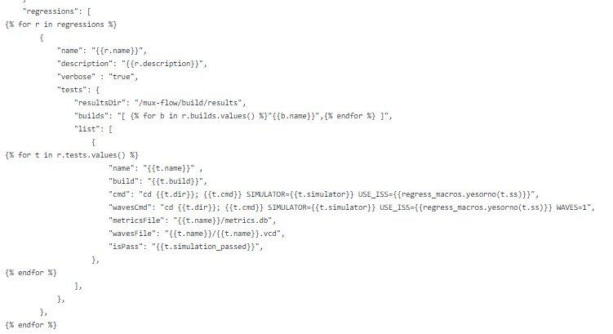
Regression Updates
Jinja templates
<core-v-verif>/bin/templates
Pros
Extremely Pythonic
Text structure identifiable
Cons
Extra module to install in user Python

Slide 8
Strategy Document Updates
Following updates will be made in next week by Steve
Minimum tools for OpenHW Verification
Simulators
Python
Required modules
Make
YAML
Assertion standards (re: last VTG meeting slides)

Slide 9
Test Specification
Goals
Remove the test “specifications” from the Makefiles
Path – where is the test
plusargs for a test
plusargs for generation for random tests
Would like to integrate initial improvements ASAP for CV32E40P
Long term
Unify tests and random generators
Tests in individual directories
YAML test specifications

Slide 10
Simulation vs. Formal
Direct technical contributions for CV32E40P mostly simulation based but receiving external contributions from formal providers
Formal is enabling and even compensating for simulation
e.g. exception verification in CV32E40P
Ideally OpenHW delivers with each core:
Comprehensive simulation environment
All tests, plans and scripts to enable 100% (with exception) coverage
How do we handle scenario where we can’t generate full coverage in simulation?

