Slide 1




Die-to-Die Protocols Specs for Chiplet-based Systems
September, 2021
Davide Schiavone, Hanan Cohen, Denis Dutoit
davide@openhwgroup.org, hcohen@wavious.com, denis.dutoit@cea.fr

Slide 2
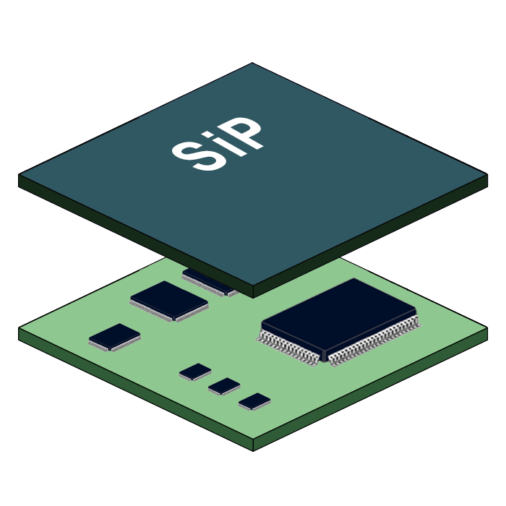
What we want to build
“We” includes as for now: Wavious, CEA, Thales, ETH Zurich, UC Santa Barbara, all WELCOME
MultiCore Application-Class Processor Chiplets (MAPETs)
Chiplet-based systems
System-In-Package
Scalable
Higher Power Efficiency
Reduced Time-To-Market
Lower Cost

Slide 3
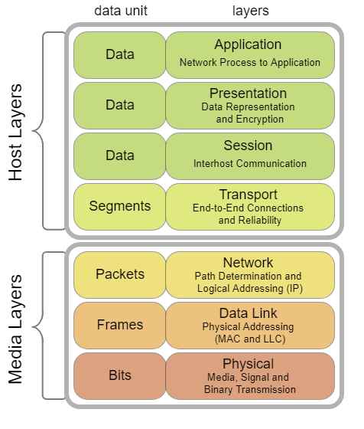
What we have/have not yet
What is available today as open-source?
CVA6: Application-Class RISC-V
OpenPiton: multiple instances of CV64A6 connected with a P-Mesh NOC (goes off-chip)
What is missing?
A standard network-layer specification for Die-to-Die communication
A standard link-layer specification for Die-to-Die communication
Relevant IPs to build the two above

Slide 4
Project Concept Network Layer Spec
A standard network-layer specification - Denis Dutoit, CEA
Output: network layer specification
We want to define the protocol at Network layer for D2D communication that carries Transport level Network-On-Chip busses as AXI or P-Mesh to a network of Chiplets.

Slide 5
Project Concept Network2Link Adapters
A set of IPs to take network-layer packets to link-layer frames Denis Dutoit, CEA
Output: TRL5 RTL IPs (can also be broken in several projects, one for TRL3 and one for TRL5)

Slide 6
Project Concept Link Layer Spec
A standard link-layer specification -
Hanan Cohen, Wavious
Output: link layer specification
We want to define the protocol at Link layer for D2D communication that carries Network level packets to frames to be transmitted by the D2D PHYs as BoW, AIB, etc.
Focus on light weight, flexible and PHY agnostic implementation
S-link (https://github.com/SLink-Protocol/S-Link) can be used as a reference.

Slide 7
Project Concept Link2PHY Adapters
A set of IPs to take link-layer frames to physical transmissions Hanan Cohen, Wavious
Output: TRL5 RTL IPs (can also be broken in several projects, one for TRL3 and one for TRL5) to adapt the link-layer to the PHY
Main targets for the PHY are BoW, AIB, LVDS, GPIOs
Other targets?

Slide 8
Even more Projects
Looking for interested members to participate to the mentioned Projects
Also would be interesting to build Transport2Network Adapter IPs
Building MAPET in scaled technology (e.g. GF12)
Building System-In-Packages (SIPs)
Cake not baked yet → Ideas welcome!!!

