Slide 1
Introduction to openIMIS Module 2: openIMIS and national eHealth landscape
Presented by
openIMIS Initiative
Inputs by
Alvin Marcelo (AeHIN), Rodrigo Assumcao (ILO), Konstanze Lang (GIZ), Saurav Bhattarai (GIZ), Daniella Majakari (Swiss TPH)

Slide 2
Overview
Learning objectives:
Relate the position of openIMIS within a national eHealth landscape
Summarize the interoperability of openIMIS with other systems
Compare with other software such as DHIS2 & OpenMRS
Duration: approx. 35min
Module 2

Slide 3
Agenda
eHealth and Digital Health
Asia eHealth Information Network
openIMIS in the eHealth Landscape
Data & ICT Governance and Management
Interoperability of openIMIS
Module 2
Notes:
This is the detailed agenda for this module with two distinct blocks as mentioned before: first an introduction to key health systems and health financing concepts and then we will get into openIMIS and what it does.

Slide 4
eHealth and Digital health
In 2005, the World Health Assembly through its resolution WHA58.28 on eHealth urged Member States “to consider drawing up a long-term strategic plan for developing and implementing eHealth services… to develop the infrastructure for information and communication technologies for health…to promote equitable, affordable and universal access to their benefits.”
In 2020, WHO released a Global Strategy on Digital Health with the goal of using and scaling up technologies to revolutionize how people worldwide achieve higher standards of health, and access services to promote and protect their health and well-being.”

Slide 5

Asia eHealth Information Network (AeHIN)
AeHIN is an informal network created by the World Health Organization in 2011 to help countries with their digital health development
It started with 7 individuals from 6 countries and has expanded to more than 1000 professionals from 25 nations
AeHIN organizes knowledge exchange and resource sharing among its members recognizing these as effective methods for capacity-building on digital health

Slide 6
AeHIN was formed to help countries address their Digital Health Challenges
The current digital health landscapes of countries are complex.
Many stakeholders, public and private (with competing interests)
Many technology components (servers, networks, databases, security, etc)
Stakeholders do not see the whole picture and understand their role in the larger national health information system.

Slide 7
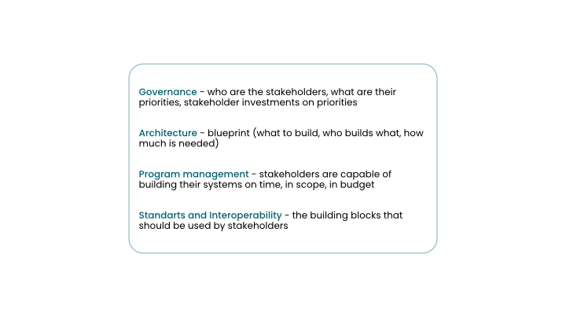
AeHIN Mind the GAPS Framework
To address these challenges, AeHIN proposes countries to adopt a systematic approach that follows this sequence:
Governance
Architecture
Program Management
Standards & Interoperability

Slide 8
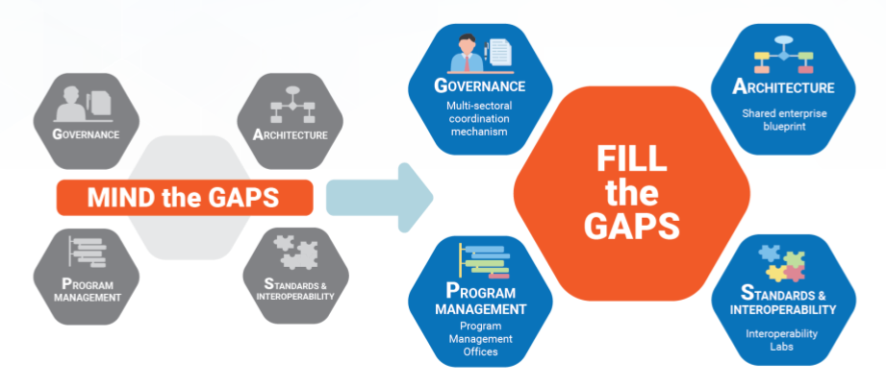
Fill the GAPS
A set of activities countries can undertake to establish capacity for digital health
The AeHIN-openMIS community of practice is part of these activities

Slide 9
Establishing an openIMIS Community of Practice
AeHIN hosts the openIMIS Community of Practice (CoP) in Asia
Brings together its members to understand the importance of digital health global public goods (DHGPGs) in general and openIMIS in particular
The members discuss and share knowledge on how DHGPGs and openIMIS can be leveraged to address their own local needs
Members contribute their learnings back to the CoP

Slide 10
AeHIN as the openIMIS Regional Hub in Asia
Vision, Mission, and Goals
AeHIN as the openIMIS regional hub in Asia consists of health education institutions, medical student associations, country interoperability labs, national health insurance agencies and other related networks that use openIMIS for their specific needs
VISION
MISSION
GOAL
Universal health coverage is achieved through appropriate use of information and communications technology
Build capacity for ICT in social health insurance in Asia through openIMIS and other global public goods
A strong community of practice around openIMIS in Asia

Slide 11
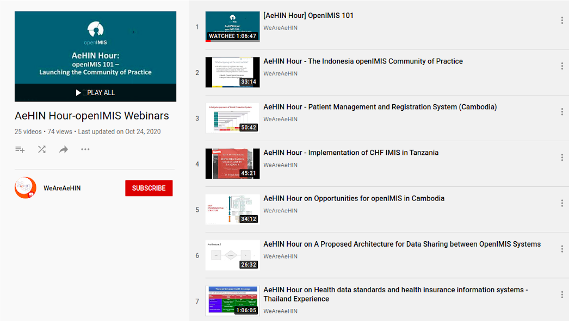
Regional Hub Activities
Identify stakeholders and their needs
Demonstrate openIMIS as a solution to their needs
Foster peer-to-peer support through webinars
AeHIN-openIMIS webinars available at https://www.youtube.com/playlist?list=PLN7M3nT7qGnfu329R2YTiuLQV_m4J6vIO

Slide 12
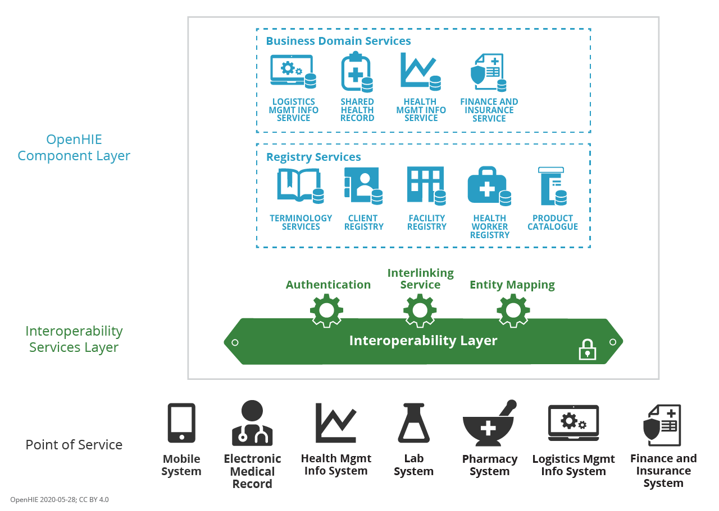
openIMIS in the Digital Health Landscape
openIMIS is a reference tool for the Finance and Insurance Service Business domain service
The service receives claims/financial data from Point of Service applications (eg. EMR)
The service manages the various processes a claim goes through before payment.

Slide 13


Data Governance and Management
Everywhere data is being collected, processed, analysed, used, reused and commercialized…
In SP data and information are fundamental assets
Enabling decision making and operations
Constituting a strategic public asset
Part of a National Data Infrastructure
The processes and policies involving Data have to be defined
Gathering, preserving, using, analysing and sharing data is the main role of ICT in SP

Slide 14
ICT Governance and Management
It is a constant journey, not a destination, learning how to do better in order to be able to do more
Technology must serve the organizational goals not the reverse
ICT has become too important to be left (only) in the hands of ICT people
SP organizations need to decipher their ICT and data operations or run the risk of being devoured by growing budgetary demands and diminishing results; they need to implement governance and management processes to increase capacity, efficiency and effectiveness
Governance and strategic planning are the responsablility of high-level decision-makers
Constant balancing of conflicting choices and trade-offs: stability versus flexibility; adapting processes to systems versus adapting the systems to the processes; open source versus licensed software; contracting cloud services versus owning data centres; security versus interoperability; outsourcing versus in-house development; etc
Effective service delivery capacity comes from harnessing ICT and data. This, combined with comprehensive social protection policies and adequate financing for institutions, can ensure social protection rights for all

Slide 15
Quizz
What is the goal of the WHO Global Strategy on Digital Health?Answer: to promote the use and scale-up of technologies to improve people’s health and access to services. Wrong answer: to strengthen data privacy / to encourage people to use more smartphone health apps.
What are the correct components of the “Mind the GAPS” framework? Answer: Governance, Architecture, Program Management, Standards & Interoperability. Wrong answer: Guidelines, Architecture, program management, standards & interoperability / Governance, architecture, program management, software
Which category, within the business domain service, does openIMIS fit in? Answer: finance and insurance service. Wrong answer: shared health record / health management information service / logistics management information service
Module 2

Slide 16
Interoperability of openIMIS
Functionalities of openIMIS can be augmented by data exchange wih other systems through standards such as HL7 FHIR:
Submission of health service claims through existing Electronic Medical Record systems
Sharing financial data (contribution received, payments approved) with financial management systems
Analysis of data within openIMIS

Slide 17
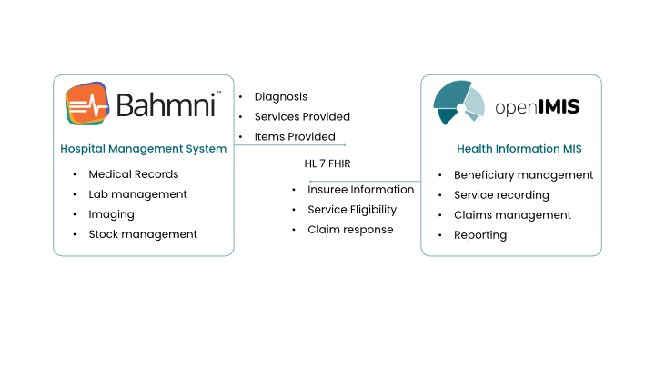
Interoperability with openIMIS
Without interoperability, all functionality would have to be built, potentially duplicated, within openIMIS.
Example: Interoperability with Electronic Health Records (EHR) for claims generation, submission

Slide 18
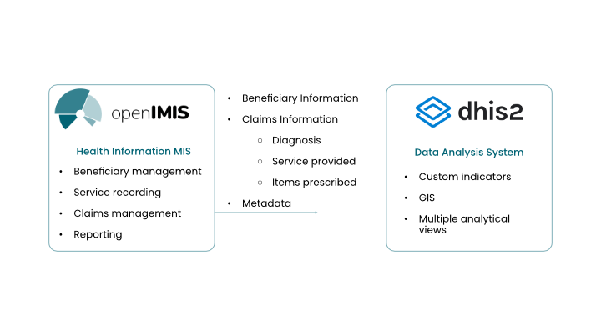
Interoperability with openIMIS
A typical implementation of openIMIS contains a wealth of data valuable to health systems.
In order to maximize the ability to analyze such data, interoperability between openIMIS and DHIS2 has been developed.

Slide 19
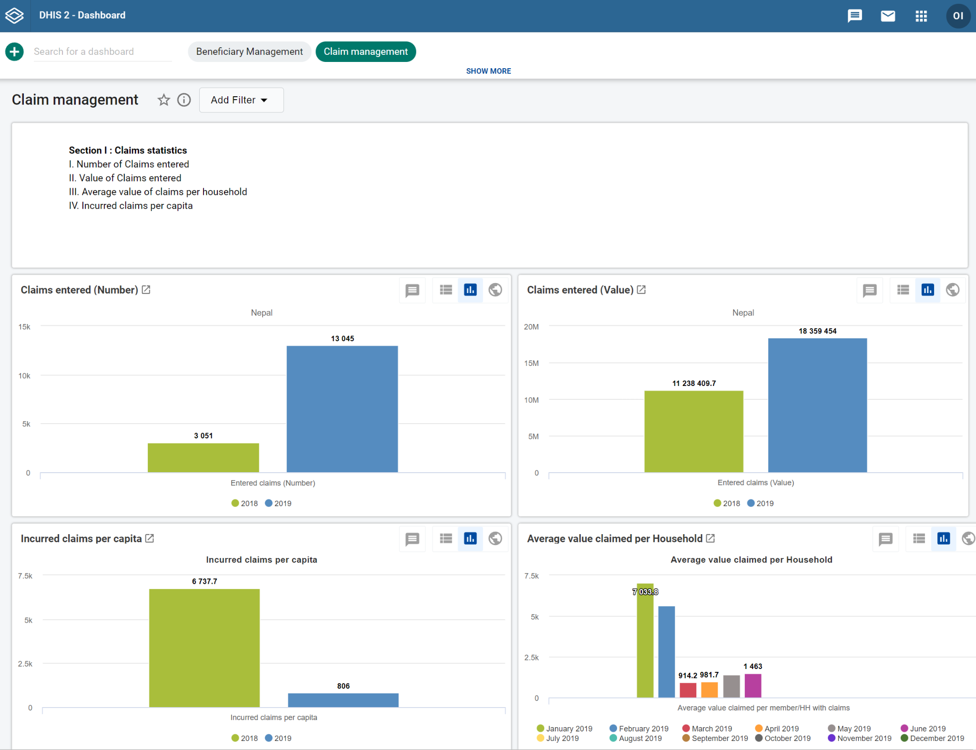
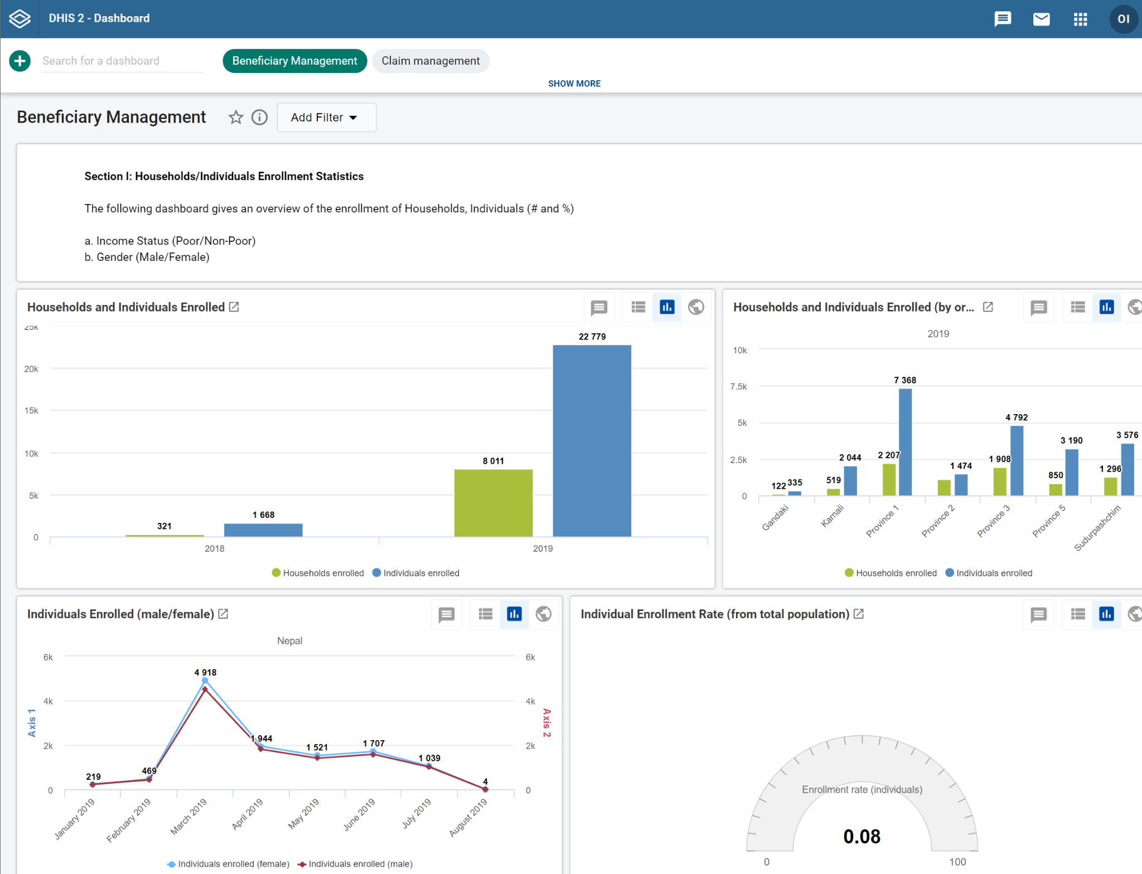
openIMIS & DHIS2
openIMIS is capable of sending HL7 FHIR compatible data on:
Beneficiaries
Policies
Claims
Services
Items
in order to produce analytical dashboards in DHIS2
Standard Dashboards available for
Beneficiary Management (~25 indicators)
Claims Management (~50 indicators)
Scheme performance (6 indicators)
Ability to customize/design dashboards according to need.

Slide 20
Quizz
What data exchange standards are used to make openIMIS interoperable? Answer: HL7 FHIR. Wrong answer: EHR-FM, CCOW, Arden Syntax
How does the Bahmni-openIMIS integration work in Nepal? Answer: claims data is sent from Bahmni to openIMIS. Wrong answer: enrolment data is sent from openIMIS to Bahmni /claims data is sent from openIMIS to Bahmni
What data can openIMIS send to DHIS2? Answer: data on beneficiaries, policies and claims. Wrong answers: data on claims / data on beneficiaries / data on beneficiaries and claims
Module 2

Slide 21
Outlook on Module 3
openIMIS Implementation process
Use cases from Tanzania, Nepal, the Gambia and Cameroon

Slide 22
Further learning resources
AeHIN Webinars on eHealth: https://www.youtube.com/playlist?list=PLN7M3nT7qGnfu329R2YTiuLQV_m4J6vIO
WHO/ITU eHealth Strategy Toolkit: https://apps.who.int/iris/bitstream/handle/10665/75211/9789241548465_eng.pdf?sequence=1&isAllowed=y
DHIS2 Academy: https://dhis2.org/academy/
openIMIS wiki: Further learning resources - openIMIS - Confluence (atlassian.net)

Slide 23
References
World Health Assembly Resolution WHA58.28 on eHealth (2005)Available from: https://www.who.int/healthacademy/media/WHA58-28-en.pdf
WHO (2020) GLobal Strategy on Digital Health 2020-2025. Available from: https://www.who.int/docs/default-source/documents/gs4dhdaa2a9f352b0445bafbc79ca799dce4d.pdf
AeHIN (2020) Mind the GAPS. Available from: https://www.asiaehealthinformationnetwork.org/mind_the_gaps/
Module 2

Slide 24





Credits
The development of this e-learning course was supported by:

