Slide 1
Introduction to openIMIS Module 3: openIMIS use cases
Presented by
openIMIS Initiative
Inputs by
Daniella Majakari (Swiss TPH), Konstanze Lang (GIZ)

Slide 2
Overview
Learning objectives:
Explain the achievements of openIMIS in selected countries/regions
Show diverse use cases (implementation scenarios) that openIMIS can serve: health insurance, employment injury insurance, cash transfer, in-kind transfer etc.
Compare the processes of implementation in the shown cases
Duration: approx. 40min
Module 3

Slide 3
Agenda
Introduction to country implementations
openIMIS implemention in 8 steps
Use case: Tanzania
Use case: Nepal
Use case: Cameroon
Use case: The Gambia
Module 3

Slide 4
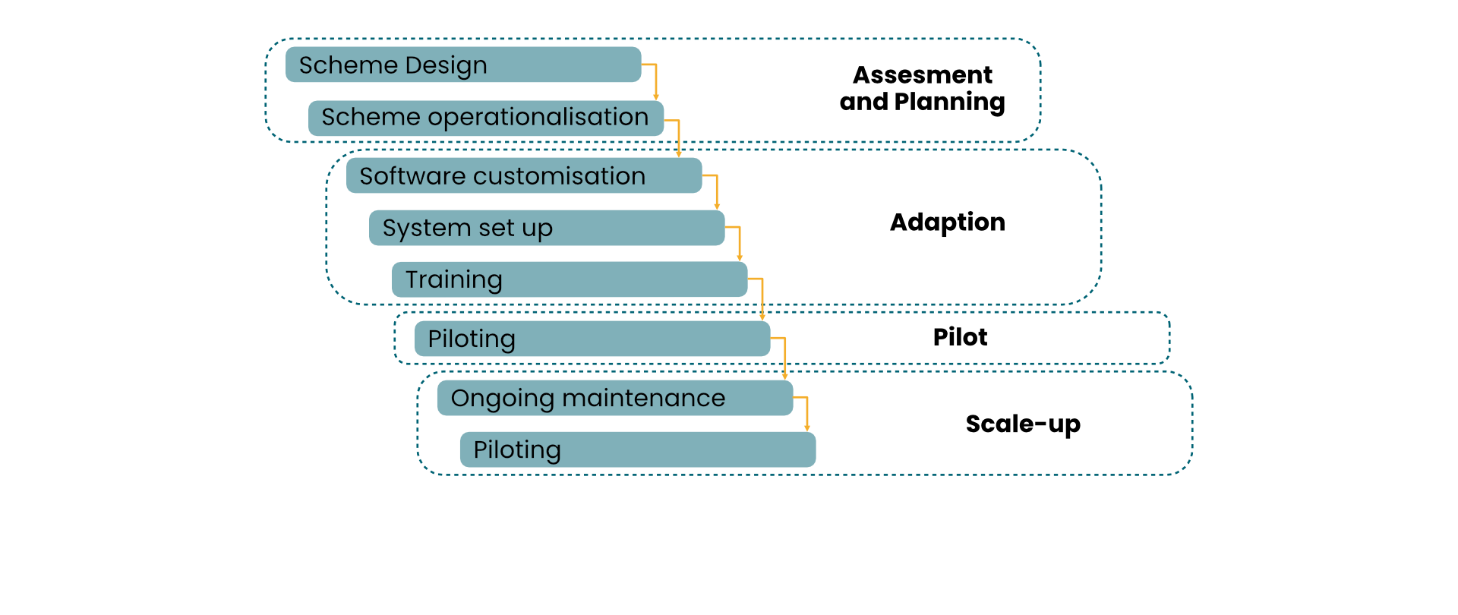
Introduction to Country Implementation

Slide 5
Step 1: Scheme Design
How will the scheme function?
Who are the key actors?
What benefits are offered?
How will providers be managed?
The following scheme design elements need to be established:
Guiding policies and regulations
Organizational structure
Operating procedures
Benefit Package
Provider payment mechanism
Provider empanelment criteria and process

Slide 6
Step 2: Scheme operationalization
Identification and contracting of:
Healthcare providers
Telecommunication provider (for data transfer services)
SMS gateway (where applicable)
Mobile payment service/provider gateway (where applicable)
Procurement of:
Data transfer packages for telecommunication provider (sim cards with internet)
SMS gateway services (SMS package)
Forms (including identification cards)
IT hardware (phones and computer)
Appropriate hosting environment
Recruitment of organizational staff at all levels

Slide 7
Step 3: Software customization
Assessment of system specifications against scheme operating procedures
Amendment to SOPs or systems specification as needed
Software modification as per modification made to system specification (if applicable)
Set up of test server (installation and loading with test dataset)
Integration with SMS gateway (if applicable)
Integration with mobile payment service/payment gateway (if applicable)
Testing of developments
Finalization of system developments based on test results
Language customization (resource files and supporting documentation)

Slide 8
Step 4: Software set up
Set up of:
Dedicated training server (installation with dummy database)
Live server
Server side security measures
Backup server and backup routine
Configuration of registers on the live server
Installation of:
Apps and uploading of extracts on mobile phones
Offline installation and uploading of extracts

Slide 9
Step 5: Training
Server administrator(s)
System administrator(s)
Scheme staff
Distribution channel/agents
Health facility staff

Slide 10
Step 6: Piloting
Design the pilot
Capture user feedback (bugs or new requests)
Translate user feedback into software/process requirements
Adapt software/processes to incorporate feedback
Test new developments/adaptations
Deploy new developments/enhancements

Slide 11
Step 7: Ongoing Maintenance & Upgrade
Day to Day management:
Updates to configurations
Ensuring system backup
Backstopping support to users at various levels
Preparing data extracts for offline use
Capacity development of (new) users
Ongoing capture of user requirements, gaps, and bugs
Local developments (if undertaken)

Slide 12
Step 7: Ongoing Maintenance & Upgrade
Link to global community:
Feedback to openIMIS global community (implementation experiences and software developments)
Downloading new openIMIS release
Upgrading of test environment to latest openIMIS release as per guidance
Test new openIMIS release
Incorporating local developments (if applicable) and testing of customization in new release
Upgrading live enviornment

Slide 13
Step 8: Scale up
Appropriate server configuration (as per expected laod)
Infrastructure (personnel and equipment)
Backstopping support structure
Trained staff
Notes:
The final step, once the solution has been piloted, will be to scale it up, based on the lessons learned.
The scale up should be properly planned and needs to be supported by having the following elements in place:

Slide 14
Quizz
Matching quiz: matching the step numbers with the step «names»
Module 3

Slide 15



openIMIS Implementation Tanzania
Impact
Type of scheme
Beneficiaries:
261,748 households, corresponding with 1,6 Mio beneficiaries actively covered (12/2020)
6,137 health facilities registered and connected with openIMIS
Significant gains achieved in
Overall scheme efficiency
Improving data quality
Simplified decision-making processes
Fund management
Improved Community-Health Fund: community-based health insurance, providing services from 6,173 health facilities
Operator
President’s Office Regional Administration and Local Government (PORALG)
Geographical coverage
iCHF: All (26) regions in the mainland Tanzania are now using openIMIS
100%
Users
About 21,700 users = staff at scheme operator and health facilities
About 19,600 enrolment officers with access to and can submit enrolment data in IMIS
Role in the community
Knowledge Sharing, Testing of releases, Feature requests, Contribution of new developments

Slide 16
Example for Tanzania

Slide 17


openIMIS Implementation Nepal
Impact
Type of scheme
Beneficiaries
Social Health Insurance (HIB): 3,7 Mio
Social Security (SSF): 200,000
Health services have been provided to 1,505,698 beneficiaries through HIB
375 empaneled health facilities
Aim to have accelerated claims management through openIMIS AI claims adjudication module
HIB: Voluntary Social Health Insurance scheme, targeting the informal sector. Coverage for all levels of health service.
SSF: Mandatory health and accident injury insurance scheme for formal sector employees.
Operator
Health Insurance Board (HIB)
Social Security Fund (SSF)
Users
Role in the community
6.230 enrolment officers
over 750 health facility personnel
140 HIB staff
24 claims review
3 IT officers at HIB
HIB has been part of openIMIS community since 2016 – sharing experiences + knowledge with wider community; uses community as platform for exchange and regularly reports on updates
close collaboration with regional hub AeHIN
Have been hosting ‘study tours’ for potential users
Cambodia 2018
Pakistan 2019
Cameroon & Nigeria 2019

Slide 18

Example in Nepal

Slide 19

openIMIS Implementation Cameroon
Impact
Beneficiaries:
BEPHA: 18,686, out of them 10,109 women = 54%
HIV fee elimination scheme: 148,000 in the 2 pilot regions; potential after scale-up to 10 regions: 540,000 beneficiaries
Type of scheme
Bamenda Ecclesiastical Province Health Assistance (BEPHA): community based micro health insurance scheme, providing services through 140 hospitals
HIV Fee Elimination: program for the elimination of user fees for HIV treatment and services, providing testing and treatment services from 95 health facilities
Potential:
Chèque Santé: a national voucher scheme for maternal and child health
EduCash: a conditional cash transfer scheme to support children of targeted households for their education
Health care purchasing scheme for IDPs and vulnerable persons in 4 Regions
Operator
Micro health insurance scheme - Bamenda Ecclesiastical Province Health Association (BEPHA)
HIV fee elimination scheme – The Regional Fund for Health Promotion, MoH
Special aspects of implementation
Multiple schemes supported by openIMIS with the potential to support health data harmonization
One of the first potential implementation cases to benefit from newly established Catalytic Implementation Fund – receiving support for capacity development in roll-out of several schemes

Slide 20

openIMIS Implementation The Gambia
Impact
Type of scheme
Beneficiaries: Cash transferred to 83.000 households in 30 of the poorest districts, with 6-8 members per household (30% of Gambian population)
IT system, based on openIMIS, was ready to deploy in 4 weeks of scheme finalisation as COVID-19 response mechanism.
Nafa quick: cash transfer scheme as a quick response to COVID-19 crisis
Potential for scale up
Nafa money: long term cash transfer scheme targeting additional 40% of population over 3 years
Operator
Special aspects of implementation
National Nutrition Agency (NaNA)
Together with Department of Community Development, Ministry of Lands and Regional Government & Department for Social Welfare of the Ministry of Women, Children and Social Welfare
First openIMIS implementation in social protection systems other than health
Demand driven: ideation and initiation of openIMIS use from 2M Corp.
Population coverage
‘Nafa quick’ 30%
‘Nafa money’ +40% planned
of the overall
Population (2 Mio)

Slide 21
Quizz
Match the country to the type of scheme
Module 3

Slide 22
Outlook on Module 4
Description of how openIMIS is sustainable
Presentation of the openIMIS Community
Long-term goals of the Initiative

Slide 23
Further Learning Resources
AeHIN Hour Webinar «openIMIS: An Implementation Experience in Nepal»: https://www.youtube.com/watch?v=S5j9YJDftCA
AeHIN Hour Webinar «Implementation of CHF IMIS Tanzania»: https://www.youtube.com/watch?v=qiHgYYtt6IU&t=1019s
BMZ article & podcast on openIMIS Implementation in the Gambia: https://health.bmz.de/stories/openimis-brings-digital-social-benefits-to-the-gambia/
openIMIS wiki: Further learning resources - openIMIS - Confluence (atlassian.net)
Module 3

Slide 24
References
Srivastava, Siddharth (2021) Implementation Steps. Available from: https://openimis.atlassian.net/wiki/spaces/OP/pages/590086190/Implementation+Steps
Srivastava, Siddharth (2021) Country Specific Implementation Resources. Available from: https://openimis.atlassian.net/wiki/spaces/OP/pages/593231889/Country+specific+implementation+resources
Tanzania video: https://www.facebook.com/SwissDevCoop/videos/156318546639670/
Nepal video: https://www.youtube.com/watch?v=7x5OVQ3ZnDs
openIMIS website: http://openimis.org/
Module 3

