Slide 1



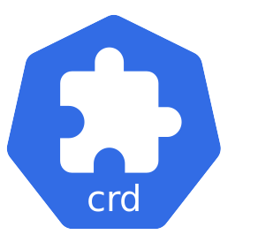
TKS Admin Cluster
TKS User Cluster
byoh Host
Registration
byohosts
BYOH Capacity pool
Linux Host

Slide 2
TKS Admin Cluster
LMA
Decapod
Registration
Your Cluster
e.g EKS , Naver Kubernetes Service

