Slide 1
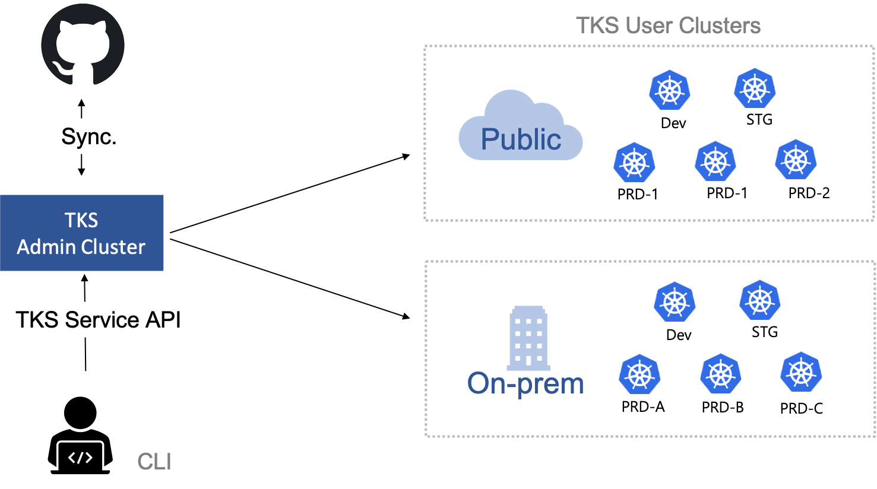
User Clusters
Admin
Cluster
gRPC API
Service API

