Slide 1

Cover the Core behind first
Solve very simple problems.
Move to the SceneGraph.
Solve more complex problems.
Start without any drawing at all.

Slide 2
Fabric runs inside a website.
To get started we have to....
Include all of the necessary files.
Create a Fabric Context.

Slide 3
Fabric deals with data types.
It comes with certain types.
They are managed inside the RegisteredTypesManager.

Slide 4

Data inside Fabric is stored in Nodes
Each element is called a “Member”.
Nodes can store n Members.

Slide 5
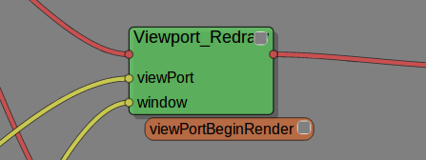
Data is modified using Operators.
An Operator is a small program.
Operators are bound to Nodes.
The language used is KL.

Slide 6
Nodes can be sliced.
A Slice is one copy of the Node's data.
Slices can be modified in parallel.
Slicing can vary from Node to Node.

Slide 7
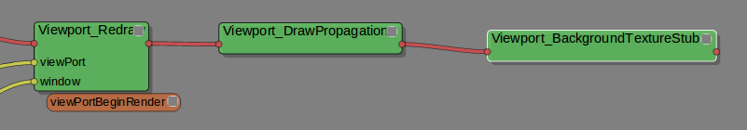
One Nodes can depend on another.
Members can be accessed.
Dependencies express the computational problem.

Slide 8
The website can interact with Fabric.
Events can be forwarded.
Fabric can fire events to the DOM.

Slide 9
You can define your own types.
Custom data types can be used in operators.
Similar to structs in C++.

Slide 10
The SceneGraph is a wrapper.
It simplifies the complexity.
It is ONE implementation, and can either be used as is...
Or taken as a reference only.
Purely in JavaScript.

Slide 11
2D Drawing can be achieved.
We use a flat 3D scene for this.
So you get all the goodness of the programmable pipeline.

Slide 12
3D Drawing involves ...
A Transform
A Geometry and
A Material.
Furthermore there are Cameras
And lights.

Slide 13
Implementing a Square means..
Creating a custom SG Node
Deriving it from Lines
Filling it with Data

Slide 14
0
3
1
2

Slide 15
Creating a new GLSL Shader
Starting off with Constant
Several Shaders in one
Vertex + Fragment

Slide 16
Incidence Based Shader
New Uniform Matrices
New Attribute “Normal”
Multiply Color by Incidence

Slide 17
Wave Deform Shader
Based in Incidence Shader
Use sinus on distance
Displace + Rotate Normal

Slide 18
Manipulation modifies members
Can be attached to anything
Customizable look + behaviour

Slide 19
CharacterSkeleton
CharacterRig
CharacterMesh
CharacterVariables
CharacterSolvers

Slide 20
Draw CharacterSkeletonDebug
Skinning is done through GLSL
Shader involves NormalMapping

Slide 21
The Pose is a flat list of Xfos
Pose computation with Solvers
Simplest: Global Manipulation
Manipulators can be attached

Slide 22
Order of bones is irrelevant
The sample is actually a bad rig
FK Computation by parenting
Parent is Xfos Multiplication
Same Manip., different result

Slide 23
IK Computation
Manip. uses solver parameters
Any manip. / solver possible

