Slide 1
Image Recognition with OpenCV and TensorFlow Workshop
Oliver Zeigermann & Tim Wüllner
OPEN KNOWLEDGE Gmbh
https://bit.ly/mlcon22_image_rec
Notes:
https://colab.research.google.com/drive/15VFJ9P4gsFn37SO-Yr3K2Z8el2fGuq_G?usp=sharing

Slide 2
Theoretical Background
Neural Network
Neurons
Activation functions

Slide 3
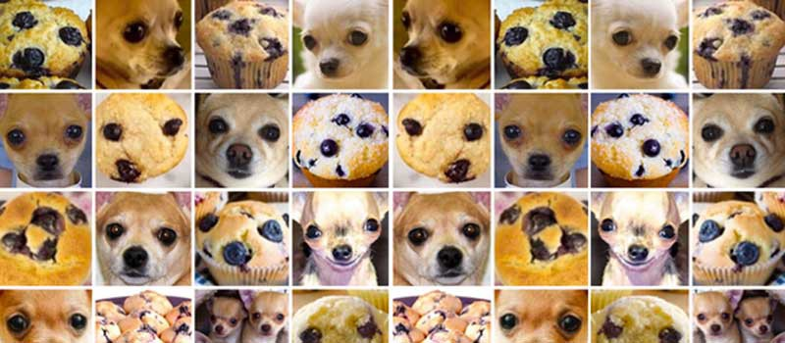
Neural Network
Input-Layer
Hidden-Layer
Output-Layer
0
2
40
0.1
0
3
0.9
0.1
11

Slide 4
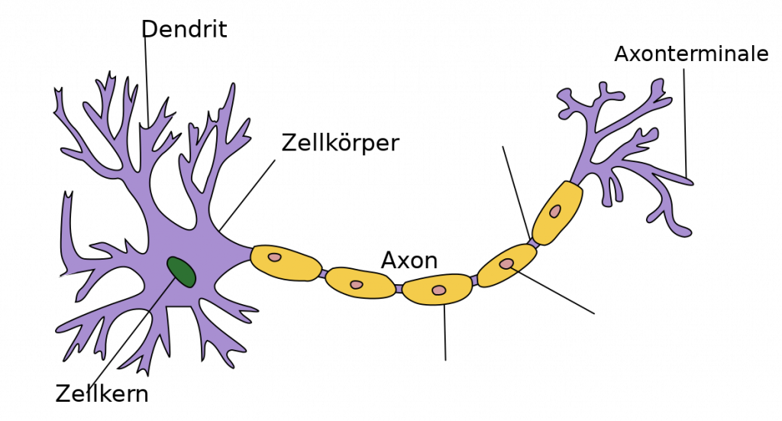
What‘s a neuron?
Dendrite
Axon terminal
Cell body
Axon
Nucleus
Notes:
Dendrites - receive signals from other neurons, and a neuron can have many dendrites.
Cell body - sums the signals to generate the output.
Axon - when the sum reaches a threshold, a signal is transmitted through the axon. Nerve cells always have only one axon
Axon terminal (synapse) - The point of connection between the axon and dendrites. The strength of the connection corresponds to the strength of the transmitted signal (synaptic weights)
Source:
"Anatomy and Physiology" by the US National Cancer Institute's Surveillance, Epidemiology and End Results (SEER) Program .

Slide 5

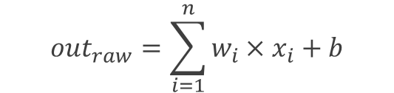
What‘s a neuron?
Dendrite
Axon terminal
Cell body
Axon
Nucleus
x₁
w₁
bias
$${out}_{raw}=\sum_{i=1}^{n}{w_{i}×x_{i}}+b$$
output of
previous neuron
w₂
x₂
b
$$ϴ({out}_{raw})$$
w_{n}
x_{n}
weights
activation function

Slide 6
Activation function (ϴ)
Subsequent modification of the neuron output
Layer-specific (not neuron-specific)
Adds non-linear properties to the network
Recognition of complex patterns
ϴ(40)
40
40
0
0.1
ϴ(3)
3
3
0.1
0.9
ϴ(11)
-11
0

Slide 7
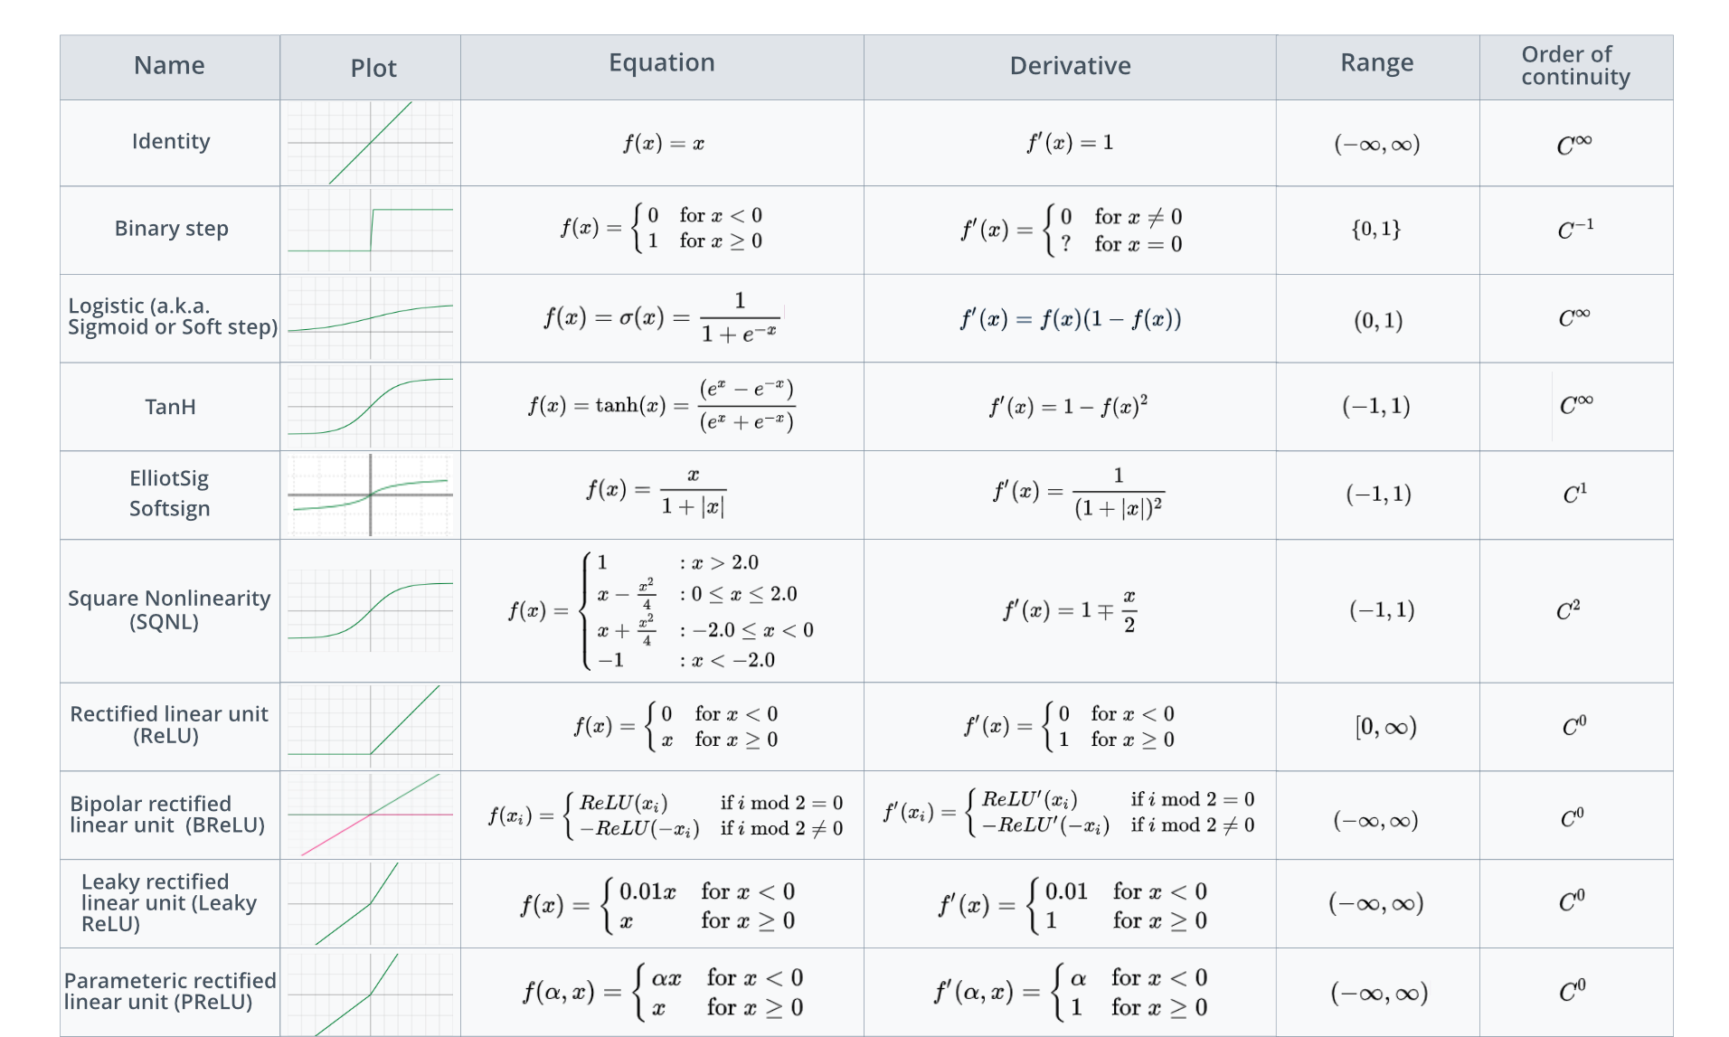
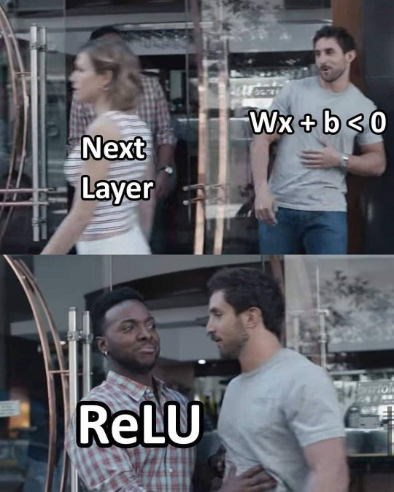
Activation function (ϴ)
[…]
Notes:
https://de.acervolima.com/aktivierungsfunktionen-im-detail-verstehen-1/

Slide 8

Softmax activation function
0
20
0.1
40
$$ϴ_{softmax}$$
200
0.9
3
Notes:
- For output layers

Slide 9
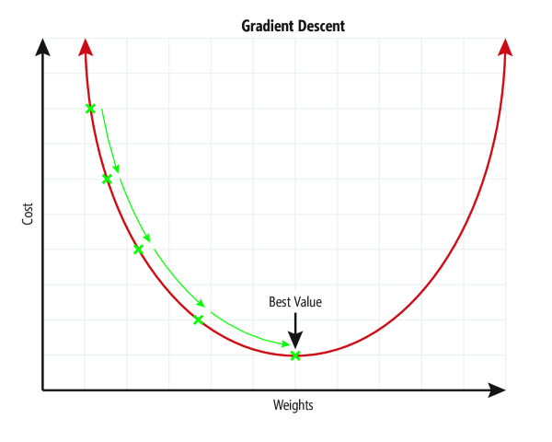
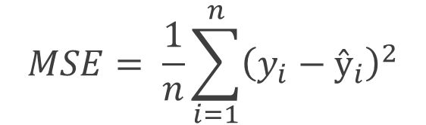
How does a neural network learn?
cost function:
prediction (ŷ)
$$MSE= \frac{1}{n}\sum_{i=1}^{n}{{\left(y_{i}−ŷ_{i}\right)}^{2}}$$
0.1
0.0
0.9
1.0
truth (y)

Slide 10
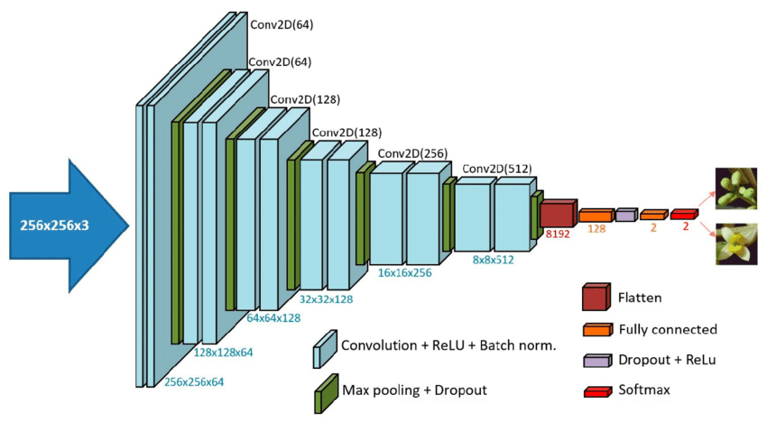
Types of Layers
Dense
Convolutional
Notes:
Milicevic, Mario & Zubrinic, Krunoslav & Grbavac, Ivan & Obradovic, Ines. (2020). Application of Deep Learning Architectures for Accurate Detection of Olive Tree Flowering Phenophase. Remote Sensing. 12. 10.3390/rs12132120.

Slide 11
Dense Layer
Each neuron is connected to each neuron from the previous layer
High computational effort
CNN: Output layer

Slide 12
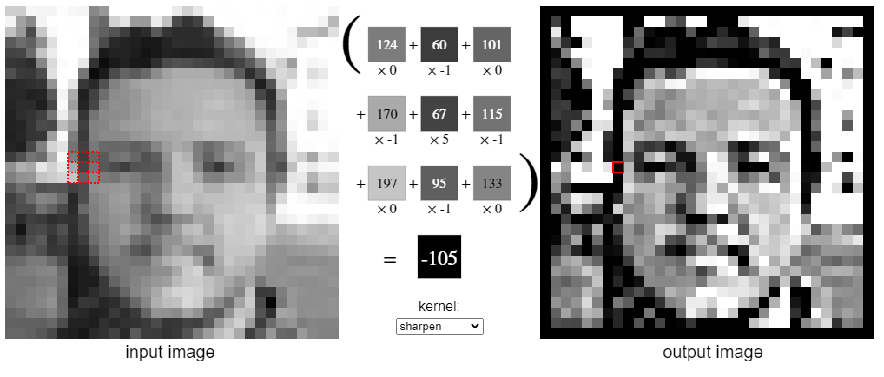
Convolutional Layer
Defines CNNs
Extraction of features
Reduction of computational effort
Mathematical convolution
by Victor Powell
( https://setosa.io/ev/image-kernels/ )
Notes:
Dot product
Padding can be applied
- zeros at edges
Stride can be set:
- Steps in x and y direction

Slide 13
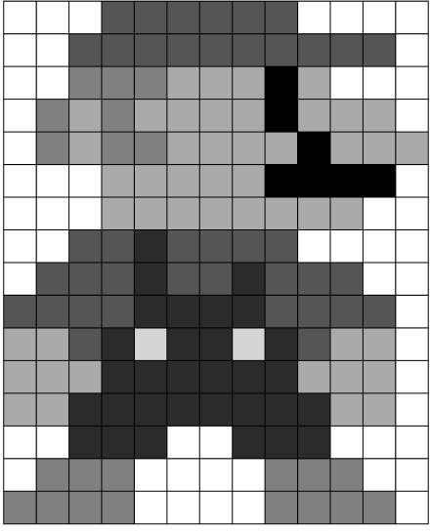
Convolutional Layer
Kernel
(trainable weights)
Resulting image
(in progress)
1
1
1
w₁ | w₂ | w₃
w₄ | w₅ | w₆
w₇ | w₈ | w₉
42
x
1
1
0.3
1
1
0.5
= 1 x w₁ + 1 x w₂ + 1 x w₃ + 1 x w₄ + 1 x w₅ + 0.3 x w₆ + […]
= 42
Notes:
https://people.sc.fsu.edu/~jburkardt/classes/imps_2017/10_31/10_31.html

Slide 14
Convolutional Layer
Kernel
(trainable weights)
Resulting image
(in progress)
1
1
0.3
w₁ | w₂ | w₃
w₄ | w₅ | w₆
w₇ | w₈ | w₉
42
34
x
1
0.3
0.3
1
0.5
0.5
= 1 x w₁ + 1 x w₂ + 0.3 x w₃ + 1 x w₄ + 0.3 x w₅ + 0.3 x w₆ + […]
= 34
Notes:
https://people.sc.fsu.edu/~jburkardt/classes/imps_2017/10_31/10_31.html

Slide 15
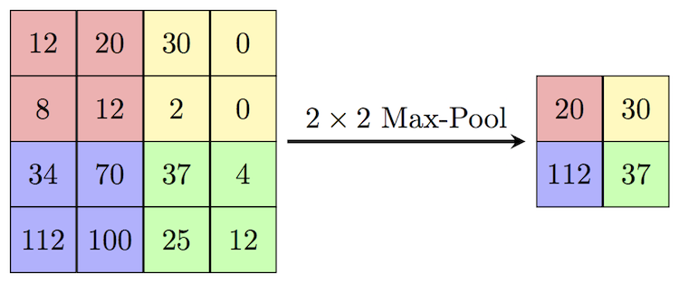
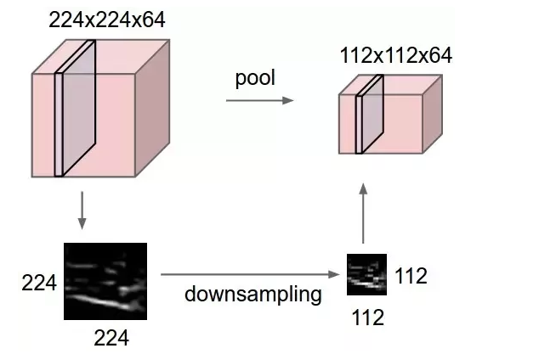
Pooling Layer
Notes:
https://computersciencewiki.org/index.php/Max-pooling_/_Pooling
Reduction of size
Doesnt matter where exactly a feature is located
Max, Average

Slide 16
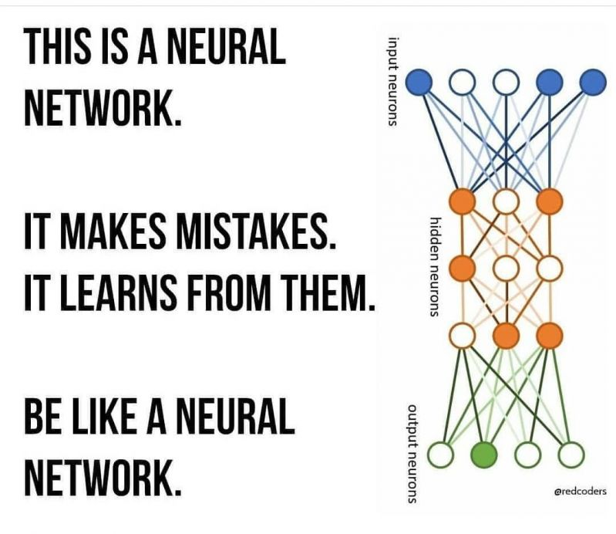
Let‘s make some mistakes!
Notes:
https://devrant.com/rants/1922673/be-like-a-neural-network

Slide 17
Histogram Equalization
4 | 4 | 4 | 4 | 4
3 | 4 | 5 | 4 | 3
3 | 5 | 5 | 5 | 3
3 | 4 | 5 | 4 | 3
4 | 4 | 4 | 4 | 4
Gray Level | No. of pixels (n) | PDF (n/sum) | CDF | CDF * 7 (max gray) | Equalized Histogram
0 | 0 | 0 | 0 | 0 | 0
1 | 0 | 0 | 0 | 0 | 0
2 | 0 | 0 | 0 | 0 | 0
3 | 6 | 6/25 = 0.24 | 0.24 | 1.68 | 2
4 | 14 | 14/25=0.56 | 0.8 | 5.6 | 6
5 | 5 | 5/25=0.2 | 1.0 | 7 | 7
6 | 0 | 0 | 1.0 | 7 | 7
7 | 0 | 0 | 1.0 | 7 | 7
6 | 6 | 6 | 6 | 6
2 | 6 | 7 | 6 | 2
2 | 7 | 7 | 7 | 2
2 | 6 | 7 | 6 | 2
6 | 6 | 6 | 6 | 6
https://www.youtube.com/watch?v=uqeOrtAzSyU
Notes:
3 bit image -> 2^3 -> 8 different colors (color depth)

