Slide 1
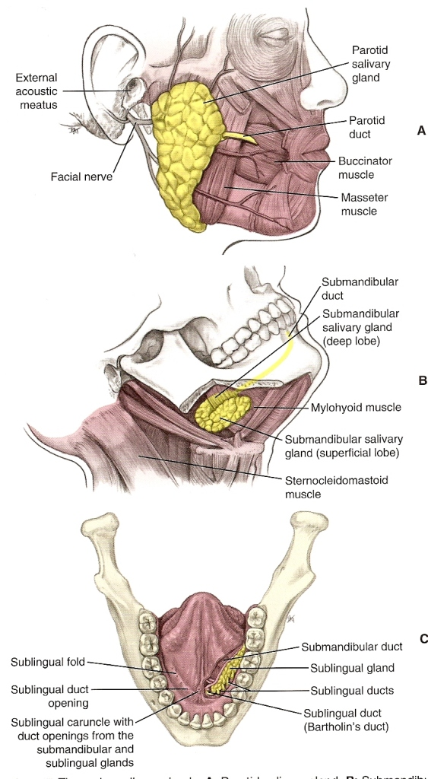
Salivary Glands

Slide 2
Salivary Glands
Saliva helps maintain oral mucosa
lubricates - protects from dryness
Cleanses
aids in digestion of foods,
serves as a buffer protecting against acids
involved in antibacterial activity,
remineralization of the tooth surface,
1st step in bacterial plaque biofilm formation and
supplies minerals for supragingival calculus formation

Slide 3
Salivary Glands
Histology
Both Major & Minor Salivary Glands – composed of both
epithelium & connective tissue
6th-8th Week Prenatal Development
3 major salivary glands begin as epithelial buds from ectodermal lining of primitive mouth.
Buds grow into underlying mesenchyme, produce secretory cells/glandular acini and the ductal system
Connective tissue portion of glands produced from mesenchyme influenced by neural crest cells.
Important – Complete development of salivary glands require interaction between developing epithelium, mesenchyme, nerves, & blood vessels.
___________________________________________________________________________
Epithelial cells – line duct system - simple cuboidal epithelium produce saliva
Connective Tissue – Surrounds the epithelium protecting and supporting the gland including: capsule, septum and lobes
_______________________________________________________________________________
Saliva is formed within endoplasmic reticulum of individual cells which is controlled by DNA/RNA and is packaged by a membrane within Golgi apparatus & moves out into cytoplasm of mucous or serous acini.

Slide 4
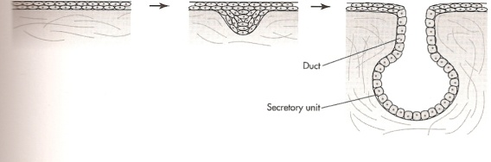
Salivary Glands
Gland = structure that produces secretion necessary for body functions.
Types: Exocrine gland – has a duct associated with it
Endocrine gland – no duct /ductless –secretions go directly into blood
Salivary glands arise from cord of epithelium growing into underlying
connective tissue
cord later forms a tube
End of tube – a cluster of secretory cells form
Cluster(like bunch of grapes) have endpieces – round or tubelike
Secretory endpieces = acini
  2 types of acinic cells:
    mucous acini
    & serous acini (also seromucous acini)
Surrounding each cell is:
connective tissue which contains nerves and blood vessels necessary for cellular activity
Myoepithelial cell – partially surrounds each secretory acinus which contracts and squeezes the acinus & aids in secretion of saliva

Slide 5
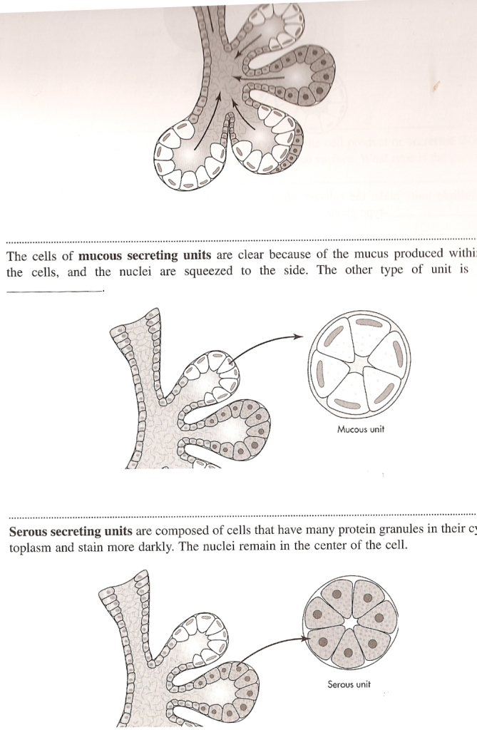

Slide 6
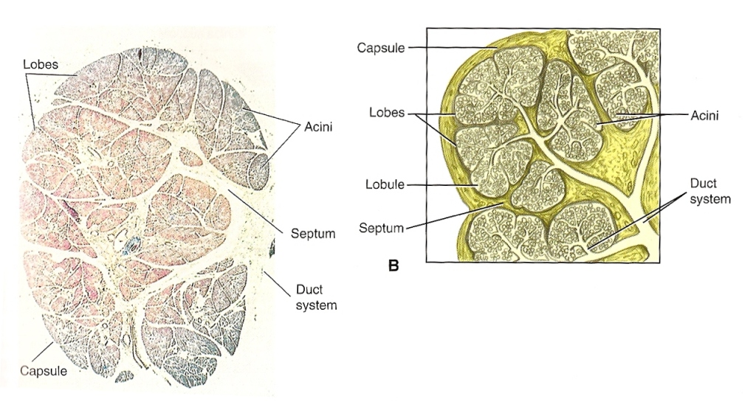

Slide 7
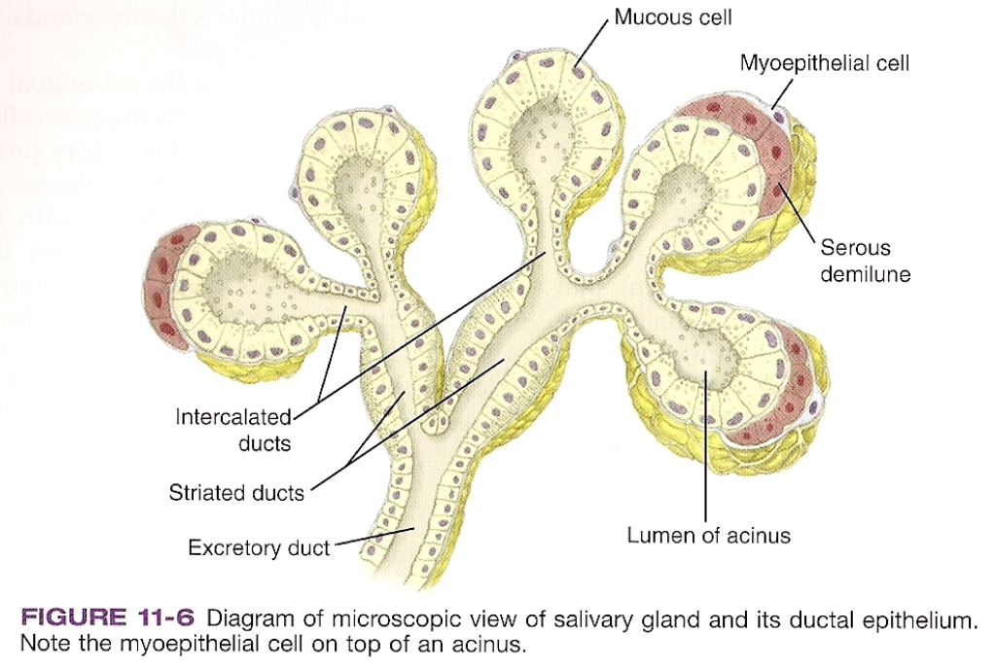
Mucous Acini mucous secretion | Serous acini Serous secretion | Seromucous acini Secretes both
slightly viscous contain mucins | thinner, more watery no mucins | cells joined together forming a half-moon cluster called a Serous Demilunes
inorganic ions, sodium, potassium chloride minor amts of amylase | primary source of amylase
tubular with large lumen | very small lumen

Slide 8
Salivary Glands
Saliva contains:
Minerals
electrolytes
buffers
enzymes
immunoglobulins (secretory IgA)
metalbolic wastes
Salivary Glands classified as:
Major depending on size
Minor both are exocrine glands (has ducts)

Slide 9
Major Salivary Glands
Parotid
Largest major salivary gland
Only provides 25% of total saliva
Mainly serous secretion
Parotid Duct/Stenson’s Duct
Submandibular
2nd largest salivary gland
Produces 60-65% of total saliva
Mixed secretions (serous-mucous)
Contains serous demilunes
Submandibular Duct/Wharton’s duct
Sublingual
Smallest
Produces 10% of total saliva
Mixed secretions (more mucous)
Sublingual duct/Bartholin’s duct
Opens into oral cavity at sublingual caruncle

Slide 10
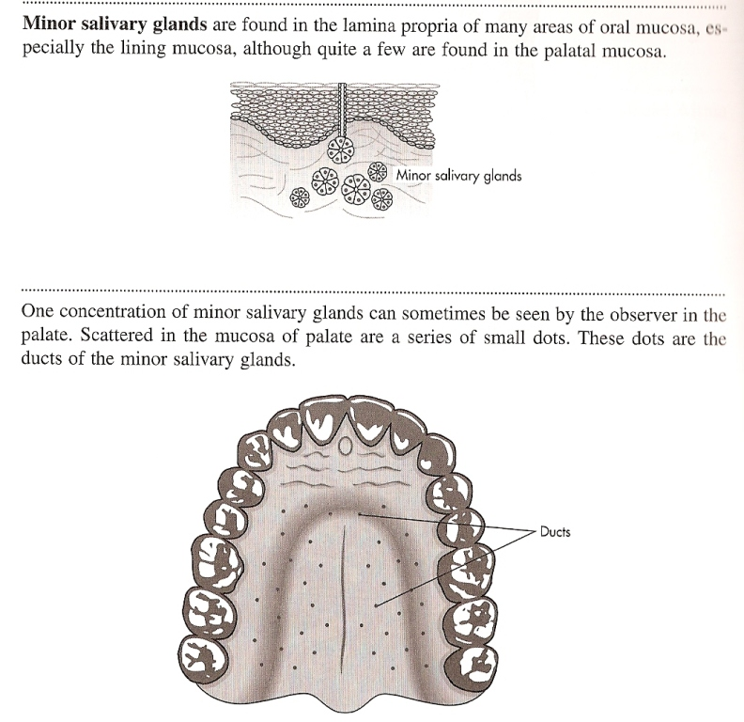
Minor Salivary Glands
Much smaller
More numerous
Unnamed ducts
Shorter ducts open directly onto
mucosal surface
Scattered in the tissues of buccal,
labial, and lingual mucosa, soft
palate lateral
portions of hard palate and floor of
mouth
Von Ebner’s salivary glands –
associated with large circumvallate
lingual papillae (posterior portion
of tongue’s dorsal surface
Most are mucous secreting
Except : Von Ebner’s glands only serous secretion

