Slide 1
PULP
Innermost soft tissue occupying the hollowed-out inner portion of the dentin;
space is called the pulp chamber and root canal;
comprised of soft connective tissue with lots of matrix and few cells

Slide 2
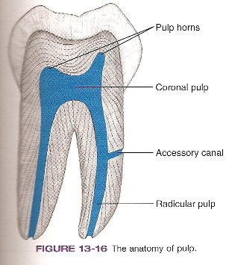
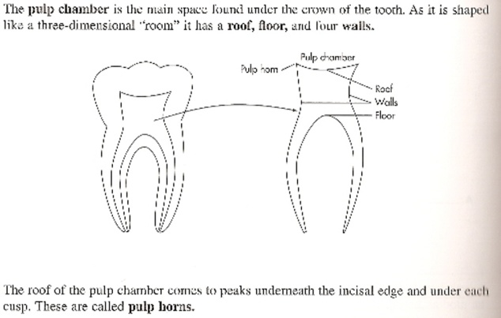
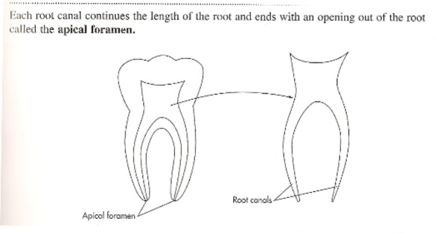
Pulp
Dental papilla pulp
Soft tissue (Connective Tissue) contained in pulp chamber.
Pulp chamber = shape of tooth
Pulp chamber = 2 divisions:
1. Coronal pulp
extensions into cusps = pulp horns
2. Radicular pulp - also called root canal
contains openings through cementum into surrounding periodontal ligament - apical foramen
Apical Foramen
Opening at apex of tooth
Surrounded by cementum
Allows arteries, veins, lymphatics & nerves to enter & exit
Last portion of tooth to form
Accessory canals/lateral canals extra openings from pulp to periodontal ligament
Formed when Hertwig’s epithelial root sheath comes in contact with blood vessel during root formation
Can cause problems/failure of root canal therapy

Slide 3
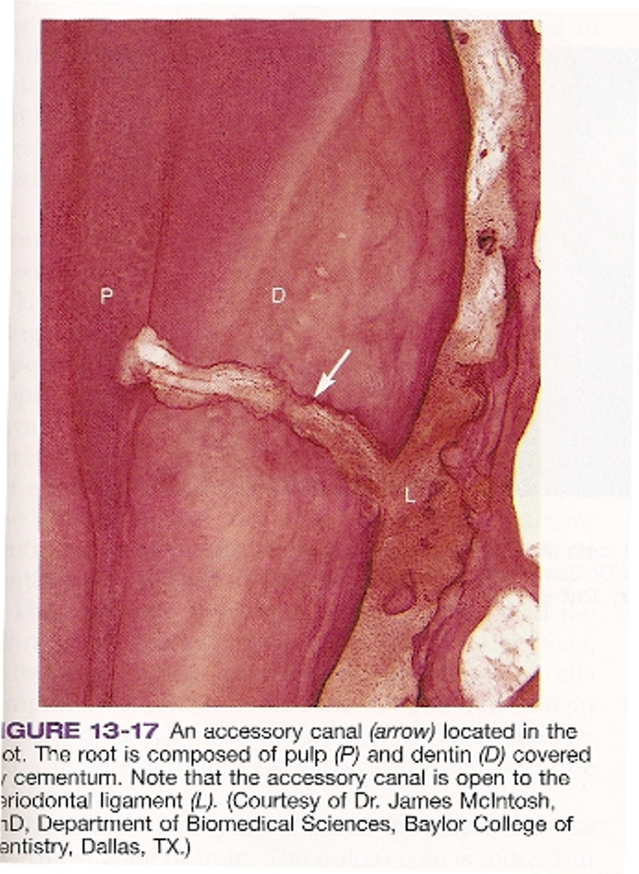

Slide 4
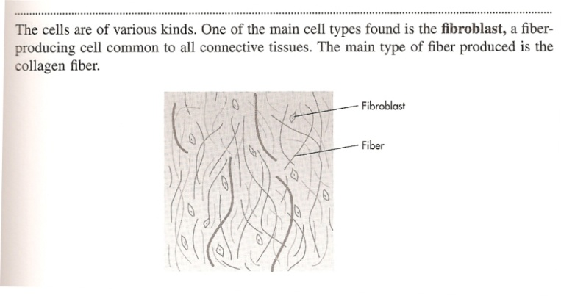
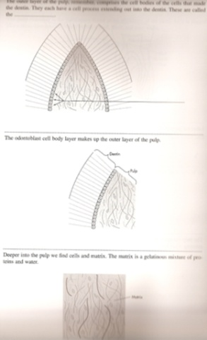
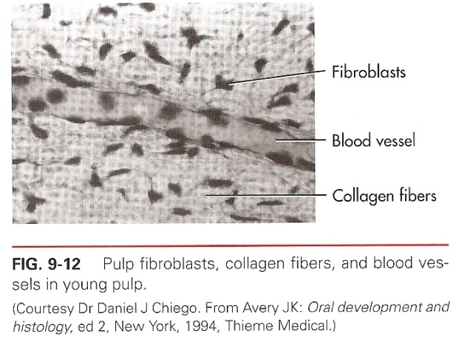
Pulp
Pulp is Connective tissue derived from undifferentiated mesenchymal cells. (ectomesenchym)
Types of cells:
* Undifferentiated mesenchymal cells/primary cells of young pulp.
Differentiate into any cell (like fibroblast – odontoblasts etc.)
Number of cells decrease with age
Respond to injury
1. Fibroblast – Largest group of cells in pulp
oval nucleus in center of cell
Large cell that gets smaller & fewer with age
Produce collagen fibers & ground substance
Star-shaped with extensive cellular junctions
2. Histocyte (Macrophage)
Important in defense of pulp
Emigrates from blood vessel to respond to inflammation
Looks like fibroblast
3. Odontoblast – Second largest group of cells in pulp
Produces dentin
Cell bodies are found in the pulp in the odontogenic zone of pulp
Large oval nucleus
Cells line up in row & exhibit junctional complexes – desmosomes/gap junctions

Slide 5
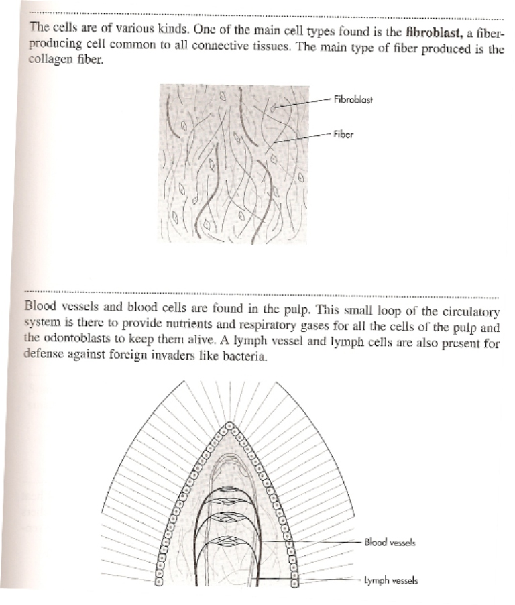
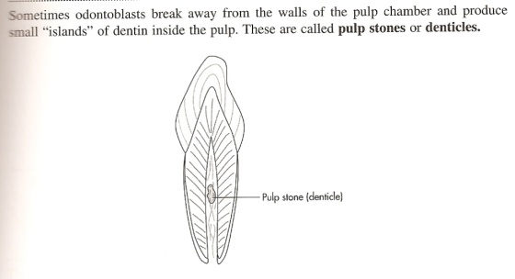
Pulp
Components of pupal tissue:
intercellular substance, tissue fluid,
cells, lymphatics, vascular system,
nerves, fibers.
Fibers – collagen fibers & some reticular fibers – NO elastic fibers
Extensive vascular supply & young lymphatic system.
Nerves – 2 types:
  Myelinated – associated with odontoblasts’ cell bodies – sensory
  unmyelinated – associated with blood vessels
Pulp stones/denticles
  calcified, round, oval masses of dentin
  free, unattached to outer pulpal wall or attached to dentin at dentin-pulp interface.
  Develop either during tooth development or later as pulp ages.
  Problem only during root canal therapy.

Slide 6
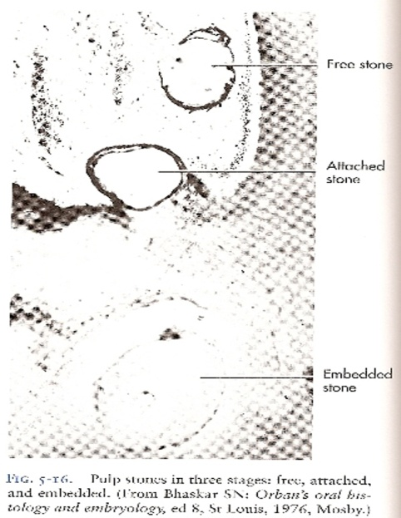
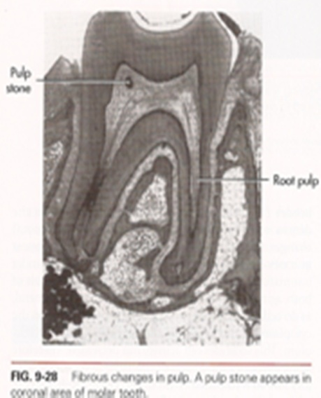
Pulp
Pulp stones/denticles
True or False Pulp stones/denticles Based on their structure:
True – histologically has: dental tubicles/odontoblastic process, Odontoblasts on surface
False – Concentric layers of calcified material

Slide 7
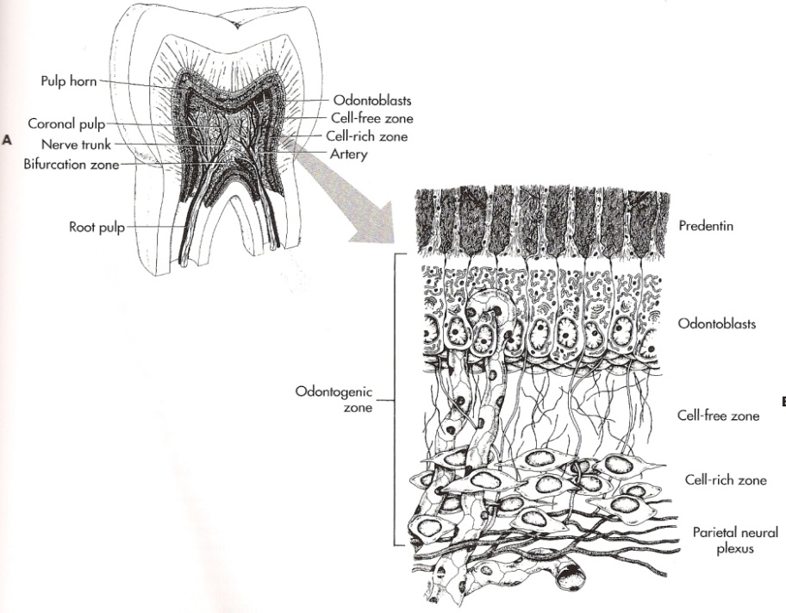
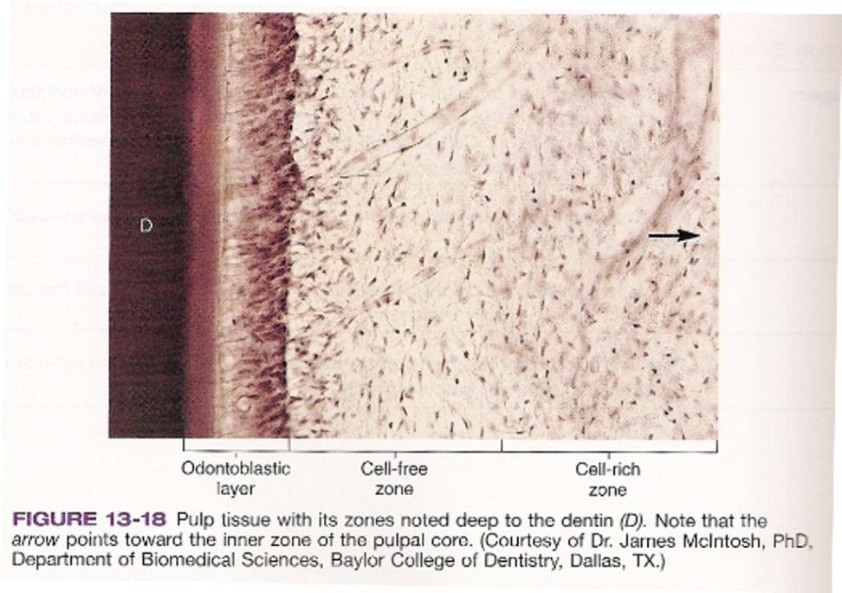
Pulp
Four Zones of Pulp Tissue:
(from outside to center)
Odontoblastic Zone
- outer most layer
- Cell body -odontoblasts
forms dentin
- first in line of defense to external
stimuli by forming secondary or
tertiary dentin along outer pulpal wall
2. Cell Free Zone
- fewer cells- contains a nerve &
capillaries
- a buffer zone
3. Cell Rich Zone
- increased density(number) of cells
- Extensive vascular system
- a resevoir zone
4. Pulpal Core
- innermost zone(center)similar to
cell-rich zone

Slide 8
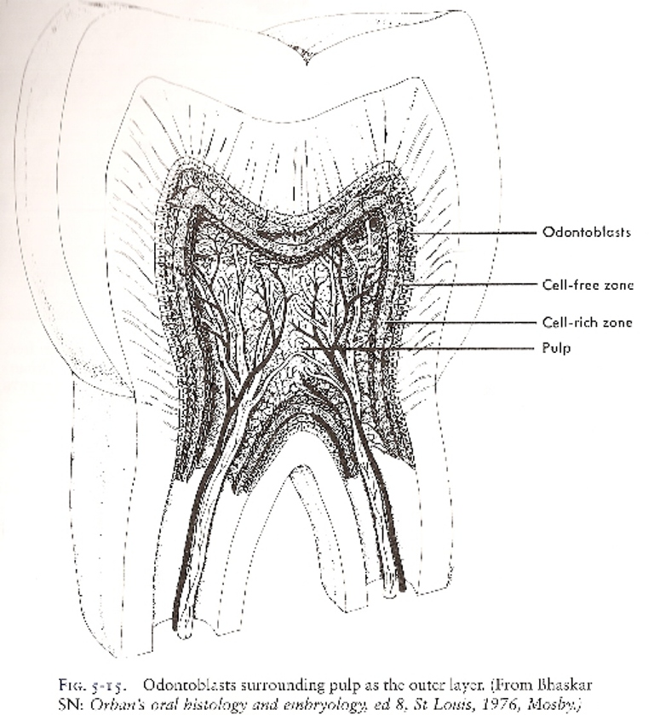

Slide 9
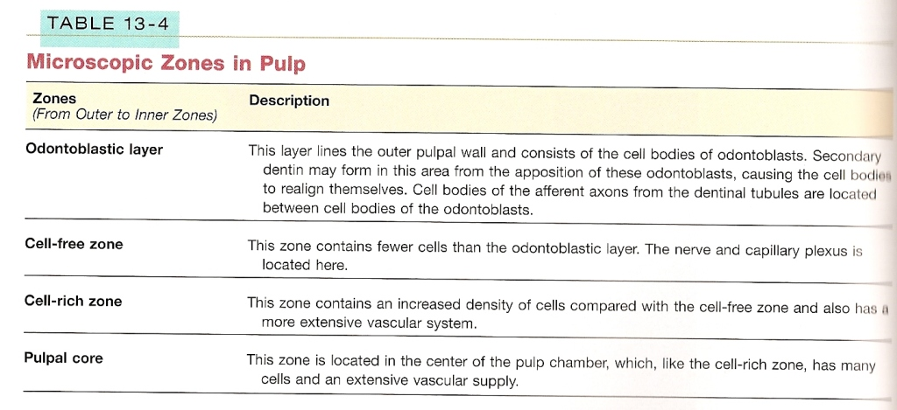

Slide 10
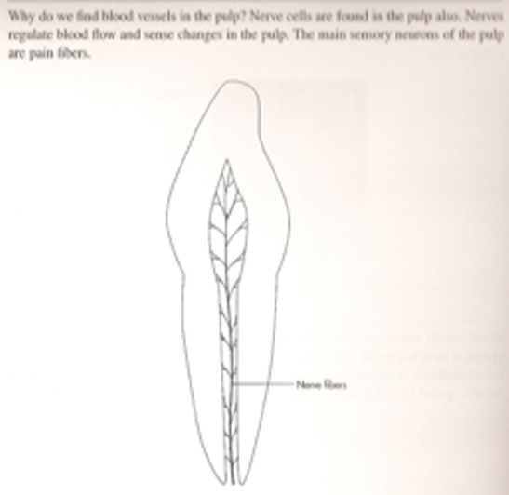
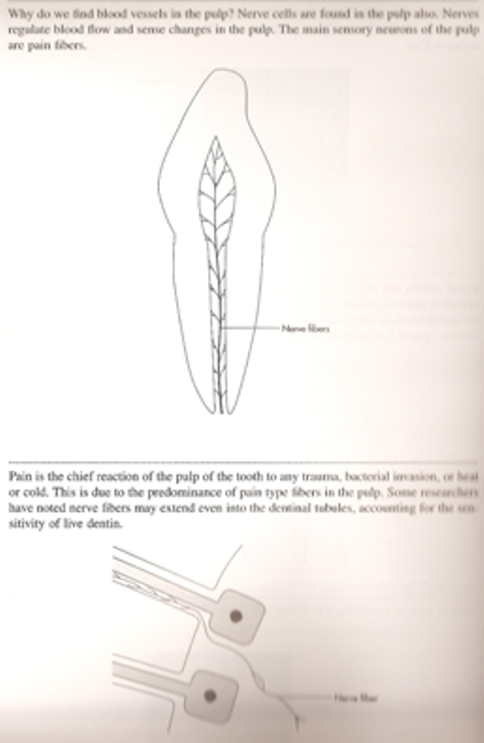
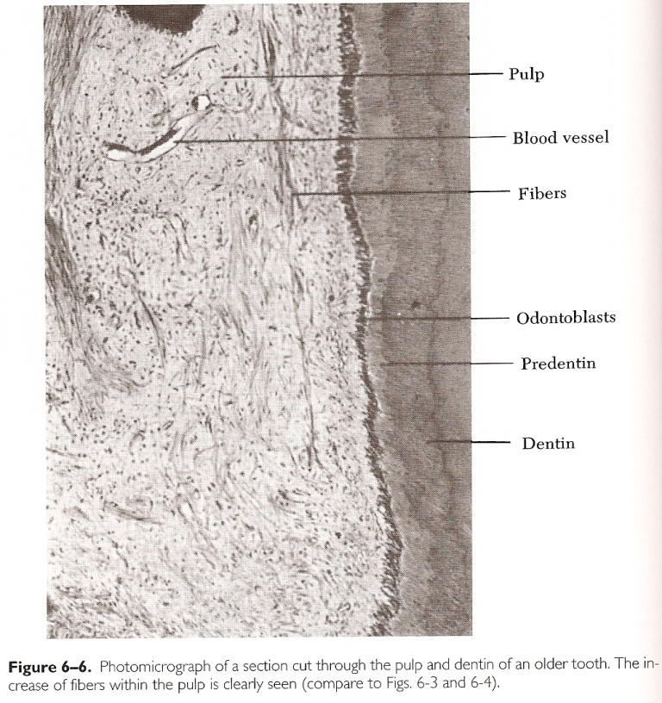
PULP
Functions
Formative | Odontoblasts
Sensory | Nerves
Nutritive | Blood Vessels
Defensive | Macrophages & Lymphatics

Slide 11
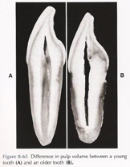
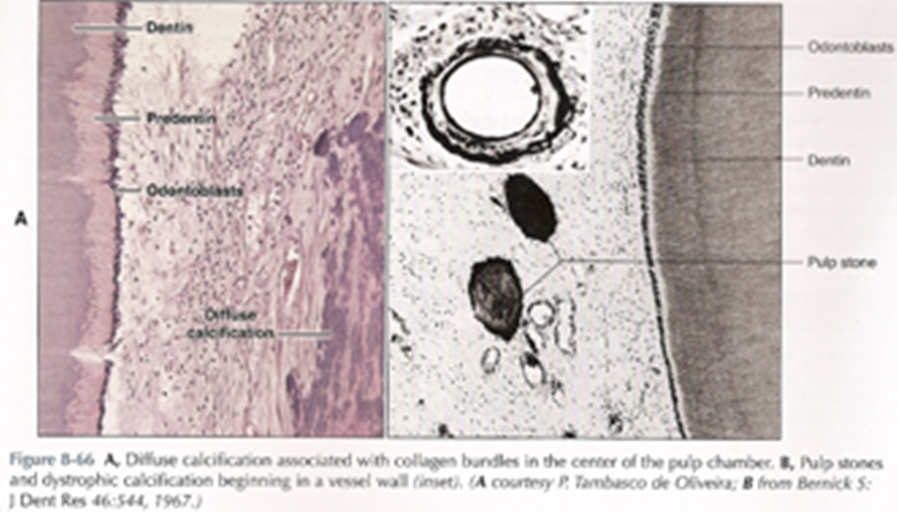
PULP
Age Related Changes
Pulp chamber get smaller
Root Canal becomes narrower
Reduction in number of cells
Increase in fibrous substance
Increase in number of pulp stones - denticles
Increase in diffuse mineralization

Slide 12
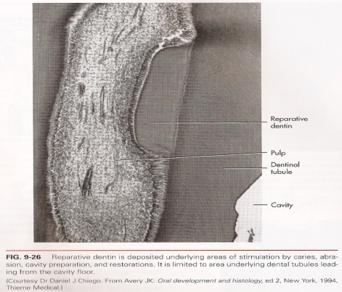
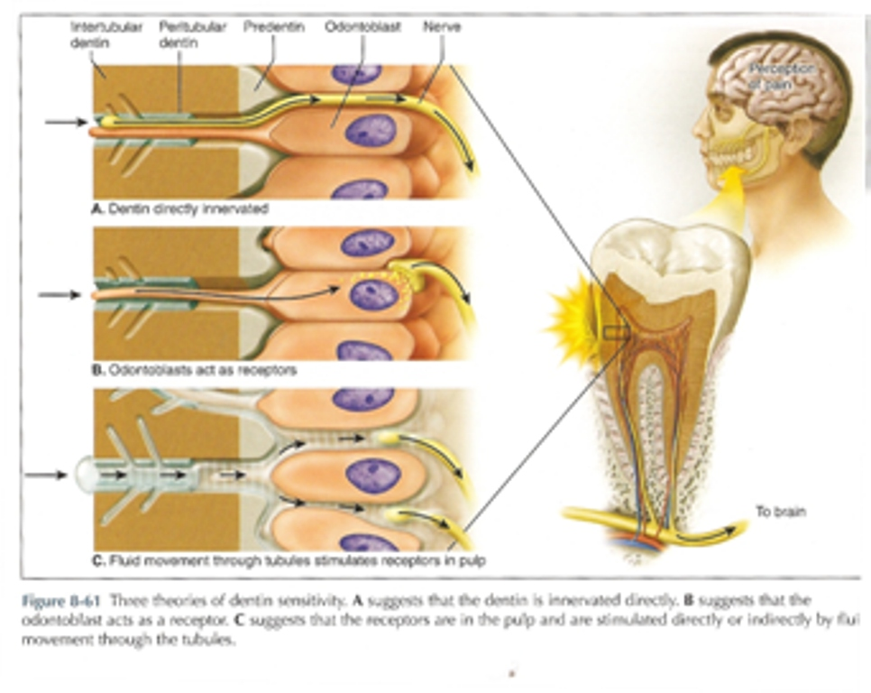
PULP
Why Root Canal Therapy
Trauma
Caries
abscess
Lack of Pulp (removed)
No nutrition
Becomes brittle
Begins to discolor
Cannot make reparative dentin
Three theories of dentin sensitivity

