Slide 1
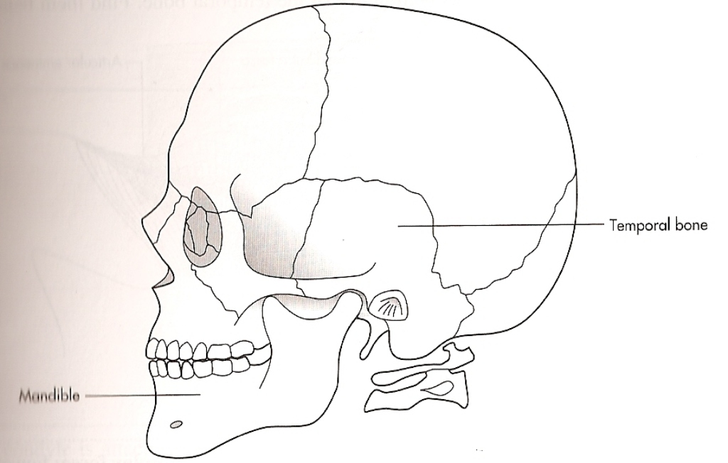
Temporomandibular Joint
Describe the gross anatomy of the temporomandibular joint.
Describe the histology of the
temporomandibular joint.
Identify the components of the synovial fluid of the TMJ.

Slide 2
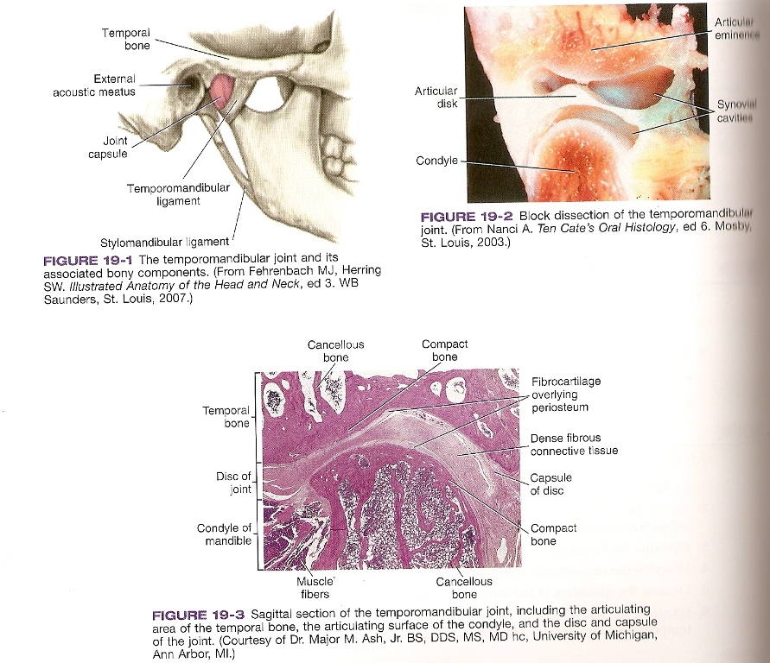
Temporomandibular Joint
Embryonic Development:
11 to 12th week of prenatal development
during the growth of the associated ligaments, muscles, and bones of the joint.

Slide 3
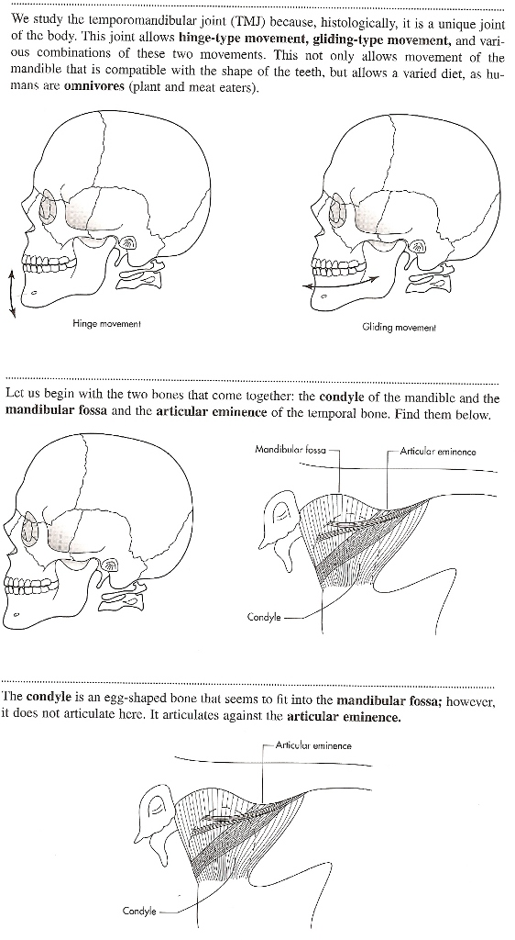
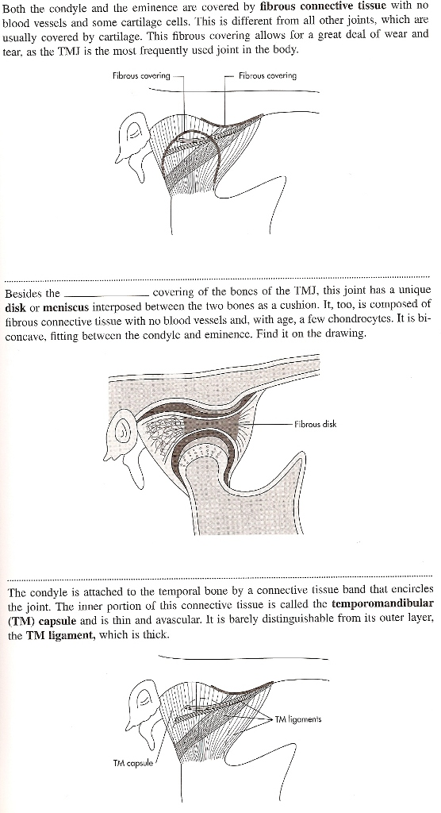
Temporomandibular Joint
Most Frequently Used Joint In The Body
Movement of the joint:
Hinge movement
Gliding movement
Bones of the joint:
Mandible - Condyle
Temporal Bone - mandibular fossa & articular
eminence
Condlye – egg-shaped bone that seems to fit into the mandibular fossa – but- it articulates against the articular eminence.
Condlye & Articular Eminence are covered with fibrous connective tissue. Fibrous covering allows for wear and tear.
Joint has a unique fibrous disc/meniscus between the bones – a cushion

Slide 4
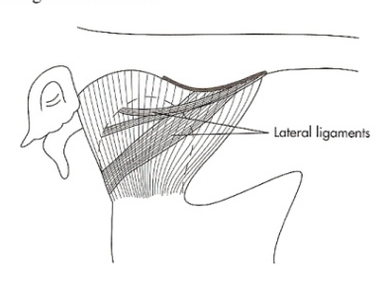

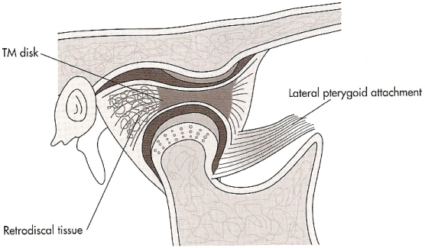
Temporomandibular Joint
Condyle is attached to temporal bone by a connective tissue band that encircles the joint.
Temporomandibular(TM) capsule | thin, avascular inner portion of the connective tissue band.
TM ligament | thick outer layer of fibrous connective tissue on the lateral side of the joint – the lateral ligaments
Disc/meniscus | attached to the capsule by fibrous tissue/ligments (appears to be suspened)
Anterior & medial discal ligaments | collagenous fibrous tissue
Posterior/retrodiscal ligaments | some elastic fibers
Loose connective tissue lying behind the joint rich in blood vessels & nerves & elastic fibers.

Slide 5
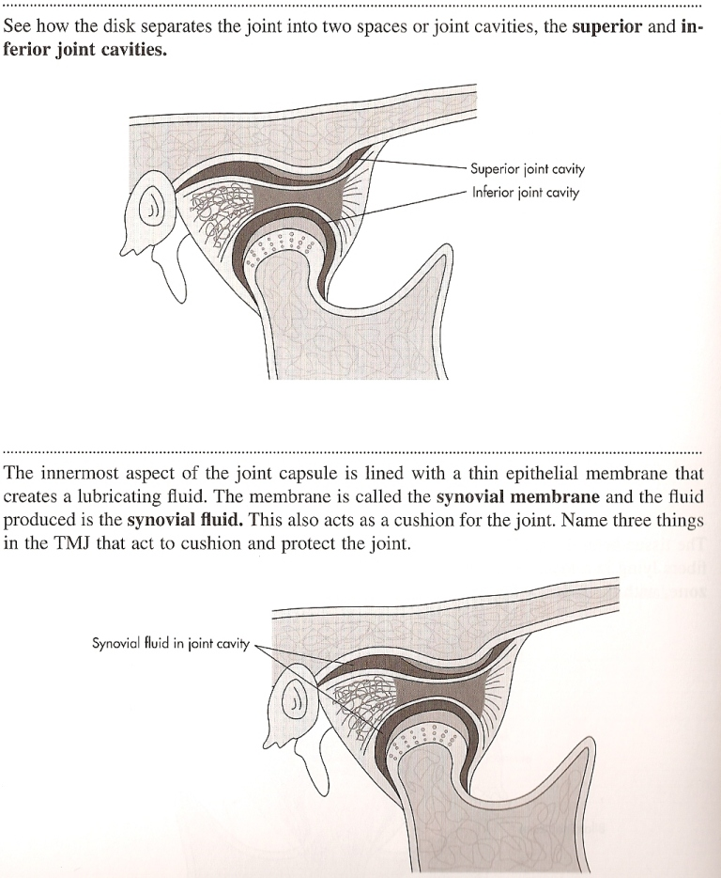
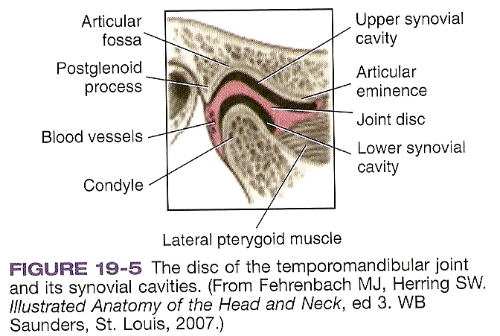
Synovial membrane:
lines the innermost part of the joint capsule
it’s lined with a thin epithelial membrane that creates a lubricating fluid/synovial fluid.
This also cushions the joint.

Slide 6
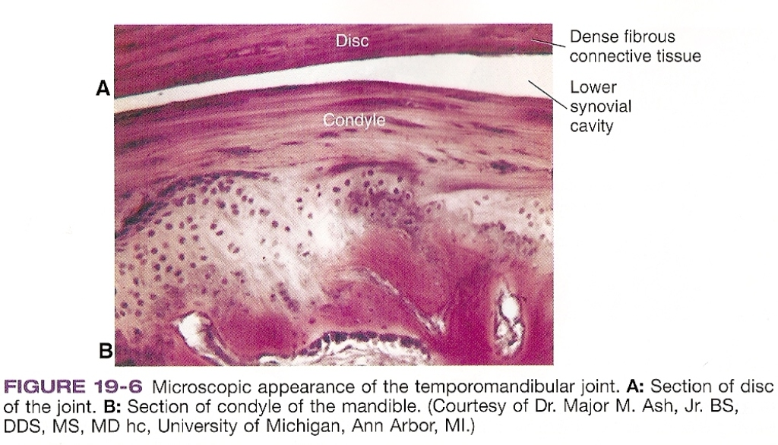

Slide 7
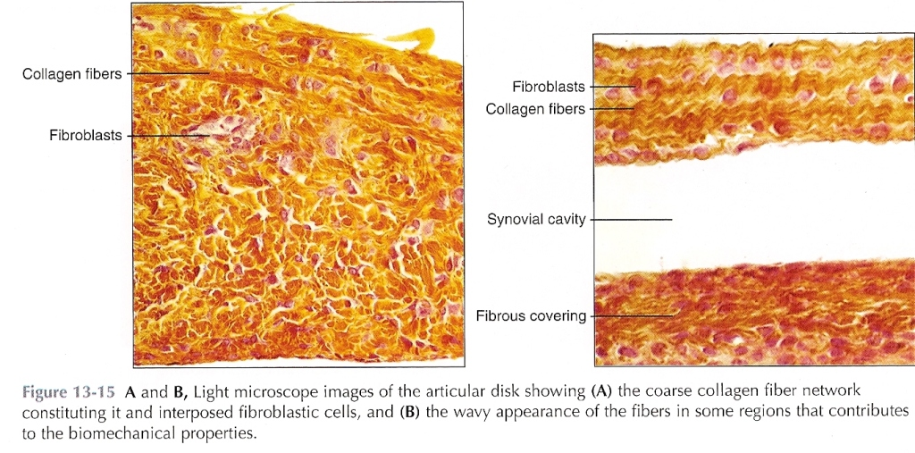

Slide 8
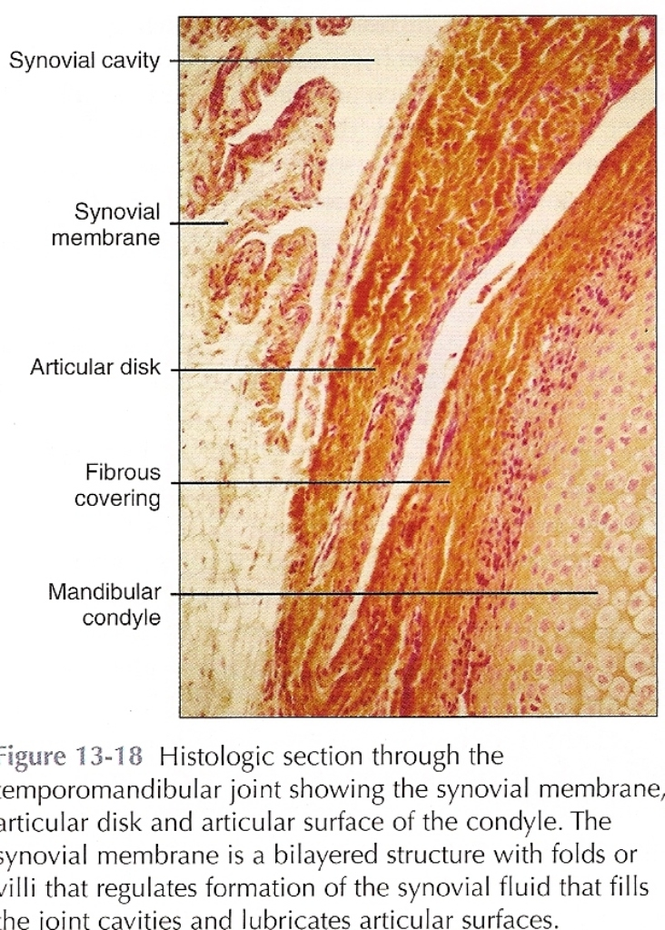

Slide 9
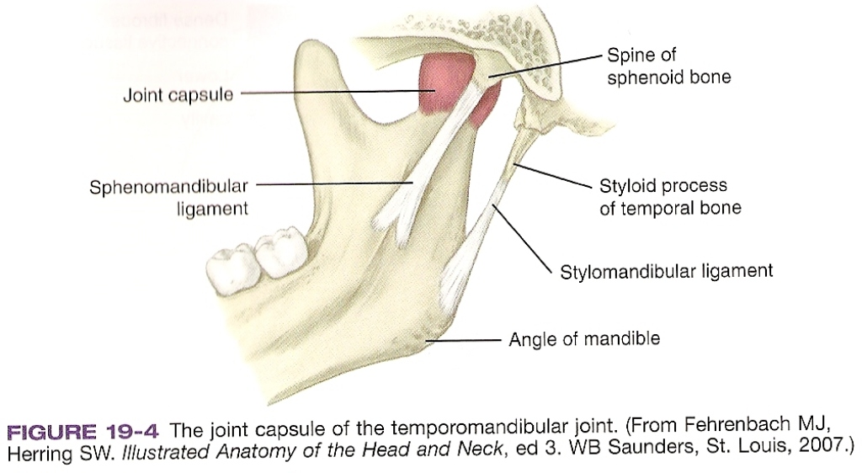

Slide 10
