Slide 1
Tonsillar Tissue
Salivary Glands
Identify the histology and function of the salivary glands and tonsils.
Know the distribution and location of the salivary glands.
Identify the difference between the major and minor salivary glands.
Discuss the clinical importance of the salivary glands.

Slide 2
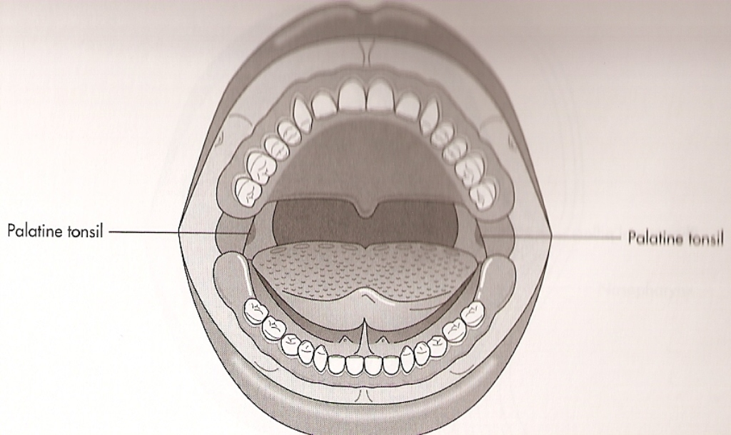
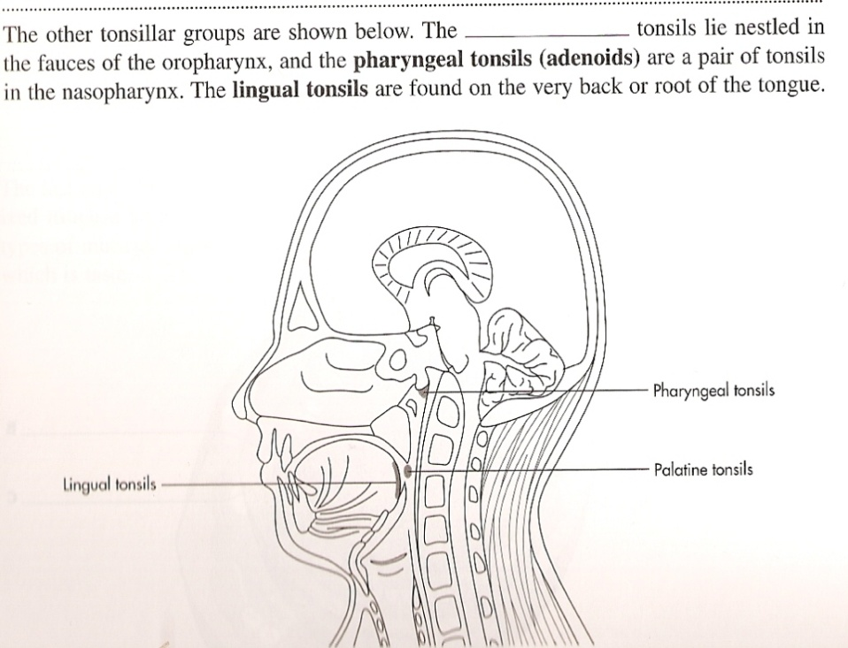
Tonsillar Tissue part of the Lymphatic System
Nonencapsulated-
large masses of lymphoid tissue
Found in lamina propria of oral mucosa
Covered by stratified squamous epithelium
Contain lymphocytes (remove toxic products)
3 Groups of Tonsillar Tissue*
Palatine tonsils
Lingual tonsils
Pharyngeal tonsils/adenoids
* Often referred to as Waldeyer’s Ring

Slide 3

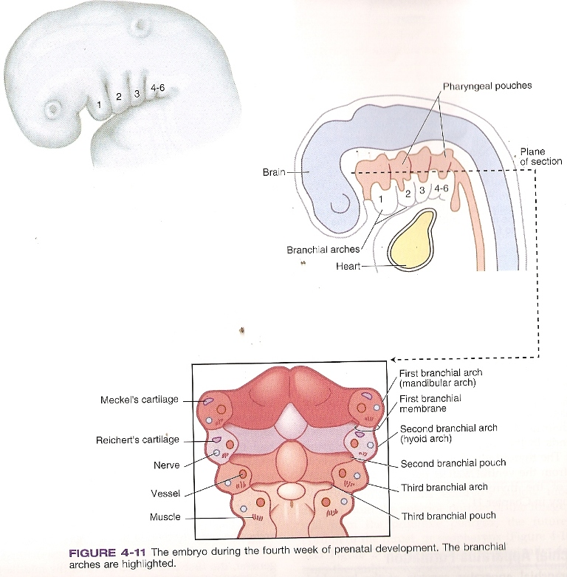
Tonsillar Tissue part of the Lymphatic System
Embryonic Development:
Derived from the lining of
the 2nd pharyngeal pouches –
(an evagination from the lateral wall lining the pharynx – between the branchial arches).

Slide 4
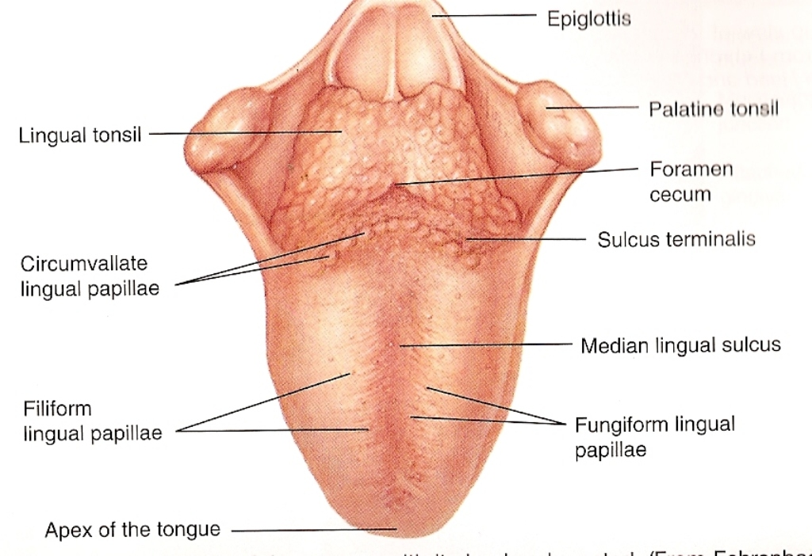
Tonsillar Tissue
Palatine Tonsils
2 rounded masses between the anterior & posterior faucial pillars
Each mass contains fused-together lymphatics nodules that have germinal centers, epithelial invaginations/grooves which form crypts
Crypts contain shed epithelial cell, mature lymphochytes & oral bacteria
Lingual Tonsil
Indistinct layer of diffuse lymphoid tissue
Base of the dorsal surface of tongue
Posterior to the circumvallate papillae
Consists of many lymphatic nodules with germinal centers & only 1 tonsillar crypt.
Pharyngeal Tonsils
Behind uvula on superior & posterior walls of nasopharynx
When enlarged = adenoids

Slide 5
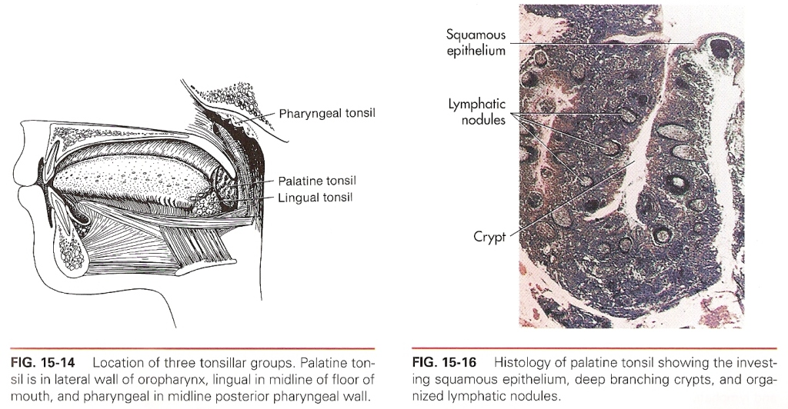

Slide 6
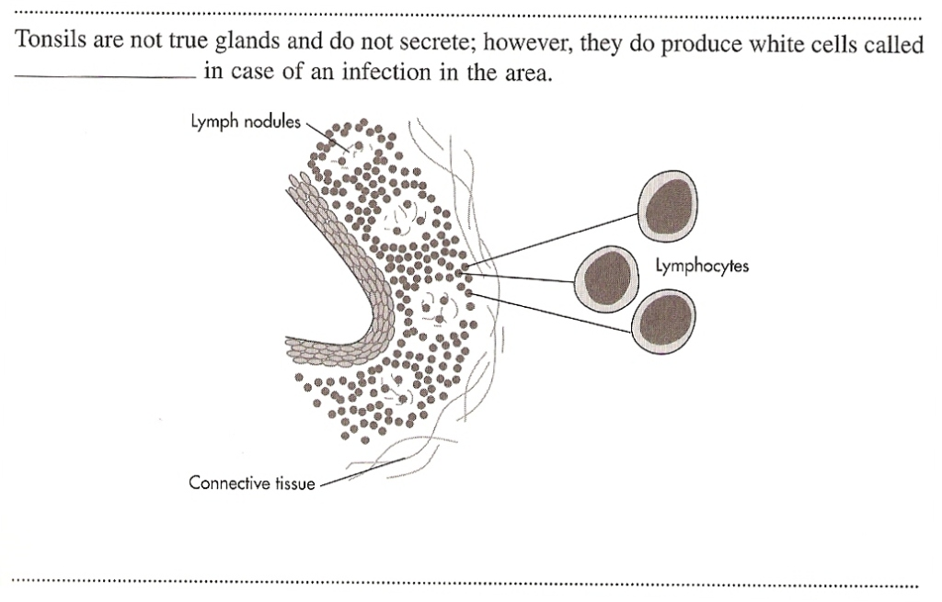

Slide 7
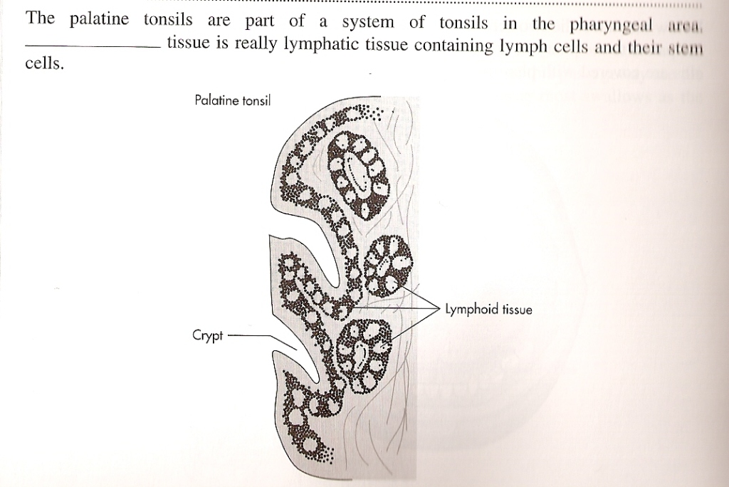

Slide 8
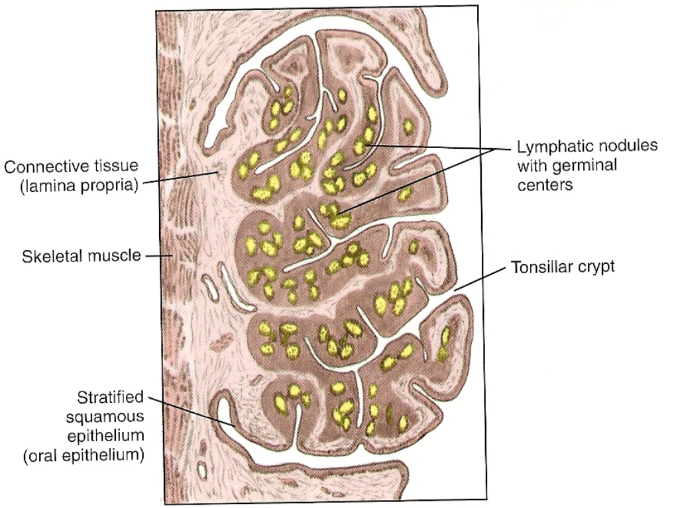

Slide 9
