Slide 1
Human Tissues
Assorted Into 4 Main Groups
Epithelial Tissue
Connective Tissue
Muscle Tissue
Nerve Tissue

Slide 2
Objectives for Lecture 3
Unit 2
Identify the different tissues present in the human body.
Identify the histological components of each tissue studied.
Describe the function of each tissue studied.
Identify the structure and histology of epithelial and connective tissue.
Describe in detail, the function of epithelial and connective tissue.
Recognize the various locations within the human body of epithelial and connective tissue.

Slide 3
Tissues
Cell Theory - All Living Tissues are composed of Cells
collections of similarly specialized cells
What makes tissues alike? What makes tissues different?
Made of cells form
Have intracellular substance number of cells
Have plasma – tissue fluid type & amount of intercellular substance amount of matrix
amount of fluid
Tissue are Categorized by:
form
number of cells
type of cells
amount of matrix
amount of tissue fluid
That which distinguishes one tissue from another
Notes:
Cells with similar characteristics of form & function – grouped together
During prenatal development – embryonic cell layers differentiate into the basic histological types

Slide 4
Tissues
Terms to know:
Intracellular – within the cell
Intercellular - between the cells – ground substance
Extracellular – outside the cell – interstitial
Interstitial - between parts of tissue
Matrix – intercellular/extracellular substance sand fibers that are partially
calcified (connective tissue)
Purpose:
> support (helps hold cells together)
> provides a medium for transport (nutrients, wastes etc…)
Two types of Matrix
1. Formed or Fibrous 2. Amorphous (no shape)
fibers – collagen, elastic, reticular Ground substance made of proteoglycans (sugars)

Slide 5
TISSUE TYPES
Epithelial Tissue Makes up the skin
* Primary Lining/covering of tubes and cavities of the body & glandular tissue
Characteristics
Closely grouped polyhedral cells
– cellular junctions = desmosomes
little or no intercellular material (matrix) or tissue fluid
Avascular – no blood supply
High rate of mitosis
Rests on top of Connective Tissue
Separated by basement membrane
No nerve supply
Functions
Secretion
Absorption
Prevents dehydration
Protection

Slide 6
TISSUE TYPES
Epithelial Tissue
Classification
Histology of Epithelial Cells based on
Cell Morphology (shape)
Histology of Epithelial tissues based on
Arrangement (# of cell layers)
Simple = 1 layer
Stratified = several layers
Pseudostratified = appears layered (ex. Trachea)
Squamous = flat
Cuboidal = cube
Columnar = rectangular
Transitional = changes based on organ size
(ex. Urinary bladder)
Only the shape of the Surface Layer determines the classification.
http://www.youtube.com/watch?v=7z2vYr5YjD8&feature=fvw

Slide 7
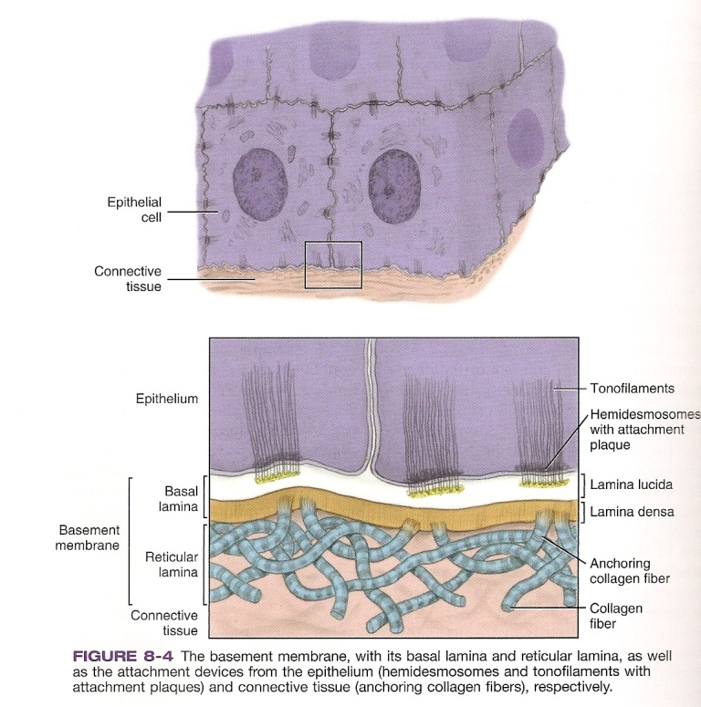
Epithelial Tissue
Stratified Squamous Epithelial Tissue

Slide 8
2 Major Groups of Epithelial Tissue
Classification
Surface epithelial Tissue
Glandular Epithelial Tissue
1. Surface epithelial Tissue
covering & lining membranes
  Simple – squamous, cuboidal, columnar
  B. Stratified (2 or more cell layers)
  squamous(skin) columnar (duct tissue )
  cuboidal (salivary glands) transitional (changes)- urinary bladder
  C. Pseudostratified – columnar (appears to be layered)

Slide 9
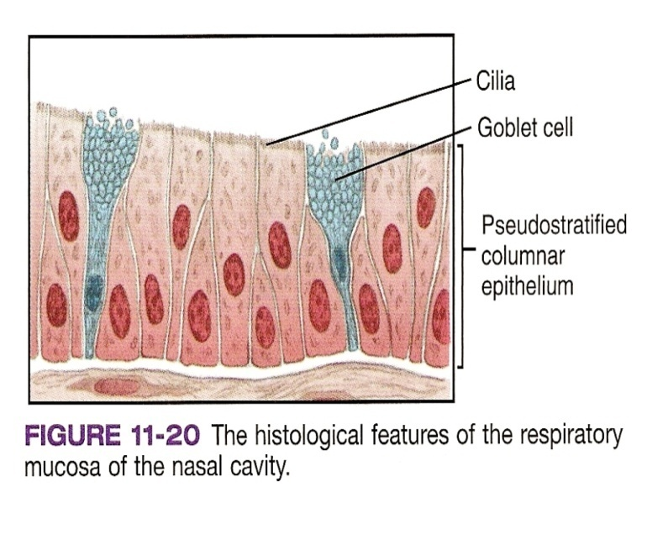
Epithelial Tissue
Simple Epithelium – delicate areas
( in areas of little or no friction)
Simple squamous epithelium
Simple cuboidal
Simple Columnar
Ex. - Lining inside of: blood vessels, ovary, cervix
Pseudostratified – appears stratified due to location of nucleus
Ex. Upper respiratory tract: sinuses ,nose,trachea
Goblet cells – simple columnar /pseudostratified
provides mucous / moisture
Ex. - found in GI tract
cilia – filtration
Stratified Squamous Epithelium –
*skin – *oral mucosa
Superficial Layers – dead cells = resistant
Surface layer = Keratinized layer
Deeper layer of epithelial tissue = basal cells = reproduction

Slide 10
2 Major Groups of EpithelialTissue Classification
2. Glandular Epithelial Tissue
Make up glands which are secreting organs – produce a specific product or secretion.
  Endocrine Glands – NO ducts/ductless (thyroid, pituitary)
  Exocrine Glands – Duct System (salivary glands)
C. Mixed endocrine/exocrine - pancreas

Slide 11
Epithelial Tissue
Tissue fluid – made up of:
part of blood plasma (that diffuses through the walls of capillaries)
  These fluids carry nutrients & waste products to intercellular substances and then to cells.
  Returned to capillaries via lymph system
Ground substance (intercellular)– chemical substance (mucopolysaccharides/glycosaminoglycans/proteoglycans)
Allows passage of metabolites between blood & tissue

Slide 12
Epithelial Tissue
Intercellular Substances
(ground substances)
Fills the spaces between cells in a tissue
Serves as barrier
Serves as a medium for the exchange of gases & metabolic substances.
Produced by the cells.
Colorless, shapeless and transparent.

Slide 13
Epithelial Tissue
Classification:
Keratinized Tissue
Keratin – type of intermediate protein filament that is found in calloused epithelial tissues.
Stratified Squamous Epithelial Tissue
(layered) (flat)
Keratinized Tissue | Non-Keratinized Tissue
Tough, fibrous, opaque ,waterproof, protein keratin Gives layers of protection Protects from bacterial invasion Resistant to friction No nucleus Examples – hard palate | No keratin Easily injured Nucleus
Most epithelial tissues in the body are Stratified Squamous Epithelium

Slide 14
TISSUE TYPES
Epithelial Tissue Makes up the skin
* Primary Lining/covering of tubes and cavities of the body & glandular tissue
Characteristics
Functions
Closely grouped polyhedral cells
– cellular junctions = desmosomes
little or no intercellular material (matrix) or tissue fluid
Avascular – no blood supply
High rate of mitosis
Rests on top of Connective Tissue
Separated by basement membrane
No nerve supply
Secretion
Absorption
Prevents dehydration
Protection

Slide 15


Slide 16
Basement Membrane
* every type of epithelial tissue rests on a Basement Membrane thin acellular non-living structure
*always located between epithelial and connective tissue.
Function:
Support
Filtration barrier
Basal Lamina – secreted by epithelial tissue
Reticular Lamina – secreted by connective tissue

Slide 18
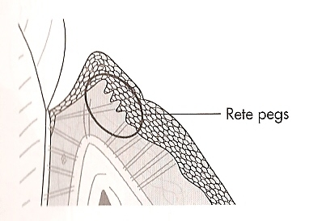
Epithelial Tissue
Rete Pegs – extensions of the epithelium into the connective tissue (dips into connective tissue)
Functions:
  adds mechanical strength
  Provides more surface area
  Blood vessels come in closer contact to epithelial layer to provide nourishment
Rete Peg’s causes stippling/dimpling effect in attached gingival.
  The irregular binding of the epithelium to the bone by collagen fibers –
  the epithelium is pulled tight to the bone.

Slide 19
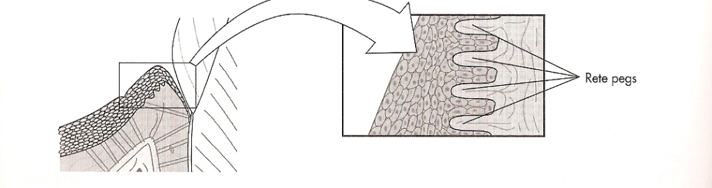
Papillary Layer – in connective tissue upward extension into epithelial tissue

Slide 20
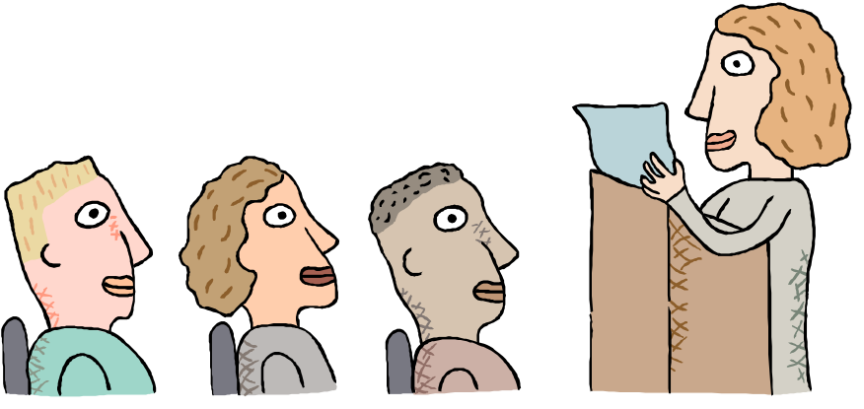
Time for:
Dental Hygiene Real World Presentations
Presenters:
12PM Class 2PM Class
Gonzalez, Sindy
Gramiak, Kay
Hepburn, Thema
Huang, Xuan Xiao
    Berger,Melinda
Berlina, Yelena Bottaro,Danielle Caceres, Britsi

Slide 21
TISSUE TYPES
Connective Tissue
* Most abundant & widespread tissue in body
* Cells + Matrix = Connective Tissue
Characteristics
Functions
Composed of fewer cells spaced further apart
Contains larger amts of matrix between cells
Capable of mitosis
Produce their own matrix
Vasular (except cartilage
Own blood supply
Nerve supply (except cartilage)
Supports/Strength to organs
Attachment
Packaging/Storage
Insulation
Transport
Repair
defense
Protection

Slide 22
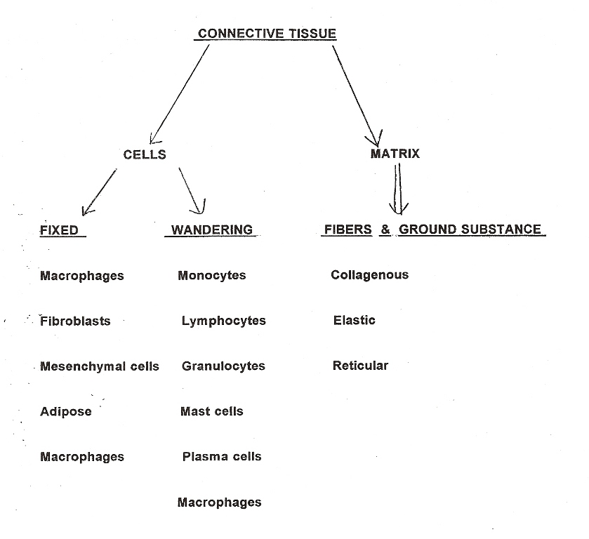
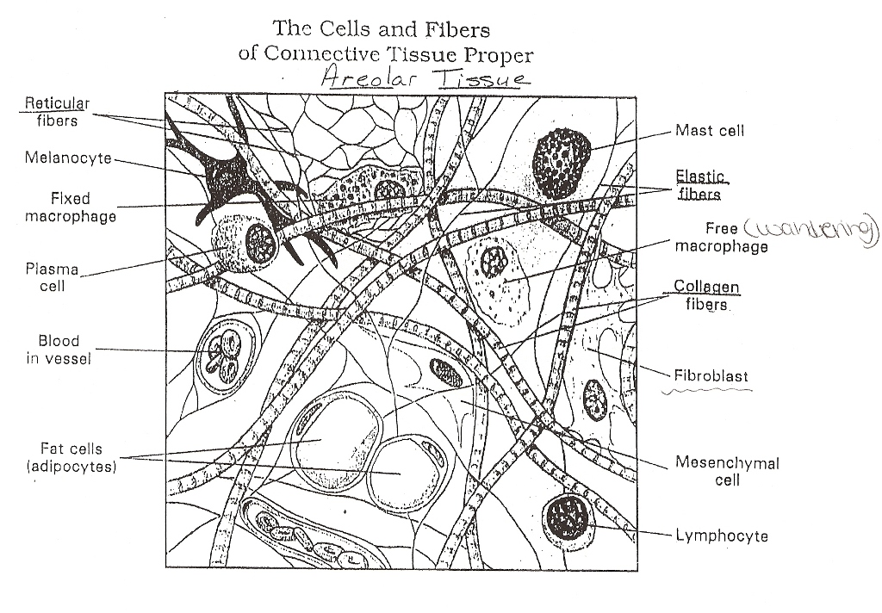

Slide 23
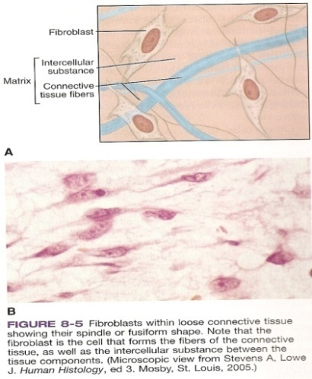

Histology of Connective Tissue
Cells: Fixed and Wandering
Matrix: Fibers and Ground Substance
Cell Types
1. Fibroblast – Principle cell (large, flat, elongated )
Fixed – do not leave tissue to enter blood
Makes up the matrix – produces fibers
Notes:
Blast refers to cells that make new cells of that type

Slide 24

Connective Tissue Cells
Most common cell
Principle cell
FIBROBLASTS
Synthesize certain types of protein fibers & intercellular substance (makes the matrix)
Flat
Elongated (spindle shaped)
Fixed in CT – do not leave the tissue to enter the blood
* young fibroblast produce fibers & intercellular substances

Slide 25
Connective Tissue
Cell types continued…
2. Macrophage “histocyte” | Irregularly shaped Engulf bacteria Can be free or fixed
3. Plasma cell Develop from ß lymphocytes | small and round Produce AB(antibodies) in immune system free
4. Mast Cell Near blood vessels | Large, irregularly shaped Produce histamine (dilates blood vessels) Produce heparin (anticoagulant/blood thinner) Free
5. Mesenchymal Cell | Can change (differentiate) into necessary cell - fibroblasts Fixed
6. Adipose Cell “adipocytes” | Stores fat nucleus pushed to side fixed

Slide 26
Matrix
Support – holds cells together
Provides a medium for transport (nutrient & wastes)
Types of Matrix
Formed (FIBROUS) | Amorphous Ground substance
Collagen thick strong Fibers: Fibroblasts Elastic yellow,thin Reticular very thin * all 3 fibers in matrix - amounts vary | Fluid made by fibroblasts Soft, viscous Contains:- polysaccrides -2 proteins proteoglycans & glycosoaminoglycans Hard, calcified Contains: Proteoglycans Hydroxyapetite (found in bone)

Slide 28
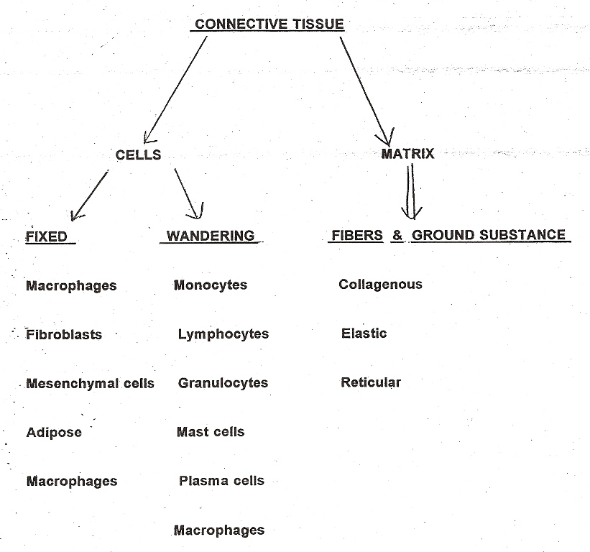

Slide 29
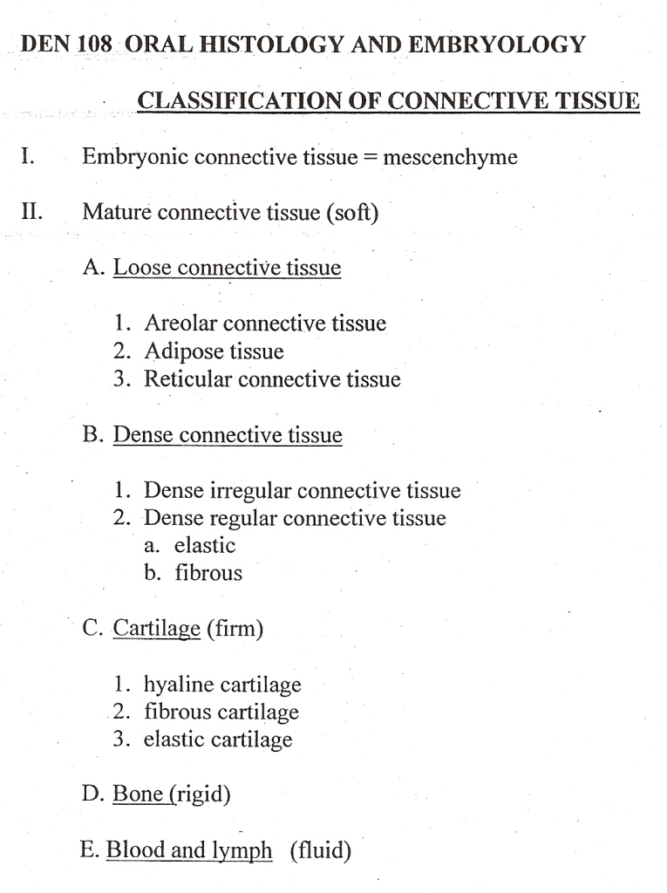

Slide 30
Classification of Connective Tissue
Classification of Type 1
Mescenchymal Tissue – Embryonic CT
first form of connective tissue – all other CT arise from
  Undifferentiated – has the potential to proliferate (reproduce) and differentiate into diverse types of connect tissue – forming cells – ex. Fibroblast, chondroblasts, osteoblasts.
  Consists of irregularly shaped cells
  Abundance of Reticular Fibers

Slide 31
Classification of Type ll
Mature Connective Tissue
(Based on Texture)
Soft
Firm
Rigid
Fluid
Found in deeper layers of skin & oral mucosa
‘Connective Tissue Proper’
Cartilage (all types)
Bone
Blood (& all of its components)
Lymph

Slide 32
Classification of Connective Tissue
Mature Connective Tissue
A. Loose (fibrous) CT (soft)
* Fills in spaces between organs & tissues
    Areolar CT
    Contains: Collagenous & Elastic fibers (no reticular fibers)
Histology | Functions: | Found in:
- Few cells - Amorphous Intercellular substance - Loose & thin network of fibrous tissue | - Holds skin to muscle - Holds muscles to muscles - Fascia (holds organs together) - Surrounds nerve & blood vessels | Mucous Membranes Subcutaneous layers of skin Papillary layer Nerves Surrounds body organs Blood Vessels

Slide 33
Classification of Connective Tissue
Mature Connective Tissue
A. Loose (Fibrous) CT (soft) cont.
    2. Adipose CT – (fat)
    Derived from Fibroblasts
    Where there is Adipose – there’ll be Areolar
    Adipose is deeper to Areolar
    Contains: Collagenous & Reticular fibers (no Elastic fibers)
    3. Reticular CT
    forms framework of certain organs: liver, spleen, lymph nodes
    Very thin fibers
    Contains: Abundance of Reticular fibers

Slide 34
Classification of Connective Tissue
Mature Connective Tissue
B. Dense (Fibrous) Connective Tissue
Basic – General Information:
Underlies epithelium of skin
Makes up tendons & ligaments (mostly dense CT)
Forms capsules around organs
Found throughout the body

Slide 35
Classification of Connective Tissue
Mature Connective Tissue
B. Dense (Fibrous) Connective Tissue
Basic – General Information:
Cell Types :
fibroblasts - produce fibers – collagenous forms
- reticular intercellular
- elastic substance

Slide 36
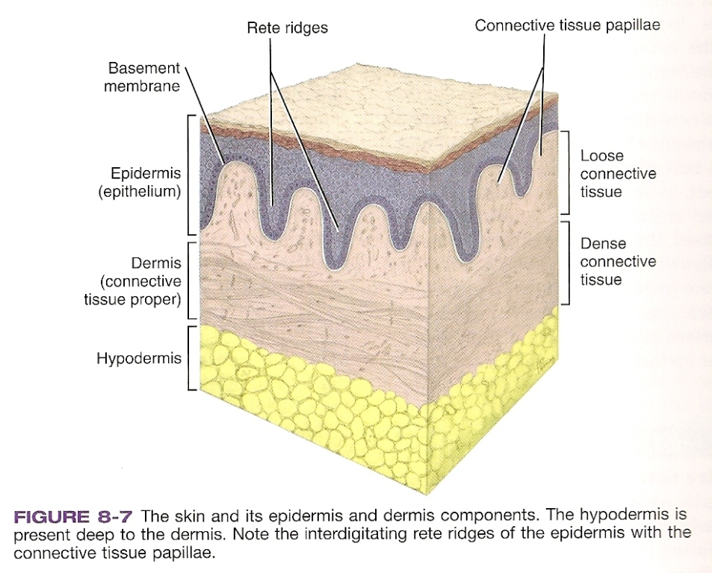
Classification of Connective Tissue
II. Mature Connective Tissue
B. Dense(Fibrous)CT - soft
Found in: deepest layers of
dermis/lamina propria
1. Dense Irregular (Fibrous) CT
    Similar to areolar (looseCT)
    More dense – due to many collagenous fibers
    Fibers arranged irregularly
    Found in: Periosteum(covering Capsules of joint (TMJ)
    Heart Valves
    Duramater (meninges
bone)
layer)

Slide 37
Classification of Connective Tissue
II. Mature Connective Tissue
  2. Dense Regular (Fibrous) CT
    Elastic
        Arranged neatly
        Abundance of fibroblasts
        Found in: Ligaments (flexible)
    Fibrous
      Heavy, tightly packed collagen fibers
      Function: Resist tension
      Found in: Tendon, Ligaments, through body
Notes:
Amorphous – intercellular substance – also called Ground Substance and is a Mucopolysaccharids (glycosaminoglycans/proteoglycans)

Slide 38
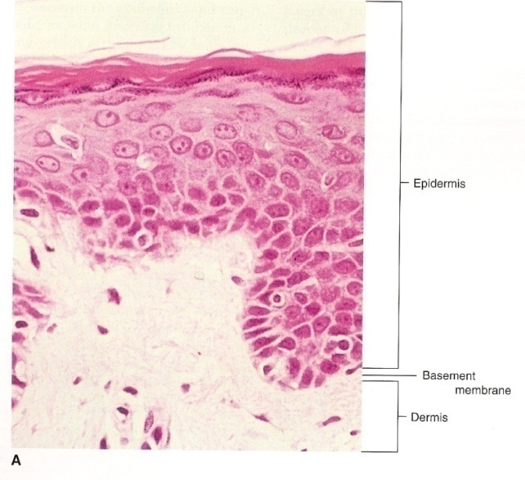
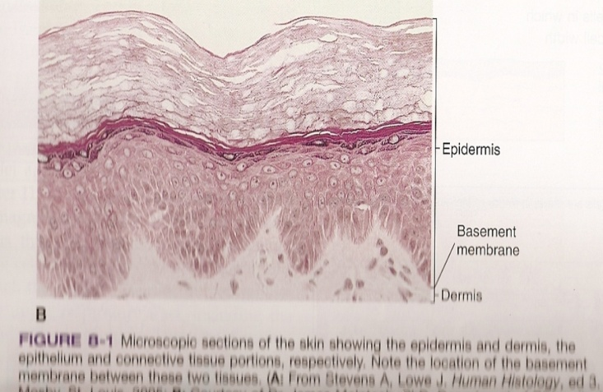

Connective Tissue Proper
Both Loose and dense Connective tissue -
found together in two layers in the form of a
connective tissue proper
Dermis- Connective Tissue Proper in the skin deep to the epidermis
Lamina Propria - Connective Tissue Proper in the Oral Mucosa

